Slide 1
Capture the conversation

Slide 2

Capture the conversation
“ Dip into the comments, the American text genre of the moment, and you can sense the currents that move American life.”
- Michael Erard in his article ‘No comments’
Comments on the NYT articles have diverse viewpoints.
Can I curate the comments to get the representative set that cover the entire spectrum?

Slide 3








Algorithm
URL String
Database
Web App
Comments
Pre-processing
Post-processing
Bag of words
Representative
comments
Pre-processing
Ranking
Tf-idf
Dimensionality
Reduction using
LSI
K-means
clustering

Slide 4
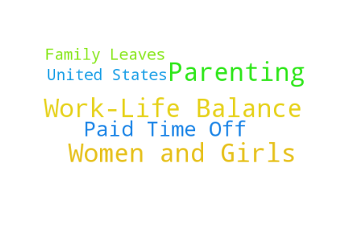
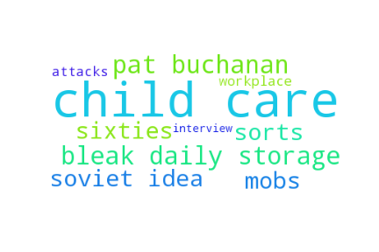

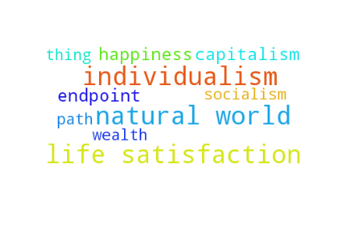
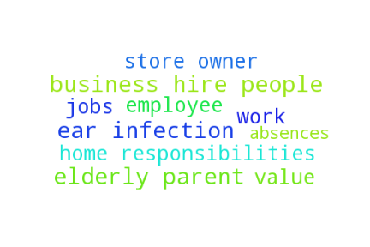
A Toxic Work World by ANNE-MARIE SLAUGHTER Sept. 18 2015

Slide 5
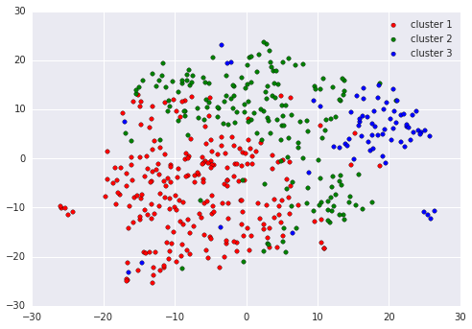
Projection of the comments in 2D space

Slide 6
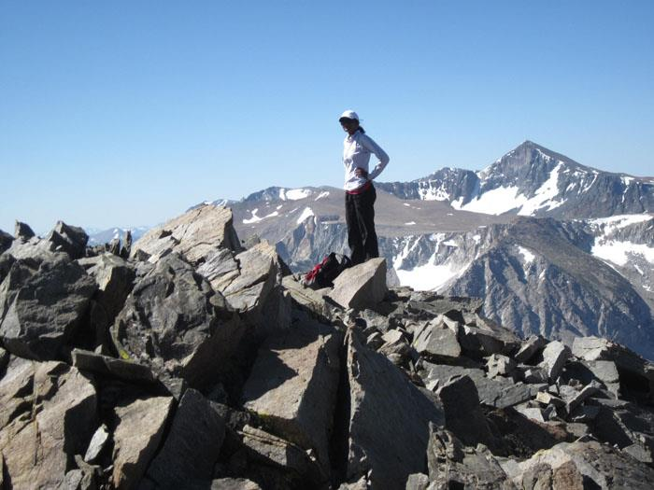




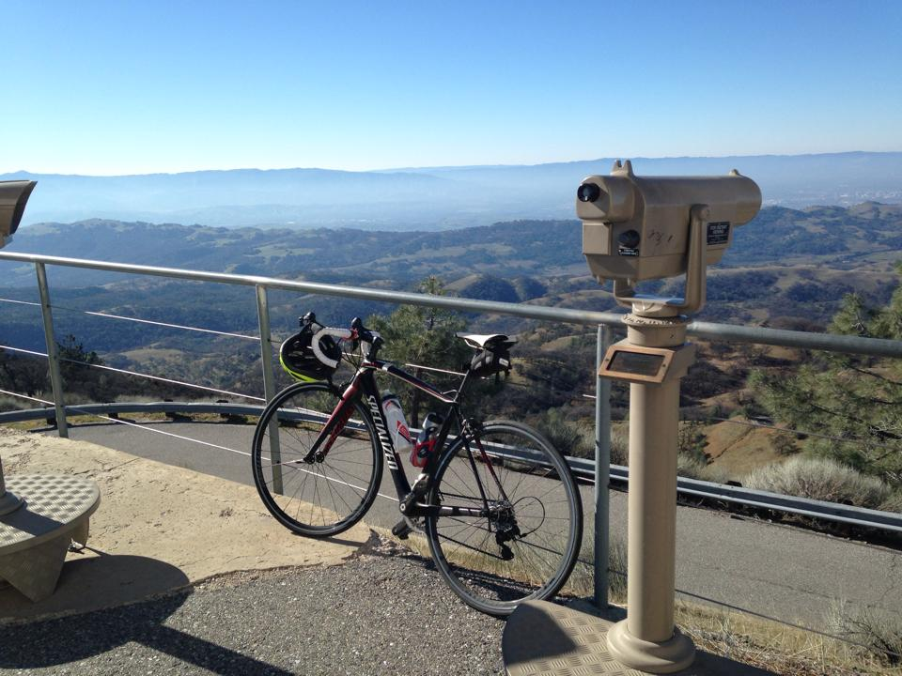
Milinda Lakkam

