Slide 1
GRAD CAREERS — EMPLOYER MENTOR PILOT EVALUATION
Recommendation: approve a limited, evaluated extension
DECISION BOTTOM LINE
Approve a limited, evaluated extension, subject to an approved budget and agreed success criteria. Defer full rollout.
+11 percentage points
+11 percentage points
About AUD727
Cost per additional outcome observed
Observed completion lift
Observed outcome lift
Per additional completion or recorded outcome
580 to 690 per 1,000 (+19.0% relative lift)
440 to 550 per 1,000 (+25.0% relative lift)
Targeting caveat: Target low-performing programs only where prior results and diagnosed barriers support mentoring. The pilot shows no proven greater benefit for that subgroup.
GOVERNANCE REQUIREMENT
Review statistical and operational evidence before approving each further batch. Do not commit to unverified scale.
Notes:
Present the primary recommendation directly: approve a limited, strictly evaluated extension while deferring any broader rollout. Walk through the 11 percentage point observed lifts, the AUD727 cost-effectiveness benchmark, and emphasize the explicit caveat around selecting low-performing historical programs.

Slide 2
STRATEGIC CONTEXT & EVALUATION MANDATE
Business problem: improve completion and participant outcomes
OBJECTIVE
PILOT & EVALUATION
Grad Careers wants to improve workshop completion and participant outcomes.
A four-week pilot compared usual delivery with an employer mentor add-on.
Evaluation focus: completion, recorded outcome rates, statistical evidence, and cost-effectiveness to inform further investment.
Completion and outcomes are distinct measures.
Measurement definition: The precise outcome definition and measurement window require confirmation. The brief describes an employment outcome, but the dataset contains only OutcomeAchieved.
2
Notes:
Clarify the core operational goal: Grad Careers wants to improve workshop completion and participant outcomes. Emphasize that completion and outcomes are distinct measures, and confirm the precise outcome definition and measurement window. The brief describes an employment outcome, but the dataset contains only OutcomeAchieved.

Slide 3
DATA INTEGRITY & TRIAL STRUCTURE
Groups have equal sizes; baseline comparability is unconfirmed
TRIAL STRUCTURE OVERVIEW · 40 PROGRAMS, 2,000 UNIQUE PARTICIPANTS
Group | Delivery | Programs | Participants | Per program
Control | Usual program without mentor add-on | 20 | 1,000 | 50
Mentor (Variant) | Usual program plus mentor add-on | 20 | 1,000 | 50
Cluster design
Data checks
Matched pairs
Each program sits wholly in one group. Participants share program conditions, so their results may be correlated. Assignment method is unconfirmed. Randomisation is not documented.
Checks found no duplicate participant IDs, missing source values, or inconsistencies between group and recorded mentor status.
Program IDs do not establish matched pairs. Equal counts do not establish comparability.
Source: verified Grad_Careers_Mentor_Evaluation.xlsx, Raw Data and Data Checks.
Recommendation: approve a limited, evaluated extension
3
Notes:
Review the pilot structure and the data checks. Each group has 20 programs, 1,000 participants and 50 participants per program. Equal sizes do not establish baseline comparability.
Method caveat: participants share their program, so they are not independent. Program IDs do not establish matched pairs. The assignment method is unconfirmed, and randomisation is not documented.
Data checks found no duplicate participant IDs, missing source values, or inconsistencies between group and recorded mentor status.

Slide 4
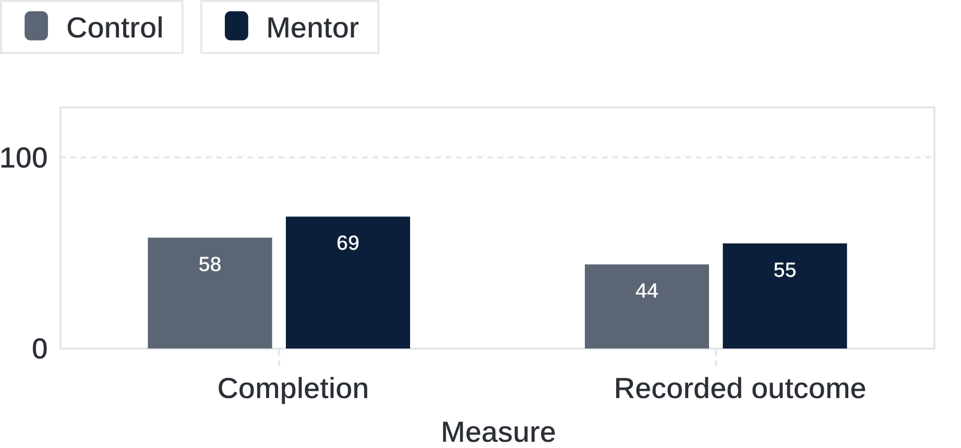
COMPARATIVE PERFORMANCE · KEY METRICS
Mentor group recorded higher completion and outcome rates
Across equally sized groups of 1,000 participants, mentor rates were 11 percentage points higher for both measures: +19.0% relative lift for completion and +25.0% for recorded outcome.
RECORDED PARTICIPANT RATES BY GROUP (%)
OBSERVED DIFFERENCES BREAKDOWN
Metric | Control | Mentor
Participants | 1,000 | 1,000
Completions | 580 (58.0%) | 690 (69.0%)
Recorded outcomes | 440 (44.0%) | 550 (55.0%)
Observed additional | — | +110 each
Participants may appear in both measures. 110 additional completions and 110 additional outcomes were observed. These may overlap and must not be added as 220 distinct beneficiaries.
4
Notes:
Walk through the core performance findings: completion moved from 58% to 69% (+19.0% relative lift), and recorded outcomes moved from 44% to 55% (+25.0% relative lift). Stress the critical governance rule: do not add the 110 completions and 110 outcomes together, as the participants substantially overlap.

Slide 5

INFERENTIAL TESTING & STATISTICAL RIGOR
Statistical evidence supports the observed differences
METHODS
RESULTS
Participant level (N = 2,000)
Participant level
Chi-squared test of independence. Assumes independent participants.
Completion · Outcome
Program level
Program level (40 programs)
Completion · Outcome
Two-sided Welch t-tests on 20 program rates per group. Assumes independent programs.
Caveat: Assignment and baseline comparability are unconfirmed. Statistical significance does not establish causation or financial value.
5
Notes:
Present the participant-level chi-squared tests and the program-level two-sided Welch t-tests as two separate methods. Both show statistically significant differences.
Exact program-level p-values: completion p = 0.000004204; outcome p = 0.000008173. Both are below 0.001 in the summary above.
Method caveats: the participant-level chi-squared tests assume independent participants. The program-level Welch t-tests assume independent programs, using 20 program rates per group (40 clusters in total).
Program ranges overlap, so individual programs vary. Significance does not establish causation or financial value. Assignment and baseline comparability require confirmation, and clarify participant mix and trainer differences.

Slide 6
FINANCIAL EVALUATION & EFFICIENCY ECONOMICS
Cost-effectiveness is about AUD727 per observed additional result
AUD80,000
AUD727.27
AUD727.27
Estimated pilot add-on cost
Cost per additional completion
Cost per additional outcome
AUD4,000 per program × 20 mentor programs
AUD80,000 ÷ 110 additional completions observed
AUD80,000 ÷ 110 additional outcomes observed
Calculation method
Cost-effectiveness vs ROI
Total mentoring expenditure divided by additional results observed.
These are cost-effectiveness measures, not commercial revenue, profit, return on investment (ROI), or break-even returns.
RESOURCING SCOPE QUESTION
Unverified: the full cost breakdown and the incremental renewal contribution. Any renewal benefit is a potential benefit requiring evidence.
Confirm whether mentor recruitment, vetting, training, coordination, and central administration are fully absorbed within the assumed AUD4,000 per-program charge.
6
Notes:
Method: total mentoring expenditure of AUD80,000 (AUD4,000 per program × 20 mentor programs) divided by 110 additional completions gives AUD727.27 per additional completion. The same AUD80,000 divided by 110 additional outcomes gives AUD727.27 per additional outcome. These are cost-effectiveness measures only, not ROI, profit, or a payment to mentors or participants.
Unverified: the full cost breakdown, including whether central overheads and recruitment costs sit within the AUD4,000 per-program figure. The incremental renewal contribution is also unverified. Any renewal benefit is a potential benefit and needs evidence before it is claimed.

Slide 7
GOVERNANCE FRAMEWORK & STAGED COMMITMENTS
Next steps: fund only against explicit decision conditions
Program lead: Diagnose barriers. Propose programs with suitable barriers.
Evaluation lead: Confirm outcome, follow-up and assignment. Predefine the primary metric and review criteria. Where feasible, randomise programs and retain a comparison group.
Finance and funders: Confirm full costs. Agree an acceptable cost per additional outcome.
Delivery lead: Confirm mentor capacity, quality and full resourcing.
Leadership: Approve a limited extension with a set budget and agreed criteria.
Pause if: results are inconclusive, agreed criteria are unmet, costs overrun, or delivery quality slips.
7
Notes:
Conclude with the clear governance roadmap. Each owner has a clear prerequisite, from program diagnosis and randomised controls to funder cost agreements. Reiterate the off-ramp: pause the program immediately if costs exceed limits or quality slips.

