Slide 1

Visvesvaraya National Institute of Technology, Nagpur
Electronics and Communication Engineering Department
Executive M.Tech. in Applied AI
Cohort 3A sem. 3, Summer 2026
NLP Project (11th May 2026)
Financial Sentiment Analysis Agent
Presented by (Group 4)
Milind Mahajan (MT24AAI196) , Chandan Chugh(MT24AAI133) & Brajesh Singh (MT24AAC020)
Presented To
Dr. Saugata Sinha,
VNIT Nagpur

Slide 2

Agenda
01
GitHub link, slides, and Project Report
04
Models Compared
07
Key Findings, Conclusions & Future Work
02
Problem Statement & Dataset
05
Training Strategy & Configuration
03
Methodology & Pipeline
06
Results: PhraseBank Benchmark & Collected Data
Financial Sentiment Analysis Agent | Group 4 | VNIT Nagpur

Slide 3
Github link, slides and Project Report
Github link - https://github.com/milindma/ECL545_S26_NLP_Group04/ (This Repository is publicly available to everyone)
Presentation link – https://github.com/milindma/ECL545_S26_NLP_Group04/tree/main/docs
Project Report - https://github.com/milindma/ECL545_S26_NLP_Group04/tree/main/docs
Financial Sentiment Analysis Agent | Group 4 | VNIT Nagpur

Slide 4

Problem Statement
The Challenge
Manually analysing financial news sentiment is time-consuming and inconsistent.
The Objective
Build an automated system to classify headlines into Positive, Negative, or Neutral sentiment.
Approaches Evaluated:
BERT (zero-shot)
Fine-tuned BERT
FinBERT (zero-shot)
Financial Sentiment Analysis Agent | Group 4 | VNIT Nagpur

Slide 5
Dataset Overview
Training Data
Financial headlines (financial_sentiment.csv) merged from multiple public sources.
Split: 80/10/10 (train/val/test)
Evaluation Set 1
453 sentences with the following breakdown
Breakdown: 114(+), 61(-), 278(n)
Evaluation Set 2 — Collected Unseen Data
1,845 financial headlines from Economic Times & The Hindu Business Line (April 2026).
Balanced evaluation subset of 1,000 samples (334/333/333) for fair per-class assessment.
Labels: Positive, Negative, Neutral (Manually verified)
Financial Sentiment Analysis Agent | Group 4 | VNIT Nagpur

Slide 6
Methodology & Pipeline
A four-stage pipeline was implemented to systematically compare zero-shot and fine-tuned transformer models for financial sentiment classification.
01
02
03
04
05
Data Preparation
Baseline Evaluation (BERT & FinBERT zero-shot)
Fine-Tuning BERT (weighted loss, cosine decay, early stopping)
Three-Way Evaluation (Training Dataset + Collected Data)
Analysis & Reporting
→
→
→
→
Financial Sentiment Analysis Agent | Group 4 | VNIT Nagpur

Slide 7
Models & Training Configuration
Models Compared
BERT (Zero-shot): bert-base-uncased— no training; lower-bound baseline
BERT (Fine-tuned): bert-base-uncased + classification head; fine-tuned on financial_sentiment.csv; class-weighted cross-entropy loss
FinBERT (Zero-shot): ProsusAI/finbert; finance-domain pre-trained; zero-shot
Key Training Hyperparameters
Optimization: Learning Rate: 1e-5 | Epochs: 10 max (early stopping) | Batch Size: 8 (effective 16)
Architecture: LR Scheduler: Cosine Decay (10% warmup) | Weight Decay: 0.01 | Max Seq: 128
Best Checkpoint: Epoch 8 (Step 3440) — Val Acc: 82.15%, Val F1 Weighted: 82.17%
Financial Sentiment Analysis Agent | Group 4 | VNIT Nagpur

Slide 8
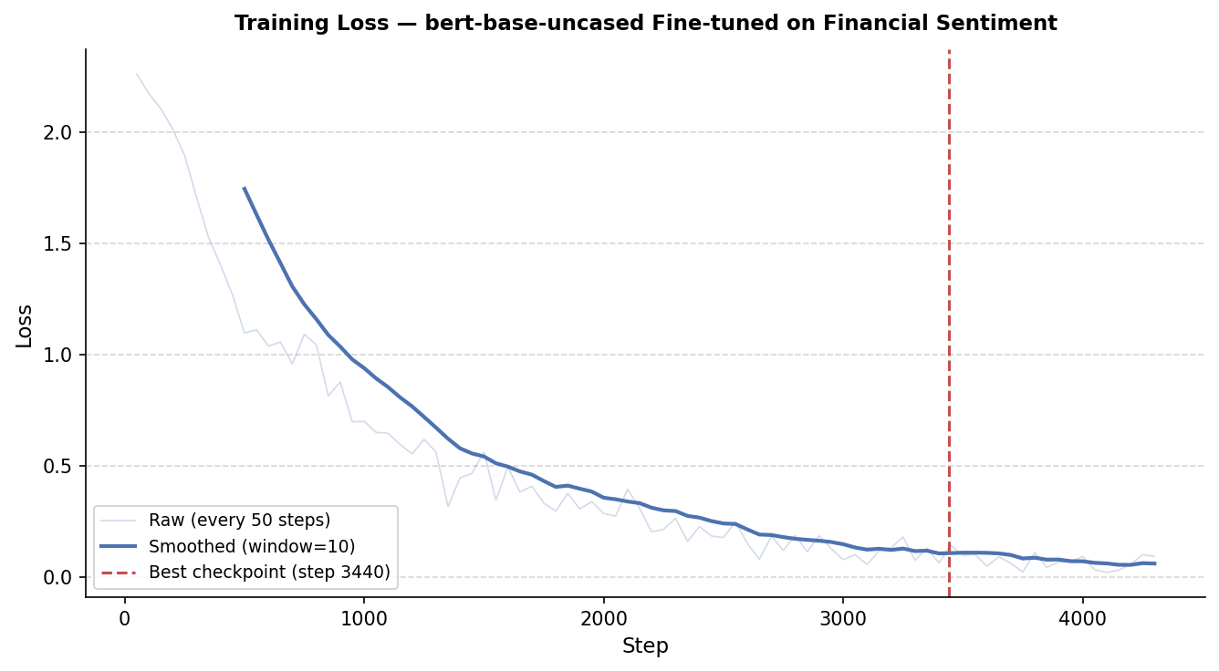
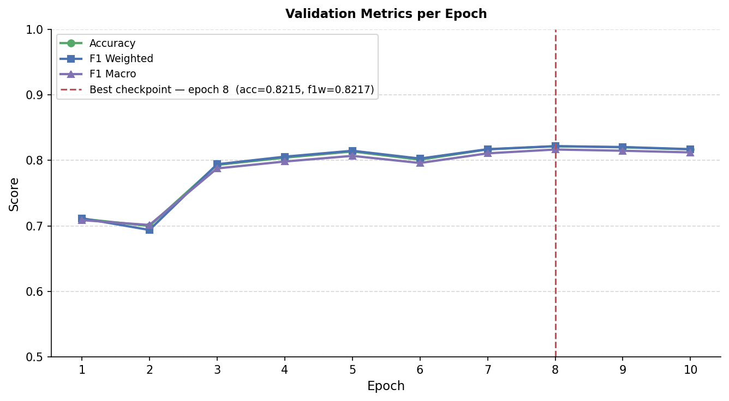
Training Dynamics & Insights
Best Checkpoint: Epoch 8 (Step 3440) — Val Accuracy: 82.15%, Val F1 Weighted: 82.17%
Strategy & Improvements
Early stopping (patience=3) monitored Val F1 Weighted; prevented overfitting
Financial Sentiment Analysis Agent | Group 4 | VNIT Nagpur

Slide 9
Results and Demo
FinBERT (97.6% acc) marginally leads Fine-tuned BERT (95.8%) — both far exceed BERT zero-shot (27.4%)
Fine-tuned BERT: strong across all classes (Pos F1=0.92, Neg F1=0.95, Neu F1=0.97)
During First Evaluation
Today:
Metric | Fine-tuned v1 | Fine-tuned v2
Accuracy | 0.33 | 0.38
Weighted F1 | 0.32 | 0.37
Model | Accuracy | F1 Macro | F1 Weighted
BERT (Zero-shot) | 0.274 | 0.237 | 0.144
BERT (Fine-tuned) | 0.958 | 0.949 | 0.958
FinBERT (Zero-shot) | 0.976 | 0.965 | 0.976

Slide 10
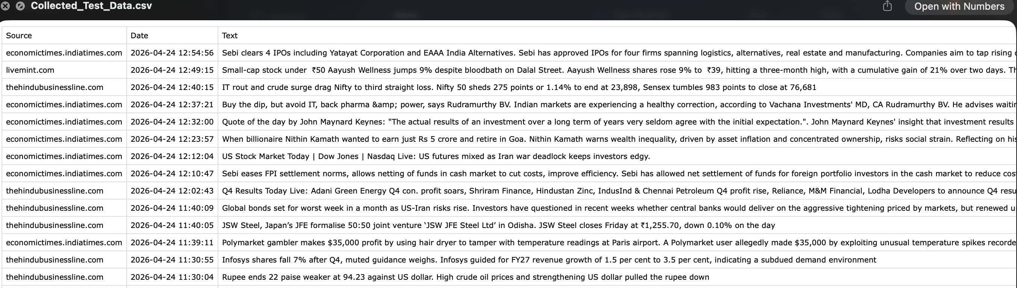
Collected Data

Slide 11
Results — Collected Unseen Data (1,000 balanced samples)
Real-world test: 334 positive / 333 negative / 333 neutral — balanced for fair evaluation
Fine-tuned BERT leads: 72.9% accuracy, 71.7% F1 Weighted — outperforms FinBERT by ~13pp
FinBERT struggles on Neutral (F1=0.379) despite domain pre-training; fine-tuned BERT achieves 0.591
Class | BERT Zero-shot | BERT Fine-tuned | FinBERT
Negative | 0.265 | 0.721 | 0.587
Neutral | 0.000 | 0.591 | 0.379
Positive | 0.532 | 0.838 | 0.747
Model | BERT (Fine-tuned) | F1 Macro | F1 Weighted
Accuracy | 0.729 | 0.716 | 0.717
FinBERT (Zero-shot) | 0.594 | 0.571 | 0.571

Slide 12
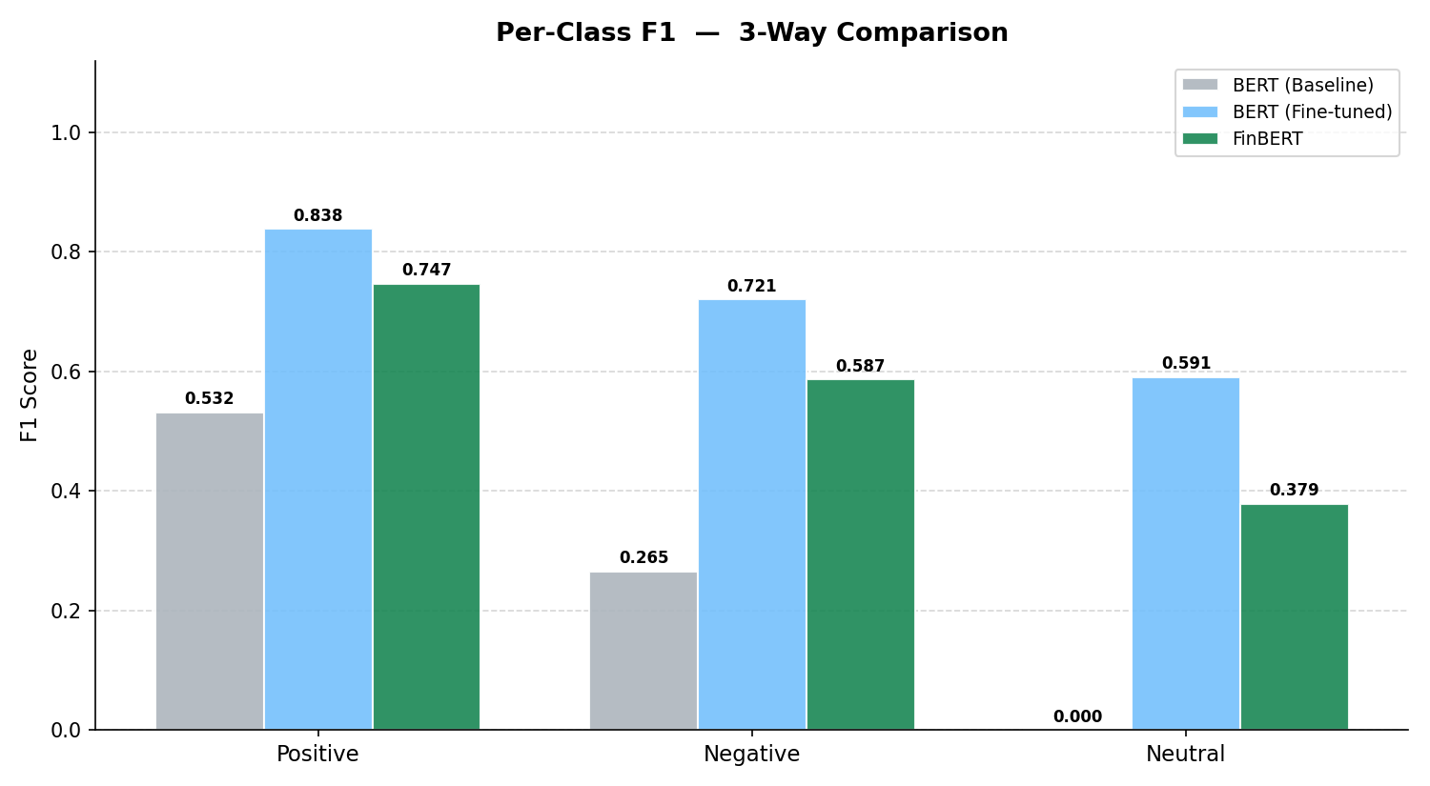
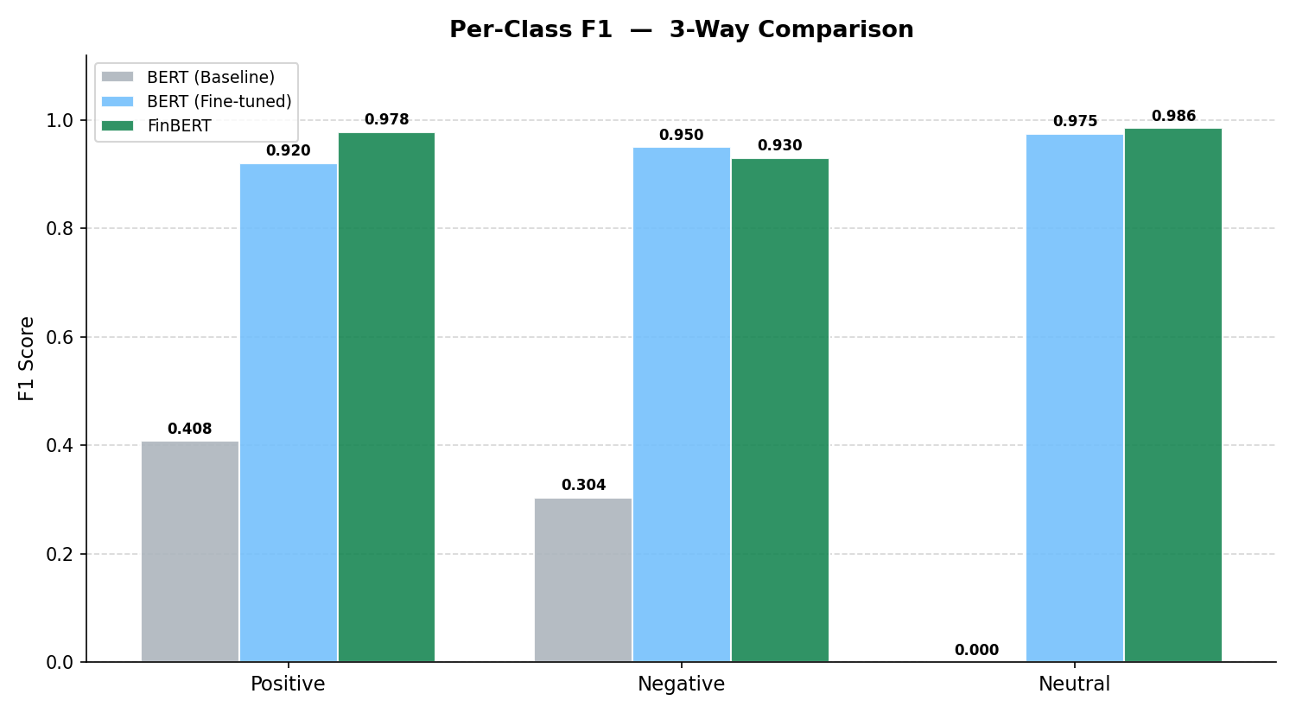
Comparative Analysis
Test Data
Collected Data

Slide 13
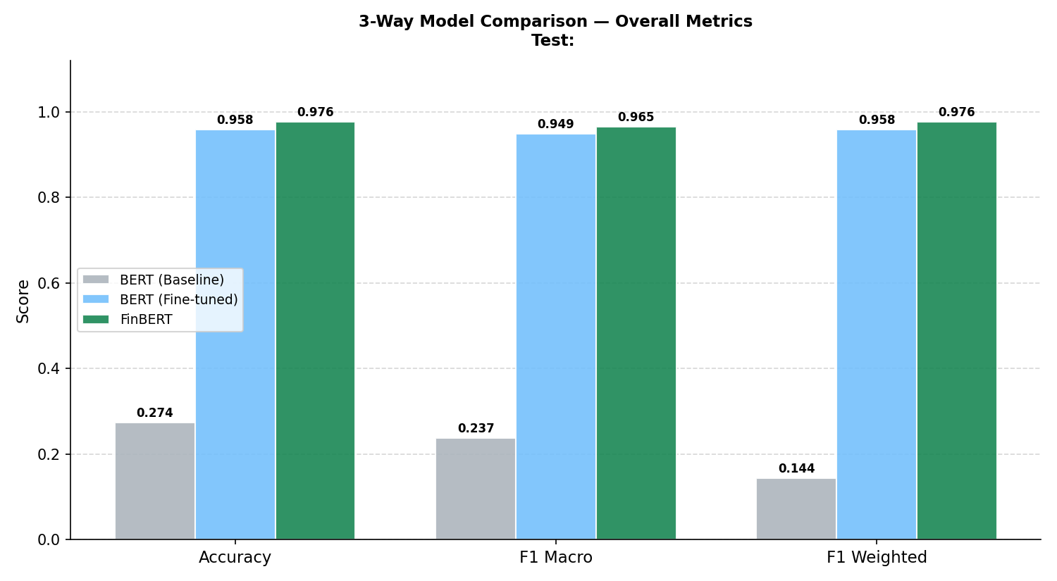
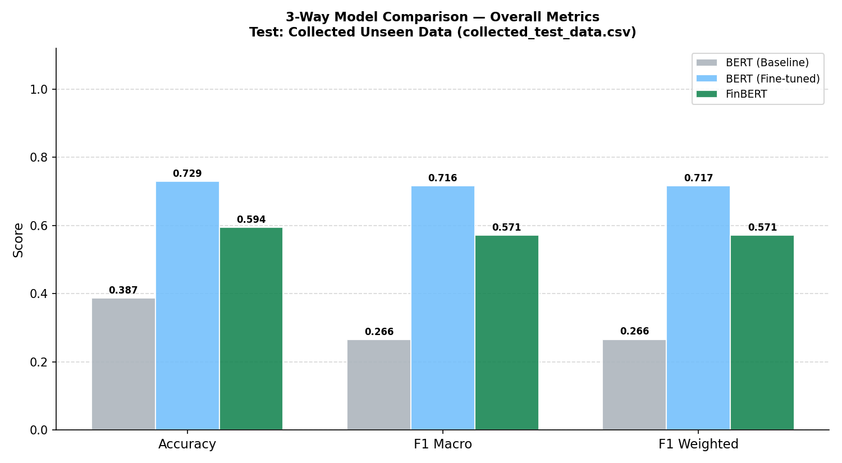
Comparative Analysis
Test Data
Collected Data

Slide 14
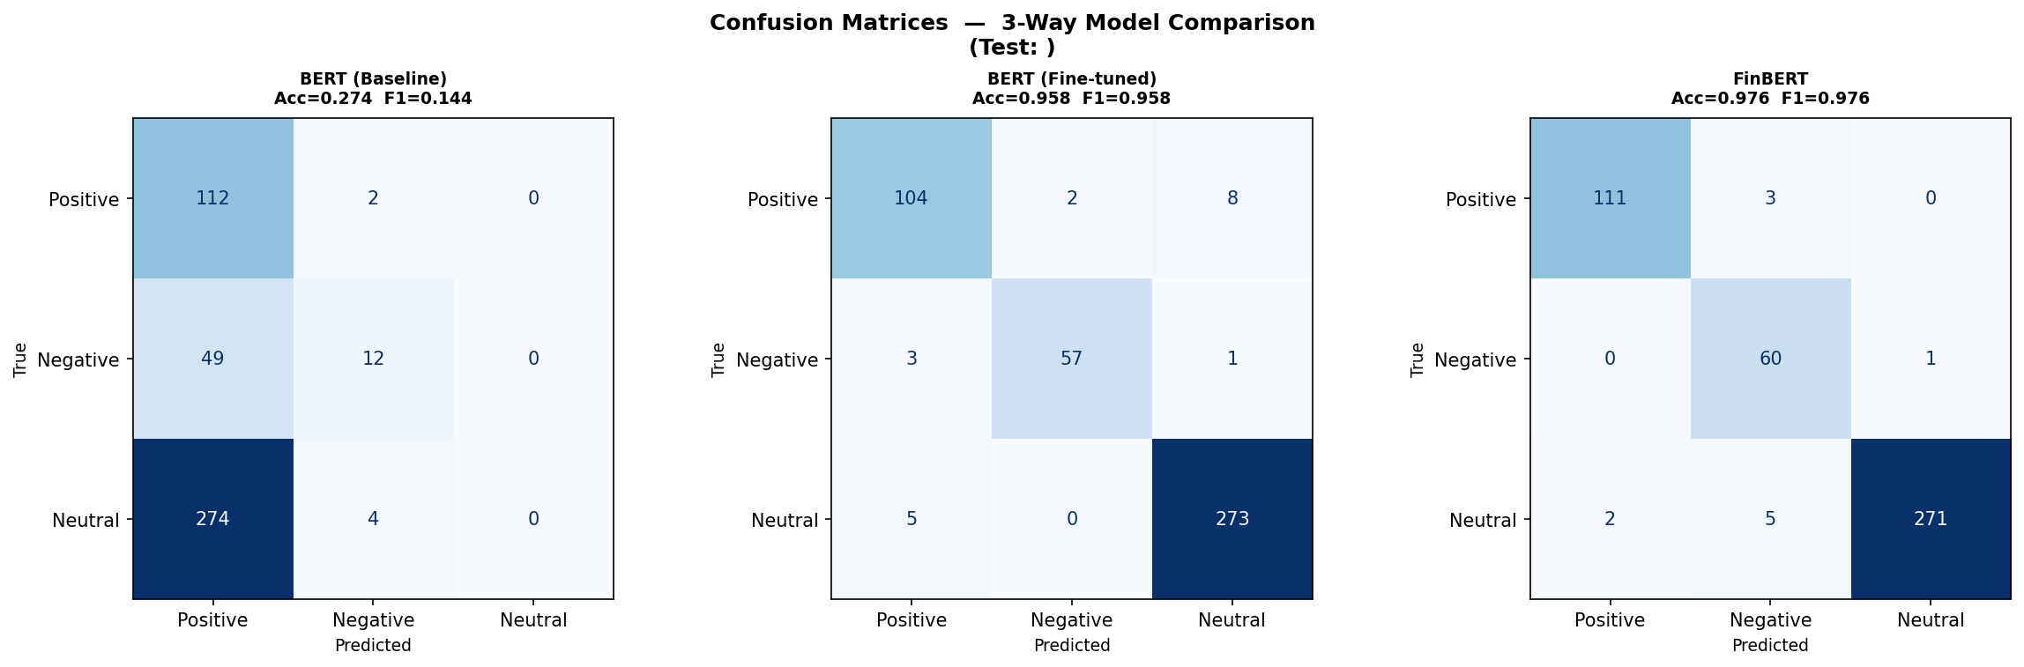
Confusion Matrices (Test Data)

Slide 15
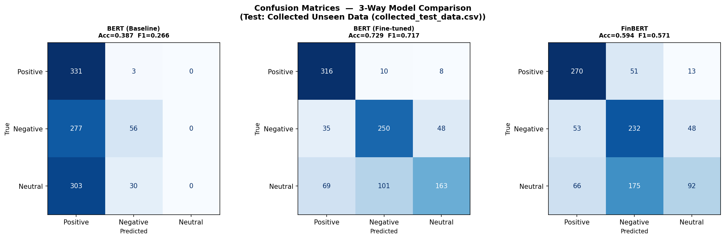
Confusion Matrices (Collected Data)

Slide 16
THANK YOU

