Slide 1
Computer Architecture And Organization
Compiler
Group Member ID Section
Michael Gashawtena UGR/3575/13 2
Daniel Misganaw UGR/6303/13 2
Abiy Biru UGR/3486/13 2
Salah Juhar UGR/8613/13 2
Milka Fasika UGR/7126/13 2
Hana Guta UGR/2919/13 2

Slide 2
Overview of the compiler to be build
First we take the source code as a stream of characters and generate a stream of tokens using the first phase of a compiler called scanner. This tokens are basic, grammatically indivisible units of the programming language being parsed. So this will take the source code written in TypeScript and break it down into tokens. And it will also identify any errors in the source code such as missing semicolons or incorrect syntax.
Next we take this stream of tokens and do syntactic changing to ensure that the stream of tokens corresponds to the grammar for the programming language and create abstract Syntax Tree(AST). Which is the representation of the source code that can be used by other parts of the compiler.
Then we perform semantic checking to ensure the statements in the language that may be syntactically correct make sense.

Slide 3
continued…
Next we make sure that the compiler builds an internal data structure known as intermediate code . then the compiler traverses the resultant data structure and translates it assembly language.
The compiler that we will develop, can manipulate arithmetic and logical operation, if conditions and loops.

Slide 4
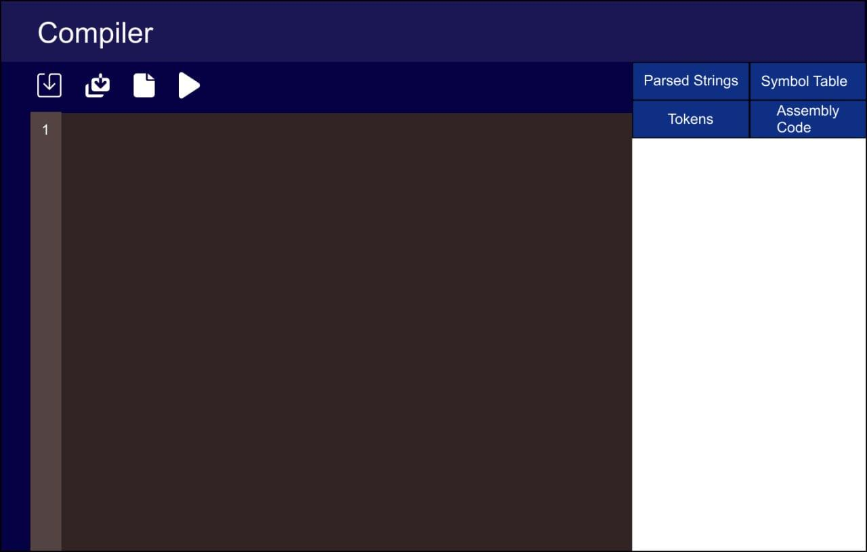
Design

