Slide 1
- TileGen –
An open source Software for applying cartographic Generalisation to
Tile-Base Mapping
Faculty of Environmental Sciences, Department of Geosciences, Institute for Cartography
Ralf Klammer
26th International Cartographic Conference
Dresden, August 25-30, 2013
Notes:
- thank you for the introducing words...
- I would like to welcome you to my presentation with the title...
- my name is...
- I am a phd-student at the dut..
- what am I going to talk about...click

Slide 2
0. Structure of the presentation
1. Motivation
2. Facts & Terms
3. TileGen - Concept
4. TileGen - Implementations
5. Conclusion & Outlook
Notes:
… what's my motivation … click

Slide 3
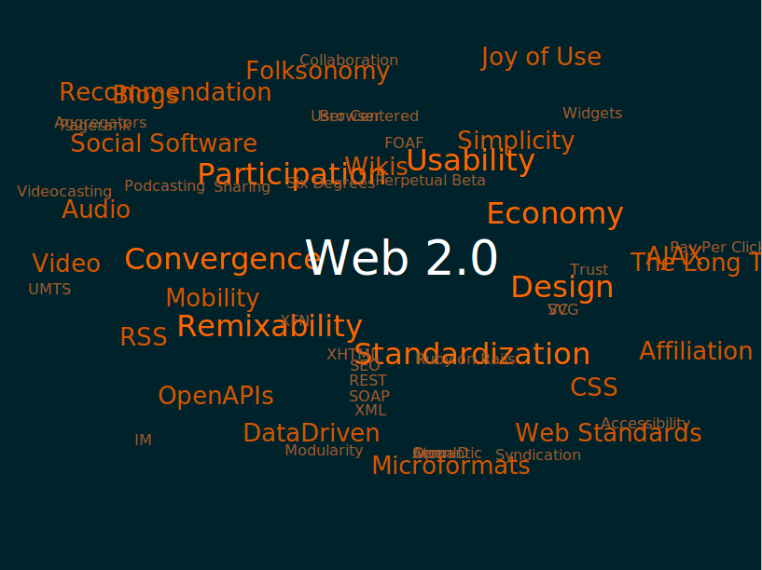
1. Motivation
1. Motivation - 2. Facts & Terms - 3. TileGen - Concept - 4. TileGen - Implementation - 5. Conclusion & Outlook
source: en.wikipedia.org/wiki/Web_2.0
Notes:
- surely you all know the term 'web2.0'
- that term concludes, the shift in communication of users in the internet from the pure consume to an active production of web contents
- in relation to cartography, these trends result in the emergence of a new digital mapping community (having a very heterogen group of participants – experts...ordinary persons)

Slide 4
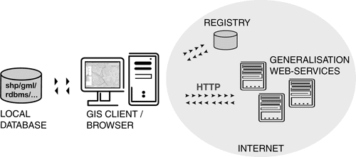
1. Motivation – Web Generalisation Services
1. Motivation - 2. Facts & Terms - 3. TileGen - Concept - 4. TileGen - Implementation - 5. Conclusion & Outlook
'WebGen 2.0'
2.
'WebGen-WPS'
'WebGen'
1.
Upload own
processes
Static requests
for available processes
WPS
Web 2.0 applications
status-quo
needed developments
Notes:
- my aim is to broadcast and spread the concept of web generalization services within the 'new' Web2.0 mapping community
- everything began with the basic concept of sharing generalisation processes & algorithms via internet, resulting in the 'WebGen' project … click
- a 1st idea of broadcasting the concept to a larger audience was to adept the communication structure to the OGC standard of WebProcessingServices
… click
→ this is the status-quo of the WebGen project
- so … the next step has to be a widening to the new possibilities of Web 2.0
- basically, 2 starting points are possible for that: … click
1 – apply WebGen-WPS within different Web 2.0 mapping applications
(broadcast by applying)
… click
2 – develop WebGen as Web2.0 technology and make it accessible for users … I've higlighted it as 'WebGen 2.0'
...point 2 is the origin for the development of TileGen …many of these 'new' applications use the technology tile-based mapping

Slide 5
2. Facts & Terms
1. Motivation - 2. Facts & Terms - 3. TileGen - Concept - 4. TileGen - Implementation - 5. Conclusion & Outlook
tile
tile-based mapping system
tile-based
Mapnik
tile-based mapping
tile-based map
cartographic parameter
renderer
Web 2.0
automatic rendering
Notes:
- but what is tile-based mapping … I'd like to begin by clarifying some basic facts and terms … click

Slide 6
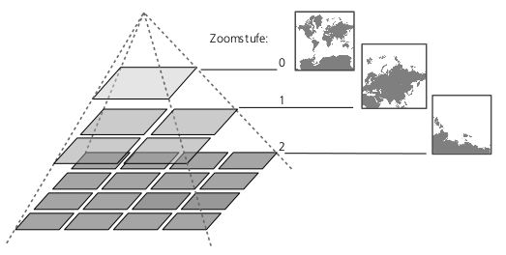
What is a tile-based mapping system?
1. Motivation - 2. Facts & Terms - 3. TileGen - Concept - 4. TileGen - Implementation - 5. Conclusion & Outlook
map tiles
Tile-based map
Tile-based mapping system
Core properties:
1. Map views are based on multiple discrete zoom levels (corresponding to a fixed map scale)
2. Multiple image tiles are used to virtualize a single map view
3. Image tiles are accessible using a discrete addressing scheme
4. Tiles are sent to client with minimal processing – as much as possible is done ahead of time
(cf. Sample & Ioup 2010)
Downloading &
Assembling of Tiles
Data &
cartographic definition
Rendering & Storing of Tiles
Zoomlevels
Tiling scheme
0,0 0,1
1,0 1,1
mapview at
zoomlevel 1
Notes:
→ a technique that has been used already for a long time especially in computer games
→ got a significant boom since Google Maps was published
→ and is by now a commonly accepted web mapping technology
- the term tile-based signifies the display of a digital image by a combined visualisation of smaller, single images → called tiles … click
- accordingly tile-based mapping is the process of computing single tiles which are used for the overall display of a map … click
→ the so called tile-base map
- as you can see in the definition of the core properties by Sample & Ioup
→each map tile is based on a discrete zoom level which corresponds to a fixed map scale
→ and the tiles are adressed by a discrete scheme which is needed for assembling them to an overall map view … click
- the term tile-based mapping system summarises the whole process chain
→ beginning with data manipulation and definition of cartogaphic parameters,
→ over rendering, storage management and server communication
→ to final display in a web browser

Slide 7
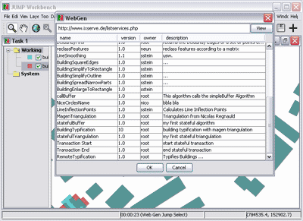
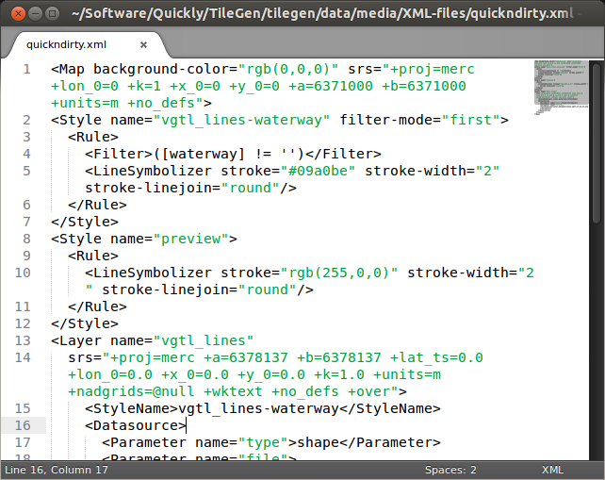
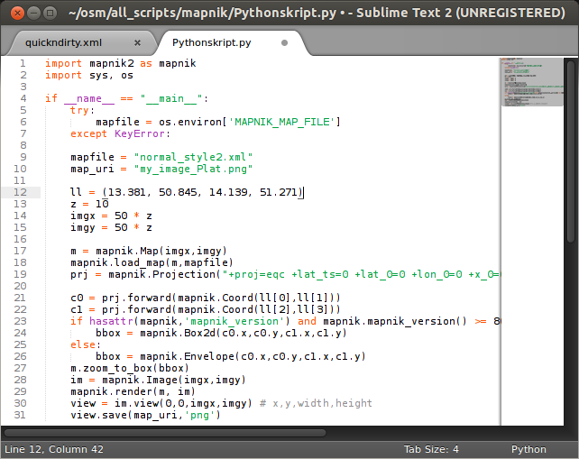
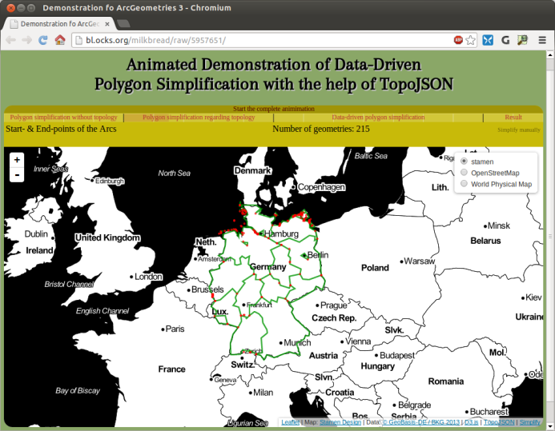
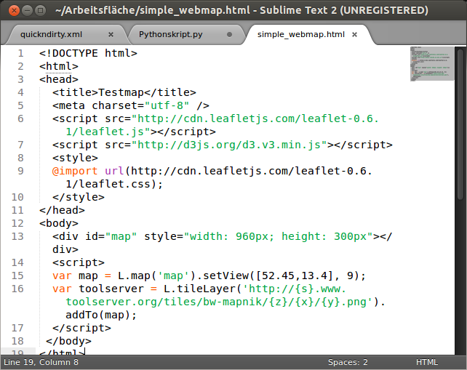
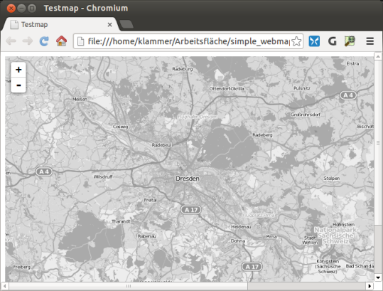
Tasks to set up a tile-based mapping system
1. Motivation - 2. Facts & Terms - 3. TileGen - Concept - 4. Realised process flow - 5. Discussion & future work
Tile-based mapping system
Klammer, R. & Burghardt, D. (2012): Approaches for enhancing tile - based mapping with cartographic generalisation. In: Proceedings 15th ICA Workshop on Generalisation and Multiple Representation, Istanbul, Turkey
Data &
cartographic definition
Rendering & Storing of Tiles
Downloading &
Assembling of Tiles
manual generalization
1st: organize geospatial data (prepare a tile-based map)
→ primary 'language': GIS (SQL, shapefile, ...)
2nd: define cartographic parameters (prepare ...)
→ primary language: XML
3rd: initialize automatic rendering (generate ...)
→ primary language: Python
4th: build a mapping framework (display ...)
→ primary language: JavaScript
[5th: add mash-ups, interaction, statistics, etc. (refine ...)
→ primary language: JavaScript
1st: organize geospatial data (prepare a tile-based map)
→ primary 'language': GIS (SQL, shapefile, ...)
2nd: define cartographic parameters (prepare ...)
→ primary language: XML
3rd: initialize automatic rendering (generate ...)
→ primary language: Python
4th: build a mapping framework (display ...)
→ primary language: JavaScript
[5th: add mash-ups, interaction, statistics, etc. (refine ...)
→ primary language: JavaScript
1st: organize geospatial data (prepare a tile-based map)
→ primary 'language': GIS (SQL, shapefile, ...)
2nd: define cartographic parameters (prepare ...)
→ primary language: XML
3rd: initialize automatic rendering (generate ...)
→ primary language: Python
4th: build a mapping framework (display ...)
→ primary language: JavaScript
[5th: add mash-ups, interaction, statistics, etc. (refine ...)
→ primary language: JavaScript
1st: organize geospatial data (prepare a tile-based map)
→ primary 'language': GIS (SQL, shapefile, ...)
2nd: define cartographic parameters (prepare ...)
→ primary language: XML
3rd: initialize automatic rendering (generate ...)
→ primary language: Python
4th: build a mapping framework (display ...)
→ primary language: JavaScript
[5th: add mash-ups, interaction, statistics, etc. (refine ...)
→ primary language: JavaScript
1st: organize geospatial data (prepare a tile-based map)
→ primary 'language': GIS (SQL, shapefile, ...)
2nd: define cartographic parameters (prepare ...)
→ primary language: XML
3rd: initialize automatic rendering (generate ...)
→ primary language: Python
4th: build a mapping framework (display ...)
→ primary language: JavaScript
[5th: add mash-ups, interaction, statistics, etc. (refine ...)
→ primary language: JavaScript
1st: organize geospatial data (prepare a tile-based map)
→ primary 'language': GIS (SQL, shapefile, ...)
2nd: define cartographic parameters (prepare ...)
→ primary language: XML
3rd: initialize automatic rendering (generate ...)
→ primary language: Python
4th: build a mapping framework (display ...)
→ primary language: JavaScript
[5th: add mash-ups, interaction, statistics, etc. (refine ...)
→ primary language: JavaScript
TileGen
automatic generalization
Notes:
- let's have a look on, the necessary task to organize when you want to set up a tile-based mapping system
- … click … 1st of all, you'll organize your data
- … click … 2nd, you have to define the cartographic parameters for each available zoomlevel of the final map … meaning: how will the map look finally
… this is a very abstract process, as these parameters are mostly defined in XML
- … click … 3rd, initialize the rendering of necessary map tiles
...complete pre-calculation or on-demand solutions are possible
- … click … 4th, then the map is finished, but you need to display it … therefore you need a mapping framework … in the web mapping context, that's preferably done within an JavaScript framework
- … click … 5th, finally, you can add map mash-up, nice interactive elements, visualise statistics this tile-based
→ the point at which we apply generalisation functionalities seems to be clear … click … we generalise when we organize the data … in a manual process flow
→ but tile-based mapping systems are mostly build as automatic process flows …so it's necessary to … define the generalization tasks within the cartographic parameters and let them execute automatically while rendering the map tiles
… managing that, is the task of TileGen

Slide 8
3. TileGen – The Concept
1. Motivation - 2. Facts & Terms - 3. TileGen - Concept - 4. TileGen - Implementation - 5. Conclusion & Outlook
1. Graphical User Interface, for visual:
- definition of cartographic parameters
- evaluation of (carto-) graphic quality (readability & legibility)
- semantic selection and classification (schematic transformations)
2. Automatic Topological Evaluation
3. Test and Define Spatial Transformations
4. Export WPS-Execute-Parameters for automatic processing
Notes:
1 - graphical user interface that enables the map author to:
- visually define the cartographic parameters while getting an immediate preview of the specified cartographic parameters … and … parallely identifing graphical lacks … what can also result in identifying the need for manual generalisation of data
- additionally, that visual definition supports the application of schematic transformations
2 - Automatic Topological Evaluation of certain feature types, by:
- collecting ancillary information of data, like density or minimum distances
- TileGen acts like an analysis tool in this relation
3 – enables users to test spatial transformations, that will be executed automatically while rendering the tiles
- in the sense of reusability, the corresponding functionalities are completely taken from an external web generalisation service, like WebGen-WPS
- after the user has tested and evaluated the parameters of the favored functionalities
4 - he/she can export the definition of the WebGen-WPS Execute parameters and request the functionalities automatically while rendering the map tiles

Slide 9

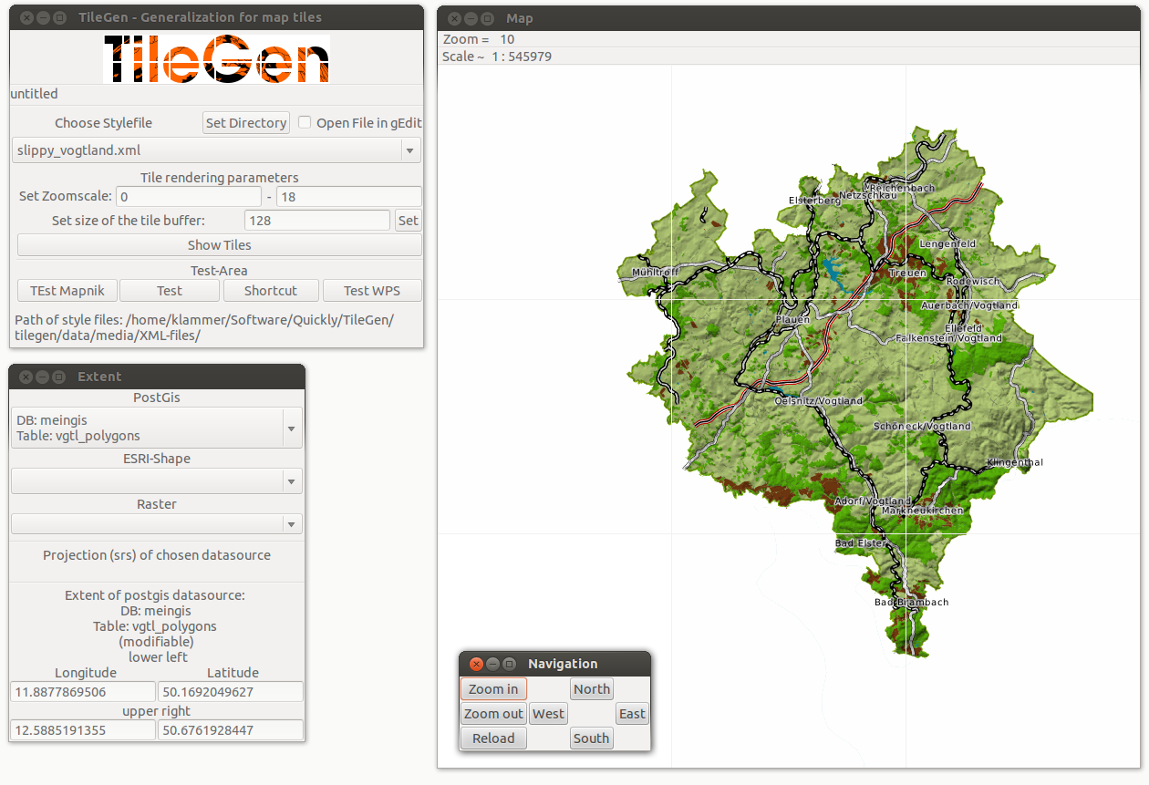






4. TileGen - Implementation
1. Motivation - 2. Facts & Terms - 3. TileGen - Concept - 4. TileGen - Implementation - 5. Conclusion & Outlook
WebGen-WPS
Notes:
- in order to prove the concept as well as the basic applicability of WebGen-WPS, I've implemented a first version
- I use Mapnik as rendering library, it...
… emerged as primary rendering tool for the major map of OpenStreetmap
… but meanwhile it is THAT standard rendering library for tile-based maps (… as well as for tile-based data delivery)
- everything is currently just basically implemented … as I am currently looking for partners, that like the idea and are interested in promoting the further developments
...will now have a short look on the basic functionalities of the concept that are implemented

Slide 10
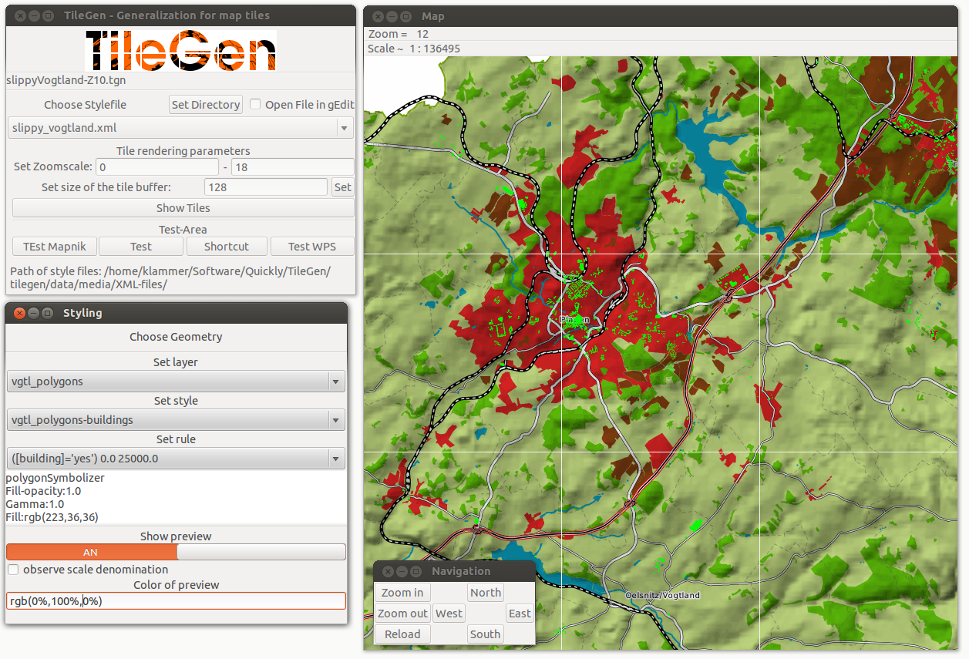
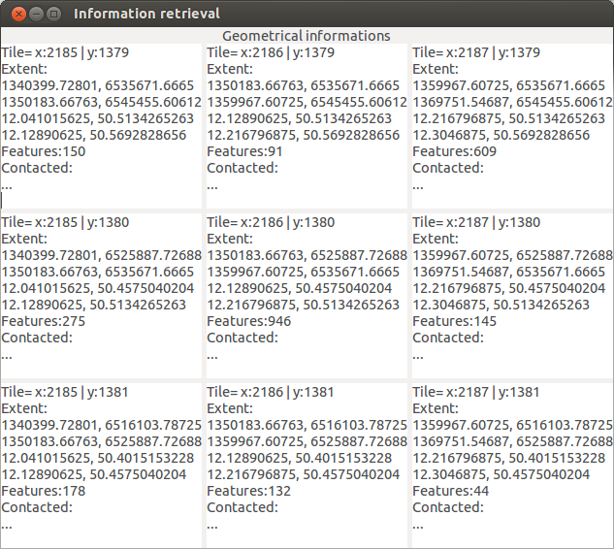
Styling and Information retrieval
1. Motivation - 2. Facts & Terms - 3. TileGen - Concept - 4. TileGen - Implementation - 5. Conclusion & Outlook
Immediate preview
evaluate topographic constraints
Read XML-file
Define
cartographic parameters
Notes:
...reading an XML-style file containing all cartographic parameters, that are necessary for the rendering the map tiles
...getting an immediate preview, by rendering the map tiles within a definable extent … click
… reading all cartographic parameters, called styles and the corresponding definitions … and … click
… getting ancilliary information of the data density of each map tile

Slide 11
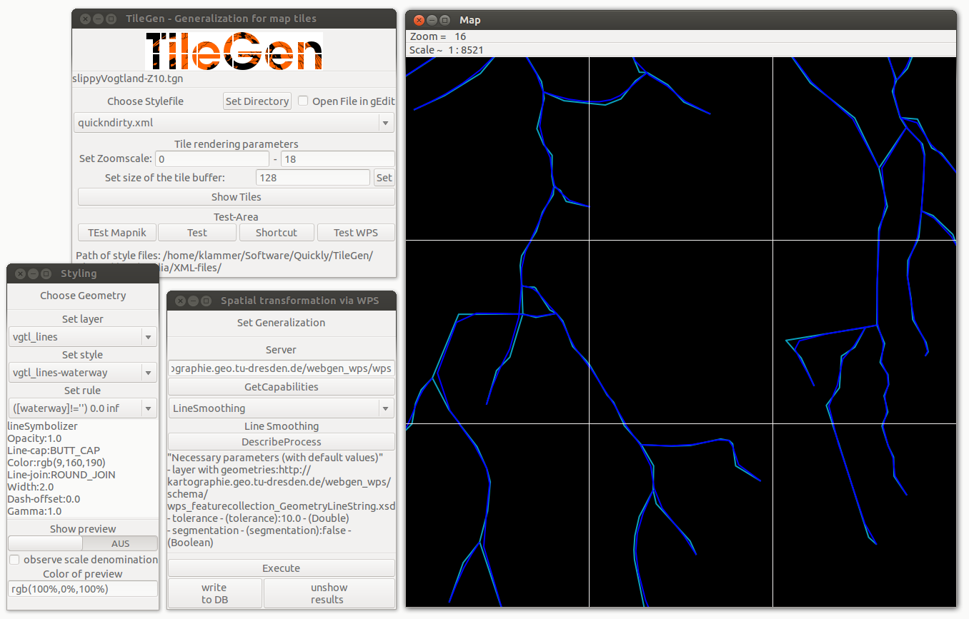
Spatial Transformation
1. Motivation - 2. Facts & Terms - 3. TileGen - Concept - 4. TileGen - Implementation - 5. Conclusion & Outlook
Evaluate result of processing
Select feature type
Execute
web generalization service
Notes:
- as already mentioned … the basic strategy is to only use external generalisation functionalities … by using WebGen-WPS
- user is able to test the application of a web generalisation service, play with transformation parameters and find the best values … remember *click*… always by having a look at the corresponding informations
… export WPS-Execute commands is currently not implemented

Slide 12
5. Conclusion
1. Motivation - 2. Facts & Terms - 3. TileGen - Concept - 4. TileGen - Implementation - 5. Conclusion & Outlook
- proof-of-concept implementation
- general feasability of concept demonstrated
- visual feedback supports definition of cartographic parameters
- WebGen-WPS applicable, but should be developed to:
→ enable Web2.0 communication structure
→ good to have also evaluation processes
Notes:
- we were able to demonstrate the general feasabiltity of the proposed architecture by the exemplary implementations
- WebGen-WPS has basically proved to be applicable
→ currently too static, would be good to enable user to add own functionalities
- the rendering of one tile takes currently too much time when WebGen-processing is applied...click

Slide 13
5. Outlook
1. Motivation - 2. Facts & Terms - 3. TileGen - Concept - 4. TileGen - Implementation - 5. Conclusion & Outlook
- implement export & automatic processing
- outsource topologic evaluation to WebGen
- implement as online-tool
- further experiments on client-applications

Slide 14
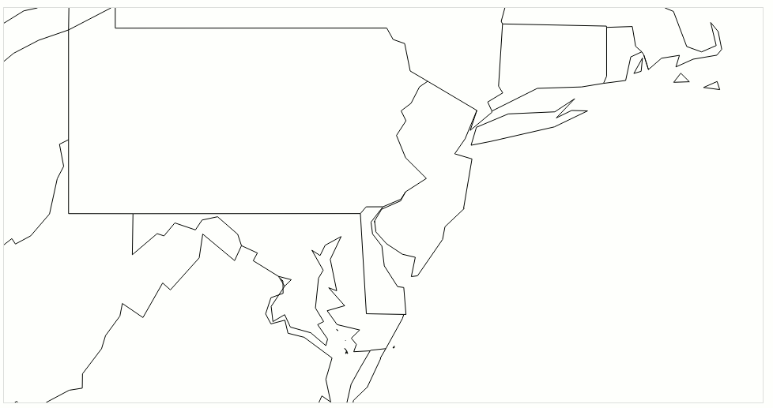
Other Web2.0 Applications???
1. Motivation - 2. Facts & Terms - 3. TileGen - Concept - 4. TileGen - Implementation - 5. Conclusion & Outlook
JavaScript-frameworks build with
D3.js, Leaflet.js & TopoJSON
For example…scale dependent simplification

Slide 15
Resources & Contact
Thank you for your attention!
Questions!?!
About TileGen:
https://github.com/milkbread/TileGen
About WebGen:
http://kartographie.geo.tu-dresden.de/webgen_docs/
About me:
Ralf.Klammer@tu-dresden.de
http://wwwpub.zih.tu-dresden.de/~rklammer
“Whether for good or bad,
online mapping is currently
in a tile-based era and will
likely be so for the
foreseeable future”
Michael P. Peterson (2012)
The Tile-Based Mapping Transition in Cartography.
In: L. Zentai, J. R. Nunez (eds.): Maps for the Future,
Children, Education and Internet. Lecture Notes in
Geoinformation and Cartography, 5:151-163.
Notes:
- I would like to close by citing michael peterson, who said that:...
...and I share that opinion!

