Slide 1

Algorithms 2017

Slide 2
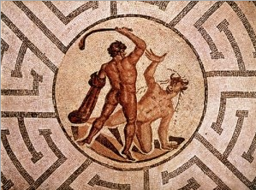
Homework #3
Theseus and That Pesky Minotaur
  Theseus (the red circle ) must escape from some mazes. There is also a mechanical Minotaur (the black circle ) in each maze. For every turn that Theseus takes, the Minotaur takes two turns. The Minotaur follows this program for each of his two turns:
    First, he tests if he can move horizontally and get closer to Theseus.
    If he can, he will move one square horizontally.
    If he cannot, he will test if he could move vertically and get closer to Theseus.
    If he can, he will move one square vertically.
    If he cannot move either horizontally or vertically, then he just skips that turn.
  Note: the key to solve these mazes is to realize that a Minotaur follows a rigid program. He does not do what you would do if you were a Minotaur. He does not look ahead more than one turn. And, most importantly, he will choose a horizontal move before a vertical move.

Slide 3
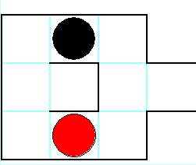
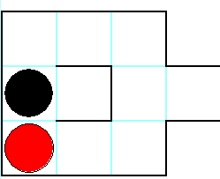
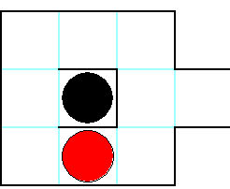
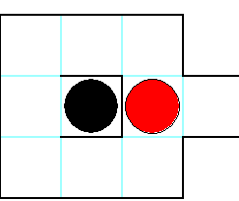
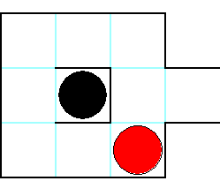
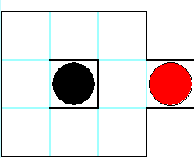
Example Illustration
Move left
Move right
Move right
Move right
Move up

Slide 4
Web Link for This Puzzle
http://www.logicmazes.com/theseus.html

Slide 5
Objective
Write a C/C++/Java program that outputs the solutions of given five puzzle instances using the following characters only.
  ‘L’: move left
  ‘R’: move right
  ‘U’: move up
  ‘D’: move down
  ‘S’: stay
  Time Limit: 30 seconds on CPU 3.0GHz

Slide 6
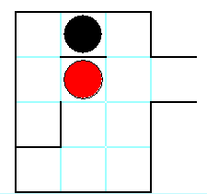
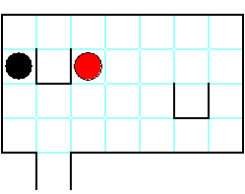
Solutions for 3 Example Instances
Output
LRRUR
Output
DDLSRRUUR
Output
RRRRUDDDLLLLLD

Slide 7
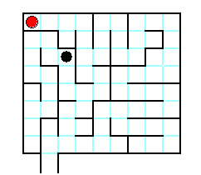
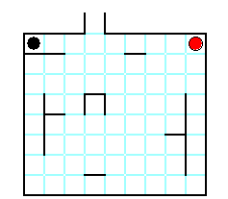
Five Puzzle Instances (1/2)
Puzzle1 (8x9)
84
Puzzle2 (8x9)
79

Slide 8
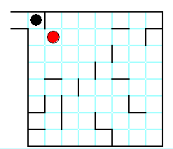
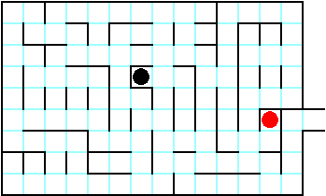
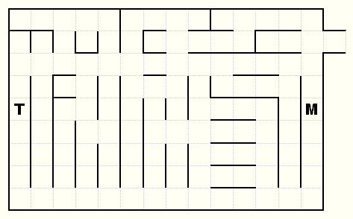
Five Puzzle Instances (2/2)
Puzzle3 (8x8)_75
Puzzle4 (9x14)_86
Solution
Puzzle5 (9x14)_87

Slide 9
Output Format
Output (standard/console output)
Puzzle1
???
Puzzle2
???
Puzzle3
URRR…DLUL
Puzzle4
UURR…URUR
Puzzle5
DLUU…UUUR

Slide 10
Due Date
Soft deadline: June 2, 2017
Hard deadline: June 4, 2017
  But, will be deducted 30% per one day from your original score
Submission Date | Deduction Rate
June 3 | 30%
June 4 | 60%
June 5 | 100%

Slide 11
Notice (cont’d)
You should observe the format of output exactly.
You should submit a compressed file (HW3_your-ID.zip) containing the following three files to the web-site (http://info.kw.ac.kr).
  HW3_your-ID.hwp/doc // report document
  HW3_your-ID.cxx or . java // source code
  HW3_your-ID.exe or HW3_your-ID // executable file

Slide 12
Notice (cont’d)
Source code
  It should be compiled in
    C Language: Visual Studio 2010 or higher, or gcc.
    C++ Language: Visual Studio 2010 or higher, or g++.
    Java Language: not restricted
  Your name and student ID should be noted at the top of your source files in the form of comment.
Report
  Free format.
  But, it must include several examples for testing your program and your own discussion.
  It will be an important factor for getting a good score.
  Mention your programming language together with compiler.

