Slide 1
Microfluidics
Max Oyewole

Slide 2
Overview
History of Microfluidics
Microfluidics Technology
Microfluidics in Drug Delivery
Microfluidics in Cell Analysis
Implementation of Microfluidics
Benefits of Microfluidics
Drawbacks of Microfluidics
Summary
Bibliography 1
Bibliography 2

Slide 3
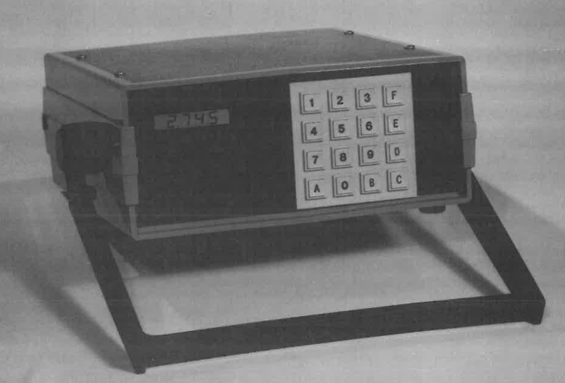
History of Microfluidics
First microfluidic device developed at Stanford
Inventors: James B. Angell, John H. Jerman, Stephen C. Terry Ph.D, and Soheil Saadat
Miniaturized gas chromatography (GC) system
GC measures and identifies gaseous samples
Ideal for analyzing industrial environments
Photograph of the prototype gas analysis system
Notes:
“The first microfluidic device was a miniaturized gas chromatography (GC) system developed by Terry et al. [2] at Stanford University in the 1970s.” Terry, et al includes Professor James B. Angell, John H. Jerman, Stephen C. Terry, Ph.D., and, Soheil Sadaat. “A gas chromatograph (GC), which is capable of separating, identifying, and measuring the constituents of a gaseous sample, is an ideal instrument for performing is an ideal instrument for performing the analysis of an industrial environment.”

Slide 4
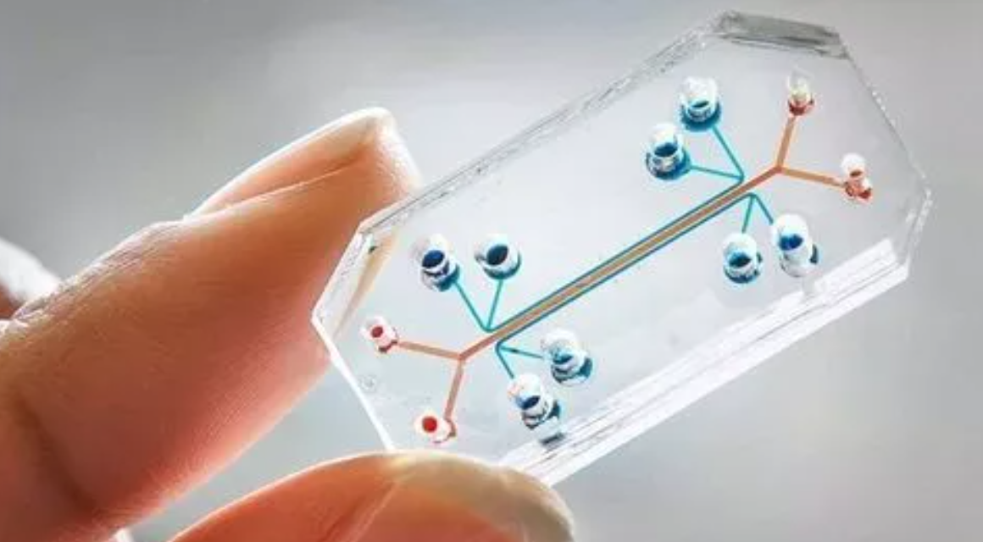
Microfluidics Technology
Combines physics, chemistry, biology, fluid dynamics, microelectronics, and material science
Various materials processed into miniature chips
Chips contain microscale channels and chambers
Used in drug encapsulation, delivery, and targeting
Utilized in cell analysis, diagnosis, and cell culture
Notes:
“Microfluidics is a newly emerging field based on the combined fields of physics, chemistry, biology, fluid dynamics, microelectronics, and material science. A variety of materials can be processed into miniature chips with channels and chambers in the microscale range (Nicelscu 1). “They can be used alone or in combination with other devices. Microfluidic chips can be employed in nanoparticle preparation, drug encapsulation, delivery, and targeting, cell analysis, diagnosis, and cell culture.” (Nicelscu 1)

Slide 5
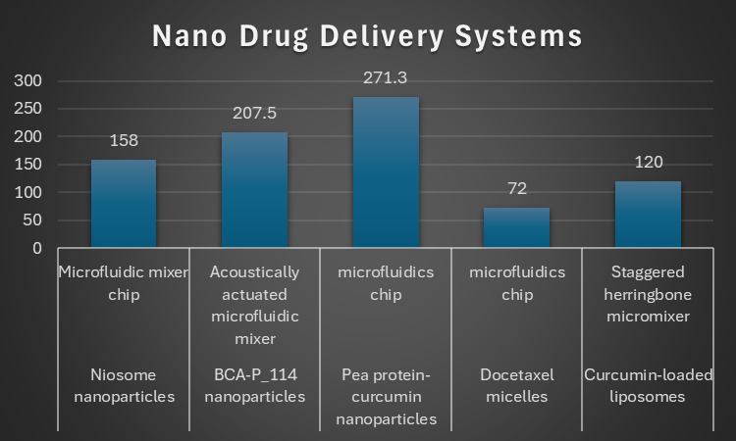
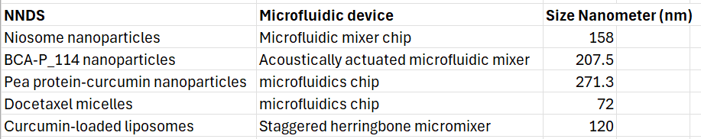
Microfluidics in Drug Delivery
Lipid-polymer nanoparticles are better in microfluidic devices
Microfluidic organ-on-a-chip platform
Organ-on-a-chip synthesizes nanoparticles for drug delivery
Notes:
“Lipid-polymer nanoparticles are problematic to synthesize in a batch approach. However, they have been fabricated with the desired characteristics in microfluidic devices. A newly emerging field, known as organ-on-a-chip introduced a new platform for evaluation and screening for drug delivery. The organ-on-a-chip platforms use microfluidic systems that aim to imitate specific functions of one or more organs. “

Slide 6
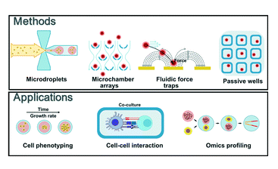
Microfluidics in Cell Analysis
Real-time cell analysis
Used for diagnosis of cancer
Utilized to diagnose immune system diseases
Notes:
“Lastly, microfluidics applications in single cell sequencing technology for the diagnosis of cancers and immune system diseases are briefly illustrated.” (Zhou, et al 1)
“The microfluidic device is a fast-rising system that offers efficient, effective, and sensitive single-cell cultivation and real-time single-cell analysis conducted either on-chip or off-chip.” (Aggraini 1)

Slide 7
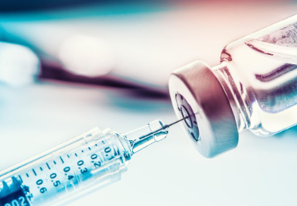
Implementation of Microfluidics
Microfluidics will impact pharmaceutical companies
Doctors benefit from better diagnostic tests
Microfluidics improve speed of cancer diagnosis
Nano Drug Delivery Systems benefit patients
Microfluidics help diabetics and asthmatics
Quicker access to vaccines
Notes:
“They can deliver drugs to the desired site and realize the drugs' sustained release, thereby reducing drugs' toxicity and improving drugs' bioavailability. Various NDDSs, such as liposomes, nanoparticles, and micelles, have been extensively studied and hold great promise in the treatment of various diseases including tumors, diabetes, and asthma.”
“At present, the marketed microfluidics-mediated NDDSs against COVID-19 include Pfizer/BioNTech's BNT162b2 and Moderna's mRNA-1273, both of which are LNPs-encapsulated mRNA vaccines”

Slide 8
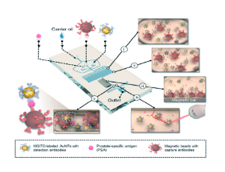
Benefits of Microfluidics
Faster reaction time
Enhanced analytical sensitivity
Enhanced temperature control
Better portability
Relatively cheap
Detection of disease biomarkers
Notes:
“Microfluidics have diverse assets: faster reaction time, enhanced analytical sensitivity, enhanced temperature control, portability, easier automation and parallelization, integration of lab routines in one device (lab-on-a-chip). It is cheap as it does not involve the use of various costly equipment.” (Elveflow)
“Another advantage of microfluidic systems is the increased precision that they offer. Microfluidic systems offer an exceptionally high level of control of experimental conditions because of their custom-designed architectures and atomization. This increased level of control yields itself to more precise experimentation and accurate results. Microfluidic systems allow multiple analytes to be processed at the same time. This simultaneous processing is possible because of the reduced amount of space that each circuit requires. By running multiple circuits at the same time, the amount of time that each experiment takes is greatly reduced, allowing for more efficient processes and increased throughput.” (Kelly Pneumatics)

Slide 9
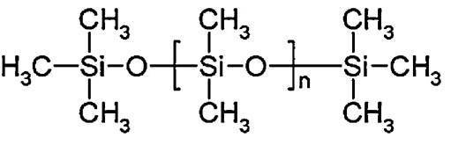
Drawbacks of Microfluidics
Chips made of PDMS (Polydimethylsiloxane) too absorbent
PDMS chips pick up contaminants
Exposure to certain chemicals dissolves PDMS
Polydimethylsiloxane
Notes:
“PDMS is known to adsorb hydrophobic molecules onto its surface, which can lead to irreversible binding and potentially alter experimental results.”
“PDMS can easily pick up contaminants from the environment.”
“Both can lead to inconsistent experimental results.”
“PDMS has limited chemical compatibility with some solvents, acids, and bases. Exposure to these chemicals can cause PDMS to swell or even dissolve, compromising the integrity of the microfluidic device and potentially affecting experimental conditions.” (Micronit)

Slide 10
Summary
I agree with the advancements in microfluidics
It will greatly revolutionize pharmaceuticals
Cancer patients will live longer lives
Asthmatics and diabetics may get a cure
This will overall benefit the world

Slide 11
Bibliography 1
A Prototype Gas Analysis System Using a Miniature Gas Chromatograph
Basic Microfluidic and Soft Lithographic Techniques
Fabrication and Applications of Microfluidic Devices: A Review
Microfluidics: A general overview of microfluidics
Microfluidic Nanoparticle Synthesis: A short review
Microfluidics applications for high-throughput single cell sequencing
Microfluidics | Definitions | uFluidix
Advantages of Microfluidic Systems
Recent advances in microfluidic devices for single-cell cultivation: methods and applications
Unique strengths of microfluidics: Optofluidic Bioassay LLC
PDMS for Microfluidics: Limitations and Alternatives

Slide 12
Bibliography 2
Microfluidics for nano-drug delivery systems: From fundamentals to industrialization
Applications of polydimethylsiloxane in analytical chemistry: A review
Recent progress of microfluidic chips in immunoassay

