Slide 1

MEALVANA ENDURANCE
Science-Based Nutrition Planning for Endurance Athletes
B.E.S.T. Coaches Presentation | March 2, 2026

Slide 2
Today's Agenda
● The Nutrition Gap in Coaching
● What is Mealvana Endurance?
● Key Features & How It Works
● Live App Demo
● Coach Mode: Your Dashboard
● Coach Mode Demo
● Product Roadmap & Upcoming Features
● Design Previews: Food Logging & More
● Pricing & Pilot Coach Program
● Q&A
5 min
5 min
5 min
10 min
5 min
5 min
3 min
3 min
3 min
5 min
2 / 22

Slide 3
The Nutrition Gap
Why endurance athletes are under-fueled
60%
30-50%
2-3 hrs/wk
of age-group athletes wing race nutrition
performance drop from poor fueling strategy
coaches spend on manual nutrition planning
"What surprised us was how many coaches mentioned the fueling knowledge gap."
-- Mealvana Coach Research, 2026
3 / 22

Slide 4
What is Mealvana Endurance?
A personalized nutritionist in every athlete's pocket
AI-powered nutrition plans generated in seconds
Science-based: ACSM formulas & evidence-based guidelines
Respects athlete food preferences (3-tier like/willing/dislike system)
Integrates with Training Peaks & Final Surge
Offline-first: works without internet, syncs when connected
Multi-sport: running, cycling, swimming & brick workouts
Phase-specific plans: Before, During & After activity
4 / 22

Slide 5
How It Works
Evidence-based nutrition science meets AI
BEFORE
DURING
AFTER
▸ 1-4g/kg carbs based on time available
▸ 30-90g/hr carbs (gut training level)
▸ 1g/kg carbs within 2 hours
▸ Low fat, low fiber for GI comfort
▸ 300-1000mg/hr sodium (heat-adjusted)
▸ 0.2g/kg protein for recovery
▸ Timing-aware: 15 min to 4 hrs before
▸ 0.4-0.8L/hr hydration
▸ Rehydration targets
▸ Personalized food recommendations
▸ Portable, easy-to-consume foods
▸ Real food preferences respected
5 / 22

Slide 6
Smart Nutrition Plans
AI + Linear Programming Optimization
Dual-System Reliability
AI primary system for personalization, algorithmic fallback ensures plans ALWAYS generate (<1 sec)
Multi-Objective Optimization
Simultaneous optimization of carbs, protein, fat, sodium & hydration using linear programming
Safety-First Design
No unsafe food combinations (no oatmeal during runs), GI sensitivity tracking, sodium limits
Weather-Aware
Adjusts hydration and sodium based on temperature, humidity & indoor/outdoor
Gut Training Levels
Graduated carb targets based on athlete's gut training experience
6 / 22

Slide 7
Training Platform Integration
Works with the tools coaches already use
Training Peaks
Final Surge
Automatic workout sync from Training Peaks
One-click OAuth connection (no credential sharing)
Smart change detection when schedules update
Automatic nutrition plan staleness flagging
Full Final Surge integration
Pull athlete schedules automatically
Support for all activity types
Bidirectional sync capability
More platform integrations coming soon (Strava, Garmin, and more)
7 / 22

Slide 8
Food Preferences System
Athletes eat what they actually like
❤ LIKED
⭐ WILLING TO TRY
⛔ DISLIKED / ALLERGIC
Strong preference (+20 priority) Recommended first in plans
Moderate preference (+5 priority) Used when needed for targets
Automatically excluded Never appears in plans
100+ foods with detailed nutrition data and phase appropriateness
Phase-specific intelligence: right foods for right timing
Higher adherence = better race results
8 / 22

Slide 9
LIVE APP DEMO
Creating a nutrition plan from scratch
Create a new activity (marathon training run)
Set distance, pace, and conditions
Generate personalized nutrition plan
Review Before / During / After phases
Swap foods and adjust quantities
9 / 22

Slide 10
Coach Mode
Manage your athletes' nutrition from one place
Athlete Management
Nutrition Oversight
Many-to-many: manage multiple athletes
Athlete codes for easy pairing (ATH-XXXXXXXX)
Permission-based access levels
Real-time messaging with athletes
Comment on specific activities or plans
View athlete nutrition plans (read or edit)
Track completion rates & macro adherence
Coach directory for athlete discovery
Seamless coach/athlete mode toggle
Web-based dashboard (coming soon)
10 / 22

Slide 11
Coach Dashboard
Everything at a glance
1
2
3
4
REGISTER
CONNECT
REVIEW
COMMUNICATE
Submit coach application for verification
Invite athletes via athlete code (ATH-XXXX)
View plans, track adherence, add comments
Direct messaging and plan annotations
Dual-Write Architecture: Changes sync in real-time across all devices
Coach writes to Supabase immediately (no sync delays)
Athletes see coach feedback and plan changes instantly
Full offline support: log locally, sync when connected
11 / 22

Slide 12
Coach Communication
Stay connected with your athletes
General Chat
Activity Comments
Nutrition Plan Notes
Direct messaging for general coaching conversation
Attach feedback to specific workouts and training sessions
Comment on nutrition plans with specific recommendations
Real-time message delivery via Supabase Realtime subscriptions
Read tracking and unread message counts
Cross-device sync across all athlete devices
Thread-based conversations organized by context
12 / 22

Slide 13
COACH MODE DEMO
Managing athletes as a coach
Coach dashboard overview
Invite an athlete using athlete code
View athlete's activity and nutrition plan
Add comments and feedback on a plan
Messaging between coach and athlete
13 / 22

Slide 14
Product Roadmap
What's coming next
IN PROGRESS
COMING SOON
Coach / Dietitian Dashboard
Pro
Ship: Feb 27
Personal Fueling Templates
Pro
Ship: Mar 13
Developing
Not started
Better Food Recommendations
Free
Ship: Feb 23
Payment Infrastructure
Free
Ship: Mar 13
Developing
Not started
Critical Usability Fixes
Free
Ship: Mar 6
Other Platform Integrations
Pro
Ship: Mar 27
Design
Not started
Race Day Spreadsheet
Pro
Ship: Feb 27
Gamification & Rewards
Free
Ship: Apr 3
Design
Not started
Meal Planning
Cookies*
Ship: Apr 17
Fueling Knowledge Gap Content
Pro
Ship: Apr 24
Design
Not started
*Cookies = token-based premium feature | Timeline subject to change
14 / 22

Slide 15
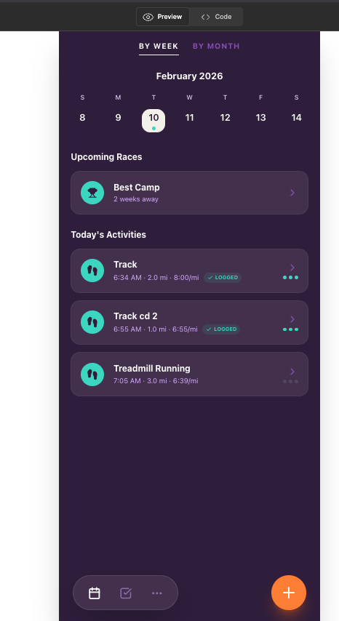
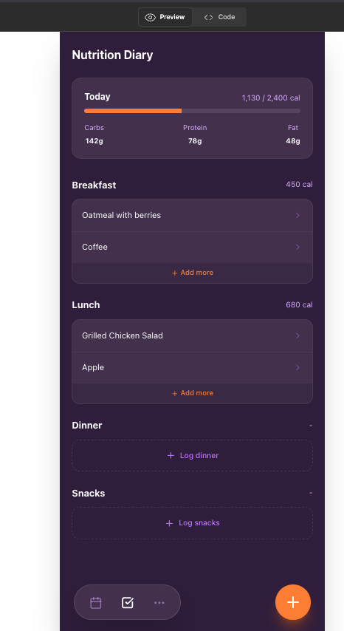
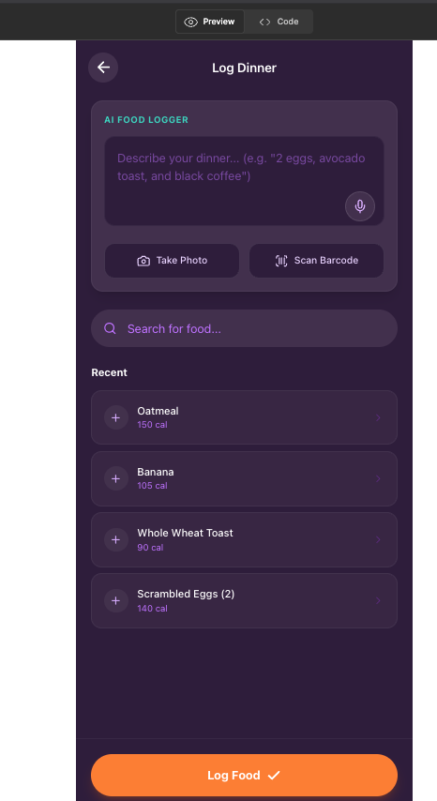
Coming Soon: Food Logging
AI-powered daily nutrition tracking
Activities View
Nutrition Diary
AI Food Logger
15 / 22

Slide 16
Food Logging Features
Multiple ways to track nutrition
AI Text Parsing
Type "grilled chicken 6oz with rice" and AI parses it into structured food items
AI Photo Recognition
Take a photo of your plate and AI identifies foods and estimates portions
Barcode Scanning
Scan product barcodes for instant nutrition data
Database Search
Search 100+ foods from our curated database
Daily Macro Dashboard
Track Calories, Carbs, Protein, Fat, Sodium & Hydration at a glance
Timeline Integration
Meals mixed chronologically with activities for a complete daily view
16 / 22

Slide 17
Coming Soon: Race Day Spreadsheet
Replace manual spreadsheets with smart race nutrition
Coaches currently use spreadsheets to plan race day nutrition
Mealvana replicates this function with better convenience and accuracy
Automatically calculated based on race distance, pace, and conditions
Easy to share with athletes through the coach portal
Design currently in progress - prototype available
Figma Prototype Available
We'd love your feedback on the race day nutrition design!
17 / 22

Slide 18
Design Preview
Additional designs
[Add your Figma designs or screenshots here]
18 / 22

Slide 19
Design Preview
Additional designs
[Add your Figma designs or screenshots here]
19 / 22

Slide 20
Payment Strategy
Simple, fair pricing for athletes and coaches
ATHLETE SUBSCRIPTION
COACH SUBSCRIPTION
$19.99
$20 - $50
per month
per month (based on athlete count)
All nutrition plan features
Training Peaks & Final Surge sync
Food preference personalization
Offline-first mobile app
Starter: $20/mo (up to 20 athletes)
Pro: $50/mo (unlimited athletes)
Full dashboard & analytics
Messaging & plan annotations
Exploring options outside Apple App Store for more flexible coach billing (Stripe)
20 / 22

Slide 21
JOIN OUR PILOT COACHES PROGRAM
30%
OFF
What Pilot Coaches Get:
30% discount on coach subscription for the first year
Early access to new features before public release
Direct line to the development team for feedback
Shape the product roadmap with your coaching expertise
Priority support and onboarding assistance
21 / 22

Slide 22
Thank You!
Questions & Discussion
MEALVANA ENDURANCE
Science-Based Nutrition for Endurance Athletes
22 / 22

