Slide 1
Sales Operations Analysis Funnel Optimization & Revenue Growth Strategies

Slide 2
Funnel Bottlenecks
Leads (100)
Critical Bottleneck:
66 MQLs → Only 38 SQLs
34%
Won (16)
Solution:
Automate MQL qualification
Retrain Sales Reps on objection handling
Deals (32)
42%
SQLs (38)
16%
MQLs (66)
50%

Slide 3
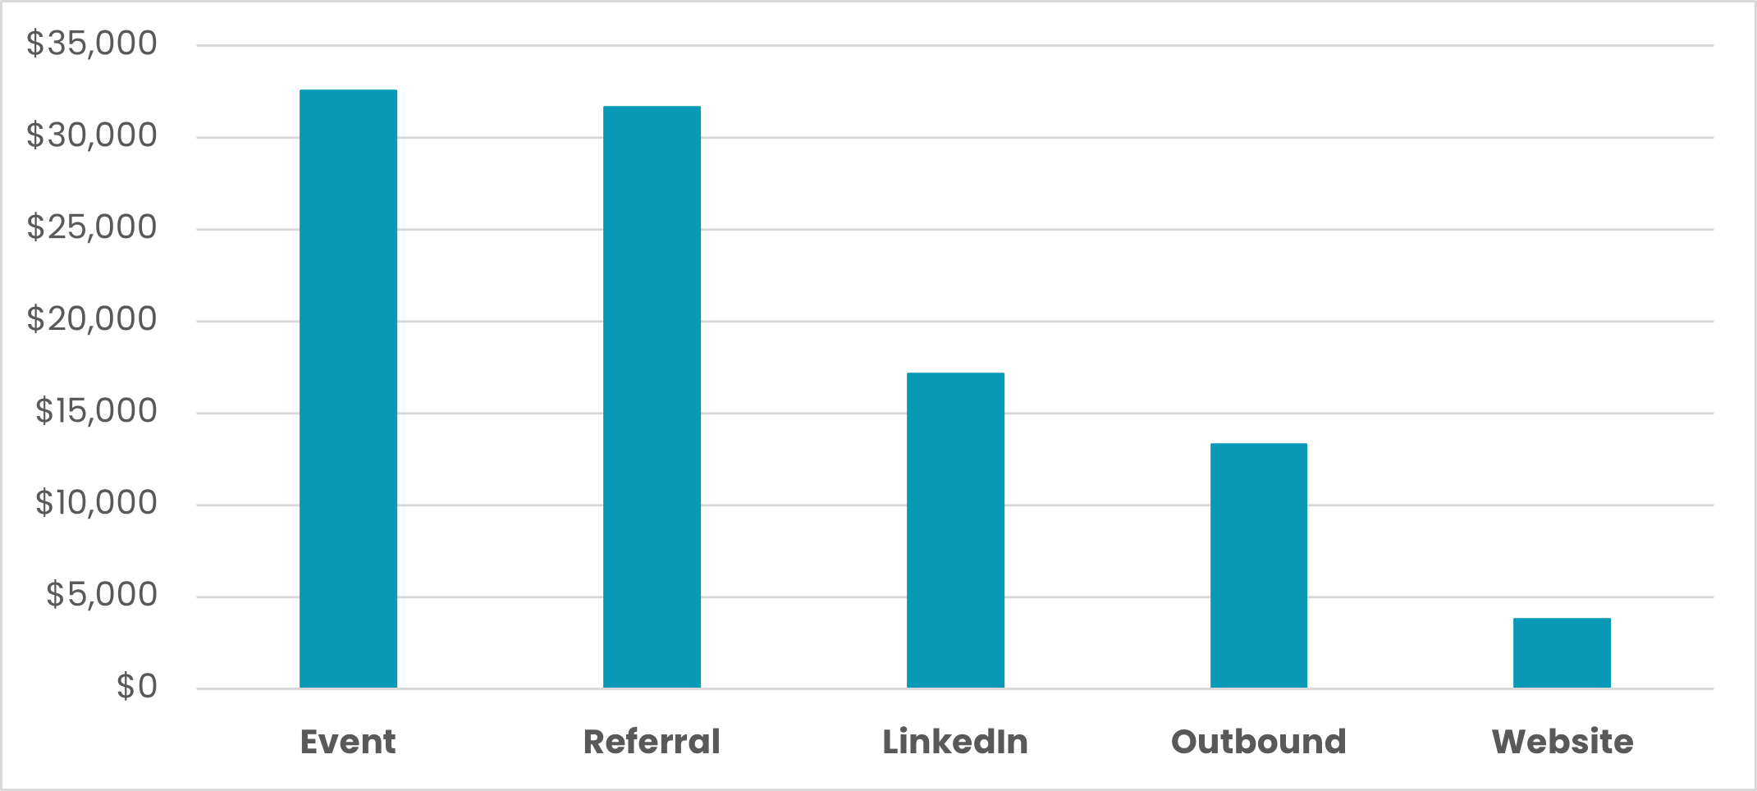
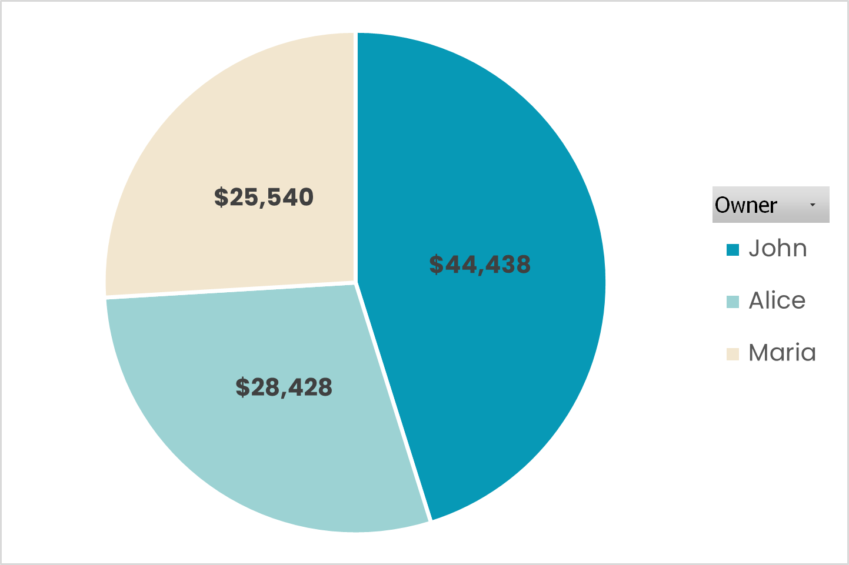
Channel & Rep Performance
Top Channels:
Rep Performance:
Event: $32,546 revenue
Referral: $31,642 revenue
Website: $3,791 revenue (Lowest Performer)
John: $44,438 | 7 deals won
Maria: $25,540 | 4 deals won (Priority for training)

Slide 4
Solutions
Quick Wins (1 Month)
Long term
Fix MQL→SQL Drop-Off
Tactic: Implement automated lead scoring + SLA for 1-hour follow-up
Scale Event/Referrals by 15%
Tactic: Shift 20% of Website budget to top-performing events
Maria’s Performance Boost
Tactic: Weekly coaching with John on referral conversions
Website Lead Transformation
Tactic:
Replace forms with interactive qualification quizzes
Embed referral CTAs in thank-you pages

Slide 5
The $50K→$60K Leap
Why We Need 2 More Deals
Current Revenue | $50,000/month
Target Revenue | $60,000/month
Gap | $10,000
Avg. Deal Value (ADV): | $6,150 → $10,000 ÷ $6,150 = 1.63 → Round to 2 deals

Slide 6
Lead Conversion Math
How Many Leads to Close 2 Deals?
Scenario | Conversion Rate | Leads Needed | Key Actions
Current | 16% | 13 | Focus on Referral/Event Leads
10% Improved | 21.3% | 10 | Fix MQL-to-SQL (58%→63%)
16% = 66% × 58% × 42% || 21.3% = (66%×1.1) × (58%×1.1) × (42%×1.1)
2 deals ÷ 16% = 13 leads || 2 deals ÷ 21.3% = 10 leads

Slide 7
Action Plan
3 Steps to Secure $60K/Month
Priority | Action | Owner | Timeline
1 | Generate 10-13 leads/month | Sales | Ongoing
2 | Improve MQL-to-SQL (58% → 63%) | Marketing | 30 days
3 | Train team on high-ACV deals | Sales Ops | 60 days

Slide 8
Lock In the Growth
1. Fix the Funnel
Stop the 42% MQL→SQL leak
(Automate MQL qualification + retrain sales reps)
2. Double Down on What Works
More Event & Referral leads
(Shift budget from underperforming channels)
3. Coach for Quick Wins
Train Maria on John’s referral framework
(Structured training + shadowing)
4. Keep It Going
Make $60K the new normal
(Review progress weekly)

Slide 9
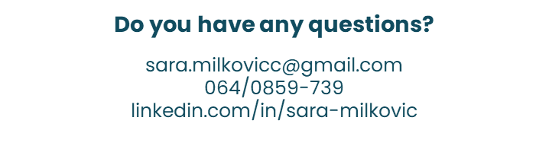
Thank you

