Slide 1

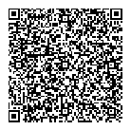
BIM VISUALISATION
| Revit Project File
‘Scan the QR code
to preview the model online and explore the design’
Follow the link below to experience 3D walkthrough
https://dev-bim-appfn.daikinthai.com/build-h5/?projectId=1683109314202746882&modelId=433db00c-e495-4ddc-97ca-46bdb0b6e797&SessionId=0b7c2269-23d2-43ac-b20d-1459432c42cf

