Slide 1
250623 :
Mod, PdoAllSts & PdoCmd for Motor CTRL

Slide 2
PDO : All Status
Item | Type | Byte / 1EA | Count | Bytes
1 | FAN Tach | 2 | 15 | 30
2 | CUR | 2 | 11 | 22
3 | BL TEMP | 2 | 8 | 16
4 | DIMM TEMP | 4 | 32 | 128
5 | TCON-N.SV | 2 | 8 | 16
6 | TCON-N.PV | 2 | 8 | 16
7 | TCON-MV | 2 | 8 | 16
8 | TCON-CH.STS | 2 | 8 | 16
9 | TCON-ALM.STS | 2 | 8 | 16
10 | TCON-RUN | 1 | 1 | 1
11 | TCON-TUNING | 1 | 1 | 1
12 | COOLER-N.PV | 2 | 8 | 16
13 | GPIO | 1 | 13 | 13
14 | H.SENSOR.HUM | 2 | 4 | 8 | Signed Int, Unit : 0.1%
15 | H.SENSOR.TEMP | 2 | 4 | 8 | Signed Int, Unit : 0.1C
16 | HI.LIMIT | 1 | 1 | 1 | 1-bit Active HIGH
17 | LO.LIMIT | 1 | 1 | 1 | 1-bit Active HIGH
18 | CBOX.CONTACT | 1 | 1 | 1 | 4-bit Active HIGH
19 | MOTOR.LOCK | 1 | 1 | 1 | 1-bit Active HIGH
20 | MOTOR.EN | 1 | 1 | 1 | 1-bit Active HIGH
21 | MOTOR.DIR | 1 | 1 | 1 | 0 for DN, 1 for UP
22 | MOTOR.RUN | 1 | 1 | 1 | 0 for Stop, 1 for Auto, 2 for Manual
23 | MOTOR.STEP | 4 | 1 | 4 | STEP = 0 @ HI_LIMIT
Total |  |  |  | 307 + 27

Slide 3
PDO : Pre-Defined Operation [ MMTC ]
Type | Channel | Address | Function ( Code / Description ) |  | Data
PDO | 0xFF | 0x00 | 0x40 | HI/LO LIMIT POLARITY : 0 – default, active low / 1-Inv, active high | 1 Byte
 | 0xFF | 0x00 | 0x41 | CBOX CONTACT POLARITY : 0 - default, active low / 1-Inv, active high | 1 Byte
 | 0xFF | 0x00 | 0x42 | MOTOR DIRECTION POLARITY : 0 - default, active low / 1-Inv, active high | 1 Byte
 | 0xFF | 0x00 | 0x43 | MOTOR STEPPING FREQ : default – 100,000 for 100us | 4 Byte
 | 0xFF | 0x00 | 0x44 | MOTOR STEPPING MAX COUNT : default - 55000 | 4 Byte
 | 0xFF | 0x00 | 0x50 | MOTOR AUTO CTRL : 0 – Stop, 1 – Up, 2 – Down | 1 Byte
 | 0xFF | 0x00 | 0x51 | MOTOR MANUAL UP : 0 – default AUTO / 1 ~ for Manual | 4 Byte
 | 0xFF | 0x00 | 0x52 | MOTOR MANUAL DOWN : 0 – default AUTO / 1 ~ for Manual | 4 Byte

Slide 4
Appendix

Slide 5
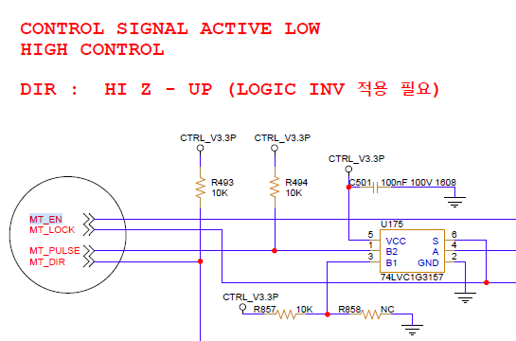
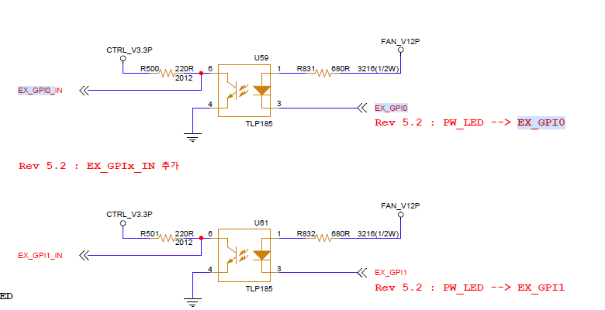
CON1 :
BL#_ST → EX_GPO_# : MT_EN, MT_LOCK, MT_PULSE, MT_DIR
DIR : Up/Dn Polarity
PULSE : Stepping Freq
CON2 :
HUM_SIO_# → PDO.All.Sts
CB_CC_# : Tape switch
EX_GPI#_IN : Photo Coupler
Sts Polarity

Slide 6
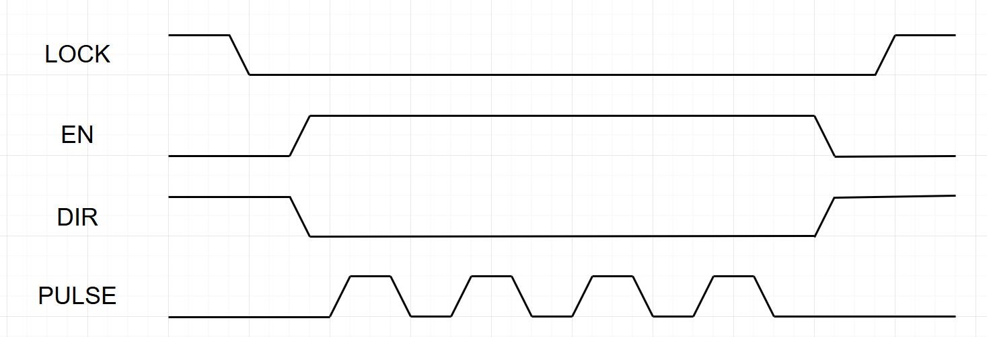
PDO.All.Sts :
습도 온도 : ( 2B + 2B ) x4 = 16Byte
Hi Limit / Lo Limit : 1B + 1B
Cbox Contact Check : 1B
Motor.Sts
En
Lock
DIR
RUN / STOP
PDO.Motor
Hi/Lo Polarity
Cbox Contact Check Polarity
Motor.Dir Polarity for DIR
Stepping Freq ( 100us, 10KHz ) :
100us * 2000 = 1 stepCnt ???
Up/Dn limit check ???
MaxStepCnt = 55000
Motor.Ctrl :
Auto : Up, Down, Stop
Manual : Stepping number w/ Up/Dn

Slide 7
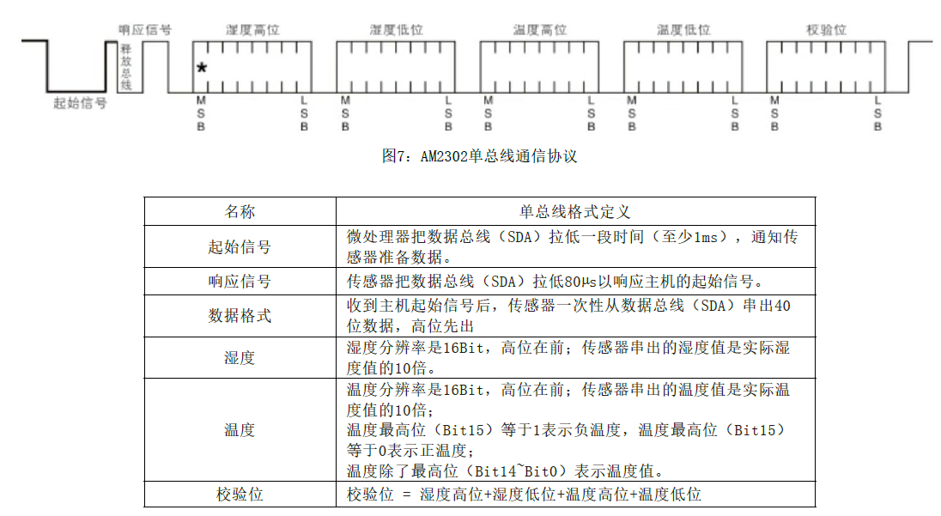
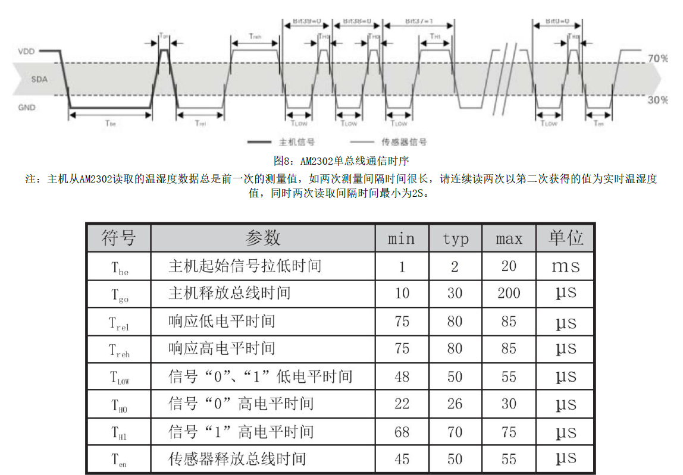
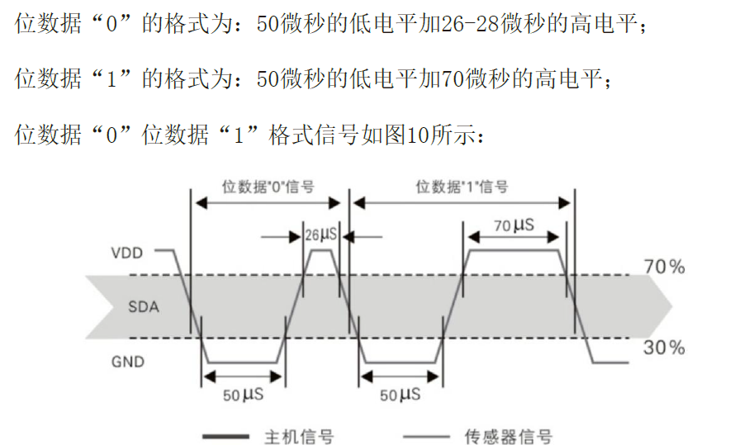

Slide 8
