Slide 1
Diagram [ 1 ]
HOST
( Client )
( TCP/IP Server )
W5500
( SPI Slave )
( SPI Master )
CTRL FPGA

Slide 2
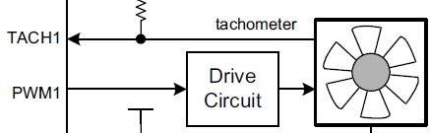
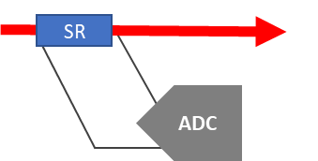
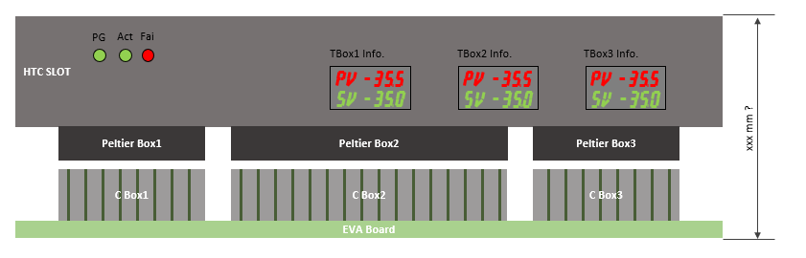
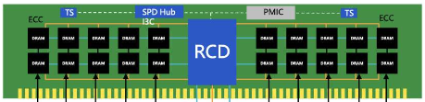
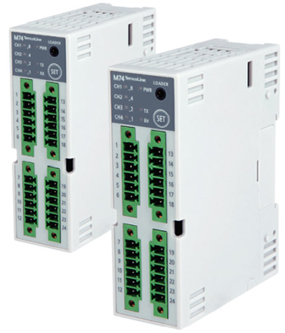
Diagram [ 2 ]
HOST
CTRL
15EA FAN
11EA Current
8EA Temperature
ETH
FP – Front Pannel
( set 8CH SV / PV )
16EA DIMM Temp.
TCON
( 2CH RS485 )
8CH SSR Control
GPIO

Slide 3
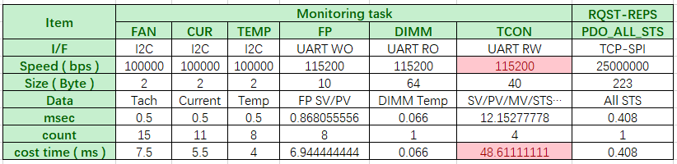
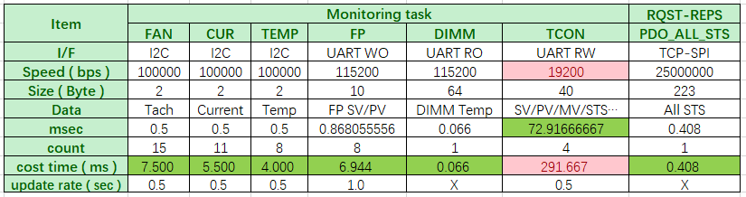
Diagram [ 3 ]
HOST
( TCP Client )
( TCP/IP Server )
W5500
( SPI Slave )
( SPI Master )
CTRL FPGA
board init();
while (1) {
board_sts();
tcp_server() {
RQST-RESP;
}
all_fan_tach();
all_cur_cur();
all_temp_temp();
all_fp_set();
all_dimm_temp();
1ea_tcon_4ch_sts();
}
100Mbps
25MHz
0.408ms
7.500ms
5.500ms
4.000ms
6.944ms
0.066ms
72.917ms
Total : 97.335ms
※ while loop에서 주기적으로 tach, cur, temp 등을 모니터링, 1초에 1번 혹은 2번 업데이트
※ host request가 발생하면, 바로 모니터링 값을 response로 전달

Slide 4
Packet Protocol
구분 | Header |  |  |  | Data N byte |  |  |  |  | Note
 | identify | len | type | requst/respons
 | 2byte | 1byte | 1byte | 1byte
의미 | 'c0de' 고정 | data length | 0=FAN 1=CUR 2=TEMP 3=FP 4=DIMM 5=TCON 6=GPIO 10=PDO | 0=Requst (pc -> fpga) 1=Response OK (fpga -> pc) 0xE=Resp.Error | CH | ADDR | FUNC | BYTE | DATA | Data Length : N BYTE : byte count of desired Read/Write DATA : NULL for Write
FAN | 0xC0DE | N | 0 |  |  |  |  |  | NULL
Request & Response
구분 | Header |  |  |  | Data N byte |  |  |  |  | Note
 | identify | len | type | requst/respons
 | 2byte | 1byte | 1byte | 1byte
의미 | 'c0de' 고정 | data length | 0=FAN 1=CUR 2=TEMP 3=FP 4=DIMM 5=TCON 6=GPIO 10=PDO | 0=Requst (pc -> fpga) 1=Response OK (fpga -> pc) 0xE=Resp.Error | CH | ADDR | FUNC | BYTE | DATA | BYTE : byte count of desired Read/Write DATA : NULL for Write
Get Operation
HOST 2 FPGA Request | 0xC0DE | 4 | 0 | 0 | 0xFF | 0x00 | 0x11 | 2 | NULL | Get 2 Byte from desired function
FPGA 2 HOST Response | 0xC0DE | 4 + 2 = 6 | 0 | 1 | 0xFF | 0x00 | 0x11 | 2 | 0xABCD | Receive 2 Byte data – 0xABCD
Set Operation
HOST 2 FPGA Request | 0xC0DE | 4 + 2 = 6 | 0 | 0 | 0xFF | 0x00 | 0x11 | 2 | 0x1234 | Set 2 Byte to CTRL FPGA
FPGA 2 HOST Response | 0xC0DE | 0 | 0 | 1 or 0xE | NULL | NULL | NULL | NULL | NULL | Set or Write OK / Fail

Slide 5
FAN : EMC2303 – 3CH Fan Controller [ 1 ]
Type | Channel | Address | Function ( Code / Description ) |  | Data
FAN | I2C_CH ( 0 ~ 4 ) | REG_ADDR | 0x00 | Write Reg | 1 Byte / 1 Reg
 | I2C_CH ( 0 ~ 4 ) | REG_ADDR | 0x01 | Read Reg | 1 Byte / 1 Reg
 | 0xFF | FAN_IDX ( 0 ~ 14 ) | 0x10 | Set Duty | 1 Byte / 1 EA
 | 0xFF | FAN_IDX ( 0 ~ 14 ) | 0x11 | Get Duty | 1 Byte / 1 EA
 | 0xFF | FAN_IDX ( 0 ~ 14 ) | 0x20 | Get Tach | 2 Byte / 1 EA
표1-1
I2C Channel | FAN Controller | CH | Function | Comment | I2C_CH | FAN_IDX
FAN1_SCL, SDA | Controller 1(U49) | 1 | Temp Box FAN1 |  | 0 | 0
 |  | 2 | Temp Box FAN2 |  | 0 | 1
 |  | 3 | Temp Box FAN3 |  | 0 | 2
FAN2_SCL, SDA | Controller 1(U50) | 1 | Temp Box FAN4 |  | 1 | 3
 |  | 2 | Temp Box FAN5 |  | 1 | 4
 |  | 3 | Temp Box FAN6 |  | 1 | 5
FAN3_SCL, SDA | Controller 1(U51) | 1 | Temp Box FAN7 |  | 2 | 6
 |  | 2 | Temp Box FAN8 |  | 2 | 7
 |  | 3 | Spare FAN (To Back Plane) | 사용용도 미정 | 2 | 8
FAN4_SCL, SDA | Controller 1(U52) | 1 | Heat Sink1 Block FAN1 |  | 3 | 9
 |  | 2 | Heat Sink1 Block FAN2 |  | 3 | A
 |  | 3 | Heat Sink1 Block FAN3 |  | 3 | B
FAN5_SCL, SDA | Controller 1(U53) | 1 | Heat Sink1 Block FAN4 |  | 4 | C
 |  | 2 | Peltier Controller CASE FAN1 |  | 4 | D
 |  | 3 | Peltier Controller CASE FAN2 |  | 4 | E
구분 | Header |  |  |  | Data N byte |  |  |  |  | Note
 | identify | len | type | requst/respons
 | 2byte | 1byte | 1byte | 1byte
의미 | 'c0de' 고정 | data length | 0=FAN 1=CUR 2=TEMP 3=FP 4=DIMM 5=TCON 6=GPIO 10=PDO | 0=Requst (pc -> fpga) 1=Response OK (fpga -> pc) 0xE=Resp.Error | CH | ADDR | FUNC | BYTE | DATA
FAN | 0xC0DE | 4 | 0 | 0 | 0xFF | 0x00 | 0x11 | 10 | NULL | Read 10-byte, 5EA tach value of FAN_0 ~ 4

Slide 6
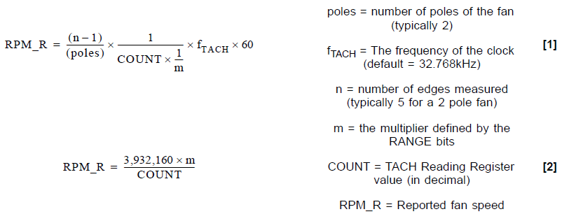
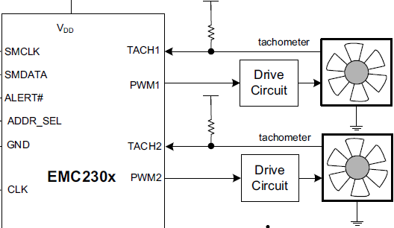
FAN : EMC2303 – 3CH Fan Controller [ 2 ]
Type | Channel | Address | Function ( Code / Description ) |  | Data
FAN | I2C_CH ( 0 ~ 4 ) | REG_ADDR | 0x00 | Write Reg | 1 Byte / 1 Reg
 | I2C_CH ( 0 ~ 4 ) | REG_ADDR | 0x01 | Read Reg | 1 Byte / 1 Reg
 | 0xFF | FAN_IDX ( 0 ~ 14 ) | 0x10 | Set Duty | 1 Byte / 1 EA
 | 0xFF | FAN_IDX ( 0 ~ 14 ) | 0x11 | Get Duty | 1 Byte / 1 EA
 | 0xFF | FAN_IDX ( 0 ~ 14 ) | 0x20 | Get Tach | 2 Byte / 1 EA
1 Byte Duty : FAN Speed % = ( Duty / 0xFF ) * 100 %
0x00 : STOP
0xFF : Full-Speed RUN
2 Byte Tach ( 13-bit ) : FAN RPM = ( 3932160 * 2 ) / Tach
0x1F_FF : STOP

Slide 7
CUR : INA226 – 1CH Current Monitor
Type | Channel | Address | Function ( Code / Description ) |  | Data
TEMP | I2C_CH ( 0 ~ 10 ) | REG_ADDR | 0x00 | Write Reg | 2 Byte / 1 Reg
 | I2C_CH ( 0 ~ 10 ) | REG_ADDR | 0x01 | Read Reg | 2 Byte / 1 Reg
 | 0xFF | CUR_IDX ( 0 ~ 10 ) | 0x11 | Get Current | 2 Byte / 1 EA
표1-2
I2C Channel | FAN Controller | CH | Function | Comment | I2C_CH | CUR_IDX
M1_SCL, SDA | Controller 1(U39) | 1 | Peltier 1 (Temp Box1) 24V Monitor |  | 0 | 0
M2_SCL, SDA | Controller 2(U40) | 1 | Peltier 2 (Temp Box1) 24V Monitor |  | 1 | 1
M3_SCL, SDA | Controller 3(U41) | 1 | Peltier 3 (Temp Box2) 24V Monitor |  | 2 | 2
M4_SCL, SDA | Controller 4(U42) | 1 | Peltier 4 (Temp Box2) 24V Monitor |  | 3 | 3
M5_SCL, SDA | Controller 5(U43) | 1 | Peltier 5 (Temp Box3) 24V Monitor |  | 4 | 4
M6_SCL, SDA | Controller 6(U44) | 1 | Peltier 6 (Temp Box3) 24V Monitor |  | 5 | 5
M7_SCL, SDA | Controller 7(U45) | 1 | Peltier 7 (Temp Box4) 24V Monitor |  | 6 | 6
M8_SCL, SDA | Controller 8(U46) | 1 | Peltier 8 (Temp Box4) 24V Monitor |  | 7 | 7
M9_SCL, SDA | Controller 9(U47) | 1 | Water Pump 12V Monitor |  | 8 | 8
M10_SCL, SDA | Controller 10(U48) | 1 | Radiator FAN 12V Monitor |  | 9 | 9
M11_SCL, SDA | Controller 11(U87) | 1 | Back Plane Output Power 12V Monitor |  | A | A
2 Byte Current : return [ Current Register ] value of INA226
구분 | Header |  |  |  | Data N byte |  |  |  |  | Note
 | identify | len | type | requst/respons
 | 2byte | 1byte | 1byte | 1byte
의미 | 'c0de' 고정 | data length | 0=FAN 1=CUR 2=TEMP 3=FP 4=DIMM 5=TCON 6=GPIO 10=PDO | 0=Requst (pc -> fpga) 1=Response OK (fpga -> pc) 0xE=Resp.Error | CH | ADDR | FUNC | BYTE | DATA
FAN | 0xC0DE | 4 | 1 | 0 | 0xFF | 0x02 | 0x11 | 2 | NULL | Read 2-byte, 1EA current of CUR_2-Peltier_3

Slide 8
TEMP : TMP102 – 1CH Temperature Sensor
Type | Channel | Address | Function ( Code / Description ) |  | Data
TEMP | I2C_CH ( 0 ~ 7 ) | REG_ADDR | 0x00 | Write Reg | 2 Byte / 1 Reg
 | I2C_CH ( 0 ~ 7 ) | REG_ADDR | 0x01 | Read Reg | 2 Byte / 1 Reg
 | 0xFF | TSENSOR_IDX ( 0 ~ 7 ) | 0x11 | Get Temperature | 2 Byte / 1 EA
표1-3
I2C Channel | FAN Controller | CH | Function | Comment | I2C_CH | TSENSOR_IDX
BL1_SCL, SDA 0 | Controller 1(U62, U65) | 1 | FET Switch BL1 Monitor 0 | Addr 0x48 | 0 | 0
BL1_SCL, SDA 1 |  |  | FET Switch BL1 Monitor 1 | Addr 0x49 | 1 | 1
BL2_SCL, SDA 0 | Controller 1(U68, U71) | 1 | FET Switch BL2 Monitor 0 | Addr 0x48 | 2 | 2
BL2_SCL, SDA 1 |  |  | FET Switch BL2 Monitor 1 | Addr 0x49 | 3 | 3
BL3_SCL, SDA 0 | Controller 1(U74, U77) | 1 | FET Switch BL3 Monitor 0 | Addr 0x48 | 4 | 4
BL3_SCL, SDA 1 |  |  | FET Switch BL3 Monitor 1 | Addr 0x49 | 5 | 5
BL4_SCL, SDA 0 | Controller 1(U80, U83) | 1 | FET Switch BL4 Monitor 0 | Addr 0x48 | 6 | 6
BL4_SCL, SDA 1 |  |  | FET Switch BL4 Monitor 1 | Addr 0x49 | 7 | 7
구분 | Header |  |  |  | Data N byte |  |  |  |  | Note
 | identify | len | type | requst/respons
 | 2byte | 1byte | 1byte | 1byte
의미 | 'c0de' 고정 | data length | 0=FAN 1=CUR 2=TEMP 3=FP 4=DIMM 5=TCON 6=GPIO 10=PDO | 0=Requst (pc -> fpga) 1=Response OK (fpga -> pc) 0xE=Resp.Error | CH | ADDR | FUNC | BYTE | DATA
FAN | 0xC0DE | 4 | 2 | 0 | 0xFF | 0x00 | 0x11 | 6 | NULL | Read 6-byte, 3EA temperature of BL1, 2, 3

Slide 9
FP : Front Pannel – SV/PV Display
Type | Channel | Address | Function ( Code / Description ) |  | Data
FP | 0xFF | TBOX_IDX ( 0 ~ 7 ) | 0x10 | Set SV | 4 Byte / 1 EA
 | 0xFF | TBOX_IDX ( 0 ~ 7 ) | 0x11 | Set PV | 4 Byte / 1 EA
4 Byte Data : Hot/Cold, 10의 자리, 1의 자리, 소수자리
Hot/Cold : 0 for Hot, 1 for Cold
한 자리 숫자 : 0 ~ 9
구분 | Header |  |  |  | Data N byte |  |  |  |  | Note
 | identify | len | type | requst/respons
 | 2byte | 1byte | 1byte | 1byte
의미 | 'c0de' 고정 | data length | 0=FAN 1=CUR 2=TEMP 3=FP 4=DIMM 5=TCON 6=GPIO 10=PDO | 0=Requst (pc -> fpga) 1=Response OK (fpga -> pc) 0xE=Resp.Error | CH | ADDR | FUNC | BYTE | DATA
FP | 0xC0DE | ？？？ | 3 | 0 | 0xFF | 0x00 | 0x10 | ??? | 0x??? | Sev SV,

Slide 10
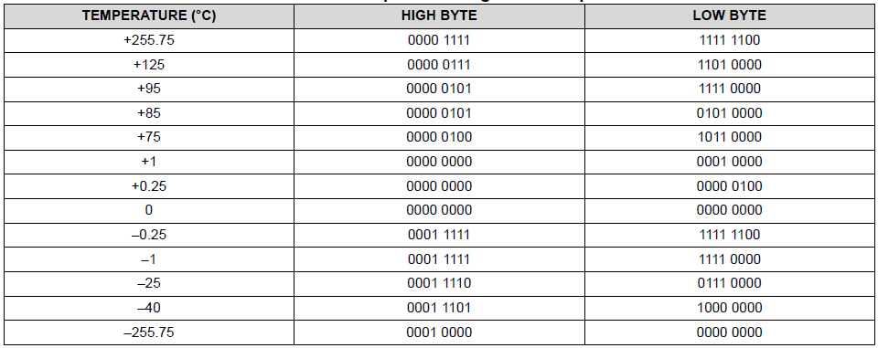
DIMM : TSOD Temperature
Type | Channel | Address | Function ( Code / Description ) |  | Data
DIMM | 0xFF | DIMM_IDX ( 0 ~ 15 ) | 0x10 | Get DIMM Temperature | 4 Byte / 1 EA
Data[31:24] | Data[23:16] | Data[15:8] | Data[7:0]
16-bit TS_a.Temp |  | 16-bit TS_b.Temp
구분 | Header |  |  |  | Data N byte |  |  |  |  | Note
 | identify | len | type | requst/respons
 | 2byte | 1byte | 1byte | 1byte
의미 | 'c0de' 고정 | data length | 0=FAN 1=CUR 2=TEMP 3=FP 4=DIMM 5=TCON 6=GPIO 10=PDO | 0=Requst (pc -> fpga) 1=Response OK (fpga -> pc) 0xE=Resp.Error | CH | ADDR | FUNC | BYTE | DATA
DIMM | 0xC0DE | 4 | 4 | 0 | 0xFF | 0x00 | 0x10 | 32 | NULL | Get DIMM temperature, 16-EA temperature of DIMM_0~15

Slide 11
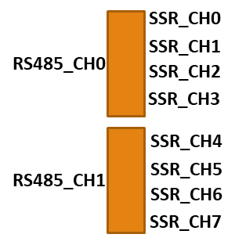
TCON : M74 – PID Controller
Type | Channel | Address | Function ( Code / Description ) |  | Data
TCON | 4bit – 4bit RS485_CH – REG_HI | REG_ADDR_LO | 0x00 | Write Reg | 2 Byte / 1 Reg
 | 4bit – 4bit RS485_CH – REG_HI | REG_ADDR_LO | 0x01 | Read Reg | 2 Byte / 1 Reg
 | 0xFF | SSR_CH_IDX ( 0 ~ 7 ) | 0x10 | Set TCON SV | 2 Byte / 1 EA
 | 0xFF | SSR_CH_IDX ( 0 ~ 15 ) | 0x11 | Set TCON 0-Stop/1-Run/2-Tuning | 2 Byte / 1EA
 | 0xFF | SSR_CH_IDX ( 0 ~ 15 ) | 0x20 | Get TCON SV | 2 Byte / 1 EA
 | 0xFF | SSR_CH_IDX ( 0 ~ 15 ) | 0x21 | Get TCON PV | 2 Byte / 1 EA
 | 0xFF | SSR_CH_IDX ( 0 ~ 15 ) | 0x22 | Get TCON MV | 2 Byte / 1 EA
 | 0xFF | SSR_CH_IDX ( 0 ~ 15 ) | 0x23 | Get TCON CH.STS | 2 Byte / 1 EA
 | 0xFF | SSR_CH_IDX ( 0 ~ 15 ) | 0x24 | Get TCON ALM.STS | 2 Byte / 1 EA
RS485_CH : 0 ~ 3 ( 4EA SSR CH / 1EA RS485 )
SSR_CH_IDX : 0 ~ 15
REG_ADDR : 0x000 ~ 0x1F3
구분 | Header |  |  |  | Data N byte |  |  |  |  | Note
 | identify | len | type | requst/respons
 | 2byte | 1byte | 1byte | 1byte
의미 | 'c0de' 고정 | data length | 0=FAN 1=CUR 2=TEMP 3=FP 4=DIMM 5=TCON 6=GPIO 10=PDO | 0=Requst (pc -> fpga) 1=Response OK (fpga -> pc) 0xE=Resp.Error | CH | ADDR | FUNC | BYTE | DATA
TCON | 0xC0DE | 4 | 5 | 0 | 0x0_1 | 0x91 | 0x11 | 2 | NULL | Read 2B of 0x0191(CH4.N.PV Reg)

Slide 12
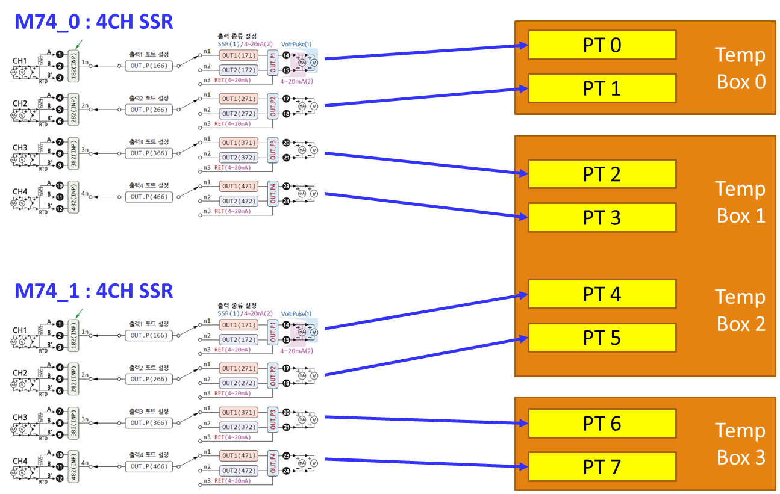
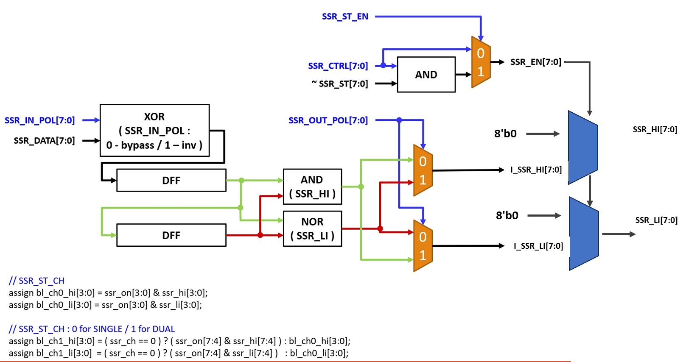
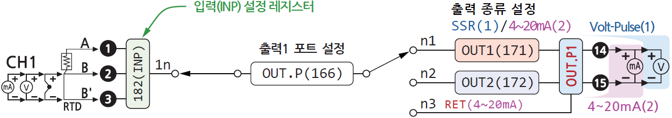
TCON : M74 – PID Controller
F
P
G
A
Seq :
FPGA Power-On
SSR_CTRL = OFF
SSR IN/OUT/CH/ST-EN 초기화
TCON 초기화
Host 제어
TCON SV 설정
TCON RUN
SSR_CTRL = ON
DIMM온도에 따라 SV 설정
SSR_CTRL = OFF
TCON STOP

Slide 13
Default : blue color
Func.0x10 ~ 12 : 1 bit 별로 SSR 1ea 채널 제어
SSR.CTRL.Off 인 경우에만, SSR.In/Out/Ch 설정 변경 가능
GPIO :
Type | Channel | Address | Function ( Code / Description ) |  | Data
GPIO | 0xFF | 0x00 | 0x10 | Set SSR Ctrl. : 0-Off/1-On | 1 Byte / 1 EA
 | 0xFF | 0x00 | 0x11 | Set SSR IN : 0-Bypass/1-Inv. | 1 Byte / 1 EA
 | 0xFF | 0x00 | 0x12 | Set SSR OUT : 0-Bypass/1-Inv. | 1 Byte / 1 EA
 | 0xFF | 0x00 | 0x13 | Set SSR CH : 0-Single/1-Dual | 1 Byte / 1 EA
 | 0xFF | 0x00 | 0x14 | Set SSR ST EN : 0-Dis/1-En | 1 Byte / 1 EA
 | 0xFF | 0x00 | 0x15 | Set Ext FAN Ctrl. : 0-Off/1-On | 1 Byte / 1 EA
 | 0xFF | 0x00 | 0x16 | Set Pump Ctrl. : 0-Off/1-On | 1 Byte / 1 EA
 | 0xFF | 0x00 | 0x17 | Set RAD FAN Ctrl. : 0-Off/1-On | 1 Byte / 1 EA
 | 0xFF | 0x00 | 0x18 | Get Slot ID : 0 ~ 9 | 1 Byte / 1 EA
 | 0xFF | 0x00 | 0x19 | Get BD Con Check : 0-N/1-Yes | 1 Byte / 1 EA
 | 0xFF | 0x00 | 0x1A | Get Slide Close : 0-No/1-Yes | 1 Byte / 1 EA
구분 | Header |  |  |  | Data N byte |  |  |  |  | Note
 | identify | len | type | requst/respons
 | 2byte | 1byte | 1byte | 1byte
의미 | 'c0de' 고정 | data length | 0=FAN 1=CUR 2=TEMP 3=FP 4=DIMM 5=TCON 6=GPIO 10=PDO | 0=Requst (pc -> fpga) 1=Response OK (fpga -> pc) 0xE=Resp.Error | CH | ADDR | FUNC | BYTE | DATA
GPIO | 0xC0DE | 5 | 6 | 0 | 0xFF | 0x00 | 0x10 | 0x01 | 0x01 | Set SSR.Ch0.Ctrl = On

Slide 14
Default : blue color
Func.0x10 ~ 12 : 1 bit 별로 SSR 1ea 채널 제어
SSR.CTRL.Off 인 경우에만, SSR.In/Out/Ch 설정 변경 가능
GPIO :
Type | Channel | Address | Function ( Code / Description ) |  | Discription | Data
GPIO | 0xFF | 0x00 | 0x10 | Set SSR Ctrl. : 0-Off/1-On | Temp Ctrl On/OFF (4CH) chamber Run/Stop정도로 생각하면 됨 | 8 BIT(2Bit 4CH) / 1 Byte / 1 EA
 | 0xFF | 0x00 | 0x11 | Set SSR IN : 0-Bypass/1-Inv. | 회로도 초기 설정 조정용 in/out 따로 Config 값 | 8 BIT(2Bit 4CH) Byte / 1 EA
 | 0xFF | 0x00 | 0x12 | Set SSR OUT : 0-Bypass/1-Inv. |  | 8 BIT(2Bit 4CH) Byte / 1 EA
 | 0xFF | 0x00 | 0x13 | Set SSR CH : 0-Single/1-Dual | Tem Ctrl CH? Config값 | 8 BIT(2Bit 4CH) 1 Byte / 1 EA
 | 0xFF | 0x00 | 0x14 | Set SSR ST EN : 0-Dis/1-En | Config값 | 1 Byte / 1 EA
 | 0xFF | 0x00 | 0x15 | Set Ext FAN Ctrl. : 0-Off/1-On | 8Bit On/Off | 1 Byte / 1 EA
 | 0xFF | 0x00 | 0x16 | Set Pump Ctrl. : 0-Off/1-On | 8Bit On/Off 이것도 Fan임 | 1 Byte / 1 EA
 | 0xFF | 0x00 | 0x17 | Set RAD FAN Ctrl. : 0-Off/1-On | 8Bit On/Off | 1 Byte / 1 EA
 | 0xFF | 0x00 | 0x18 | Get Slot ID : 0 ~ 9 | Ip 와 같이 identify값. IP와 확인정도? | 1 Byte / 1 EA
 | 0xFF | 0x00 | 0x19 | Get BD Con Check : 0-N/1-Yes | MainBoard Contact? | 1 BIT / 1 Byte / 1 EA
 | 0xFF | 0x00 | 0x1A | Get Slide Close : 0-No/1-Yes | Box Open / Close? | 1 BIT / 1 Byte / 1 EA
구분 | Header |  |  |  | Data N byte |  |  |  |  | Note
 | identify | len | type | requst/respons
 | 2byte | 1byte | 1byte | 1byte
의미 | 'c0de' 고정 | data length | 0=FAN 1=CUR 2=TEMP 3=FP 4=DIMM 5=TCON 6=GPIO 10=PDO | 0=Requst (pc -> fpga) 1=Response OK (fpga -> pc) 0xE=Resp.Error | CH | ADDR | FUNC | BYTE | DATA
GPIO | 0xC0DE | 5 | 6 | 0 | 0xFF | 0x00 | 0x10 | 0x01 | 0x01 | Set SSR.Ch0.Ctrl = On

Slide 15
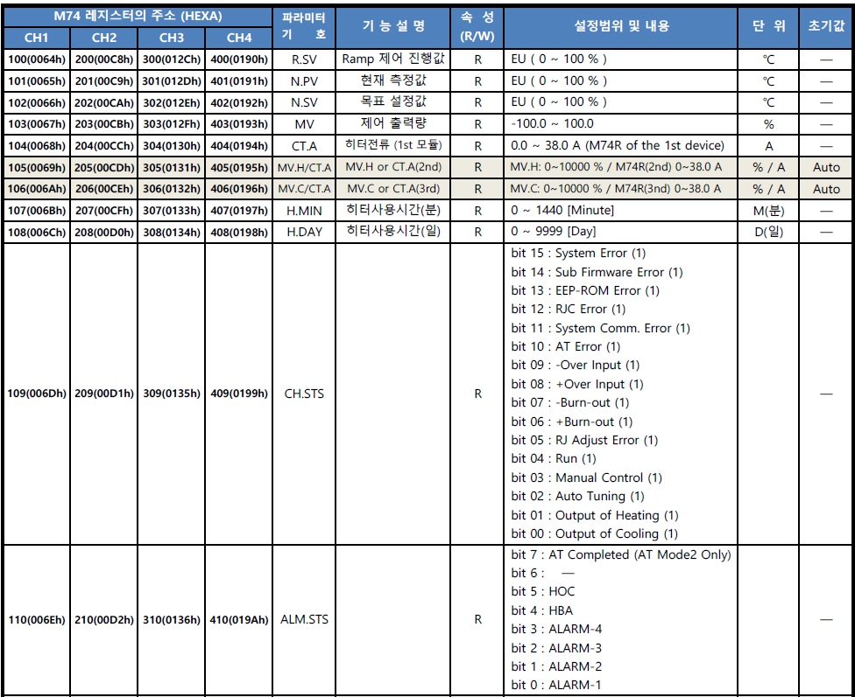
PDO : Pre-Defined Operation [ 1 ]
Type | Channel | Address | Function ( Code / Description ) |  | Data
PDO | 0xFF | 0x00 | 0x10 | Project Version | 32 Byte
 | 0xFF | 0x00 | 0x11 | Read All Status ( FAN, CUR, … ) | 241 Byte
 | 0xFF | 0x00 | 0x12 | Read All I/F Status | 8 Byte
Project Ver : 32B
“HTC Rev0.50@230719”
7 | 6 | 5 | 4 | 3 | 2 | 1 | 0
TCON-RUN/TUNING : 1-bit / 1-ch, 0 for stop – 1 for ing…
All Status : 241B
Item | Type | Byte / 1EA | Count | Bytes
1 | FAN Tach | 2 | 15 | 30
2 | CUR | 2 | 11 | 22
3 | BL TEMP | 2 | 8 | 16
4 | DIMM TEMP | 4 | 16 | 64
5 | TCON-N.SV | 2 | 8 | 16
6 | TCON-N.PV | 2 | 8 | 16
7 | TCON-MV | 2 | 8 | 16
8 | TCON-CH.STS | 2 | 8 | 16
9 | TCON-ALM.STS | 2 | 8 | 16
10 | TCON-RUN | 1 | 1 | 1
11 | TCON-TUNING | 1 | 1 | 1
12 | COOLER-N.PV | 2 | 8 | 16
13 | GPIO | 1 | 11 | 11
Total |  |  |  | 241

Slide 16
PDO : Pre-Defined Operation [ 2 ]
Type | Channel | Address | Function ( Code / Description ) |  | Data
PDO | 0xFF | 0x00 | 0x10 | Project Version | 32 Byte
 | 0xFF | 0x00 | 0x11 | Read All Status ( FAN, CUR, … ) | 241 Byte
 | 0xFF | 0x00 | 0x12 | Read All I/F Status | 8 Byte
All I/F Status : 8B
Item | Type | Byte / 1EA |  | Bytes
1 | FAN I2C | 2 |  | 2
2 | CUR I2C | 2 |  | 2
3 | TEMP I2C | 2 |  | 2
4 | TCON RS485 | 2 |  | 2
5
6
7
8
9
9
11
Total |  |  |  | 8
15 | 14 | 13 | 12 | 11 | 10 | 9 | 8 | 7 | 6 | 5 | 4 | 3 | 2 | 1 | 0
1-bit for 1-I/F Status :
0 : Pass
1 : Fail
I/F Type & Count :
FAN I2C : 0 ~ 4
CUR I2C : 0 ~ 10
TEMP I2C : 0 ~ 7
TCON RS485 : 0 ~ 3

Slide 17

PDO : Pre-Defined Operation [ 3 ]
Type | Channel | Address | Function ( Code / Description ) |  | Data
PDO | 0xFF | 0x00 | 0x10 | Project Version | 32 Byte
 | 0xFF | 0x00 | 0x11 | Read All Status ( FAN, CUR, … ) | 241 Byte
 | 0xFF | 0x00 | 0x12 | Read All I/F Status | 8 Byte
 | 0xFF | 0x00 | 0x20 | Erase FPGA PROM | 4 Byte Address
 | 0xFF | 0x00 | 0x21 | Program FPGA PROM | 4B Addr + 128B data
 | 0xFF | 0x00 | 0x22 | Reboot FPGA from PROM | 4 Byte Address
Config PROM : about 1 minute for programing 10-MByte bitstream
Erase all PROM flash
PDO_FUNC_ERASE_PROM : erase 64KB/once
Argu : 4 byte flash address with 64KB씩 증가 ( 0x0000_0000, 0x0001_0000, 0x0002_0000, … )
Program *.bit file to PROM flash
PDO_FUNC_CFG_PROM : program 128B/once
Argu : 4 byte flash address with 128B씩 증가 , 128 byte bitstream data
Reboot FPGA
PDO_FUNC_REBOOT_FPGA
Argu : 4 byte flash address = 0

Slide 18
Status | LED[0] | LED[1] | LED[2] | LED[3]
ERR | 0.1s blink | Off | Init fail : 0.FAN, 1.CUR, 2.TEMP, 3.TCON
RUN | 0.3s blink | Contack check | Slide close | Socket connect

