Slide 1
SIR Model – Vaccination
Group 20
Tania BELVEDERE
Jonas Kruse
Sara Milla
Marcus Pilgram
Notes:
Jonas

Slide 2
Model
Base Model: Classical SIR (Susceptible-Infectious-Recovered)
Split the 'Infectious' compartment into three severity levels:
  Home: Mild cases who recover in isolation
  Severe: Patients requiring general hospital beds
  Critical: Patients requiring ICU beds
This allows us to track bed occupancy directly not just total cases
Added a flow from Susceptible to Vaccinated to simulate the immunization campaign
Task 1
Notes:
Jonas

Slide 3
Casual Loop Diagram
Task 1
Notes:
Jonas

Slide 4
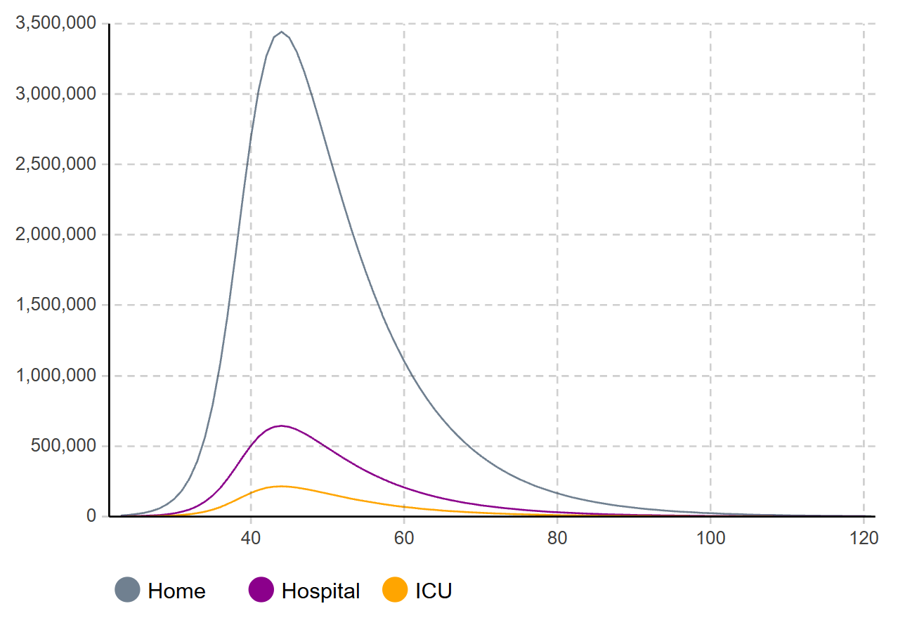
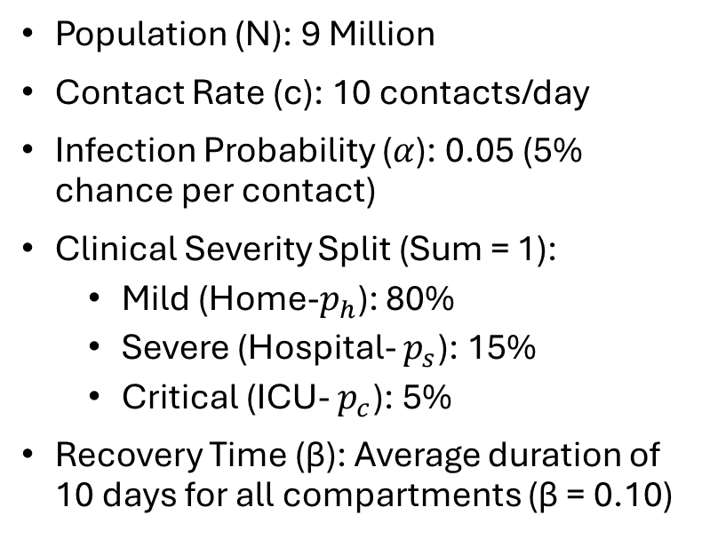
Model Parameters
Population (N): 9 Million
Contact Rate (c): 10 contacts/day
Infection Probability ($α$): 0.05 (5% chance per contact)
Clinical Severity Split (Sum = 1):
  Mild (Home-$p_{h}$): 80%
  Severe (Hospital- $p_{s}$): 15%
  Critical (ICU- $p_{c}$): 5%
Recovery Time (β): Average duration of 10 days for all compartments (β = 0.10)
Task 1
Notes:
Jonas

Slide 5
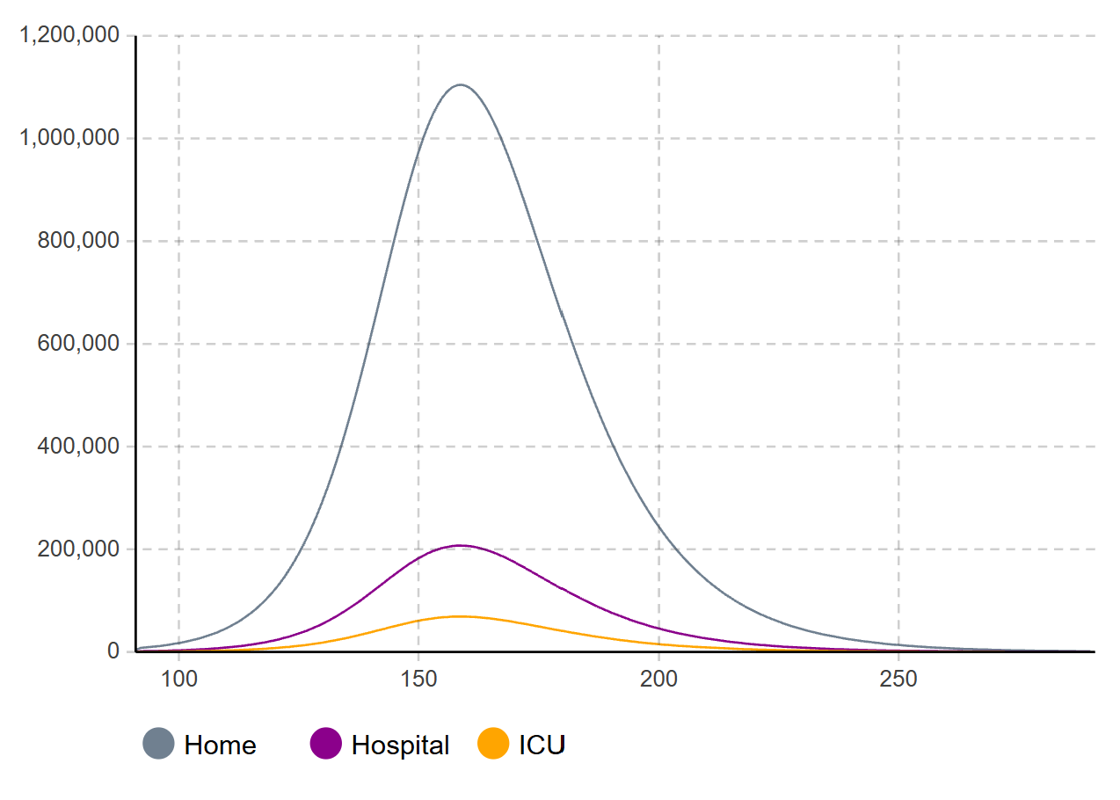
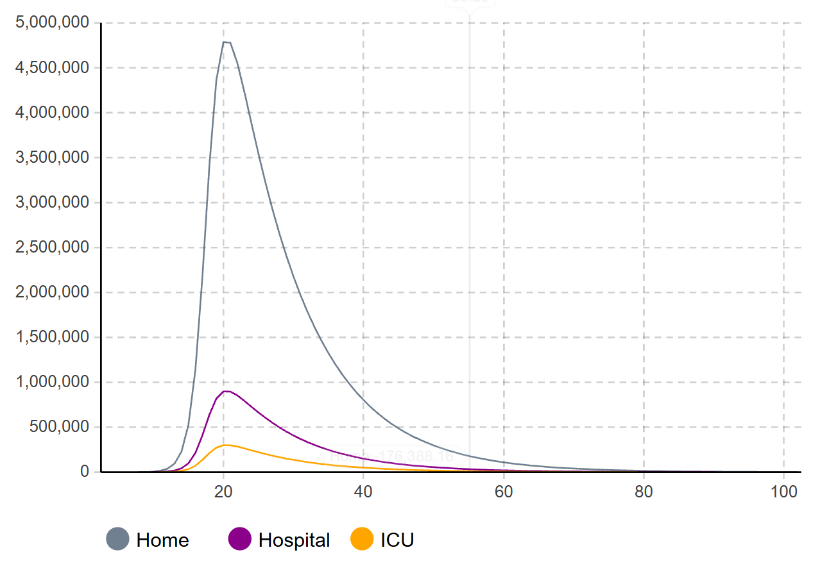
Sensitivity Analysis 1: Contact Rates
High contact rates (c = 20) peak shifts to day 20
  system overwhelmed instantly
Low contact rates (c = 4) peak delayed to day 159
  flattened curve and manageable ICU load
Contact rate drives the timing of the epidemic
Task 2
Notes:
Sara

Slide 6
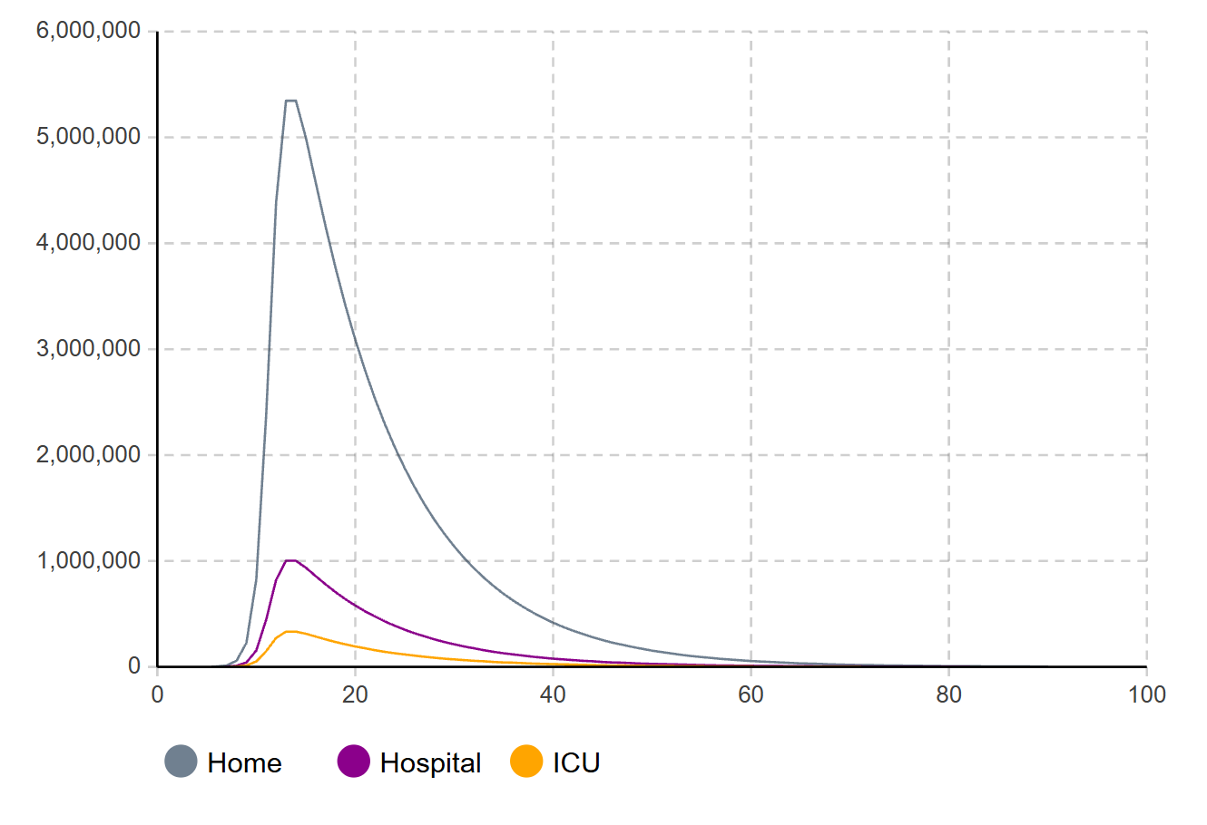

Sensitivity Analysis 2: Infection Probability
Higher infection probability ($α$ =0.15):
  Peak timing is earlier – Day 13
  Home infections increase to 5.3 million from 3.4 million in the baseline
  Hospitalizations hit 1 million
  High transmissibility can lead to system failure
Task 2
Notes:
Sara

Slide 7
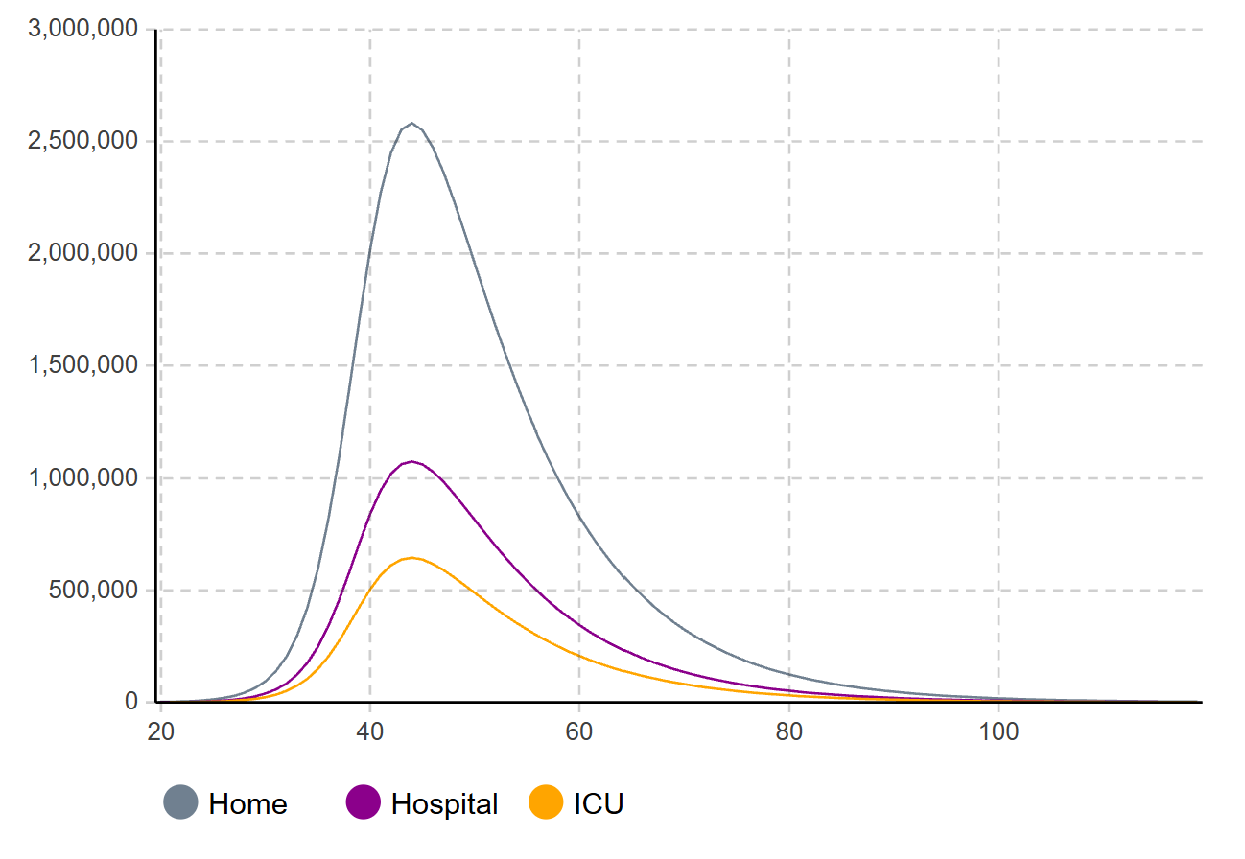

Sensitivity Analysis 3: Dangerous Variant
Increasing the severity more people need ICU care $p_{c}=15\%$ from 5%
Peak timing still on day 44
ICU demand triples – 642 K cases
Task 2
Notes:
Sara

Slide 8
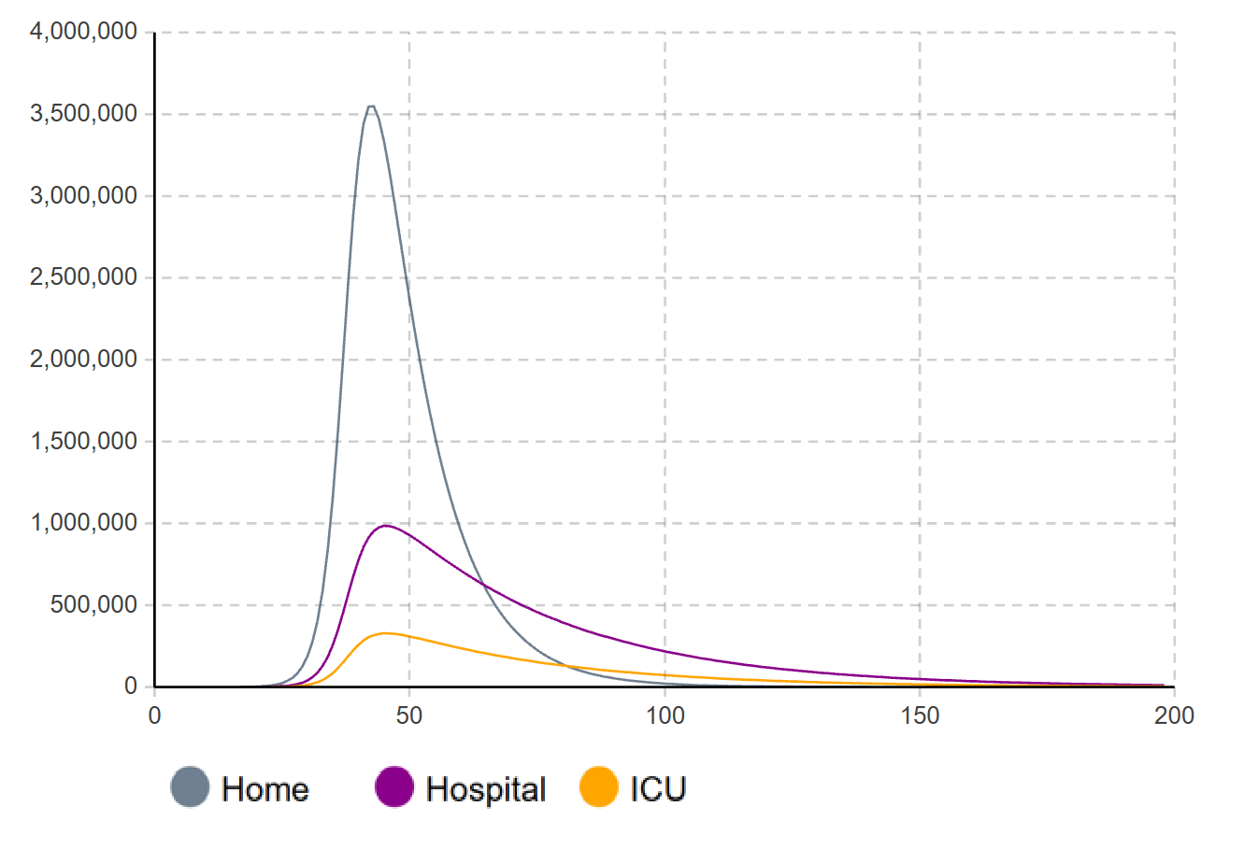

Sensitivity Analysis 4: Slow Recovery
Slowing recovery rate $β=33 days$
Peak timing still near day 44
Hospitalizations increase
Capacity depends on recovery/outflow
Task 2
Notes:
Sara

Slide 9
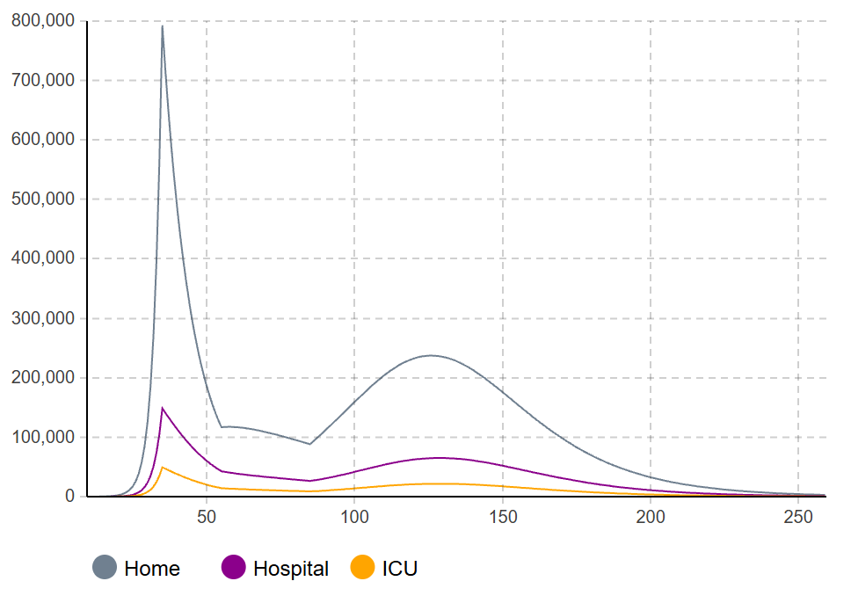
Lockdown Simulation
Lockdown Start (Day 35): Contacts drop from 10 to 2
Relaxation (Day 55): Rules loosen & contacts rise to 4
Lockdown End (Day 85): Contacts rise to 6 – people are cautious
Task 2
Notes:
Sara
-Implemented 3 dynamic events to change parameters during simulation
-prevents an immediate second wave, proving behavior is as critical as the lockdown itself

Slide 10
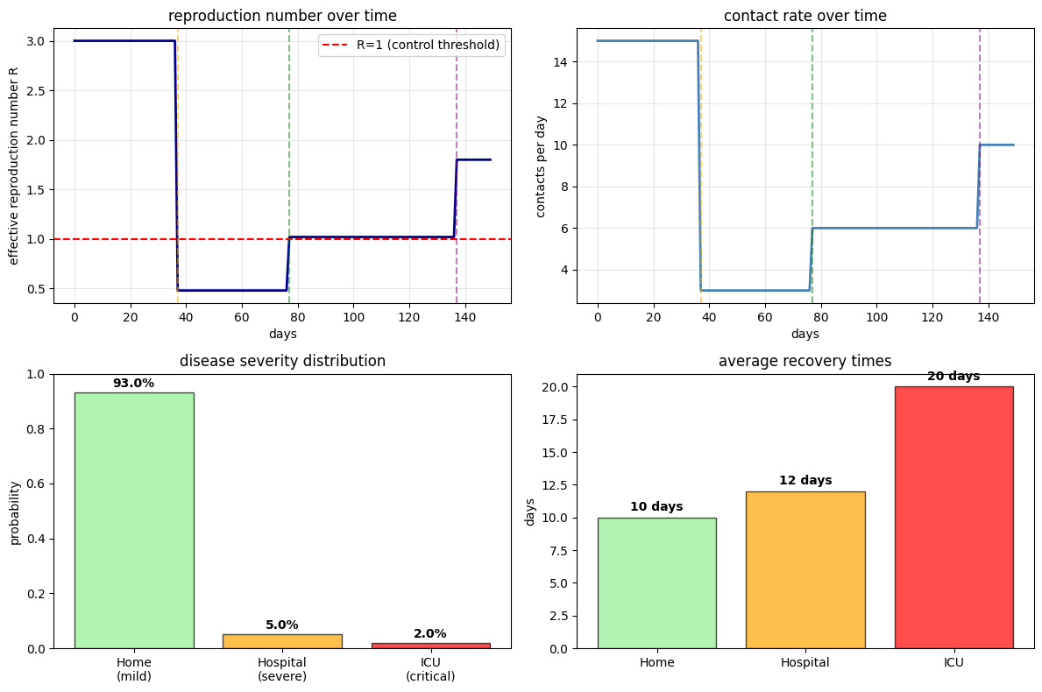

Calibration of Parameters
Parameters derived from The 2020 UK "First Wave" dynamics
of the 2020 COVID-19 pandemic
Key Calibrated Values:
  Transmission: $R_{0}=3.0$
  Severity ratios:
    Hospitalization Rate: 5% (Aligns with observed data)
    ICU Admission Rate: 2% (Matches clinical reports)
Task 3
Notes:
Tania

Slide 11
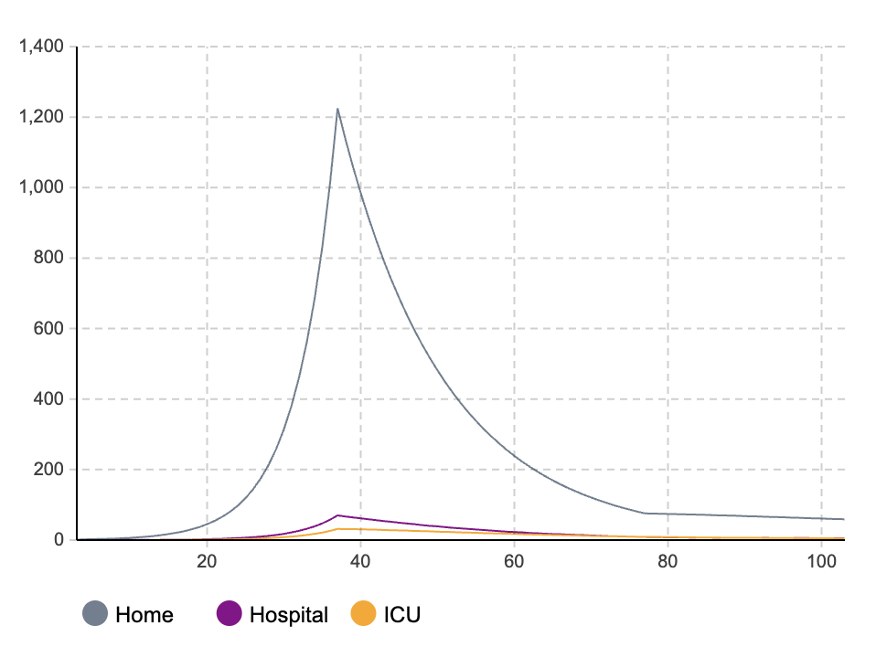
Calibration Results
The baseline model successfully reproduces the expected epidemic curve
Peak Timing: Occurs between Day 40–50, consistent with the UK timeline
Lockdown Event (Day 37): flattens the curve and reduces the healthcare burden (hospital/ICU occupancy)
Task 3
Notes:
Tania

Slide 12
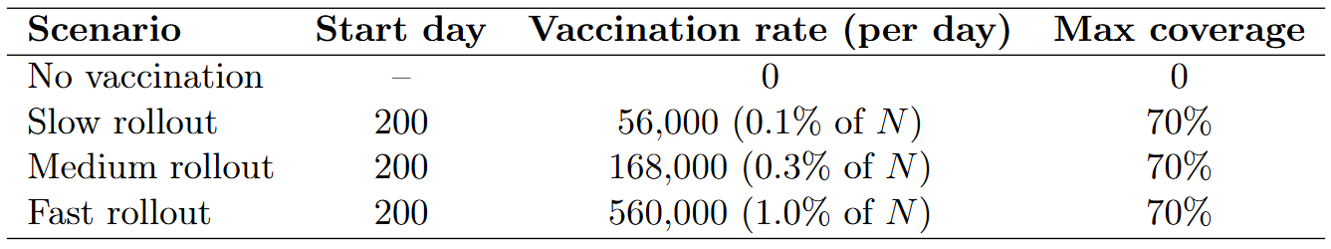
Vaccination Implementation
New Flow from Susceptible → Vaccinated
Assumes vaccinated individuals exit the infection loop
Max coverage limited to 70%
Starts at day 200 (post-first wave)
Task 4
Notes:
Marcus

Slide 13
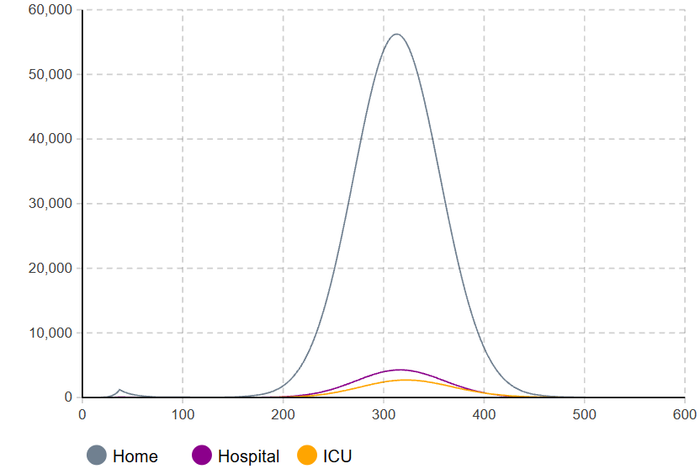
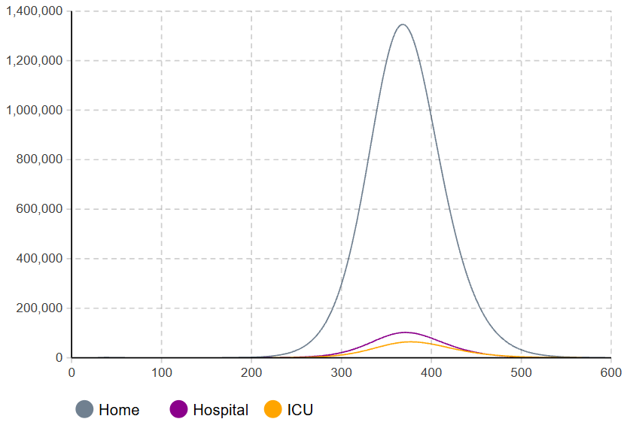
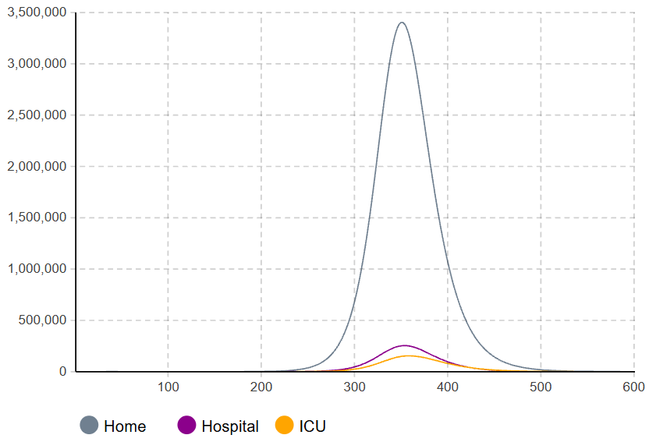
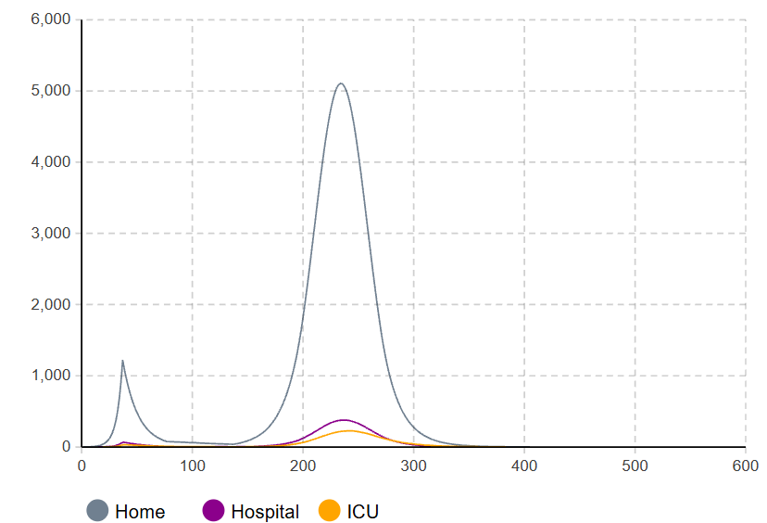
Impact of Vaccination Rollout Speed
Task 4
Notes:
Marcus

Slide 14

Critical Vaccination Threshold
Calculate Basic Reproduction Number:
$D_{avg}$ is weighted average duration of infectiousness
across the three compartments
$R_{0}=c∙α∙ D_{avg}$
$R_{0}≈3.01$
Calculate Minimum Immunization Coverage:
$P_{crit}=1−\left(\frac{1}{R_{0}}\right)$
$P_{crit}=66.8\%$
Required Doses:
$Doses=Population ∙{ P}_{crit}$
$Doses≈37.4 Million$
Task 5
Notes:
Tania

Slide 15
Conclusions
Lockdowns are effective but only delay the epidemic; they cannot prevent resurgence once lifted
Vaccination is the long-term intervention to permanently lower transmission and healthcare burden
Rollout speed is a critical factor: slow vaccination fails to outpace the virus, while fast rollout suppresses the second wave
Safety Threshold: ~67% coverage (37.5M people) is required to guarantee ICU safety with zero restrictions
Notes:
Sara
-To conclude, our study demonstrates that while lockdowns are effective at quickly suppressing transmission, they are merely a delaying tactic.
-Vaccination is the only sustainable exit strategy.
-Our simulations show that speed is crucial - a slow rollout risks a severe second wave, while a fast rollout suppresses it.
-We found that vaccinating 67% of the population is the critical threshold to guarantee ICU safety without any restrictions

Slide 16

Outlook
Demographics: Add age-structures (young spreaders vs. elderly vulnerability)
Immunity: Model waning immunity (SIRS) and booster doses
Spatial Dynamics: Capture geographic spread and regional hotspots
Notes:
Sara
-For future work, we suggest extending the model to include age groups, waning immunity, and looking at geographic spread and regional hotspots to better reflect long-term endemic scenarios

Slide 17
Work Breakdown
Jonas: Task 1
Sara: Task 2, Presentation
Tania: Task 3, 5
Marcus: Task 4

