Slide 1


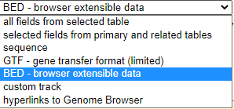
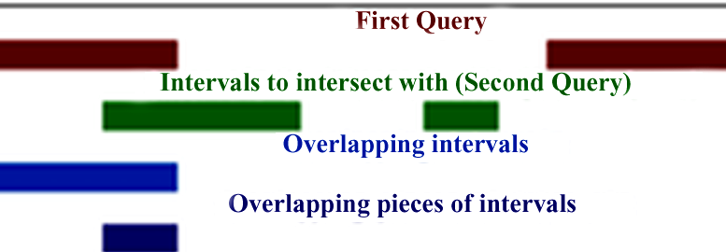
Introduction to Galaxy tools : CHEAT SHEET
FROM PEAKS TO GENES Tutorial
Tools
Input parameters
Output
E.g.
UCSC Main
In a table browser select dataset, define region of interest (genome | position + identifiers) then retrieve or display the data
File type as a plain text - data is in ASCII format, or as *.gzip compressed archive format for Linux|Unix
Retrieve list of genes of an animals, viruses, insects for i.e. mice etc.
Goal: retrieve and export data from the Genome Browser annotation track database
File formats
Select last
Keep last lines| Keep from this line on
Keep the last X lines in a dataset.
File format is not restricted, dataset table
to compare the two files, to make sure that the chromosome names follow the same format
chr1 | 10 | 20 | geneA
chr1 | 50 | 80 | geneB
chr5 | 10 | 40 | geneL
chr1 | 50 | 80 | geneB
chr5 | 10 | 40 | geneL
Input table
Replace Text in a specific column
Choose column number to look at, use
“Find pattern“ and type expression to be replaced. Replace with: text, or & (ampersand) and \\1 (\\ is a term to find a digit) Insert Replacement – adds a new replacement for a new column
The same text file in a *.gzip with replacement or replacements
For i.e. to convert the chromosome names, to change 20 and 21 to X and Y
Perform find & replace operation on a specified column in a given file.
use awk tool for complex patterns
Get flanks
Adding promoter regions, i.e. to get regions 2kb bases upstream of the start of the gene to 10kb bases downstream of the start (12kb in length)
Find the upstream and/or downstream flanking region(s) of all the selected regions
Every line should contain at least 3 columns: Chromosome number, Start and Stop co-ordinates
BED format file with flanking regions for every gene
Convert
Genomic intervals file
BED file
Converts Genomic Intervals To BED
Intersect
Choose to return Overlapping intervals OR Overlapping pieces of intervals for TWO datasets in BED format. The order of datasets important!
The intersection of two queries that are found in interval format (BED)
Extracting the genes which overlap/intersect with peaks regions in a dataset
Finding all exons containing repeats OR all regions that are both exonic and repetitive

Slide 2


Introduction to Galaxy tools : CHEAT SHEET
FROM PEAKS TO GENES Tutorial
Tools
Input parameters
Output
E.g.
Dataset is in TAB format.
Group by column number
Chose aggregate functions: Mean, Median, …Randomly pick on any column(s). etc Possible to ignore lines with character or by case.
Result in TAB format
To group the table by chromosome and count the number of genes with peaks on each chromosome
Group
If not?
Text manipulation ->Convert
Goal: group the input dataset by a particular column and perform aggregate functions
Compute
TAB data
Columns are referenced with c and a number. For example, c1 refers to the first column of a tab-delimited file. Add an expression as a new column too a selected file.
Compute an expression for every row of a dataset and append the result as a new column (field)
File format is not restricted, dataset table
To generate a new BED file from the peak file that contains the positions of the peak summits.
Cut
This tool breaks column assignments. Dataset is in csv. format . Cut columns for e.g. c1, c2 Delimited by Tab | Whitespace | Dot | Comma etc.
Output is always in tabular format (e.g., if your original delimiters are commas, they will be replaced with tabs).
Input dataset c1,c2,c3,c4,c5,c6 .
E.g. cut on columns "c6,c5,c4,c1"
Select (cuts out) specified columns from the dataset.
a | 1 | # | % | 0 | +
b | 2 | $ | % | 0 | +
a | % | +
b | % | +
To re-establish column assignments
click on pencil icon
in the latest history item.
Join two Datasets
To add in the end of BED file list of Gene names to RefSeq Gene identifiers in the table
Joining 4 column in dataset with 1st of Dataset 2
Join lines of two datasets on a common field.
This tool will force the output data type to tabular. Two Input files are in TAB format, to join set two column numbers that should be joined e.g. using column 4 and 1
BED format file with flanking regions for every gene
Result (Keep the header lines –No)
To change metadata assignments click on the "edit attributes" link of the history item generated by this tool.
chr1 | 10 | 20 | geneA
chr1 | 50 | 80 | geneB
chr5 | 10 | 40 | geneL
chr1 | 10 | 20 | geneA | geneA | Tumor suppressor
chr1 | 50 | 80 | geneB | geneB | Foxp2
geneA | tumor suppressor
geneB | Foxp2
geneC | Gnas1
geneE | INK4a
Result (Keep the header lines –Yes)
chr1 | 10 | 20 | geneA | geneA | Tumor suppressor
chr1 | 50 | 80 | geneB | geneB | Foxp2
chr5 | 10 | 40 | geneL
Sort
For listing unique genes that was unsorted.
E.g. Sort for „alphabetic order”
Sort the input file in a specific order
Select a column and way it should be sorted. Initial format can differ. Ways to sort columns: in Ascending | Descending order Flavor Fast numeric sort (-n), General numeric sort ( scientific notation -g),Natural/Version sort (-V) etc.
Output file format equals input
chr13
chr2
chr20
chr4

