Slide 1


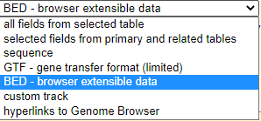
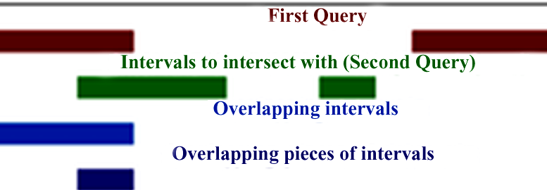
Introduction to Galaxy tools : CHEAT SHEET
FROM PEAKS TO GENES Tutorial
Tools
Input parameters
Output
E.g.
UCSC Main
In a table browser select dataset, define region of interest (genome | position + identifiers) then retrieve or display the data
File type as a plain text - data is in ASCII format, or as *.gzip compressed archive format for Linux|Unix
Retrieve list of genes of an animals, viruses, insects for i.e. mice etc.
Goal: retrieve and export data from the Genome Browser annotation track database
File formats
Select last
Keep last lines| Keep from this line on
Keep the last X lines in a dataset.
File format is not restricted, dataset table
to compare the two files, to make sure that the chromosome names follow the same format
chr1 | 10 | 20 | geneA
chr1 | 50 | 80 | geneB
chr5 | 10 | 40 | geneL
chr1 | 50 | 80 | geneB
chr5 | 10 | 40 | geneL
Input table
Replace Text in a specific column
Choose column number to look at, use
“Find pattern“ and type expression to be replaced. Replace with: text, or & (ampersand) and \\1 (\\ is a term to find a digit) Insert Replacement – adds a new replacement for a new column
The same text file in a *.gzip with replacement or replacements
For i.e. to convert the chromosome names, to change 20 and 21 to X and Y
Perform find & replace operation on a specified column in a given file.
use awk tool for complex patterns
Get flanks
Adding promoter regions, i.e. to get regions 2kb bases upstream of the start of the gene to 10kb bases downstream of the start (12kb in length)
Find the upstream and/or downstream flanking region(s) of all the selected regions
Every line should contain at least 3 columns: Chromosome number, Start and Stop co-ordinates
BED format file with flanking regions for every gene
Convert
Genomic intervals file
BED file
Converts Genomic Intervals To BED
Intersect
Choose to return Overlapping intervals OR Overlapping pieces of intervals for TWO datasets in BED format. The order of datasets important!
The intersection of two queries that are found in interval format (BED)
Extracting the genes which overlap/intersect with peaks regions in a dataset
Finding all exons containing repeats OR all regions that are both exonic and repetitive

