Slide 1


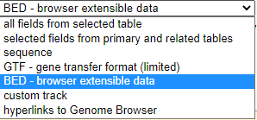
Introduction to Galaxy tools : CHEAT SHEET
FROM PEAKS TO GENES Tutorial
Tools
Input parameters
Output
E.g.
UCSC Main
In a table browser select dataset, define region of interest (genome | position + identifiers) then retrieve or display the data
File type as a plain text - data is in ASCII format, or as *.gzip compressed archive format for Linux|Unix
Retrieve list of genes of an animals, viruses, insects for i.e. mice etc.
Goal: retrieve and export data from the Genome Browser annotation track database
File formats
Select last
Keep last lines| Keep from this line on
Keep the last X lines in a dataset.
chr1 | 10 | 20 | geneA
chr1 | 50 | 80 | geneB
chr5 | 10 | 40 | geneL
Retrieve list of genes of an animals, viruses, insects for i.e. mice etc.
chr1 | 50 | 80 | geneB
chr5 | 10 | 40 | geneL

