Slide 1
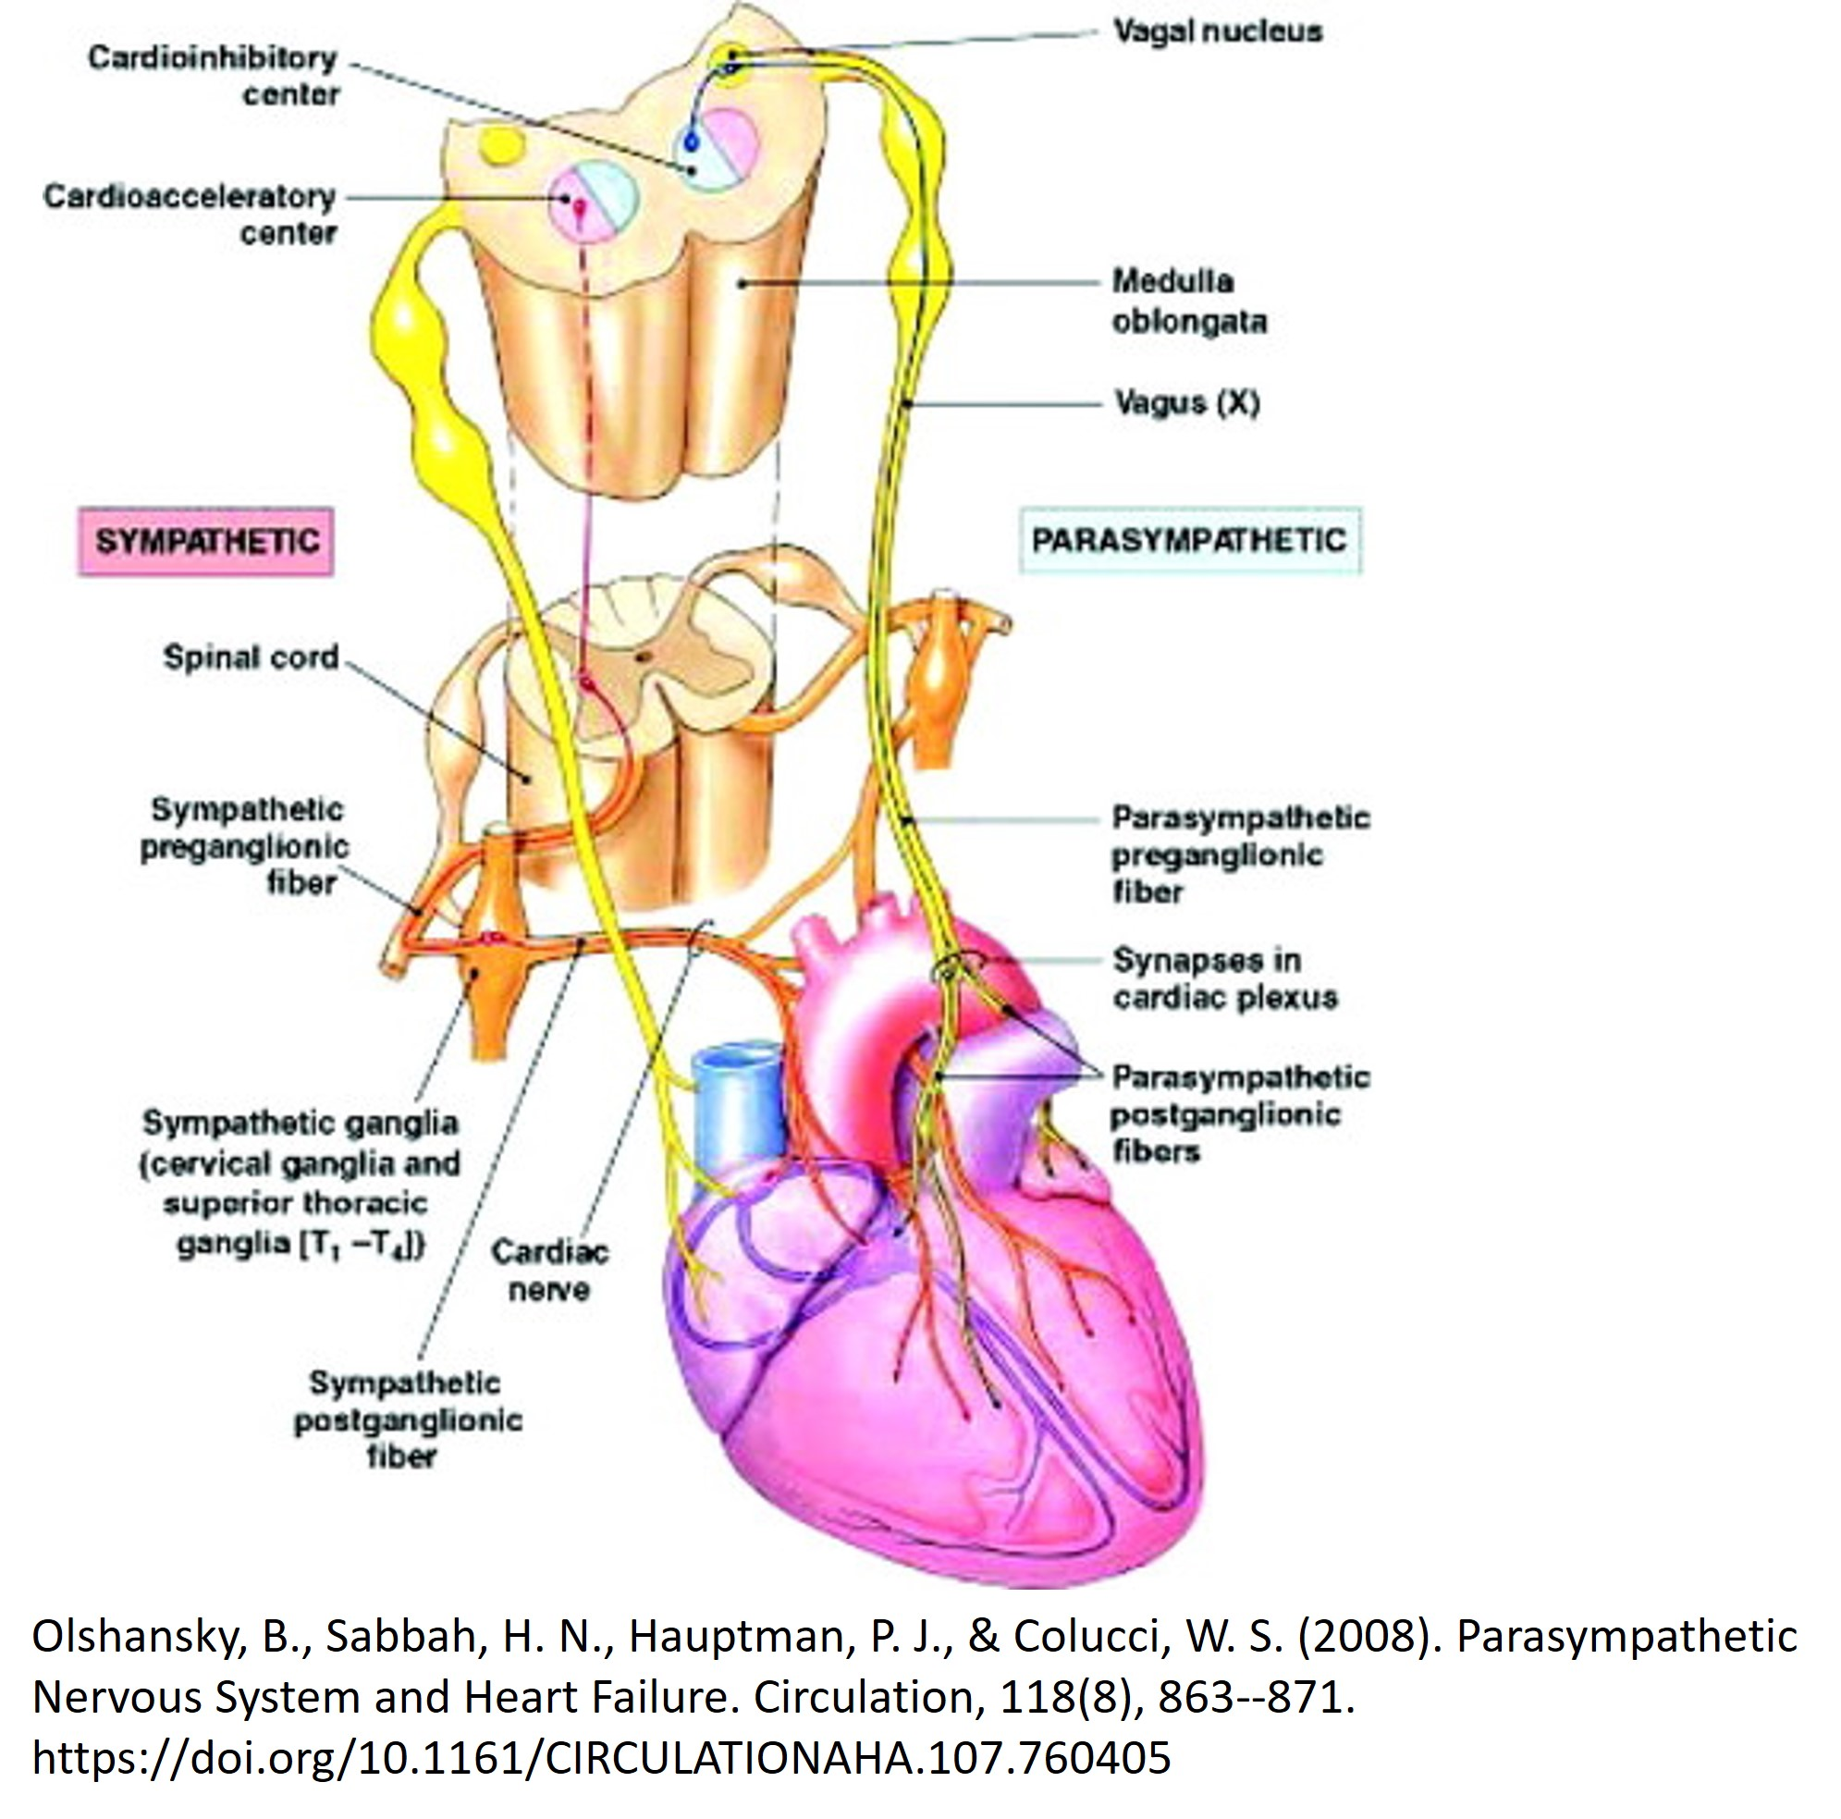
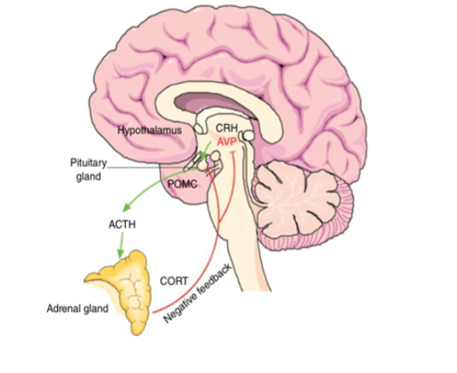
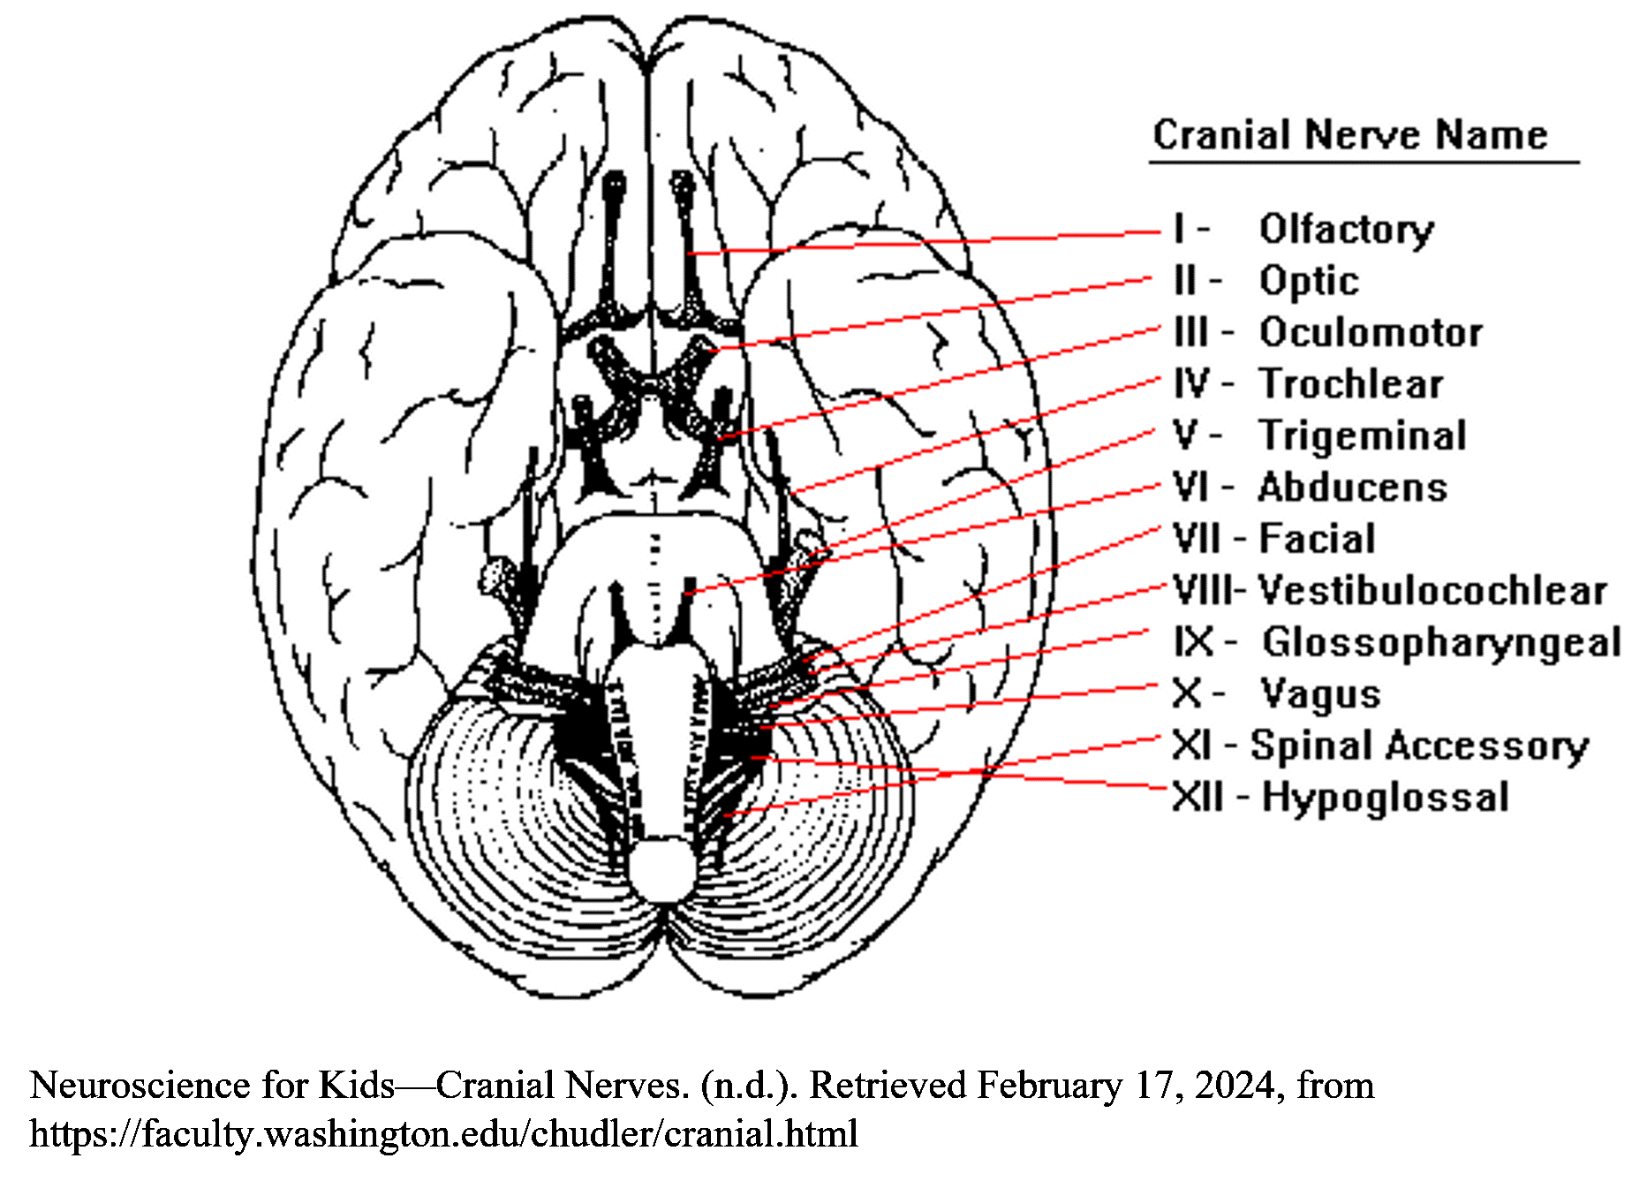
Jubb. (2016). Molecular neuroendocrinology : from genome to physiology (Murphy & H. Gainer, Eds.). Wiley Blackwell.​

