Slide 1
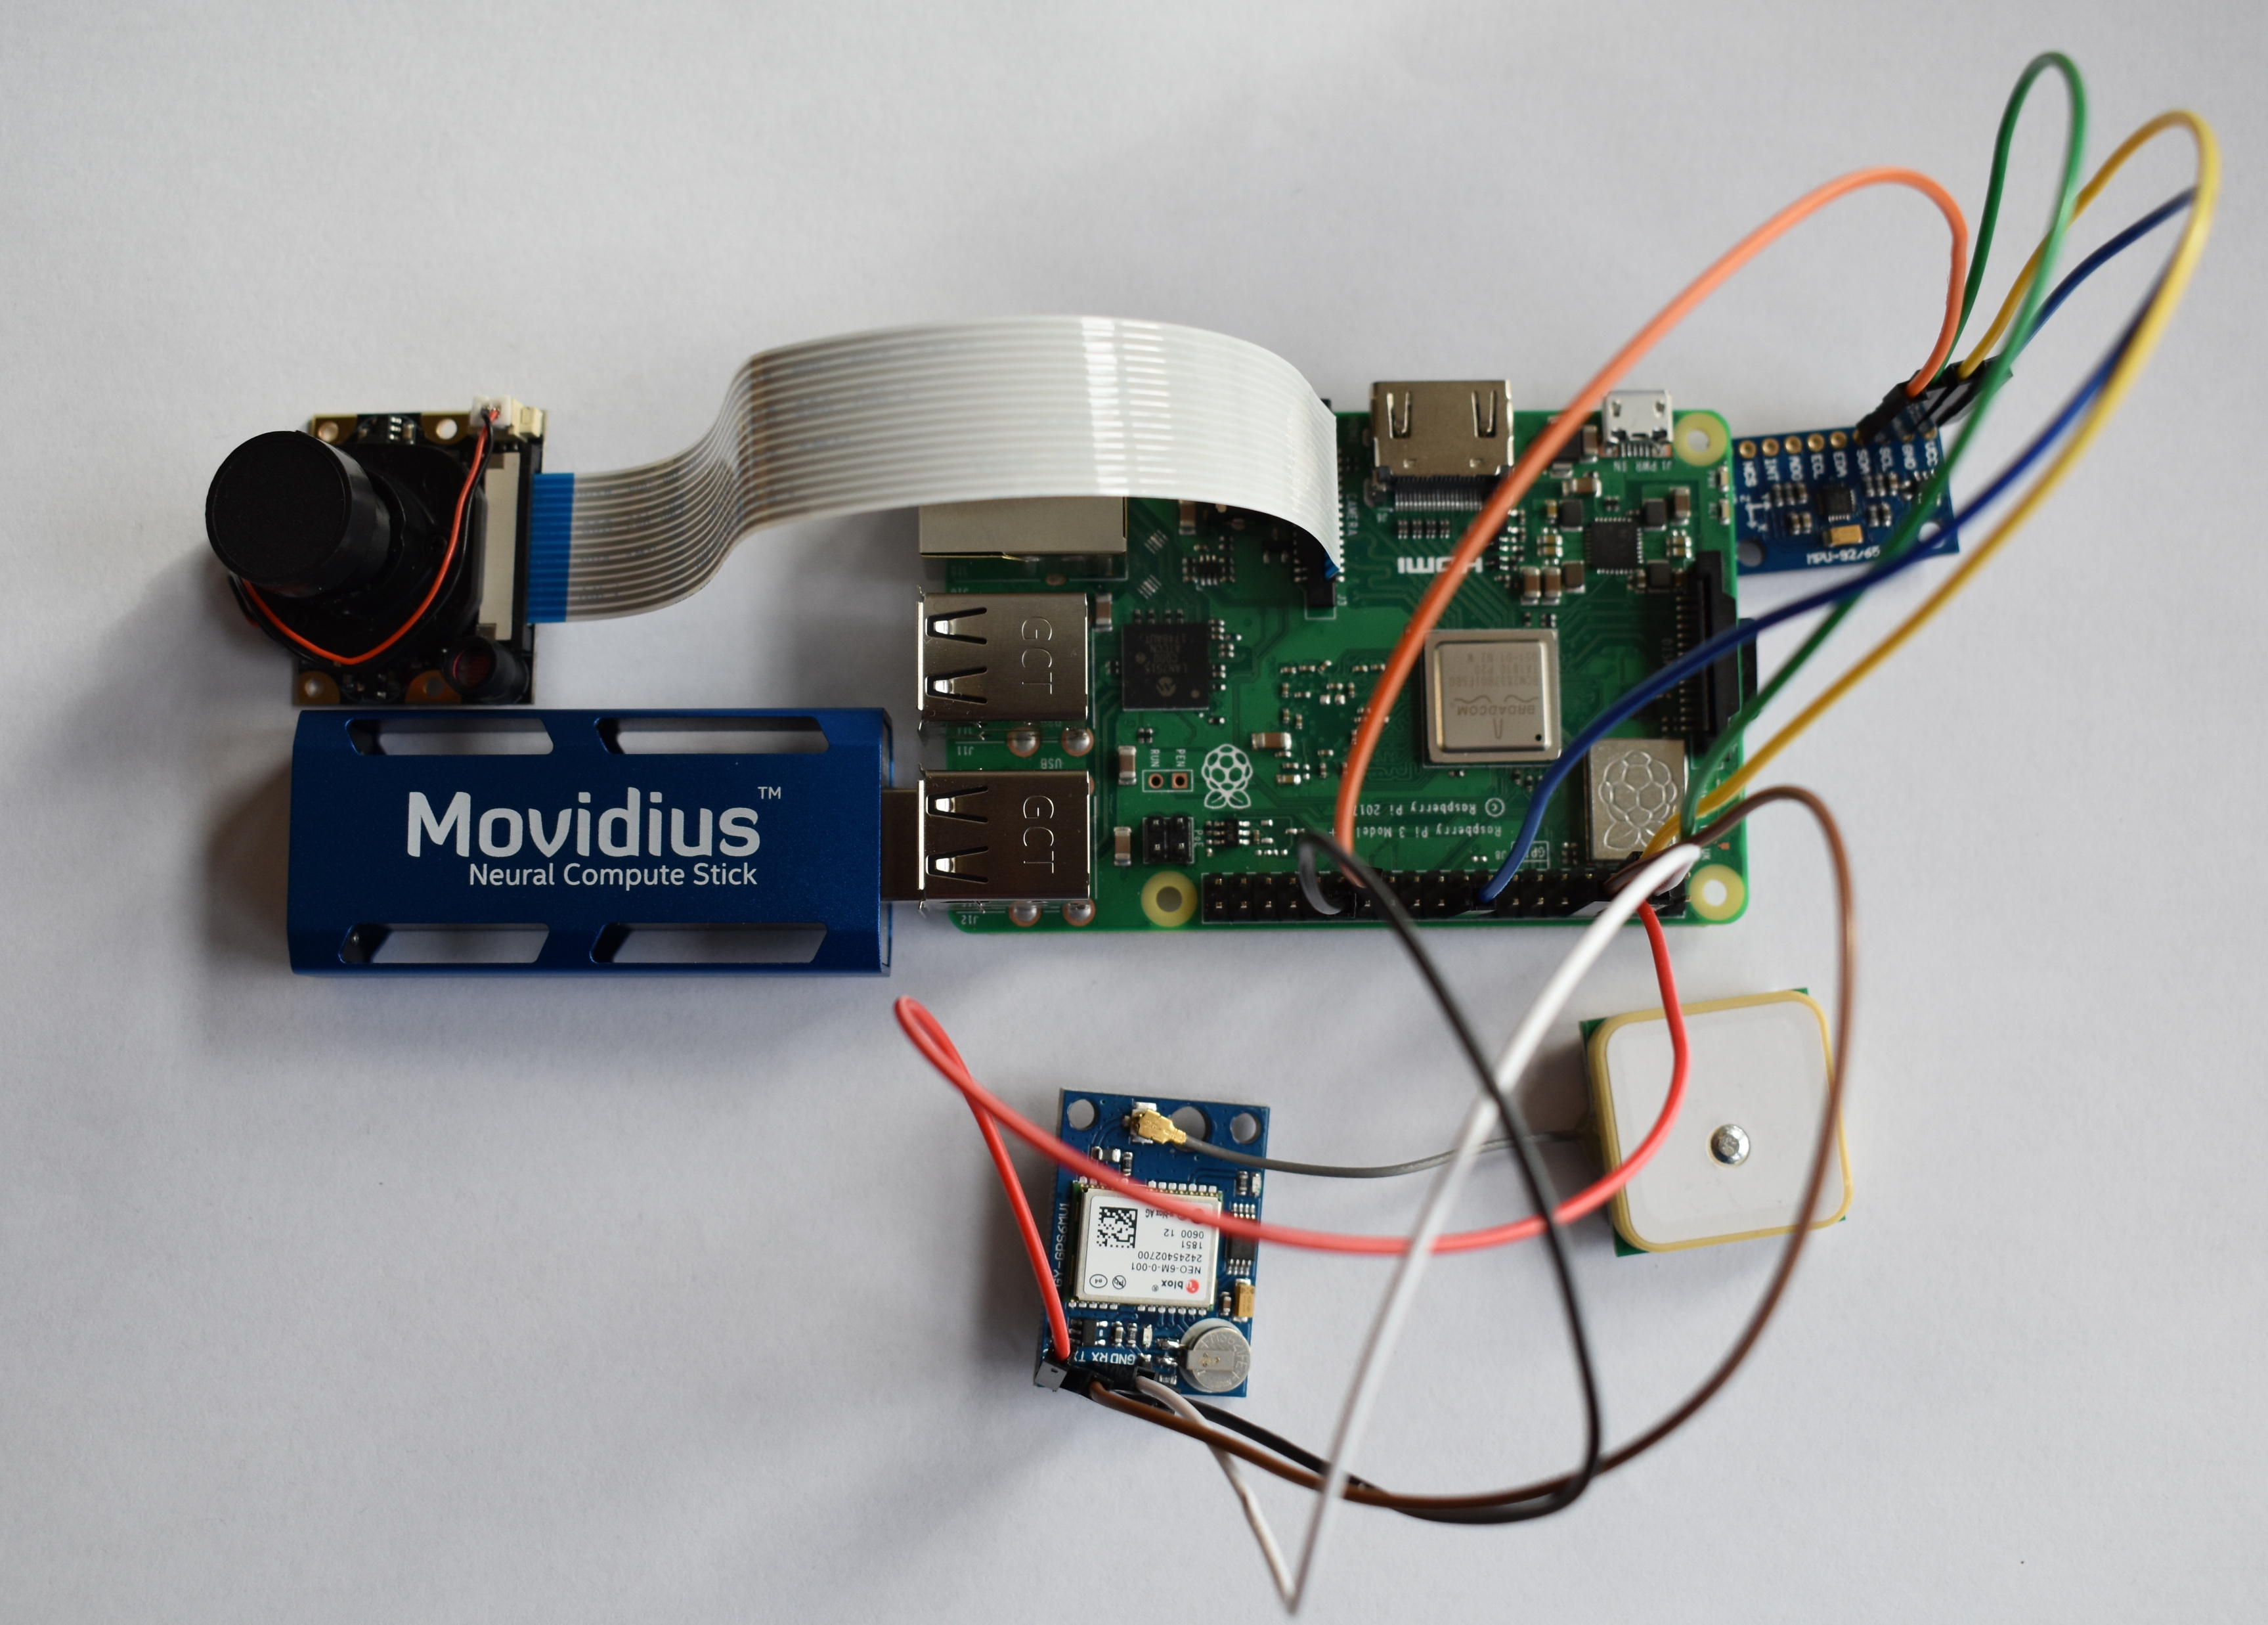
DROID Vision
A Distributed Intelligence Operator
Ian Miller & Rishi Shah
Intel is paramount for situational awareness
Process of gathering intel is largely manual
Eats up soldiers’ time and focus
Design and build a lightweight, flexible system that can passively help soldiers understand an AO
Camera captures frames continuously
Each frame run through object detection model, distance between camera and detections estimated
Combined with GPS and orientation data, location of detected objects is determined
2D vector (object, location) is broadcasted to automatically populate Nett Warrior map
Vision Modules will be able to continuously feed data about an AO into Nett Warrior, distributing intelligence to all members of the network
Each Vision Module is small, cheap, and easy to use
Integrate with HUD in order to dynamically improve situational awareness
Notes:
Add a cost analysis

Slide 2
DROID Vision
A Distributed Intelligence Operator
Ian Miller & Rishi Shah
Soldier Problem
Design Challenge
Continuous intelligence collection about an AO is vital to the success of any mission.
The collection and dissemination of intelligence from soldiers is currently a slow and manual process.
Soldiers using systems like Nett Warrior to disseminate intelligence are forced to be distracted from the mission.
Build a device that enables real-time, passive, and automatic dissemination of intelligence.
Device should feed information into the existing Nett Warrior framework.

Slide 3
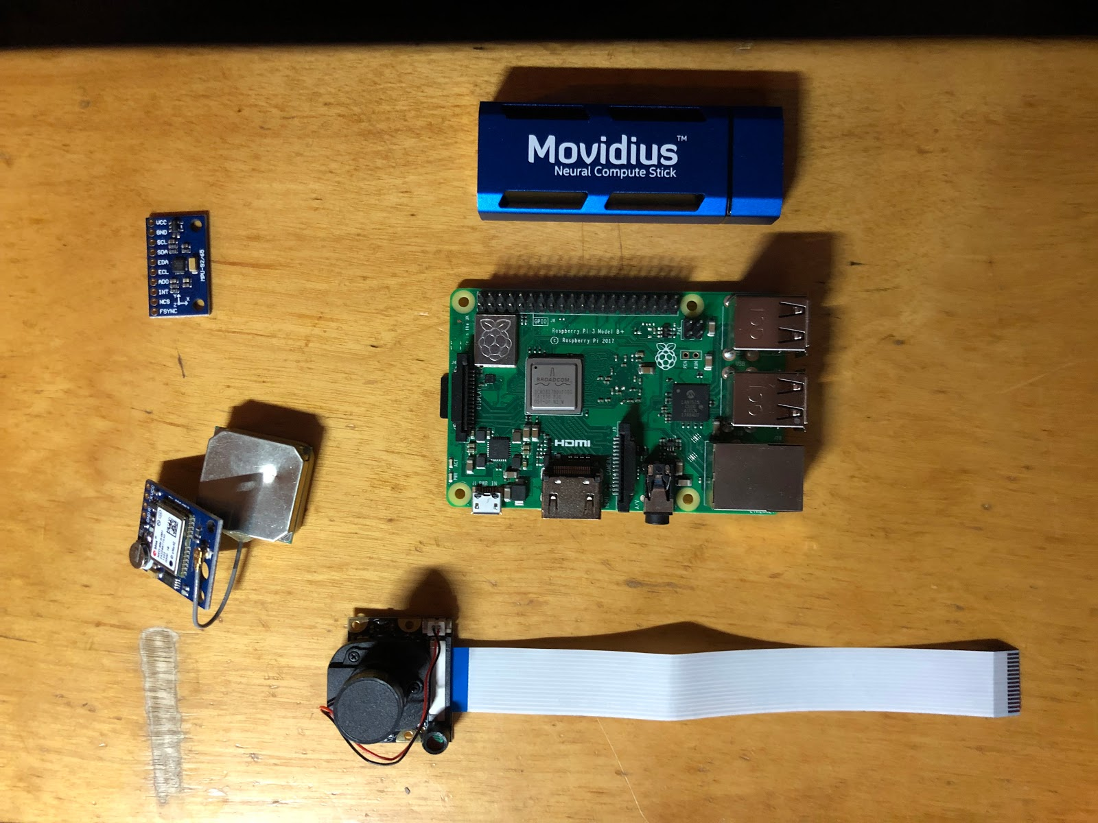
Prototype Design Overview
Hardware:
Raspberry Pi
Intel Neural Compute Stick
Camera, GPS, Magnetometer
Protective case
Object Detection & Localization at the edge
Integrated with Nett Warrior
Lightweight & Low Cost
Object Detection
Object Localization
Populate Nett Warrior Map

Slide 4
Design Details and Testing
Vision Module:
Object Detection Classes
Distance from Camera Approximated via Facial Detection
Object Localization from GPS & Magnetometer data
Nett Warrior Integration:
Currently connected via WiFi
Object Type & Location sent via Cursor-on-Target protocol
Leverages existing Army infrastructure
Notes:
DROID Vision is essentially a bunch of these ‘Vision Modules’ that are gateways to the Nett Warrior system. The Nett Warrior system is like a Google Doc but with maps that display the locations of objects of interest. If you are familiar with Google Docs, one of the really useful things about them is that many decentralized members of the network can edit this global available document. Everyone on the network contributes to this global copy and can also see all other contributions. Nett Warrior is like Google Docs for military maps. In the field, soldiers access this map via end-user-devices (EUDs) like Samsung tablets or Android smartphones.
The idea is that these networked Vision Modules can be delivered to the battlefield in a ton of different ways. A few that we have pitched are: 1) mounted on the body of a soldier, 2) mounted to the bottom of an airborne drone, 3) attached to a stake in the ground, and 4) part of the payload of an Illumination Round.

Slide 5
Design Merits
Small, light, and cheap
Connects to battery and operates passively
Module would be shipped ready to go (only requirement is battery)
No external safety concerns
Immediately valuable to the ground soldier

Slide 6
Future of Design
Next generation improvements
Train custom classification model on a more precise mission-set to improve accuracy for detection
Employ optical flow to improve efficiency
Final product vision
Soldiers have hundreds of Vision Modules deployed throughout a combat zone that can continuously feed intel to higher command as well as ground soldiers acting in real-time

Slide 7
DROID Vision
A Distributed Intelligence Operator
Ian Miller & Rishi Shah
Intel is paramount for situational awareness
Process of gathering intel is largely manual
Eats up soldiers’ time and focus
Design and build a lightweight, flexible system that can passively help soldiers understand an AO
Camera captures frames continuously
Each frame run through object detection model, distance between camera and detections estimated
Combined with GPS and orientation data, location of detected objects is determined
2D vector (object, location) is broadcasted to automatically populate Nett Warrior map
Vision Modules will be able to continuously feed data about an AO into Nett Warrior, distributing intelligence to all members of the network
Each Vision Module is small, cheap, and easy to use
Integrate with HUD in order to dynamically improve situational awareness
Notes:
Add a cost analysis

