Slide 1

Machine Learning to Predict Playoff Teams in the NHL
Cody Miller

Slide 2
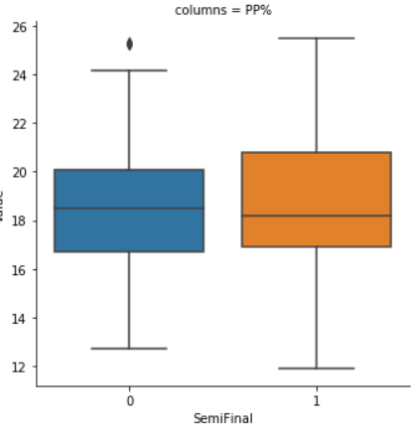
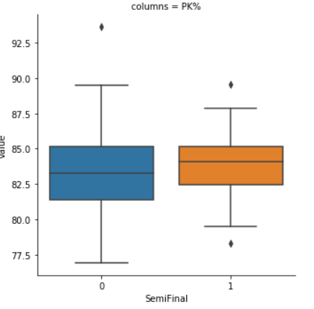
Inspiration
Worked on similar project last semester in Data Science class
Github link to last semester’s project: https://github.com/millerc4/DS-Project
Notes:
I worked on a similar project last semester in my data science course where I analyzed only Powerplay and Penalty Kill percentages and their impact on a team’s success in the playoffs.

Slide 3
Tools Used
http://corsica.hockey/
Jupyter Notebook
Pandas, NumPy, SciKit Learn libraries for analysis
Matplotlib, Seaborn libraries for visualization

Slide 4

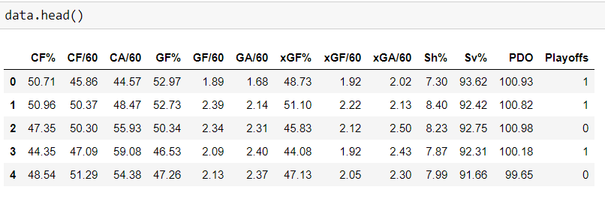
The dataset
Made up of 12 components and 1 label that indicates whether the team made or missed the playoffs
Data had to be labeled by me as I could not find data with labels
All stats are advanced NHL stats and their descriptions can be found on http://corsica.hockey/

Slide 5
Step 1: Feature Selection
Wanted to get number of features down to 4 most important ones
Used Chi-squared and logistic regression to do this

Slide 6
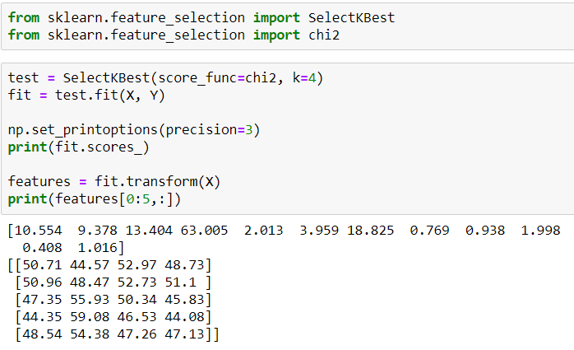
Chi-squared
Chi-squared told me that Corsi For%, Corsi Against per 60 minutes, Goals For percentage, and Expected Goals For percentage were 4 most important features

Slide 7
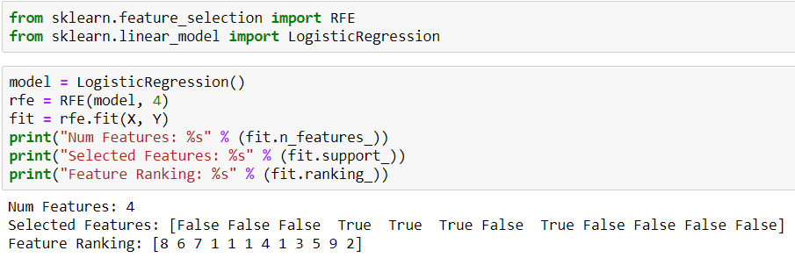
Logistic Regression
Logistic Regression told me that Goals For percentage, Goals For per 60 minutes, Goals Against per 60 minutes, and Expected Goals For per 60 minutes were 4 most important features
Went with these 4 features for rest of the project

Slide 8
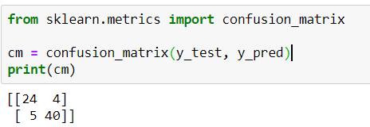
Step 2: PCA Combined with Logistic Regression
2-component PCA and Logistic Regression with an 80/20 train/test split gave a confusion matrix that correctly classified 64 out of 73 playoff teams

Slide 9
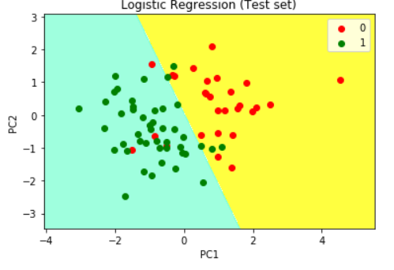
Logistic Regression on Test Data
Notes:
Pretty good separation of data with a few outliers

Slide 10
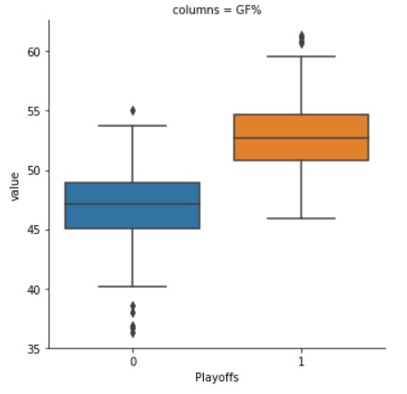
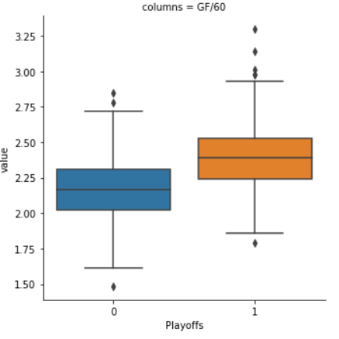
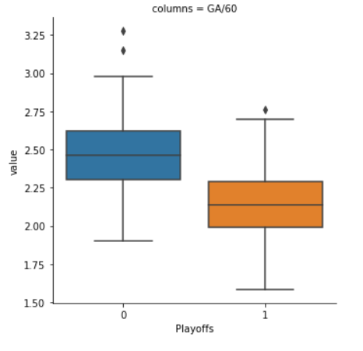
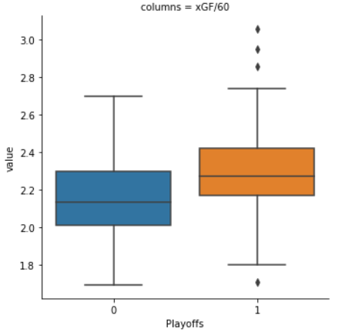
Step 3: Further Visualization
Notes:
All 4 features are pretty good predictors of a team making a playoffs based on the graphs, but let’s dive even deeper

Slide 11
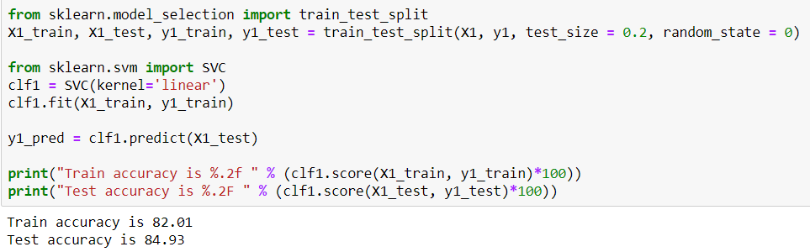
Step 4: Linear SVC
Linear SVC for Goals For percentage

Slide 12
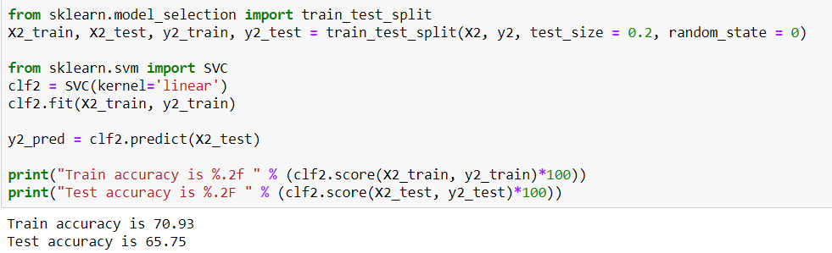
Step 4 (Continued)
Linear SVC for Goals For per 60 minutes

Slide 13
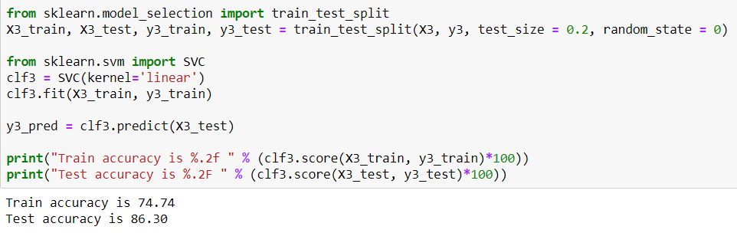
Step 4 (Continued)
Linear SVC for Goals Against per 60 minutes

Slide 14
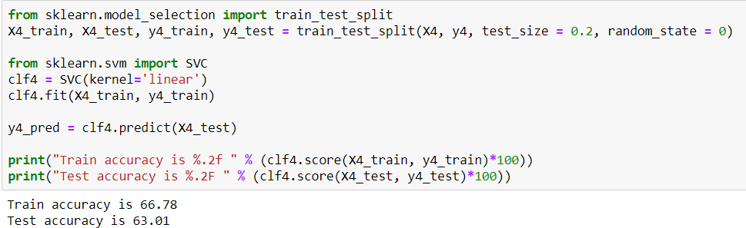
Step 4 (Continued)
Linear SVC for Expected Goals For per 60 minutes

Slide 15
Step 4 (Continued)
Linear SVC had Goals For percentage and Goals Against per 60 minutes as the 2 best features out of the 4
As a result, we will continue further with just those 2

Slide 16
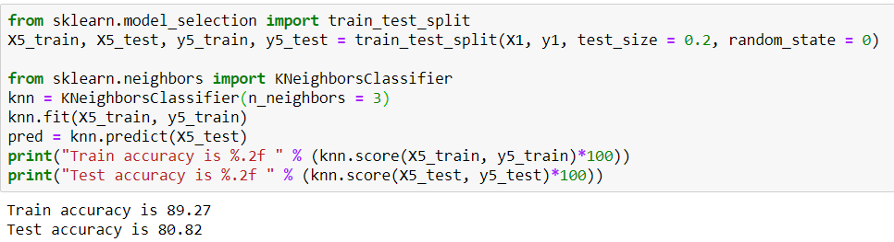
Step 5: K-Neighbors Classifier
K-Neighbors Classifier on Goals For percentage

Slide 17
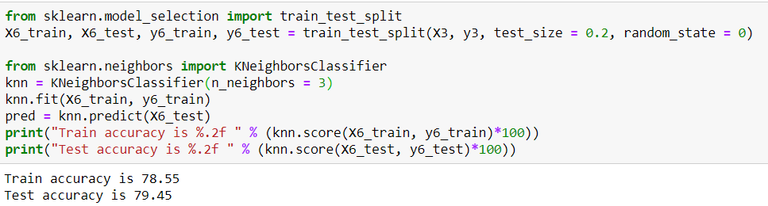
Step 5 (Continued)
K-Neighbors Classifier for Goals Against per 60 minutes

Slide 18
Conclusions
Out of all the machine learning techniques and NHL advanced stats used, the best combination for playoff prediction was Goals For percentage (percentage of goals that you score versus your opponents) with a 3 neighbor K-Neighbors Classifier

Slide 19
Questions?

