Slide 1
Warm Up
https://jamboard.google.com/d/1dtXftknaSSOC0Y_Qd0Mlk8wjBHOoa1xJIWB5DcCwa3A/viewer?f=0

Slide 2
Factoring Binomials
Ax²+Bx

Slide 3

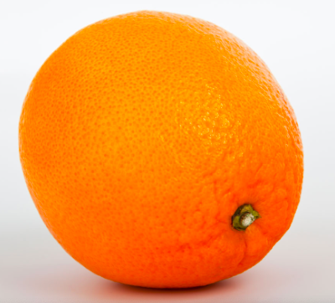
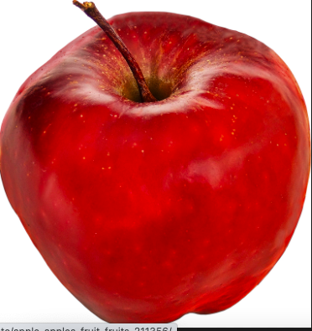
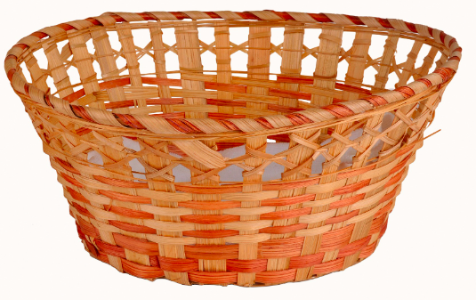
What is factoring
Sally
Johnny

Slide 4
What is factoring
(
Sally
Johnny
)

Slide 5
What is factoring

Slide 6
Factoring
2x²+12x

Slide 7
Factoring
2x²+12x
2*x²+ 2*6x

Slide 8
Factoring
2x²+12x
2*x²+ 2*6x
2x*x + 2x*6

Slide 9
Factoring
2x²+12x
2*x²+ 2*6x
2x*x + 2x*6
2x(x+6)

Slide 10
Solving Binomials
2x²+12x = 0

Slide 11
Solving Binomials
2x²+12x = 0
2x(x+6) = 0

Slide 12
Solving Binomials
2x²+12x = 0
2x(x+6) = 0
2x = 0 or x+6 = 0

Slide 13
Solving Binomials
2x²+12x = 0
2x(x+6) = 0
2x = 0 or x+6 = 0
X = 0 or x = -6

Slide 14
Solving Binomials
2x²+12x = 0
2x(x+6) = 0
2x = 0 or x+6 = 0
X = 0 or x = -6
2(0)²+12(0) = 0
2(-6)²+12(-6) = 0

Slide 15
Kahoot.it

