Slide 1
Factoring

Slide 2
Warm Up
https://jamboard.google.com/d/1dtXftknaSSOC0Y_Qd0Mlk8wjBHOoa1xJIWB5DcCwa3A/viewer?f=0

Slide 3

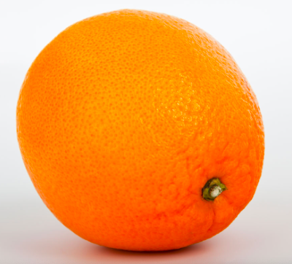
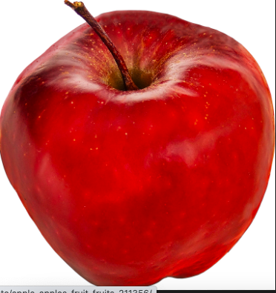
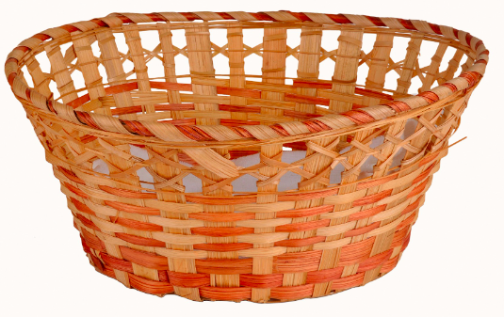
Factoring as grouping
Sally
Johnny

Slide 4
Factoring as grouping

Slide 5
Factoring
2x²+12x

Slide 6
Factoring
2x²+12x
2*x²+ 2*6x

Slide 7
Factoring
2x²+12x
2*x²+ 2*6x
2x*x + 2x*6

Slide 8
Factoring
2x²+12x
2*x²+ 2*6x
2x*x + 2x*6
2x(x+6)

Slide 9
Solving Binomials
2x²+12x = 0

Slide 10
Solving Binomials
2x²+12x = 0
2x(x+6) = 0

Slide 11
Solving Binomials
2x²+12x = 0
2x(x+6) = 0
2x=0 or x+6 = 0

Slide 12
Solving Binomials
2x²+12x = 0
2x(x+6) = 0
2x=0 or x+6 = 0
X=0 or x=-6

Slide 13
Practice Activity 1
https://jamboard.google.com/d/1WbfnV6BW-gm8fvmLmuW4J8eJmYO97L7_KxbDzBwbFRs/viewer?f=0

