Slide 1


Coffee Break
“Ceci n’est pas un pipe”

Slide 2


Slide 3

https://www.amazon.com/Story-Storm-Store-magrittr-Stickers/dp/B07YD3HJSB

Slide 5
Func_1()
Data_1
Data_2

Slide 6
Func_1()
Data_1
Data_2
Func_2()
Data_2
Data_3

Slide 7
Func_1()
Data_1
Data_2
Func_2()
Data_2
Data_3
Func_3()
Data_3
Data_4

Slide 8
Func_1()
Data_1
Data_2
Func_2()
Data_2
Data_3
Func_3()
Data_3
Data_4
Func_4()
Data_4
Data_5

Slide 9
Func_1()
Step #1
Data_1
Data_2
Func_2()
Step #2
Data_2
Data_3
Func_3()
Step #3
Data_3
Data_4
Func_4()
Step #4
Data_4
Data_5

Slide 10
Raw / unprocessed
Func_1()
Step #1
Data_1
Data_2
Func_2()
Step #2
Data_2
Data_3
Func_3()
Step #3
Data_3
Data_4
Func_4()
Step #4
Data_4
Data_5
Cleaned / Processed

Slide 11
Raw / unprocessed
Func_1()
Step #1
Data_1
Data_2
Func_2()
Step #2
Data_2
Data_3
Func_3()
Step #3
Data_3
Data_4
Func_4()
Step #4
Data_4
Data_5
Cleaned / Processed

Slide 12
Raw / unprocessed
Func_1()
Func_2()
Func_3()
Func_4()
Cleaned / Processed
Data_1
Data_5

Slide 13
Raw / unprocessed
Func_1()
Func_2()
Func_3()
Func_4()
Cleaned / Processed
Data_1
Data_5

Slide 14
Pipeline_1()
Raw / unprocessed
Func_1()
Func_2()
Func_3()
Func_4()
Cleaned / Processed
Data_1
Data_5

Slide 15
Raw / unprocessed
Pipeline_1()
Cleaned / Processed
Data_1
Data_5

Slide 16

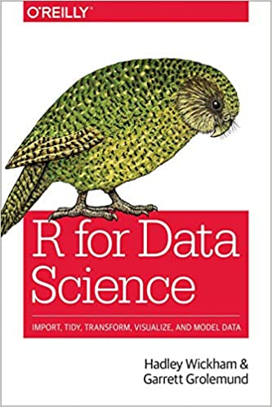
https://www.tidyverse.org/
https://www.amazon.com/Data-Science-Transform-Visualize-Model/dp/1491910399

Slide 17
Pipeline_1()
Raw / unprocessed
Func_1()
Func_2()
Func_3()
Func_4()
Cleaned / Processed
Data_1
Data_5

Slide 18
Raw / unprocessed
Cleaned / Processed
Func_1()
Func_2()
Func_3()
Func_4()
Data_1
%>%
%>%
%>%
%>%
->
Data_5

Slide 19
Raw / unprocessed
Cleaned / Processed
Func_1()
Func_3()
Func_4()
Data_1
%>%
%>%
%>%
->
Data_5
%T>%
Func_2()

Slide 20
Raw / unprocessed
Cleaned / Processed
Func_1()
Func_3()
Func_4()
Data_1
%>%
%>%
%>%
->
Data_5
%T>%
Func_2()
Func_2’()
Func_2’’()
%>%
%>%

Slide 21
Raw / unprocessed
Cleaned / Processed
Func_1()
Func_3()
Func_4()
Data_1
%>%
%>%
%>%
->
Data_5
%T>%
Func_2()
Func_2’()
Func_2’’()
%>%
%>%

Slide 22
Func_3()
Func_3’()
Func_3’’()
%>%
%>%
%T>%
Raw / unprocessed
Cleaned / Processed
Func_1()
Func_4()
Func_5()
Data_1
%>%
%>%
%>%
->
Data_5
%T>%
Func_2()
Func_2’()
Func_2’’()
%>%
%>%

Slide 23
https://www.tidyverse.org/
https://www.amazon.com/Story-Storm-Store-magrittr-Stickers/dp/B07YD3HJSB

Slide 24
Thank you!
Questions?

