Slide 1
EDES 301 PCB Project
<Name>
Due 05/05/2025 @ 11:59pm

Slide 2
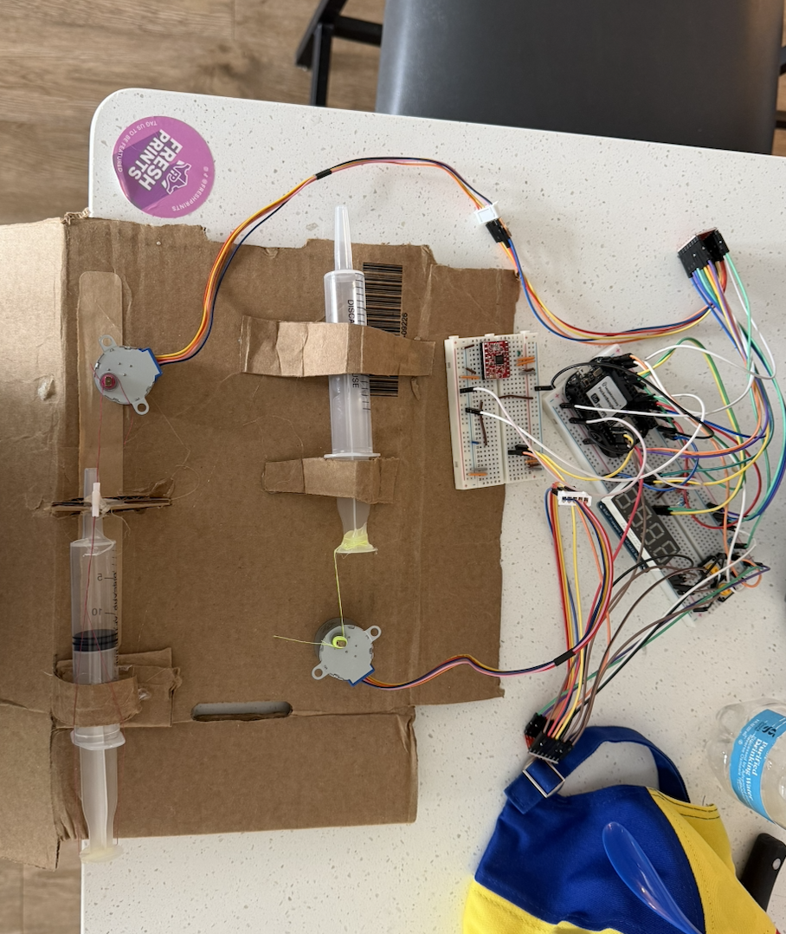
Background Information
This device operates two motors to push syringes to act as an automated washing machine for lab use.
You are able to choose how many washing cycles, each cycle consists of a variable amount of liquid dispensed, a 5 minute incubation period, and the reuptake of that liquid into a waste syringe.

Slide 3
Bill on Materials
Hardware:
Seven Segment Display
Four Resisters
Two Buttons (Choose the cycle, start and Stop)
Pocket Beagle
Two Stepper Motors
Two Motor Drivers

Slide 4
System Block Diagram
7 Segment Display
I2Cx2
Pocket Beagle
3
Motor Driver
Stepper Motor
GPIO x3
3 x Buttons
GPIO x3
Motor Driver
3
Stepper Motor
GPIO x3

Slide 5
Mechanical Drawing
3”
Pocket Beagle
Seven Segment Display
USB
2”
Button
Button
Driver
Driver
FRONT
BACK

