Slide 1
EDES 301 Automated Western Blot Washing Proposal
February 22, 2026
Miller Harris

Slide 2
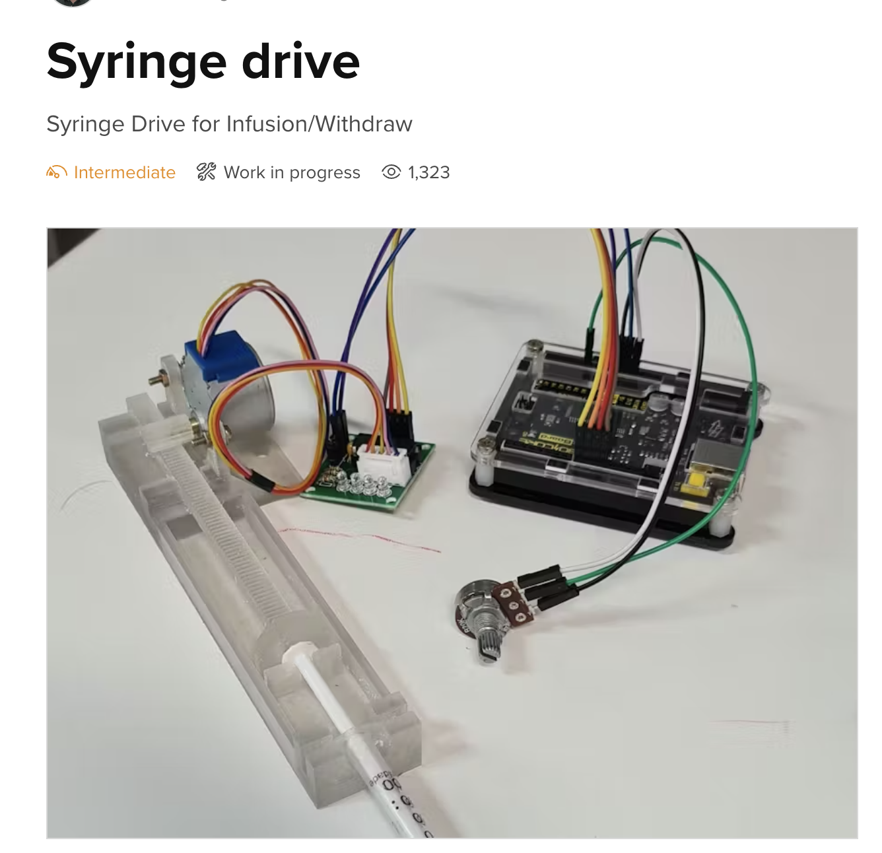
Background Information
I work in a lab here at Rice, and so much time is wasted in washing protocols which are simple and relatively mindless tasks that require repeated washing, shaking, and draining 3 times for 5 minutes
It would be far easier to set it once for 15 minutes, and in lab settings, allow you to prep something else in the meantime
For liquid supply and disposal
https://www.hackster.io/ericmgf/syringe-drive-2884a5

Slide 3
System Block Diagram
7 Segment Display
I2Cx2
Pocket Beagle
3
Motor Driver
Motor
GPIO x3
3
Motor Driver
Motor
GPIO x3
3 x Buttons
GPIO x3
3
Motor Driver
Motor
GPIO x3

Slide 4
Power Block Diagram
5 V
5 V supply
5 V
5 V
3.3 V Signal
5 V
Pocket Beagle
3.3 V Signal
Motor Driver
Motor Driver
Motor Driver
3.3 V Signal
5 V
5 V
5 V
3.3V
3.3V
Motor
Motor
Motor
7 Segment Display
3 x Buttons

Slide 5
Components / Budget
Component | EDES301 to Buy? | Cost
3 Stepper Motors (https://www.amazon.com/HiLetgo-ULN2003-28BYJ-48-Stepper-4-phase/dp/B00LPK0E5A/) | Yes | $14.59 for 5
Syringes (https://www.amazon.com/Plastic-Syringes-Scientific-Lubricant-Supplies/dp/B0B68HRFZN/?th=1) | Yes | $5.99
Power (https://www.amazon.com/ALAMSCN-Solderless-Breadboard-Battery-Arduino/dp/B08JYPMCZY/) | Yes | $8.99
Battery (9V) | No

