Slide 1
CSE3213 Computer Network I
Medium Access Control Protocols
(Ch. 6.1 – 6.3)
Course page:
http://www.cse.yorku.ca/course/3213
Slides modified from Alberto Leon-Garcia and Indra Widjaja

Slide 2
Chapter Overview
Broadcast Networks
  All information sent to all users
  No routing
  Shared media
  Radio
    Cellular telephony
    Wireless LANs
  Copper & Optical
    Ethernet LANs
    Cable Modem Access
Medium Access Control
  To coordinate access to shared medium
  Data link layer since direct transfer of frames
Local Area Networks
  High-speed, low-cost communications between co-located computers
  Typically based on broadcast networks
  Simple & cheap
  Limited number of users

Slide 3
Multiple Access Communications

Slide 4
Multiple Access Communications
Shared media basis for broadcast networks
  Inexpensive: radio over air; copper or coaxial cable
  M users communicate by broadcasting into medium
Key issue: How to share the medium?
3
2
4
1
Shared multiple
access medium
M
5
…

Slide 5
Approaches to Media Sharing
Medium sharing techniques
Static channelization
Dynamic medium access control
Partition medium
Dedicated allocation to users
Satellite transmission
Cellular Telephone
Scheduling
Random access
Polling: take turns
Request for slot in transmission schedule
Token ring
Wireless LANs
Loose coordination
Send, wait, retry if necessary
Aloha
Ethernet

Slide 6
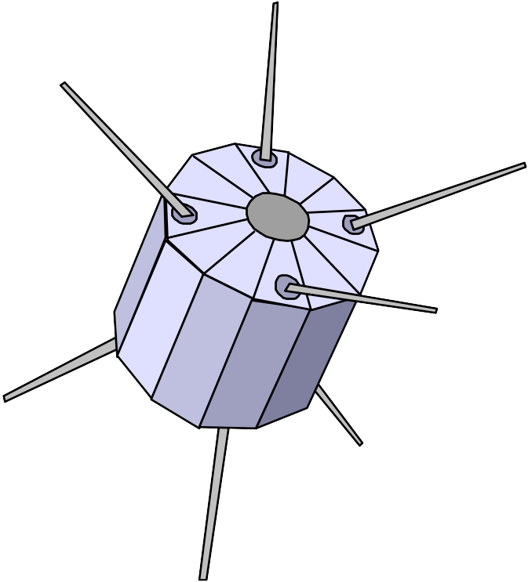

Channelization: Satellite
Satellite Channel
uplink f_{in}
downlink f_{out}

Slide 7


Channelization: Cellular
uplink f₁ ; downlink f₂
uplink f₃ ; downlink f₄

Slide 8
Scheduling: Polling
Inbound line
Data from 1
Data from 2
Poll 1
Poll 2
Data to M
Outbound line
Host
computer
1
2
3
M
Stations

Slide 9
Scheduling: Token-Passing
Ring networks
token
Data to M
token
Station that holds token transmits into ring

Slide 10
Random Access
Multitapped Bus
Crash!!
Transmit when ready
Transmissions can occur; need retransmission strategy

Slide 11
Wireless LAN
AdHoc: station-to-station
Infrastructure: stations to base station
Random access & polling

Slide 12
Selecting a Medium Access Control
Applications
  What type of traffic?
  Voice streams? Steady traffic, low delay/jitter
  Data? Short messages? Web page downloads?
  Enterprise or Consumer market? Reliability, cost
Scale
  How much traffic can be carried?
  How many users can be supported?
Current Examples:
  Design MAC to provide wireless DSL-equivalent access to rural communities
  Design MAC to provide Wireless-LAN-equivalent access to mobile users (user in car travelling at 130 km/hr)

Slide 13
Delay-Bandwidth Product
Delay-bandwidth product key parameter
  Coordination in sharing medium involves using bandwidth (explicitly or implicitly)
  Difficulty of coordination commensurate with delay-bandwidth product
Simple two-station example
  Station with frame to send listens to medium and transmits if medium found idle
  Station monitors medium to detect collision
  If collision occurs, station that begin transmitting earlier retransmits (propagation time is known)

Slide 14
Two-Station MAC Example
Two stations are trying to share a common medium
Distance d meters
t_{prop} = d / ν seconds
A transmits at t = 0
A
B
Case 1
B does not transmit before t = t_{prop} & A captures channel
A
B
Case 2
B transmits before t = t_{prop} and detects
collision soon
thereafter
A
B
A detects
collision at
t = 2 t_{prop}
A
B

Slide 15
Efficiency of Two-Station Example
Each frame transmission requires 2t_{prop} of quiet time
  Station B needs to be quiet t_{prop} before and after time when Station A transmits
  R transmission bit rate
  L bits/frame
Normalized Delay-Bandwidth Product
Propagation delay
Time to transmit a frame

Slide 16
Typical MAC Efficiencies
Two-Station Example:
If a<<1, then efficiency close to 100%
As a approaches 1, the efficiency becomes low
CSMA-CD (Ethernet) protocol:
Token-ring network
a΄= latency of the ring (bits)/average frame length

Slide 17
Typical Delay-Bandwidth Products
Distance | 10 Mbps | 100 Mbps | 1 Gbps | Network Type
1 m | 3.33 x 10⁻⁰² | 3.33 x 10⁻⁰¹ | 3.33 x 10⁰ | Desk area network
100 m | 3.33 x 10⁰¹ | 3.33 x 10⁰² | 3.33 x 10⁰³ | Local area network
10 km | 3.33 x 10⁰² | 3.33 x 10⁰³ | 3.33 x 10⁰⁴ | Metropolitan area network
1000 km | 3.33 x 10⁰⁴ | 3.33 x 10⁰⁵ | 3.33 x 10⁰⁶ | Wide area network
100000 km | 3.33 x 10⁰⁶ | 3.33 x 10⁰⁷ | 3.33 x 10⁰⁸ | Global area network
Max size Ethernet frame: 1500 bytes = 12000 bits
Long and/or fat pipes give large a

Slide 18
MAC protocol features
Delay-bandwidth product
Efficiency
Transfer delay
Fairness
Reliability
Capability to carry different types of traffic
Quality of service
Cost

Slide 19
MAC Delay Performance
Frame transfer delay
  From first bit of frame arrives at source MAC
  To last bit of frame delivered at destination MAC
Throughput
  Actual transfer rate through the shared medium
  Measured in frames/sec or bits/sec
Parameters
  R bits/sec & L bits/frame
  X=L/R seconds/frame
  λ frames/second average arrival rate
  Load ρ = λ X, rate at which “work” arrives
  Maximum throughput (@100% efficiency): R/L fr/sec

Slide 20
Normalized Delay versus Load
E[T]/X
E[T] = average frame
transfer delay
At low arrival rate, only frame transmission time
At high arrival rates, increasingly longer waits to access channel
Max efficiency typically less than 100%
X = average frame
transmission time
Transfer delay
1
ρ
ρ_{max}
1
Load

Slide 21
Dependence on Rt_{prop}/L
E[T]/X
a′ > a
a′
a
Transfer Delay
1
ρ
ρ′_{max}
ρ_{max}
1
Load

Slide 22
Random Access

Slide 23
ALOHA
Wireless link to provide data transfer between main campus & remote campuses of University of Hawaii
Simplest solution: just do it
  A station transmits whenever it has data to transmit
  If more than one frames are transmitted, they interfere with each other (collide) and are lost
  If ACK not received within timeout, then a station picks random backoff time (to avoid repeated collision)
  Station retransmits frame after backoff time
First transmission
Retransmission
Backoff period B
t
t₀-X
t₀
t₀+X
t₀+X+2t_{prop}
t₀+X+2t_{prop} + B
Vulnerable
period
Time-out

Slide 24
ALOHA Model
Definitions and assumptions
  X frame transmission time (assume constant)
  S: throughput (average # successful frame transmissions per X seconds)
  G: load (average # transmission attempts per X sec.)
  P_{success} : probability a frame transmission is successful
Any transmission that begins during vulnerable period leads to collision
Success if no arrivals during 2X seconds
X
X
Prior interval
frame transmission

Slide 25
Throughput of ALOHA
Collisions are means for coordinating access
Max throughput is ρ_{max}= 1/2e (18.4%)
Bimodal behavior:
  Small G, S≈G
  Large G, S↓0
Collisions can snowball and drop throughput to zero
e⁻² = 0.184

Slide 26
Slotted ALOHA
Time is slotted in X seconds slots
Stations synchronized to frame times
Stations transmit frames in first slot after frame arrival
Backoff intervals in multiples of slots
Backoff period B
t
kX
(k+1)X
t₀ +X+2t_{prop}
t₀ +X+2t_{prop}+ B
Vulnerableperiod
Time-out
Only frames that arrive during prior X seconds collide

Slide 27
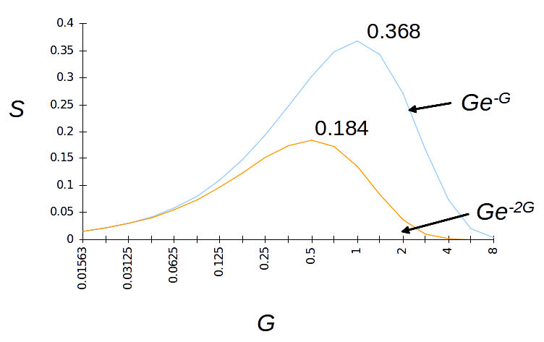
Throughput of Slotted ALOHA

Slide 28
Carrier Sensing Multiple Access (CSMA)
A station senses the channel before it starts transmission
  If busy, either wait or schedule backoff (different options)
  If idle, start transmission
  Vulnerable period is reduced to t_{prop} (due to channel capture effect)
  When collisions occur they involve entire frame transmission times
  If t_{prop} >X (or if a>1), no gain compared to ALOHA or slotted ALOHA
Station A begins transmission at t = 0
A
Station A captures
channel at t = t_{prop}
A

Slide 29
CSMA Options
Transmitter behavior when busy channel is sensed
  1-persistent CSMA (most greedy)
    Start transmission as soon as the channel becomes idle
    Low delay and low efficiency
  Non-persistent CSMA (least greedy)
    Wait a backoff period, then sense carrier again
    High delay and high efficiency
  p-persistent CSMA (adjustable greedy)
    Wait till channel becomes idle, transmit with prob. p; or wait one mini-slot time & re-sense with probability 1-p
    Delay and efficiency can be balanced
Sensing

Slide 30
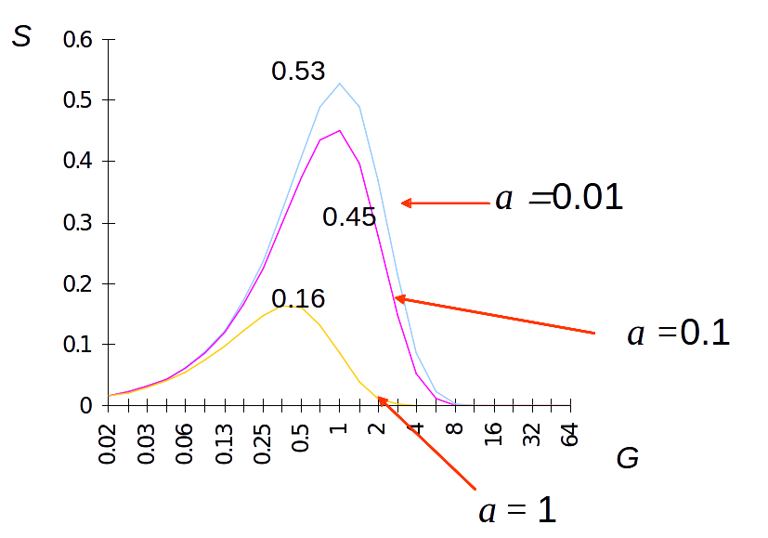
1-Persistent CSMA Throughput
Better than Aloha & slotted Aloha for small a
Worse than Aloha for a > 1

Slide 31
Non-Persistent CSMA Throughput
a = 0.01
S
0.81
Higher maximum throughput than 1-persistent for small a
Worse than Aloha for a > 1
0.51
a = 0.1
0.14
G
a = 1

Slide 32
CSMA with Collision Detection (CSMA/CD)
Monitor for collisions & abort transmission
  Stations with frames to send, first do carrier sensing
  After beginning transmissions, stations continue listening to the medium to detect collisions
  If collisions detected, all stations involved stop transmission, reschedule random backoff times, and try again at scheduled times
In CSMA collisions result in wastage of X seconds spent transmitting an entire frame
CSMA-CD reduces wastage to time to detect collision and abort transmission

Slide 33
CSMA/CD reaction time
A begins to
transmit at
t = 0
A
B
B begins to
transmit at
t = t_{prop}- δ; 
B detects
collision at
t = t_{prop}
A
B
A detects
collision at
t= 2 t_{prop}- δ
A
B
It takes 2 t_{prop} to find out if channel has been captured

Slide 34
CSMA-CD Model
Assumptions
  Collisions can be detected and resolved in 2t_{prop}
  Time slotted in 2t_{prop} slots during contention periods
  Assume n busy stations, and each may transmit with probability p in each contention time slot
  Once the contention period is over (a station successfully occupies the channel), it takes X seconds for a frame to be transmitted
  It takes t_{prop} before the next contention period starts.
(a)
Busy
Contention
Busy
Idle
Contention
Busy
Time

Slide 35
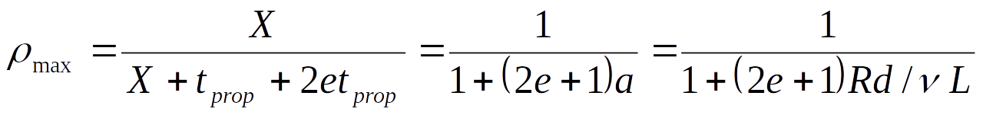
CSMA/CD Throughput
Busy
Contention
Busy
Contention
Busy
Contention
Busy
Time
At maximum throughput, systems alternates between contention periods and frame transmission times
where:
  R bits/sec, L bits/frame, X=L/R seconds/frame
  a = t_{prop}/X
  ν meters/sec. speed of light in medium
  d meters is diameter of system
  2e+1 = 6.44

Slide 36
CSMA-CD Application: Ethernet
First Ethernet LAN standard used CSMA-CD
  1-persistent Carrier Sensing
  R = 10 Mbps
  t_{prop} = 51.2 microseconds
    512 bits = 64 byte slot
    accommodates 2.5 km + 4 repeaters
  Truncated Binary Exponential Backoff
    After nth collision, select backoff from {0, 1,…, 2^{k} – 1}, where k=min(n, 10)

Slide 37
Throughput for Random Access MACs
CSMA/CD
1-P CSMA
Non-P CSMA
ρ_{max}
Slotted ALOHA
ALOHA
a
For small a: CSMA-CD has best throughput
For larger a: Aloha & slotted Aloha better throughput

Slide 38
Carrier Sensing and Priority Transmission
Certain applications require faster response than others, e.g. ACK messages
Impose different interframe times
  High priority traffic sense channel for time τ₁
  Low priority traffic sense channel for time τ₂>τ₁
  High priority traffic, if present, seizes channel first
This priority mechanism is used in IEEE 802.11 wireless LAN

Slide 39
Scheduling

Slide 40
Scheduling for Medium Access Control
Schedule frame transmissions to avoid collision in shared medium
  More efficient channel utilization
  Less variability in delays
  Can provide fairness to stations
  Increased computational or procedural complexity
Two main approaches
  Reservation
  Polling

Slide 41
Reservations Systems
Centralized systems: A central controller accepts requests from stations and issues grants to transmit
  Frequency Division Duplex (FDD): Separate frequency bands for uplink & downlink
  Time-Division Duplex (TDD): Uplink & downlink time-share the same channel
Distributed systems: Stations implement a decentralized algorithm to determine transmission order
Central
Controller

Slide 42
Reservation Systems
Reservation
interval
Frame
transmissions
r
d
d
d
r
d
d
d
Time
Cycle n
Cycle (n + 1)
r
=
1
2
3
M
Transmissions organized into cycles
Cycle: reservation interval + frame transmissions
Reservation interval has a minislot for each station to request reservations for frame transmissions

Slide 43
Reservation System Options
Centralized or distributed system
  Centralized systems: A central controller listens to reservation information, decides order of transmission, issues grants
  Distributed systems: Each station determines its slot for transmission from the reservation information
Single or Multiple Frames
  Single frame reservation: Only one frame transmission can be reserved within a reservation cycle
  Multiple frame reservation: More than one frame transmission can be reserved within a frame
Channelized or Random Access Reservations
  Channelized (typically TDMA) reservation: Reservation messages from different stations are multiplexed without any risk of collision
  Random access reservation: Each station transmits its reservation message randomly until the message goes through

Slide 44
Example
Initially stations 3 & 5 have reservations to transmit frames
(a)
r
3
5
r
3
5
r
3
5
8
r
3
5
8
r
3
t
Station 8 becomes active and makes reservation
Cycle now also includes frame transmissions from station 8
(b)
8
r
3
5
r
3
5
r
3
5
8
r
3
5
8
r
3
t

Slide 45
Example: GPRS
General Packet Radio Service
  Packet data service in GSM cellular radio
  GPRS devices, e.g. cellphones or laptops, send packet data over radio and then to Internet
  Slotted Aloha MAC used for reservations
  Single & multi-slot reservations supported

Slide 46
Reservation Systems and Quality of Service
Different applications; different requirements
  Immediate transfer for ACK frames
  Low-delay transfer & steady bandwidth for voice
  High-bandwidth for Web transfers
Reservation provide direct means for QoS
  Stations makes requests per frame
  Stations can request for persistent transmission access
  Centralized controller issues grants
    Preferred approach
  Decentralized protocol allows stations to determine grants
    Protocol must deal with error conditions when requests or grants are lost

Slide 47
Polling Systems
Centralized polling systems: A central controller transmits polling messages to stations according to a certain order
Distributed polling systems: A permit for frame transmission is passed from station to station according to a certain order
A signaling procedure exists for setting up order
Central
Controller

Slide 48
Polling System Options
Service Limits: How much is a station allowed to transmit per poll?
  Exhaustive: until station’s data buffer is empty (including new frame arrivals)
  Gated: all data in buffer when poll arrives
  Frame-Limited: one frame per poll
  Time-Limited: up to some maximum time
Priority mechanisms
  More bandwidth & lower delay for stations that appear multiple times in the polling list
  Issue polls for stations with message of priority k or higher

Slide 49
Walk Time & Cycle Time
Assume polling order is round robin
Time is “wasted” polling stations
  Time to prepare & send polling message
  Time for station to respond
Walk time: from when a station completes transmission to when next station begins transmission
Cycle time is between consecutive polls of a station
Overhead/cycle = total walk time/cycle time
Polling messages
1
2
3
4
5
…
M
1
2
t
Frame transmissions
Cycle Time

Slide 50
Application: Token-Passing Rings
token
Free Token = Poll
Frame Delimiter is Token
Free = 01111110
Busy = 01111111
Listen mode
Transmit mode
Input
from
ring
Output
to
ring
Delay
Delay
To device
From device
Ready station looks for free token
Flips bit to change free token to busy
Ready station inserts its frames
Reinserts free token when done

Slide 51
Methods of Token Reinsertion
Ring latency: number of bits that can be simultaneously in transit on ring
Multi-token operation
  Free token transmitted immediately after last bit of data frame
Single-token operation
  Free token inserted after last bit of the busy token is received back
  Transmission time at least ring latency
  If frame is longer than ring latency, equivalent to multi-token operation
Single-Frame operation
  Free token inserted after transmitting station has received last bit of its frame
  Equivalent to attaching trailer equal to ring latency
Busy token
Free token
Frame
Idle Fill

Slide 52
Application Examples
Single-frame reinsertion
  IEEE 802.5 Token Ring LAN @ 4 Mbps
Single token reinsertion
  IBM Token Ring @ 4 Mbps
Multitoken reinsertion
  IEEE 802.5 and IBM Ring LANs @ 16 Mbps
  FDDI Ring @ 50 Mbps
All of these LANs incorporate token priority mechanisms

Slide 53
Comparison of MAC approaches
Aloha & Slotted Aloha
  Simple & quick transfer at very low load
  Accommodates large number of low-traffic bursty users
  Highly variable delay at moderate loads
  Efficiency does not depend on a
CSMA-CD
  Quick transfer and high efficiency for low delay-bandwidth product
  Can accommodate large number of bursty users
  Variable and unpredictable delay

Slide 54
Comparison of MAC approaches
Reservation
  On-demand transmission of bursty or steady streams
  Accommodates large number of low-traffic users with slotted Aloha reservations
  Can incorporate QoS
  Handles large delay-bandwidth product via delayed grants
Polling
  Generalization of time-division multiplexing
  Provides fairness through regular access opportunities
  Can provide bounds on access delay
  Performance deteriorates with large delay-bandwidth product

