Slide 1
Creating Our Own Microbial Fuel
Cell Ecosystem
By: Nora Elena, Jonathan, Jaleel, William

Slide 2
Table of contents
01
02
03
04
05
06
Goal & Motivation
Short Functionality
Short Specification
Detailed Functionality
Demo
Successes/Failures

Slide 3
01
Goal & Motivation
Notes:
Nora

Slide 4
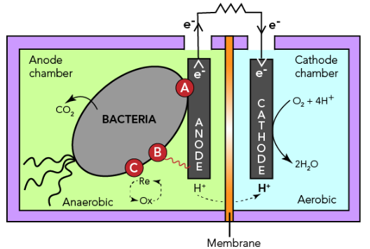
Goal & Motivation
Concrete Example
A wastewater engineer (Southampton Lab) designing a microbial fuel cell can adjust microbial interactions (e.g., cross-feeding or cooperation) and simulate whether the community produces stable electrical output before implementing it in a treatment system
Our objective is to translate real genetic circuits from sludge environments into a configurable simulation platform, allowing users to design ecosystems and assess their stability before implementation

Slide 5
02
Short Functionality
Notes:
Nora

Slide 6
Short Functionality
GUI
Six sliders let you adjust the influence of different biological circuit categories
System picks which modified strains belong in the community based on slider settings
Ecosystem simulation graph updates dynamically as parameters change
Simulates how the community behaves over time and displays it as a live graph
Purpose
Enables rapid exploration of how circuit combinations affect ecosystem behavior
Notes:
Nora

Slide 7
03
Short Specification
Notes:
Nora

Slide 8
Short Specification of circuits
Genetic circuits must be from sludge microbial environments
Circuits must map to defined interaction categories:
Auxotrophic cross-feeding
Metabolite production
Metabolite dependency
Cooperation
Each circuit must be representable using standardized components
promoter, RBS, CDS, terminator
The system must support modular selection and combination of multiple circuits
Design Requirements
Circuit selection limited to literature-supported sludge organisms
Biological interactions simplified into abstracted interaction models
Dependence on predefined categories
Limited parameter availability for accurate kinetic modeling
Simulation must remain computationally efficient for real-time use
Design Constraints
Notes:
Nora

Slide 9
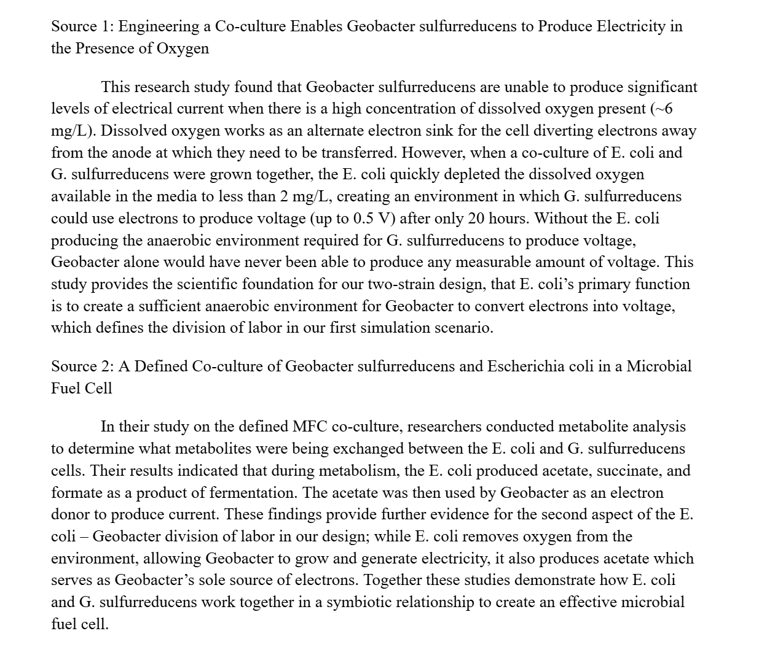
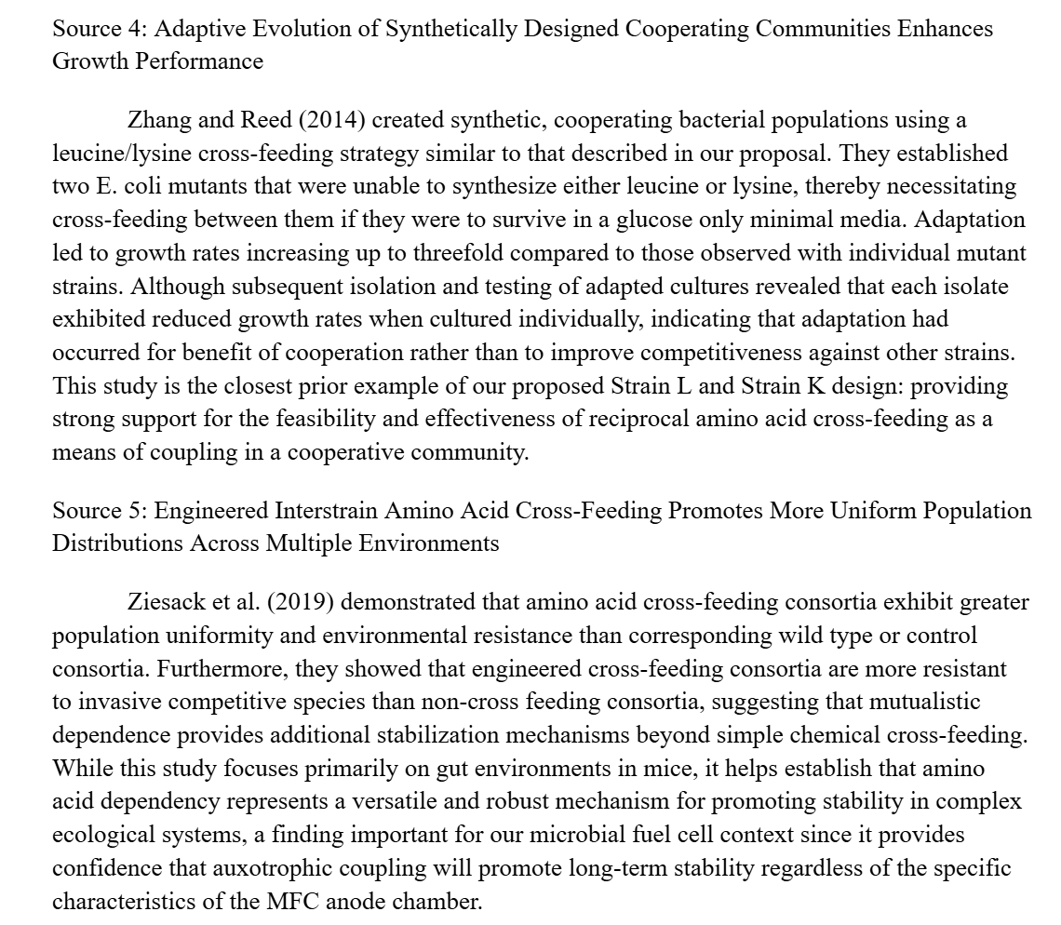
Literature Review that was used for Knox circuits
Notes:
Nora

Slide 10
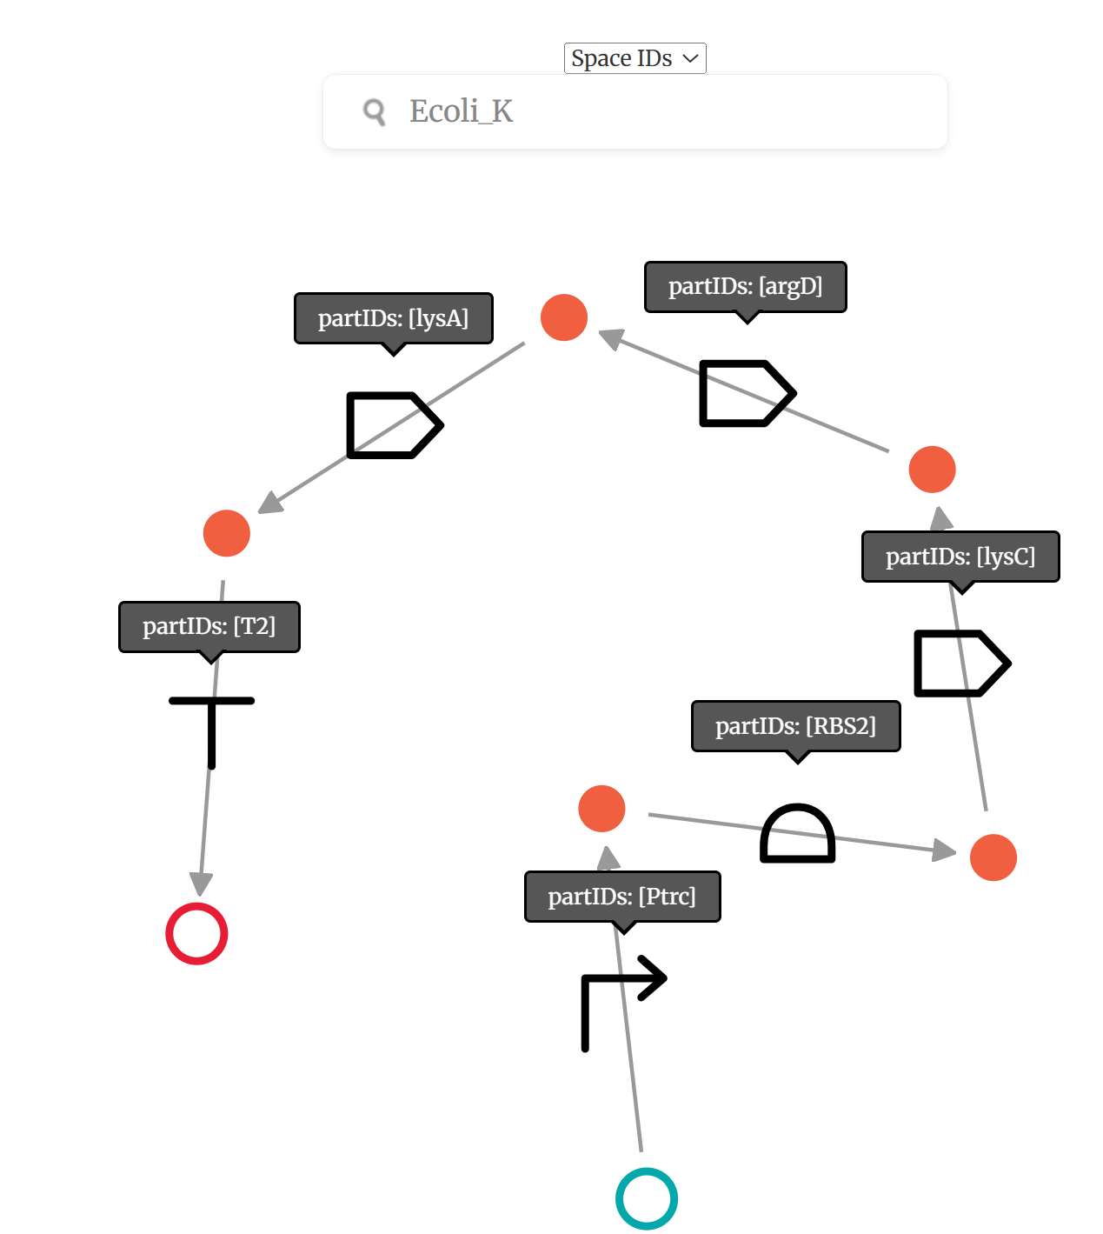
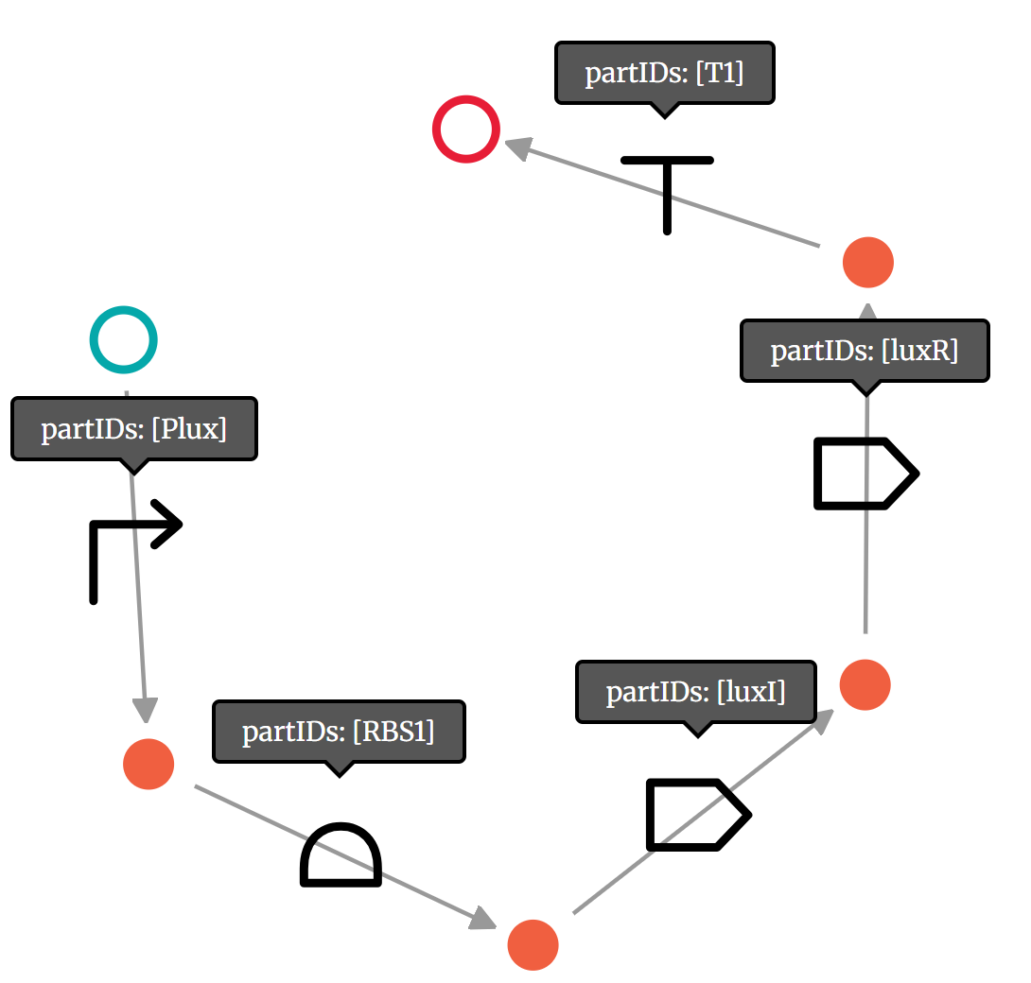
Short Specification: Knox Circuit Examples
Ecoli_K
Luxl_LuxR
Notes:
Nora

Slide 11
04
Detailed Functionality

Slide 12
Step 1) Create the Knox circuits
Step 2) Find the relevant ODEs from goldbar circuits (lit review)
Step 3) Run Claude to make xml file to run simulation in iBioSim
Detailed Workflow for Simulation Creation:
Notes:
WD

Slide 13
Detailed Functionality: Parameters
Cross-feeding — obligate amino acid mutualism
Kill switches — biosafety via toxin-antitoxin
Electroactivity — EET cytochrome current boost
Nitrification — ammonia to nitrate oxidation
Denitrification — nitrate to N₂ reduction
Production — valuable secondary metabolite biosynthesis
Quorum sensing — cell-density-dependent coordination

Slide 14
Detailed Functionality: iBioSim
Created GOLDBAR to define circuits for each bacterium
Assumed single modification for each organism
Utilized knowledge from literature review to get biochemical equations (ODEs) which describe an ecosystem
d[Lys]/dt = k_prod_K · [Ecoli_K] − k_uptake_L · [Ecoli_L] · [Lys]
d[Leu]/dt = k_prod_L · [Ecoli_L] − k_uptake_K · [Ecoli_K] · [Leu]
d[Trp]/dt = k_prod_T · [Ecoli_Trp] − k_uptake_H · [Ecoli_His] · [Trp]
d[His]/dt = k_prod_H · [Ecoli_His] − k_uptake_T · [Ecoli_Trp] · [His]
d[Ecoli_K]/dt = μ_K · [Ecoli_K] · [Leu] − d_cell · [Ecoli_K]
d[Ecoli_L]/dt = μ_L · [Ecoli_L] · [Lys] − d_cell · [Ecoli_L]
(same pattern for Trp/His pair)
Cross-feeding kinetics:
• Wintermute & Silver 2010 — E. coli amino acid cross-feeding
• Mee et al. 2014 — Syntrophic exchange
Nitrification rates:
• Arp et al. 2007 — Nitrosomonas europaea review
• Starkenburg et al. 2006 — Nitrobacter winogradskyi genome
Denitrification:
• Zumft 1997 — Cell biology and molecular basis of denitrification
• Stouthamer 1991 — Paracoccus review
Geobacter electrogenesis:
• Lovley 2012 — review of EET in Geobacter
• Yalcin et al. 2020 — OmcZ filament paper
Quorum sensing:
• Waters & Bassler 2005 — QS in bacteria review
• Miller & Bassler 2001 — original review
Kill switches:
• Chan et al. 2016 — Deadman & Passcode kill switches
• Engelberg-Kulka et al. 2006 — MazE/MazF
Metabolite pathways:
• Ajikumar et al. 2010 — taxadiene isoprenoid
• Santos et al. 2011 — naringenin in E. coli
• Zha et al. 2009 — malonyl-CoA
Notes:
WD

Slide 15
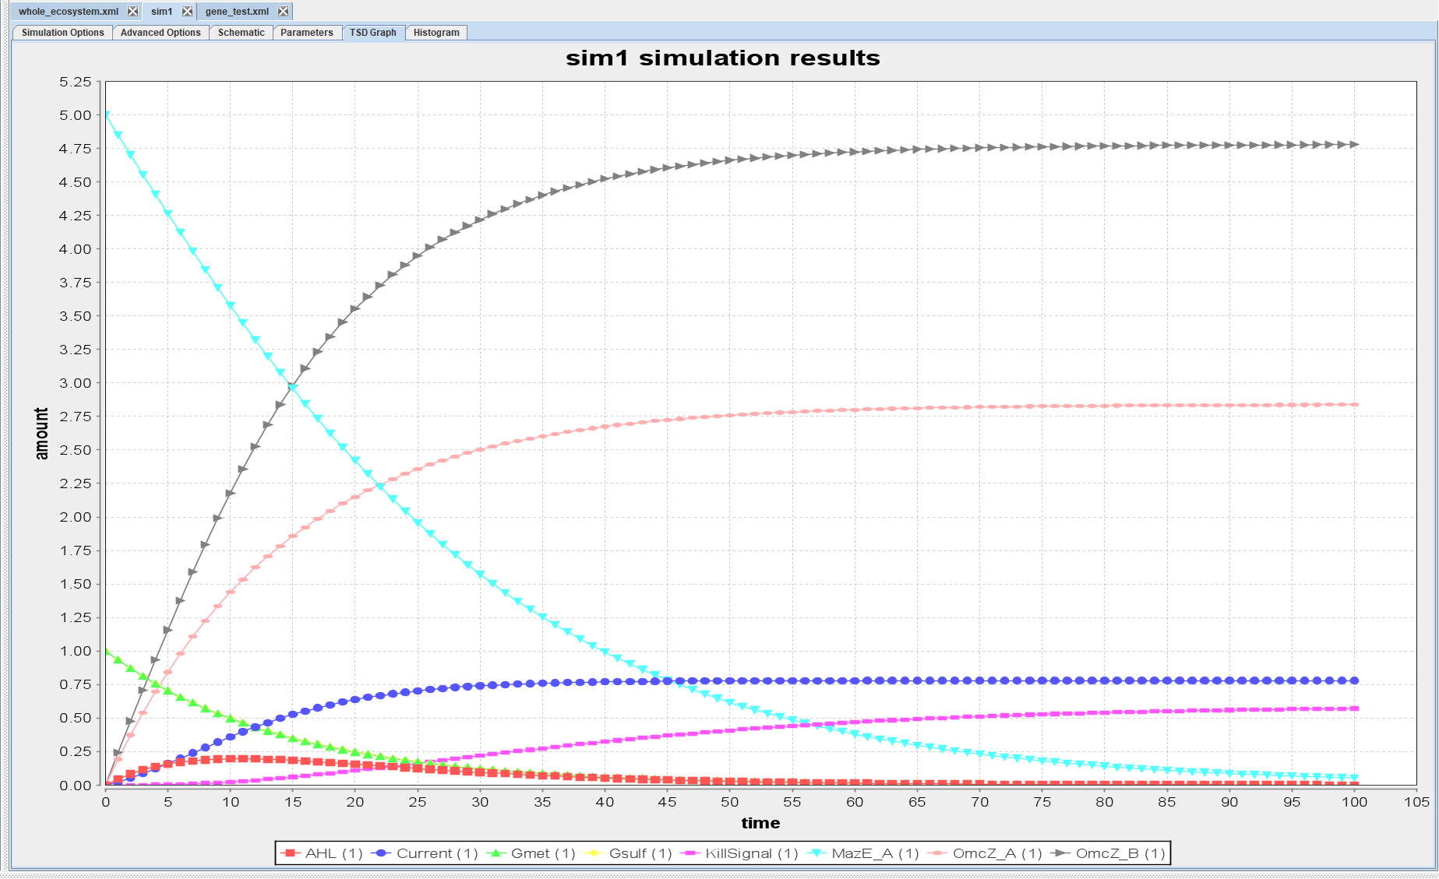
Detailed Functionality: iBioSim
Inserted equations into claude to generate SBML file
Uploaded directly to iBioSIM
Manually Verified
Notes:
WD

Slide 16
Detailed Functionality: iBioSim
Model Identity & Structure
Model ID: "whole_ecosystem_20circuits"
Defines a single shared compartment called "cell" with size = 1
Contains 33 species, 50+ reactions, and 47 parameters
Organized around 7 distinct biological circuits
Each circuit represents a different microbial function or interaction
4 E. coli strains defined as dynamic population species:
Ecoli_K — lysine producer, leucine auxotroph
Ecoli_L — leucine producer, lysine auxotroph
Ecoli_Trp — tryptophan producer, histidine
Ecoli_His — histidine producer, tryptophan
2 Geobacter strains defined as electrogenic organisms:
Gsulf — Geobacter sulfurreducens, Strain A
Gmet — Geobacter metallireducens, Strain B

Slide 17
Detailed Functionality: iBioSim
Metabolite descriptions
Amino acid pools
Nitrogen cycle intermediates
Quorum sensing molecules
Kill switch components
Electron transfer & biosynthesis effects
The parameters (w/ organisms)
E. coli amino acid production rates
E. coli growth rates on cross-fed amino acids
E. coli death rates
Geobacter growth rates
Geobacter death rates
OmcZ expression rates
Quorum sensing rates
Nitrogen cycle rates
Biosynthesis rates

Slide 18
Detailed Functionality: iBioSim
Component Interplay
E. Coli Cross Feeding
Geobacter Electrogenic Co-culture
MazE/MazF Kill Switch
Quorum Sensing (LuxI/LuxR & LuxS
Nitrogen Denitrification Cascade
Biosynthesis Pathways
How the Circuits Connect
Quorum Sensing → Kill Switch:
Gsulf population → AHL → LuxR_AHL → KillSignal → MazF → cell death
Nitrogen Cascade → Geobacter:
NO (from nirS step) → induces extra OmcZ_B → boosts Current output
E. coli → Biosynthesis:
E. coli strains maintain population stability, providing metabolic context for AcetylCoA-driven biosynthesis
Geobacter → Quorum Sensing:
Gsulf produces AHL (LuxI); Gmet produces AI2 (LuxS)
Both signals reflect Geobacter population density
Kill Switch → Geobacter:
When KillSignal threshold is reached, MazF accumulates and kills both Gsulf and Gmet
Reduces current output and OmcZ expression as a consequence

Slide 19
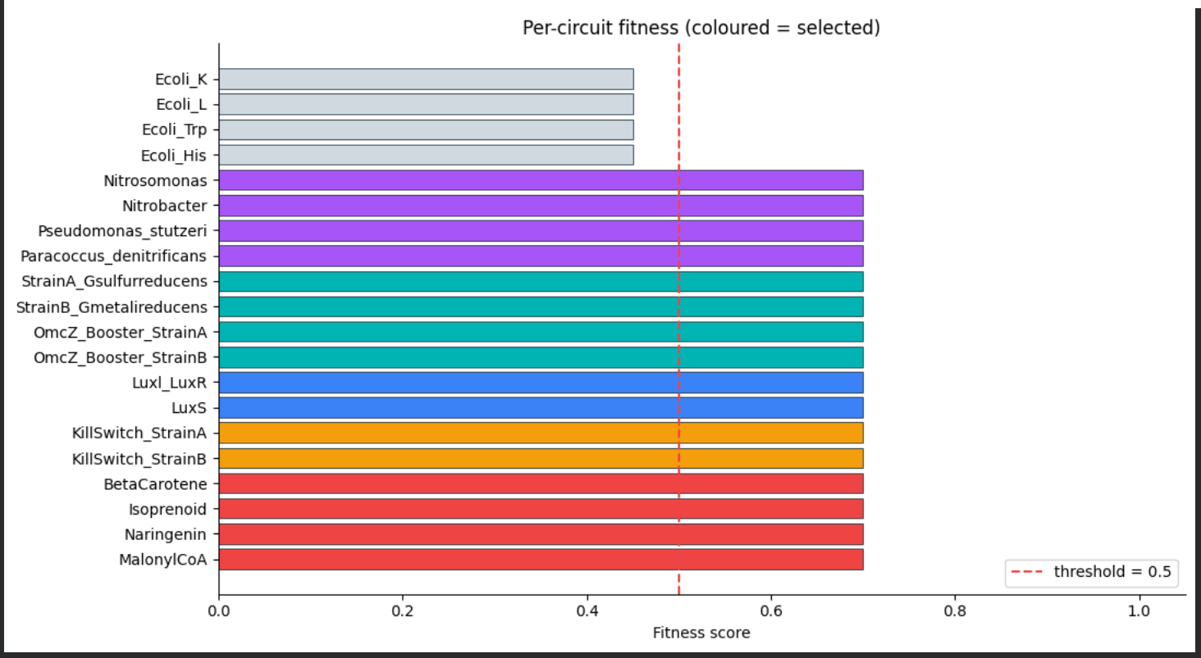
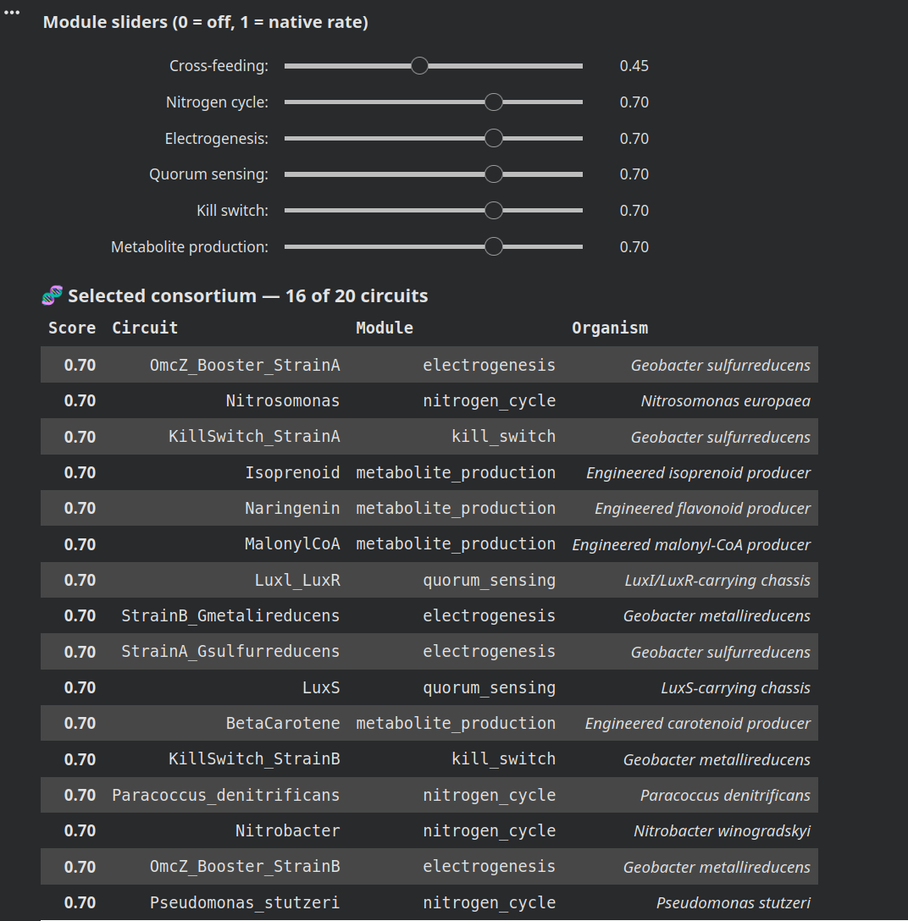
Detailed Functionality: User Application
Circuits library based on SBML file inputs
Genetic circuit reference table
“Species” defines concentrations for each condition
Sliders affect rates for each attribute
ODE and simulation
Selects Consortium
Notes:
WD

Slide 20
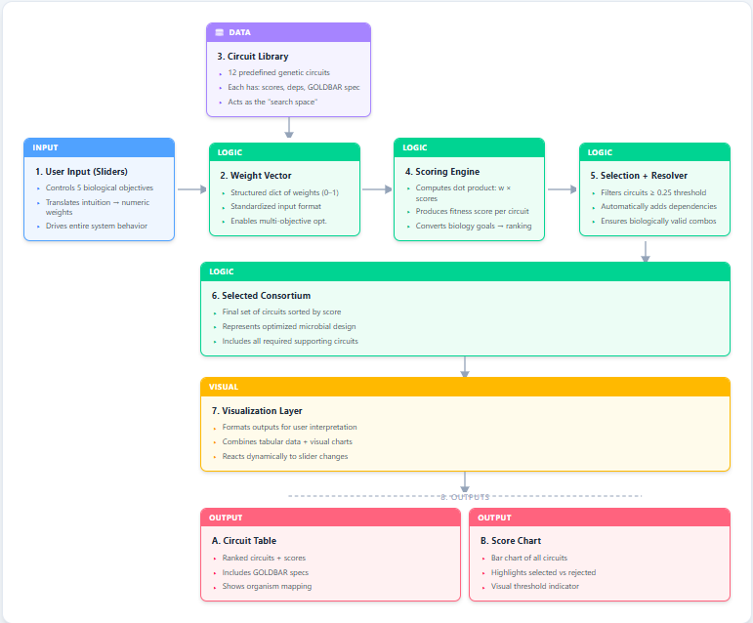
Detailed Functionality: Data Flow Diagram
Notes:
WD

Slide 21
05
Demo

Slide 22
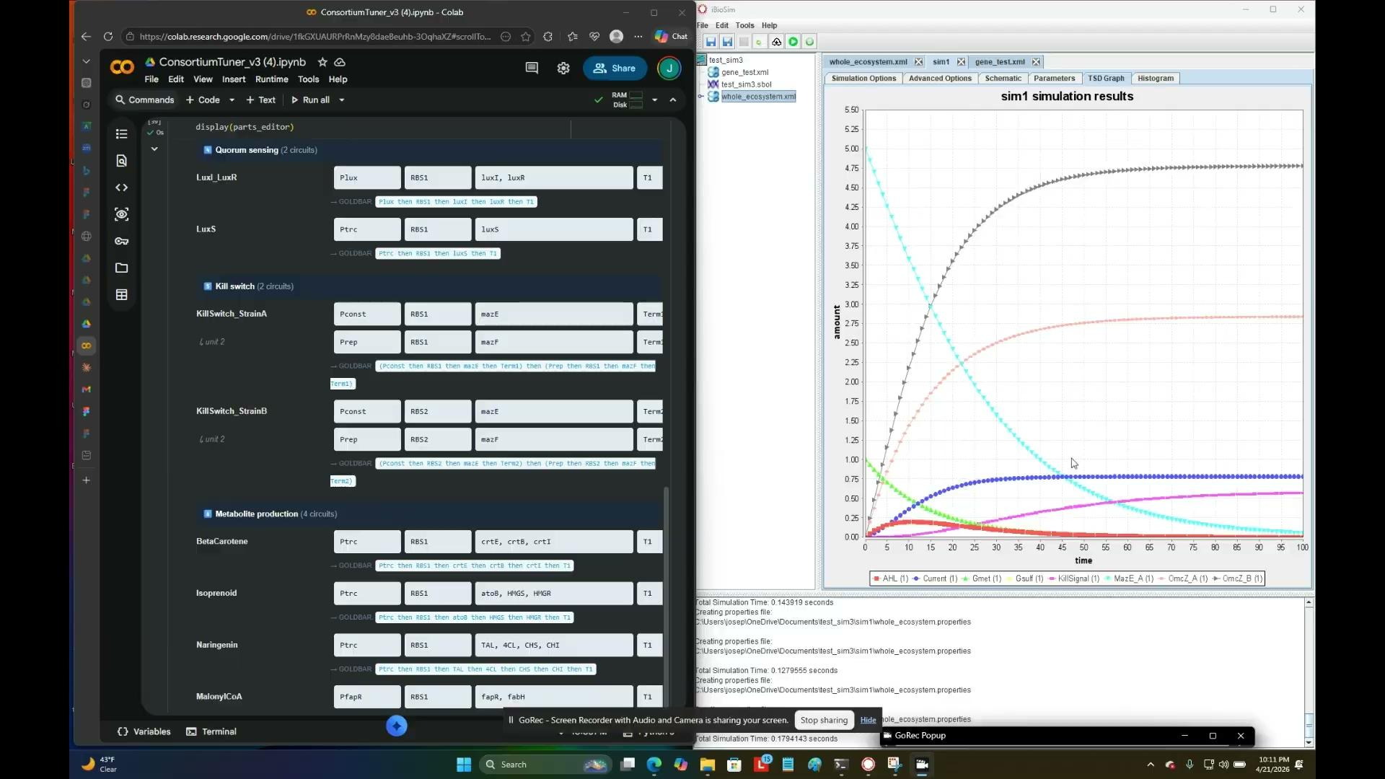
Demo Video

Slide 23
Demo
From iBiosim to GUI
Steps:
Uploaded xml ODE file to claude to remake simulation in python that is adjustable and tunable
Made a GUI that selects the tunable parameters
This knob selection then closes and removes various modified strains to increase or decrease characteristics of sludge of choice

Slide 24
06
Successes & Failures

Slide 25
Analyses
What Went Right
What Went Wrong
Modular Design
Flexible framework allowed circuits to be freely combined across categories
Enabled rapid ecosystem assembly
Biological Grounding
Sludge circuits were drawn from validated literature, reflecting grounded data
Accessible Interface
GUI design made complex ecosystem approachable
Users can easily configure and simulate microbial communities
Organized Structure
Circuit categorization (cross-feeding, dependency, cooperation) clarified design choices
Difficult to Address Complexity
Model connections are extremely diverse and difficult to keep track of
Difficult to Validate
Model assumptions may not hold in real world scenarios
No Standard MFC Models
A lack of existing standards makes industry adoption difficult
Oversimplified Models
Models did not capture full complexity
Data Limitations
Limited quantitative data reduced accuracy weakening the predictive reliability of outcomes
Notes:
WD

Slide 26
Design Tradeoffs
Biological Realism vs. Computational Simplicity
Simplified models kept simulation fast but sacrificed accuracy in metabolic dynamics, may not be accurate to real world behavior
Modularity vs. System Stability
Free circuit combination boosted flexibility in circuits but made ecosystems prone to collapse
User Accessibility vs. Model Complexity
The GUI lowered the learning curve for Users but constrained parameter control
Literature-Based Selection vs. Design Flexibility
Grounding circuits in validated literature ensured biological relevance but narrowed circuit diversity

Slide 27
Potential Improvements
Scoring relies solely on design rules
experimental validation would strengthen predictive confidence
Simulations lack uncertainty quantification
adding stochastic modeling would capture biological variability
The circuit library is static
enabling user defined combinations would expand design space
Dependency rules are manually curated
Integrating automated inference would improve scalability
Slider outputs are deterministic
incorporating sensitivity ranges would better reflect real system dynamics
Expanding circuit categories would increase the platform's biological coverage
Notes:
WD

Slide 28
Who Worked on What
Literature Review: Jaleel
Knox Circuits: Nora & Jon
Simulations: Nora, Jon, Jaleel, William
GUI interface: Nora, Jon, Jaleel, William
Notes:
WD

Slide 29
Thanks!
GitHub:

