Slide 1
Consortium Tuner
By: Nora Elena, Jonathan, Jaleel, William

Slide 2
Table of contents
01
02
03
04
05
06
Goal & Motivation
Short Functionality
Short Specification
Detailed Functionality
Demo
Successes/Failures

Slide 3
01
Goal & Motivation
Notes:
Nora

Slide 4
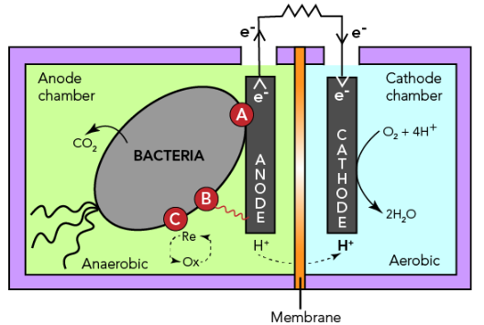
Goal & Motivation
Our objective is to translate real genetic circuits from sludge environments into a configurable simulation platform, allowing users to design ecosystems and assess their stability before implementation

Slide 5
Concrete Example
Application in Wastewater-to-Energy Systems
We engineered a synthetic E. coli–Geobacter co-culture to enable stable electric power generation in micro-bioelectrochemical fuel cells
This directly aligns with the business model of Cambrian Innovation
Current Limitation (Industry Problem)
Cambrian’s Bio-Electrochemical Reactors (BBER) are deployed in:
Breweries
Food processing facilities
However, performance is limited by biological instability:
Microbial populations fluctuate over time
Electrical output becomes inconsistent
Systems require continuous reseeding
Key Innovation — Obligate Cross-Feeding
Engineered dependency between species
Prevents:
Competitive takeover
Community drift
Emergence of non-productive “cheaters”
Result: stable, cooperative, long-term operation
Impact
Produces consistent and reliable electric output
Eliminates need for frequent reseeding
Requires no hardware modification to existing systems
Immediately deployable across Cambrian’s existing industrial sites
Notes:
For our concrete example, we looked at how this system would integrate into a real company - Cambrian Innovation.
Cambrian already deploys bio-electrochemical reactors in breweries and food processing facilities to convert wastewater into energy. However, their main limitation is biological, not mechanical. The native microbial communities fluctuate over time, leading to inconsistent power output and requiring constant reseeding.
Our solution replaces this unstable biology with a designed E. coli – Geobacter co-culture. In this system, E. coli converts organic waste into acetate, which Geobacter then uses to generate electrical current.
Because we engineered an obligate cross-feeding relationship, neither organism can outcompete the other. This eliminates community drift and maintains long-term stability.
As a result, Cambrian can achieve consistent energy production without modifying their existing hardware, making this a directly deployable solution.

Slide 6
02
Short Functionality
Notes:
Nora

Slide 7
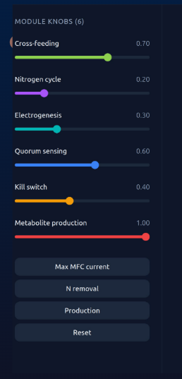
Short Functionality
Simulation Output
Time-evolution of species populations
Stability classification:
Stable / Collapse / Oscillatory
Functional behavior (e.g., current output trends)
Purpose
Enables rapid exploration of how circuit combinations affect ecosystem behavior
GUI
User Inputs (Control Layer)
Six adjustable parameters:
Cross-feeding strength
Quorum sensing intensity
Kill switch activation
Electroactivity level
Metabolic production rate
System Processing
Selects compatible genetic circuits from library
Maps circuits → interaction categories
Constructs ODE-based ecosystem model
Notes:
Nora

Slide 8
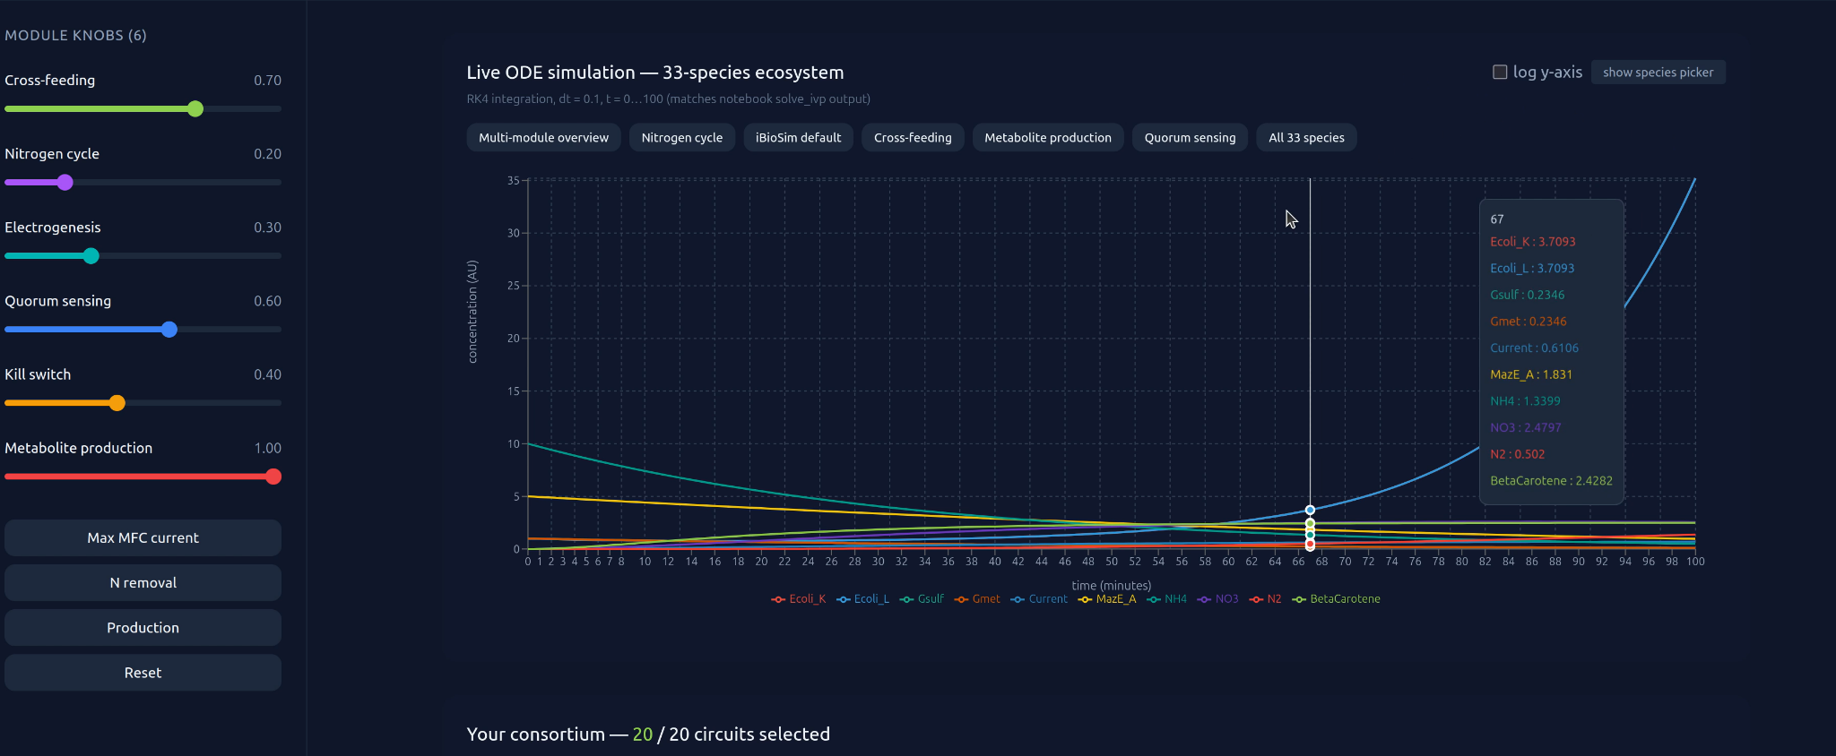
Short Functionality: Image of Gui
Notes:
Nora

Slide 9
03
Short Specification
Notes:
Nora

Slide 10
Short Specification of circuits
Genetic circuits must be from sludge microbial environments
Circuits must map to defined interaction categories:
Auxotrophic cross-feeding
Metabolite production
Metabolite dependency
Cooperation
Each circuit must be representable using standardized components
promoter, RBS, CDS, terminator
The system must support modular selection and combination of multiple circuits
Design Requirements
Circuit selection limited to literature-supported sludge organisms
Biological interactions simplified into abstracted interaction models
Dependence on predefined categories
Limited parameter availability for accurate kinetic modeling
Simulation must remain computationally efficient for real-time use
Design Constraints
System enforces requirements by filtering circuits based on predefined interaction categories and standardized components before simulation
Notes:
Nora

Slide 11
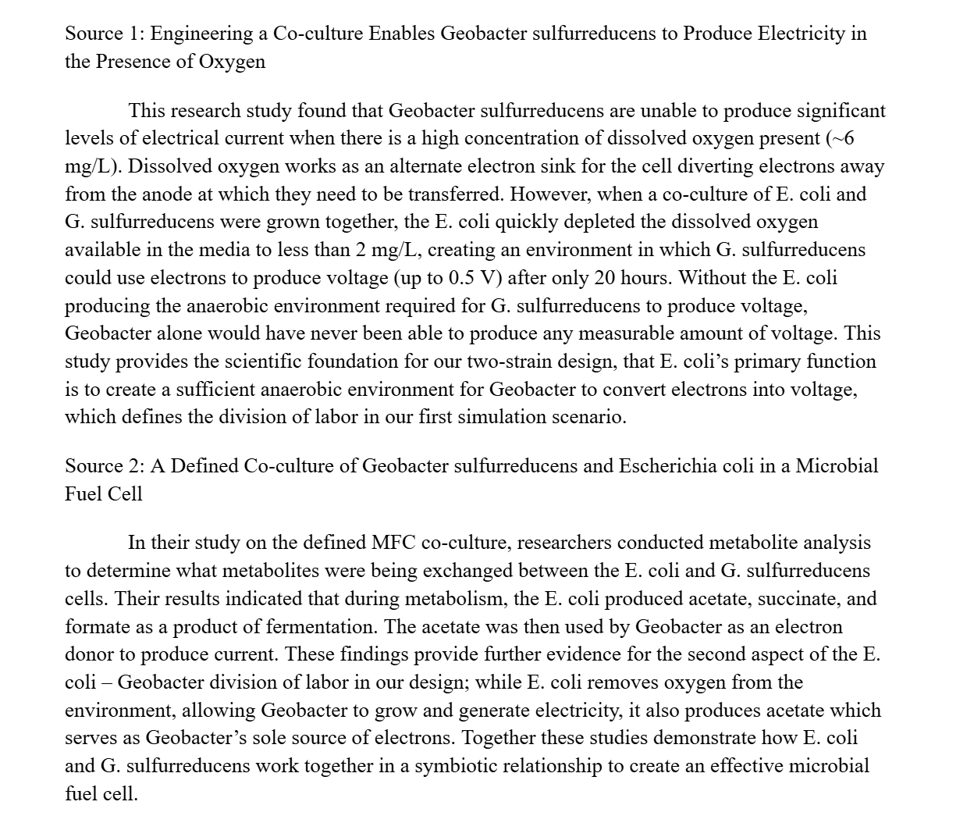
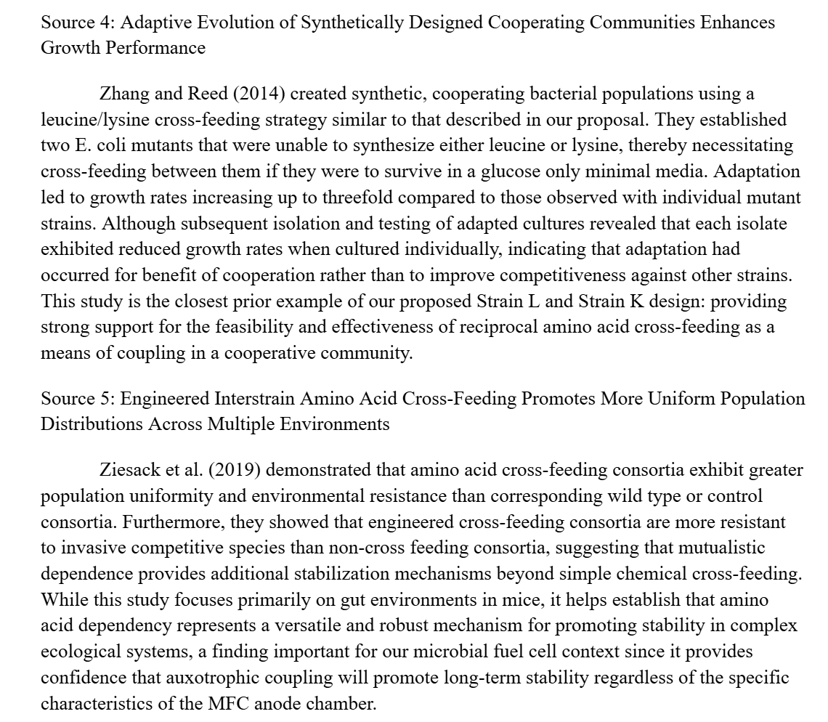
Literature Review that was used for Knox circuits
Notes:
Nora

Slide 12
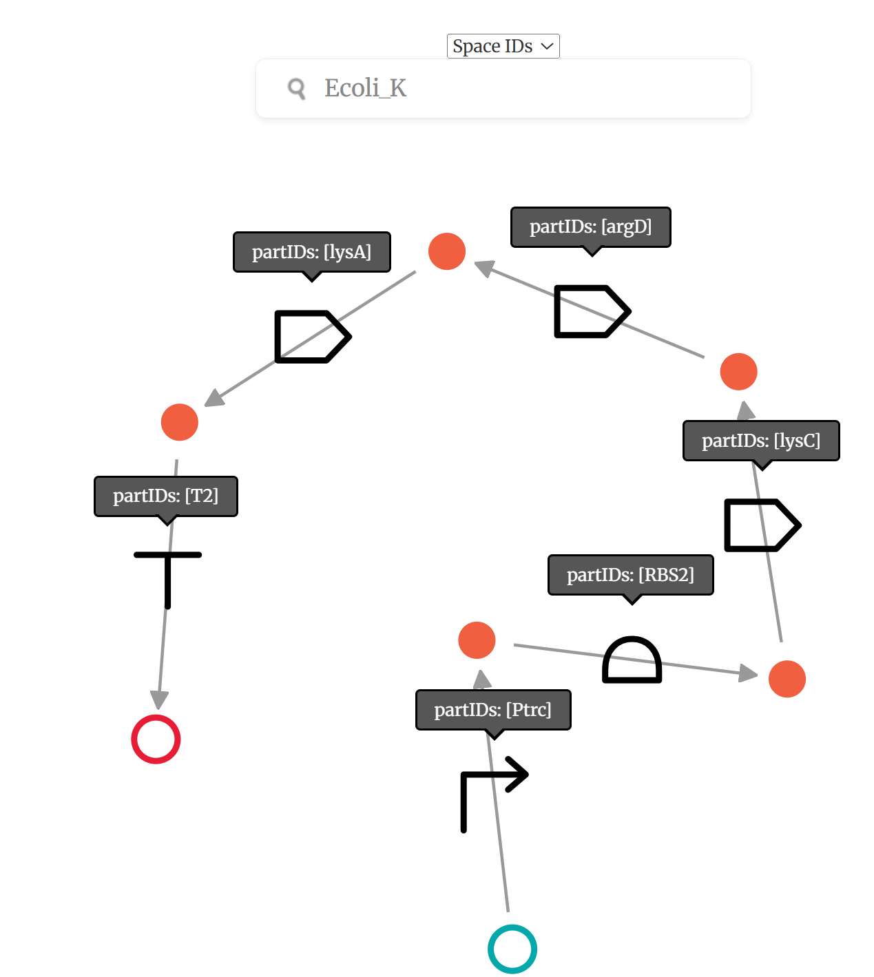
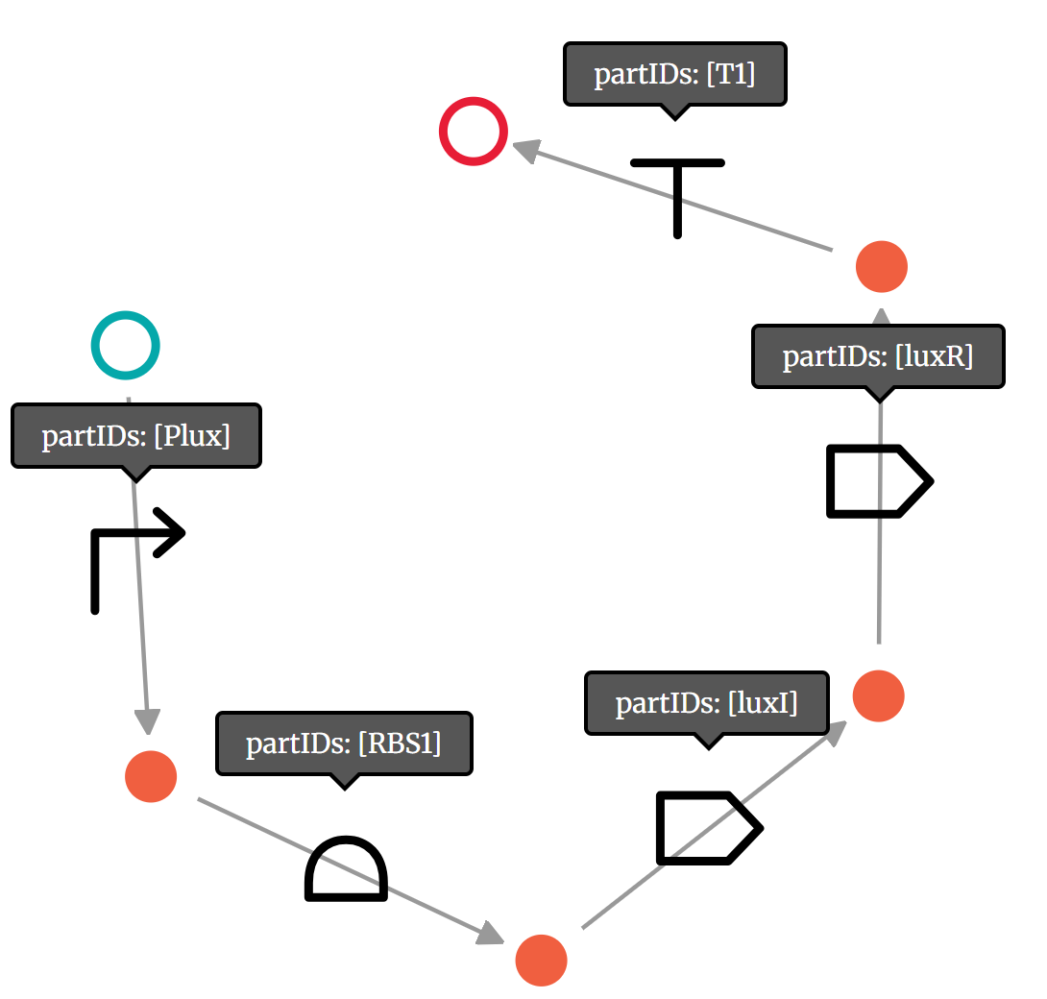
Short Specification: Knox Circuit Examples
Ecoli_K
Luxl_LuxR
Notes:
Nora

Slide 13
04
Detailed Functionality

Slide 14
Step 1) Create the Knox circuits
Step 2) Find the relevant ODEs from goldbar circuits (lit review)
Step 3) Run Claude to make xml file to run simulation in iBioSim
Detailed Workflow for Simulation Creation:
Notes:
WD

Slide 15
Detailed Functionality: Parameters
Cross-feeding — obligate amino acid mutualism
Kill switches — biosafety via toxin-antitoxin
Electroactivity — EET cytochrome current boost
Nitrification — ammonia to nitrate oxidation
Denitrification — nitrate to N₂ reduction
Production — valuable secondary metabolite biosynthesis
Quorum sensing — cell-density-dependent coordination

Slide 16
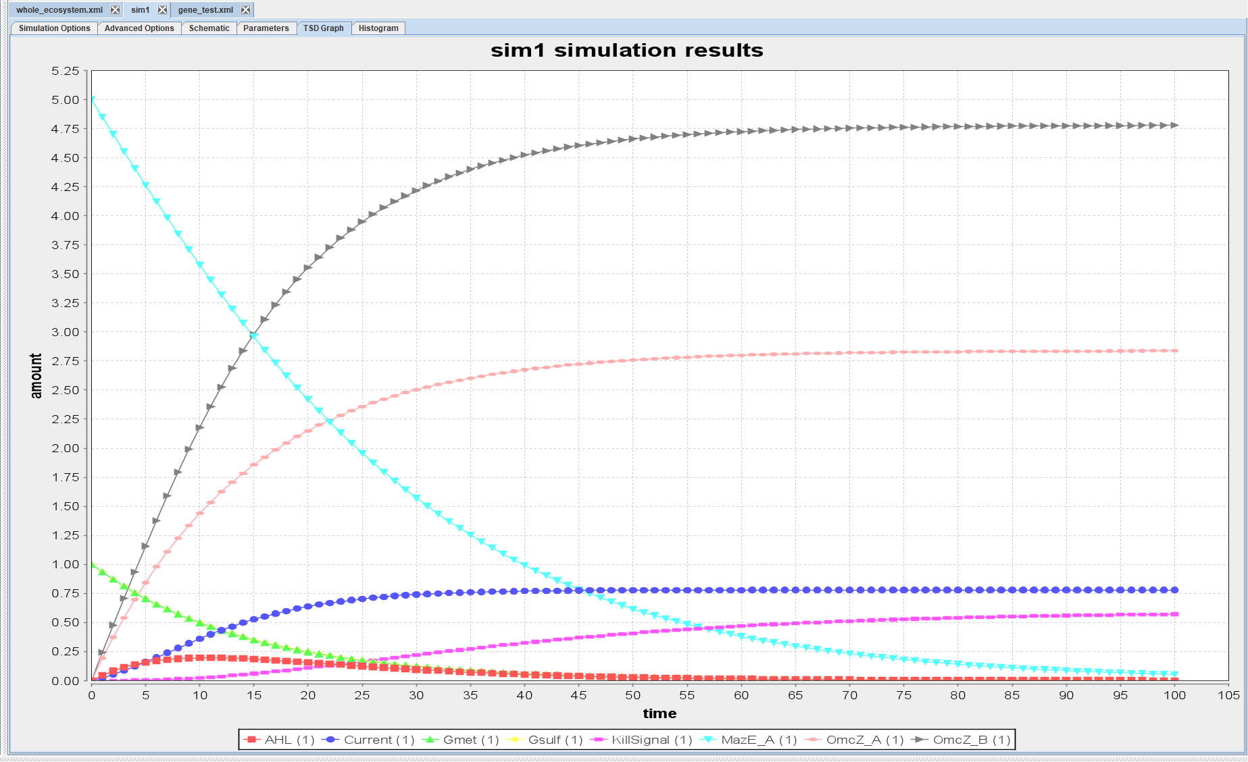
Detailed Functionality: iBioSim
Inserted equations into claude to generate SBML file
Uploaded directly to iBioSIM
Manually Verified
Notes:
WD

Slide 17
Detailed Functionality: iBioSim
How the Circuits Connect
Quorum Sensing → Kill Switch:
Gsulf population → AHL → LuxR_AHL → KillSignal → MazF → cell death
Nitrogen Cascade → Geobacter:
NO (from nirS step) → induces extra OmcZ_B → boosts Current output
E. coli → Biosynthesis:
E. coli strains maintain population stability, providing metabolic context for AcetylCoA-driven biosynthesis
Geobacter → Quorum Sensing:
Gsulf produces AHL (LuxI); Gmet produces AI2 (LuxS)
Both signals reflect Geobacter population density
Kill Switch → Geobacter:
When KillSignal threshold is reached, MazF accumulates and kills both Gsulf and Gmet
Reduces current output and OmcZ expression as a consequence
Component Interplay
E. Coli Cross Feeding
Geobacter Electrogenic Co-culture
MazE/MazF Kill Switch
Quorum Sensing (LuxI/LuxR & LuxS)
Nitrogen Denitrification Cascade
Biosynthesis Pathways

Slide 18
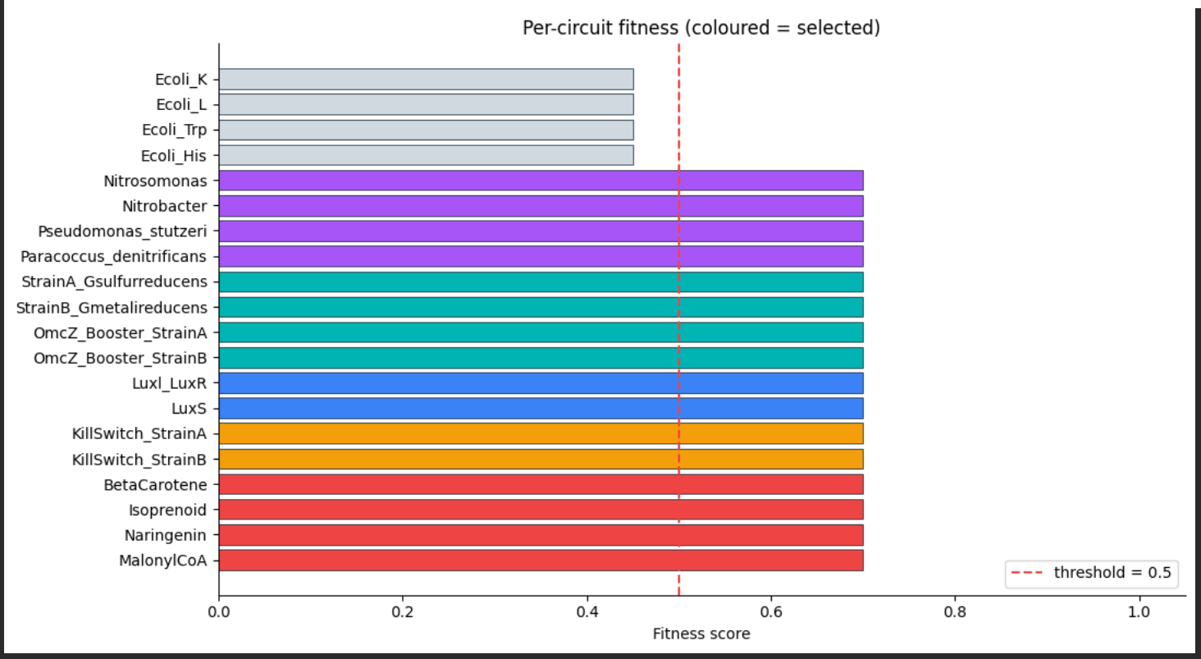
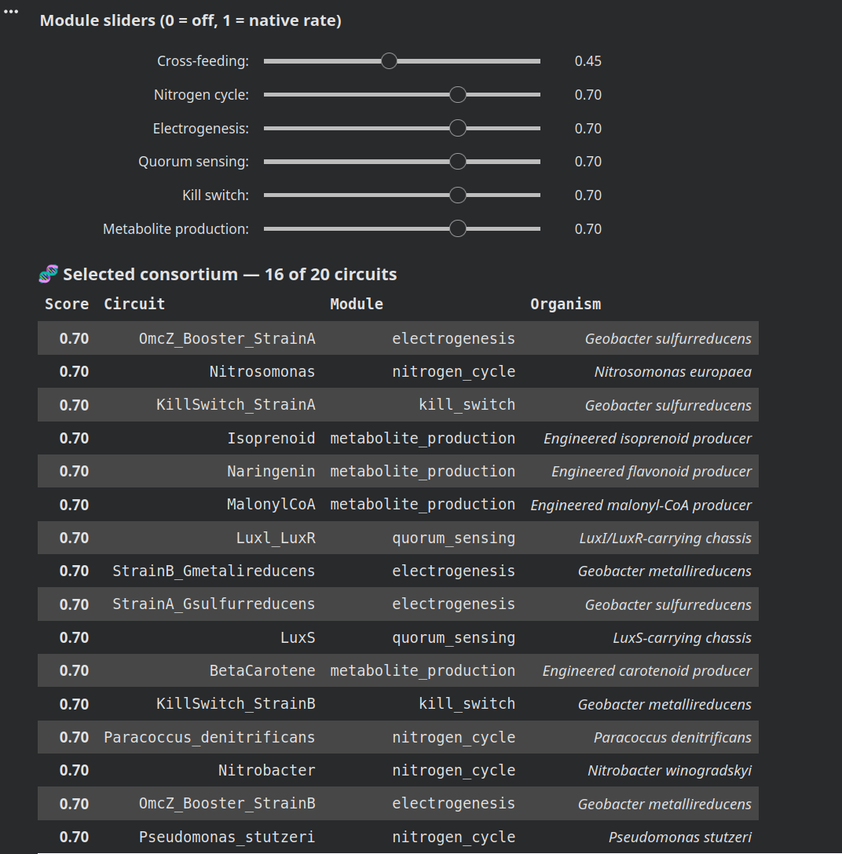
Detailed Functionality: User Application
Circuits library based on SBML file inputs
Genetic circuit reference table
“Species” defines concentrations for each condition
Sliders affect rates for each attribute
ODE and simulation
Selects Consortium
Notes:
WD

Slide 19
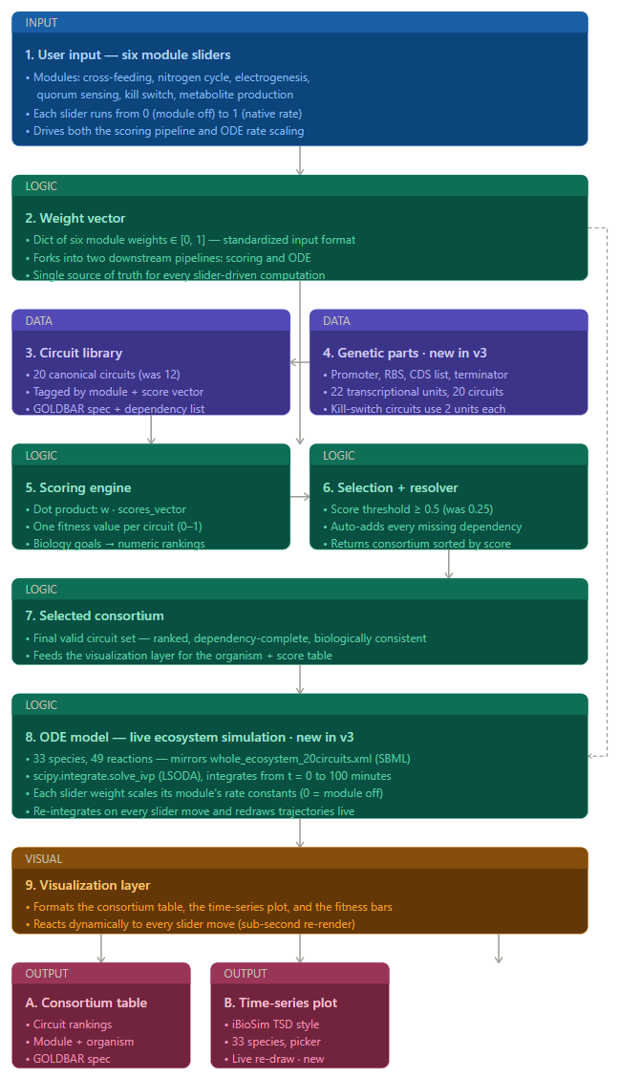
Detailed Functionality: Data Flow Diagram
***See next sections, in next slide
Notes:
WD

Slide 20
Detailed Functionality: Data Flow Diagram Cont.
***See next sections, in next slide
Notes:
WD

Slide 21
Detailed Functionality: Data Flow Diagram Cont.
Notes:
WD

Slide 22
05
Demo

Slide 23

Demo Video

Slide 24
06
Successes & Failures

Slide 25
Analyses
What Went Right
What Went Wrong
Modular Design
Flexible framework allowed circuits to be freely combined across categories
Enabled rapid ecosystem assembly
Biological Grounding
Sludge circuits were drawn from validated literature, reflecting grounded data
Accessible Interface
GUI design made complex ecosystem approachable
Users can easily configure and simulate microbial communities
Relevant Literature
Plenty of relevant literature was found for our project, including relevant equations
Difficult to Address Complexity
Model connections are extremely diverse and difficult to keep track of
Difficult to Validate
Model assumptions may not hold in real world scenarios
No Standard MFC Models
A lack of existing standards makes industry adoption difficult
Oversimplified Models
Models did not capture full complexity
Data Limitations
Limited quantitative data reduced accuracy weakening the predictive reliability of outcomes
Notes:
WD

Slide 26
Design Tradeoffs
Biological Realism vs. Computational Simplicity
Simplified models kept simulation fast but sacrificed accuracy in metabolic dynamics
Modularity vs. System Stability
Free circuit combination boosted flexibility in circuits but made ecosystems prone to collapse
User Accessibility vs. Model Complexity
The GUI lowered the learning curve for Users but constrained parameter control
Literature-Based Selection vs. Design Flexibility
Grounding circuits in validated literature ensured biological relevance but narrowed circuit diversity

Slide 27
Potential Improvements
Scoring relies solely on design rules
experimental validation would strengthen predictive confidence
Simulations lack uncertainty quantification
adding stochastic modeling would capture biological variability
The circuit library is static
enabling user defined combinations would expand design space
Dependency rules are manually curated
Integrating automated inference would improve scalability
Slider outputs are deterministic
incorporating sensitivity ranges would better reflect real system dynamics
Expanding circuit categories would increase the platform's biological coverage
Notes:
WD

Slide 28
Who Worked on What
Literature Review: Jaleel
Knox Circuits: Nora & Jon
Simulations: Nora, Jon, Jaleel, William
GUI interface: Nora, Jon, Jaleel, William
Notes:
WD

Slide 29
Thanks!
GitHub:
millerjd-netizen/Microbial_Cell_Ecosystem: Microbial Cell Ecosystem: a terminal-first E. coli + Geobacter co-culture design recommender with KNOX-inspired circuit selection, Tellurium verification, uncertainty-aware scoring, and optional calibration support

