Slide 1
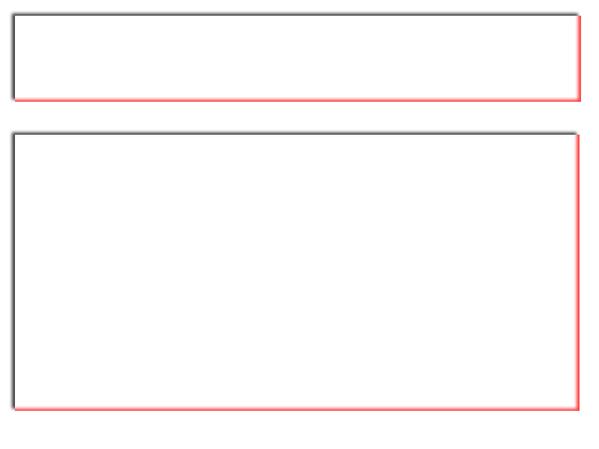
Payment Checklist
Jared Berkowitz berkowij1@hawkmail.newpaltz.edu
Lee Miller millerl2@hawkmail.newpaltz.edu

Slide 2
Payment Checklist
Payment Checklist is an app to keep track of bills payment, payments to and from friends, and income.
This app is useful for anyone who needs help keeping track of payments, such as paying your bills or paying your friends using popular apps like Venmo, Facebook Pay, or Samsung Pay.
Our app provides an interface for the user to keep track of any and all payments in a singular centralized app.

Slide 3
Project Goals

Slide 4
Design Strategy
The main page shows all entries in the list
The app will sort entries based on type (All, Debt, Income, Settled)
  All: all entries saved
  Debt: payments owed (negative entries)
  Income: money coming in (positive entries)
  Settled: payments checked off
Users can delete entries
Users can check off entries (checked off entries go under “Settled”)
Each entry has a field for: Name, Description, Amount, Positive or Negative, Date, Time of Entry, Date and Time Due.
  Negative entries are debts
  Positive entries are income

Slide 5
Design Unknowns/Risks

Slide 6
Implementation Schedule

