Slide 1

Data Structures and Analysis (COMP 410)
David Stotts
Computer Science Department
UNC Chapel Hill

Slide 2
The Big Six Functions (advanced)
0. data (types, simple information)
1. data storage (variables, assignment)
2. data retrieval (expressions, evaluation)
3. repetition (loops)
4. decision making (conditionals)
5. procedure abstraction (functions)
6. data abstraction (arrays)
7. objects: all-the-above, wrapped up

Slide 3
Function call
We are by now familiar with calling a function to get some work done
distance = calcMiles ( speed, time );
One function can call another function to help get its own job done
We are already doing this…
myMain function calls your other functions

Slide 4
Trace Calls and Returns
function myMain() {
var result = cube(4) ;
alert(result);
return result;
}
function cube (n) { return n*n*n ; }
myMain function is called when button clicked
cube function is called by myMain
cube returns
alert function is called by myMain
alert returns

Slide 5
Calling Tree
function calls create a “tree” of memory maps
(“root” at top, “leaves” at the bottom)
myMain ( )
alert()
cube()
call
(from button)
return
(to HTML page)
return
return
call
call
alert memory map goes away
Cube memory map goes away

Slide 6
Another Example
function myMain() {
var result = mash(3) ;
alert(result);
return result;
}
function mash (n) { return cube(2*n) + 5; }
function cube (n) { return n*n*n ; }
calls myMain
myMain calls mash
mash calls cube
cube returns
then mash returns
3 active
function calls,
3 active
memory maps

Slide 7
Calling Tree
return
(to HTML page)
myMain ( )
mash()
alert()
cube()
call
(from button)
call
return
return
mash memory map goes away
call
alert memory map goes away
call
return
Cube memory map goes away

Slide 8
So … Functions can call Functions
Ok, it’s brain bending time
Can a function call itself ?
Yes it can, and it is very useful
A function that calls itself is “recursive”
Computing with a self-calling function is called “recursion”

Slide 9
Recursion
Root of “recursive” is “occur again”
A recursive function has a call to its own name in its code body
function doTask ( n ) {
…
x = doTask (n-1); // parameter is smaller
…
return result;
}

Slide 10
Recursion
Computer scientists love recursion. We are twisted people. Easy to entertain.
It has been known for programming books to include a joke entry in their index like this:
Recursion, see Recursion.
Page 269, index of C language manual says
recursion 86, 139, 141, 182, 202, 269

Slide 11
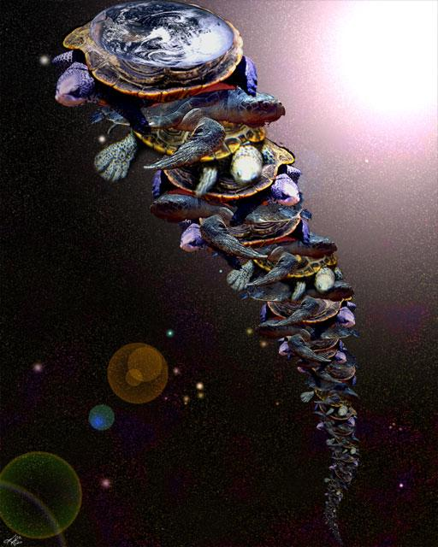
In our favored version, an Eastern guru affirms that the earth is supported on the back of a tiger. When asked what supports the tiger, he says it stands upon an elephant; and when asked what supports the elephant he says it is a giant turtle. When asked, finally, what supports the giant turtle, he is briefly taken aback, but quickly replies "Ah, after that it is turtles all the way down."
Antonin Scalia, footnote in Rapanos vs. United States, 2006
A well known “myth” recursive tall turtle tale

Slide 12
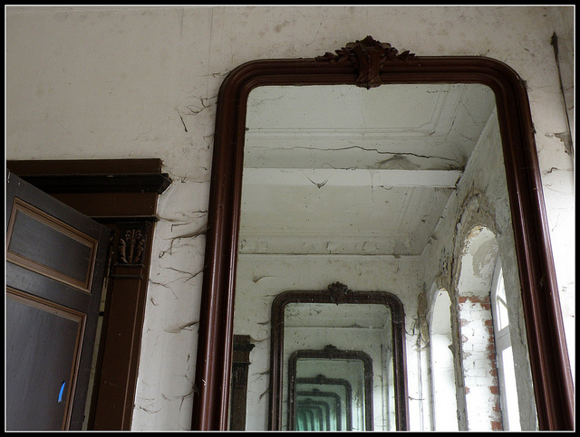
"What is reflected in a mirror
which is reflected
in a mirror?"

Slide 13
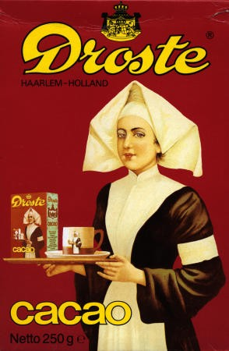

This is infinite recursion…
Not quite what we want in programming

Slide 14
Consider the call “tree”
myMain
calls doTask
calls doTask
calls doTask
calls doTask
calls doTask
calls doTask
…. its turtles all the way down
the calling has to stop somehow…
or the program will run forever

Slide 15
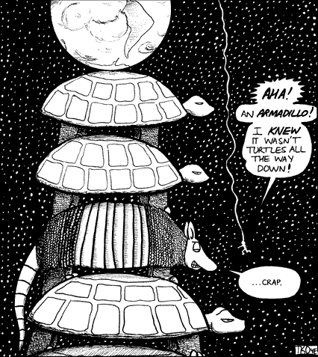
We like finite
We need the recursion to end at some point
We need an armadillo in the pile

Slide 16
Where is the armadillo?
We write a recursive function by following a very specific pattern
base case, then recursive case
Base case: the problem is so small the solution is easy with no recursive call.
Base case ends the recursion
Base case is our armadillo
Recursive case: we call the function again but the parameter makes a “smaller” problem.
Recursion stops when the smaller problem becomes the base case

Slide 17
Factorial in Math
Classic recursive definition… has base case and recursive case… “recurrence equation” in math
fact(1) = 1 (the base case)
fact(2) = 2 * 1 = 2 * fact(1)
fact(3) = 3 * ( 2 * 1 ) = 3 * fact(2)
fact(4) = 4 * 3 * ( 2 * 1 ) = 4 * fact(3)
etc.
In general
fact(n) = 1 , if n is 1 base case
n * fact ( n-1 ) , otherwise recurrence

Slide 18
Factorial program
Coding pattern reflects the parts of the definition
function factorial ( n ) {
if (n==1) return 1 ; // base case
// the armadillo at the bottom
else {
// the recursive call
// the parameter must be smaller
// we solve a smaller problem, then use
// that result to solve the current problem
return n* factorial ( n - 1 ) ;
}
}

Slide 19
Summation program
Coding pattern reflects the parts of the definition
function sum ( n ) {
if (n==1) return 1 ; // base case, the armadillo
else { return n + sum ( n - 1 ) ; }
}
function sum ( n ) {
if (n==1) return 1;
if (n==2) return 3;
if (n==3) return 6;
return n+sum(n-1);
}

Slide 20
Summation program
Coding pattern reflects the parts of the definition
function sum ( n ) {
switch (n) {
case 1: return 1; // armadillo
case 2: return 3; // another armadillo
case 3: return 6; // dillo
default: return n + sum(n-1); // recursion
}
}

Slide 21
Iteration = Recursion
Recursion is a notational convenience
It does not create new computational power
Any loop can be expressed as a recursion
and…
Any recursion can be expressed as a loop

Slide 22
Iteration = Recursion
function sum ( n ) { // non recursive
var acc = 0;
for (var i=1; i<=n; i++) {
acc = acc + i ;
}
return acc;
}
function sum ( n ) { // recursive
if (n==1) return 1 ;
return n + sum(n-1) ;
}

Slide 23
Iteration == Recursion
function factorial ( n ) { // non recursive
var acc = 1;
for (var i=1; i<=n; i++) {
acc = acc * i ;
}
return acc;
}
function factorial ( n ) { // recursive
if (n==1) return 1 ;
return n * factorial(n-1) ;
}

Slide 24
Run-time System
The “insides” of a programming language…
the mechanisms needed to make abstractions like variables, objects, function definitions, function calls, scope… make them work and deliver results when the code is executed
Two main dynamic memory “piles”:
-- The Stack (func call-return management)
-- The Heap (for “new” calls, objects)
Function calls need what we refer to as a “call frame” or “stack frame” or an “activation record”

Slide 25
Call Frame
Every method/function has a call frame… a template for the dynamic memory needed for the function to execute
Frame contains space for all parameters, all local variables, bookkeeping information like return address (where is the code calling the function)
When a function is called, a frame is allocated from the runtime stack

Slide 26
Call Frame
function factorial ( n ) {
var tmp, k, x;
if (n==1) return 1 ;
tmp = n * factorial(n-1) ;
return tmp;
}
x value
k value
local vars
tmp value
return address
138764225…
parameters
n value
Every time factorial is called, a call frame for that call is added to the run-time stack
The call frame is popped off the run-time stack when the call to factorial does a “return”

Slide 27
tmp
Call Stack
factorial call
ret addr
n 1
function main ( ) {
var K = 4;
var res;
res = factorial ( K );
alert(res);
}
function factorial ( n ) {
var tmp;
if (n==1) return 1 ;
tmp = n * factorial(n-1) ;
return tmp;
}
1
tmp
factorial call
ret addr
n 2
2
tmp
factorial call
ret addr
n 3
6
tmp
factorial call
ret addr
n 4
res
24
is pop a call frame off the call stack
K 4
main call
. . .
. . .

Slide 28
Call Stack
function main ( ) {
var K = 4;
var res;
res = factorial ( K );
alert(res);
}
function factorial ( n ) {
var tmp;
if (n==1) return 1 ;
tmp = n * factorial(n-1) ;
return tmp;
}
locals…
alert call
ret addr
msg “24”
res
24
K 4
main call
. . .
. . .

Slide 29
The Heap
The Heap is a “pool” of memory, chunks of which can be dynamically allocated to your program (as it runs)
No systematic discipline for allocating/deallocating, such as we do in the run-time stack (LIFO)
Very possible for space to be allocated in the heap during a function call, and then still be used in the program when the call stack is gone (after function return)
When / how ?
TCell tc = new TCell( );
// space for the object comes out of heap
// variable “tc” contains pointer to (address of) the
// new heap memory chunk

Slide 30
The Heap
When / how ?
function main ( ) {
TCell tcm;
tcm = objMaker( ) ;
}
function objMaker ( ) {
TCell tc = new TCell( );
TCell tx = new TCell( );
return tc;
}
TCell sized heap memory
fields
methods
. . .
fields
tx
methods
tc
. . .
objMaker call
ret addr
objMaker return
TCell sized heap memory
. . .
tcm
main call
. . .
. . .
Call stack

Slide 31
The Heap
When / how ?
function main ( ) {
TCell tcm;
tcm = objMaker( ) ;
}
function objMaker ( ) {
TCell tc = new TCell( );
TCell tx = new TCell( );
return tc;
}
TCell sized heap memory
fields
No way to access this object, it is
now “garbage”
methods
. . .
fields
methods
. . .
TCell sized heap memory
tcm
main call
. . .
. . .
Call stack

Slide 32
Program Memory Use
class vars, globals, static (writable)
stack
heap
available
literals (read-only)
4th call frame
code instructions
object
3rd call frame
static
2nd call frame
object
main call frame
allocated
smaller objects

Slide 33
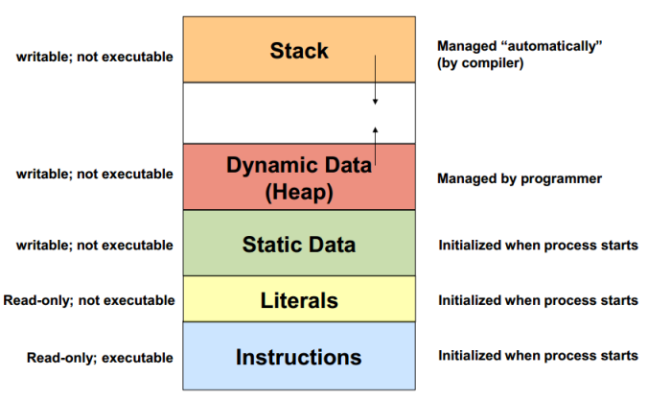
One Physical RAM Space

Slide 34
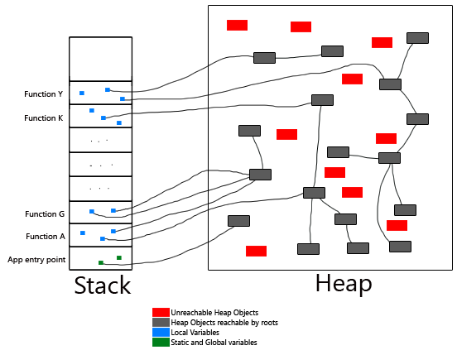
Stack refs into Heap

Slide 35
Heap Managment
Fragmentation
As execution proceeds, object refs are lost
methods return, call frames popped off run-time stack, local object vars are gone
heap fills with unreachable chunks/objects
C: manual heap management
malloc gives heap space (in bytes)
free must be called to return space to heap
Forgetting to call free causes “memory leaks”

Slide 36
Garbage Collection
stack
heap
unallocated
Java:
semi-auto heap management
new gives space big enough for object of class
no giving it back… garbage collection sweeps up unreachable chunks, consolidates heap into two used and open chunks
unreachable
stack
heap
After garbage collection
unallocated

Slide 37
Recursion with LIST
A LIST can be defined recursively
LIST is
-- null
-- or [ val ] → LIST
[ beta ] → [ theta ] → [ alpha ] → [ gamma ]
So a function F can process a LIST by dealing with the head item, and then calling the function F recursively , passing in the “rest of” the LIST as a LIST itself.
car
head
cdr
rest
from LISP

Slide 38
Recursion with LIST
Just a note…
We did not deal with LIST recursively
It’s so easy to do iteratively
No worries on blowing out the run time stack
TREE is different… code in text is recursive

Slide 39
Recursion with TREE
TREE is
-- value (root)
-- left TREE (child)
-- right TREE (child)
insert(nVal) {
if (nVal==value) return false;
if (nVal<value) {
if (L!==null) L.insert(nVal)
else { // add new node as L } }
if (nVal>value) {
if (R!==null) R.insert(nVal)
else { // add new node as R } }
value
( or TREE is null )
value
L, TREE
L, TREE
R, TREE
R, TREE

Slide 40
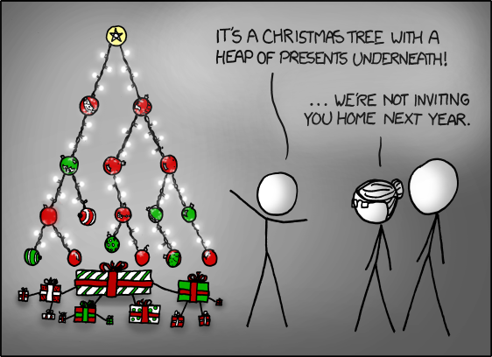

Slide 41
function main ( ) {
var x = getUserInput( );
var res = factorial(x);
print(res);
}
function factorial ( n ) {
if (n<=1) return 1;
return n * factorial(n-1);
}

