Slide 1

Data Structures and Analysis (COMP 410)
David Stotts
Computer Science Department
UNC Chapel Hill

Slide 2
Basic Algorithm Complexity
(Big-Oh)

Slide 3
Complexity
Sometimes an algorithm will solve a problem but not be practical to use in real situations (BubbleSort anyone?)
We need a way of comparing the efficiency or complexity of algorithms
We would like to have general categories that are similar in their ability to be applied to practical problems,
yet allow “unimportant” differences between different algorithms in a category

Slide 4
“Big Oh”
We do this with a notation usually referred to as “Big Oh” (or “Big O”)
We will use Big O to describe how fast the run-time grows as the size of a problem grows
Problem size is usually the amount of data that is to be processed… length of a list, for example, or number of items that need to be sorted

Slide 5
“Big Oh”
Consider an algorithm we have implemented, and we run it against lists of different sizes… get this data:
N (items) Time (msec)
2 2
3 3
4 4
5 5
8 8
16 16
32 32
128 128
Linear
2 4 8 16 32

Slide 6
“Big Oh”
Consider an algorithm we have implemented, and we run it against lists of different sizes… get this data:
N (items) Time (msec)
2 4
3 9
4 16
5 25
8 64
16 256
32 1024
128 16384
Squared
Grows faster than linear
2 4 8 16 32

Slide 7
“Big Oh”
Consider an algorithm we have implemented, and we run it against lists of different sizes… get this data:
N (items) Time (msec)
2 4
3 6
4 8
5 10
8 16
16 32
32 64
128 256
Linear??
Grows faster, but not like squared
2 4 8 16 32

Slide 8
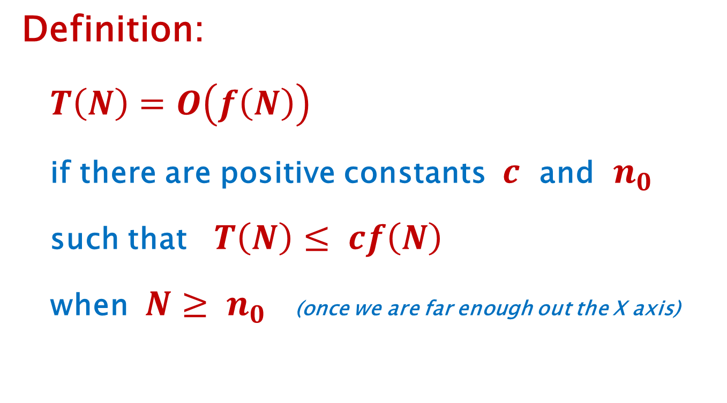
“Big Oh”
Definition:
$T\left(N\right)=O\left(f\left(N\right)\right)$
if there are positive constants $c$ and $n_{0}$
such that $T\left(N\right)≤ cf\left(N\right)$
when $N≥ n_{0}$ (once we are far enough out the X axis)

Slide 9
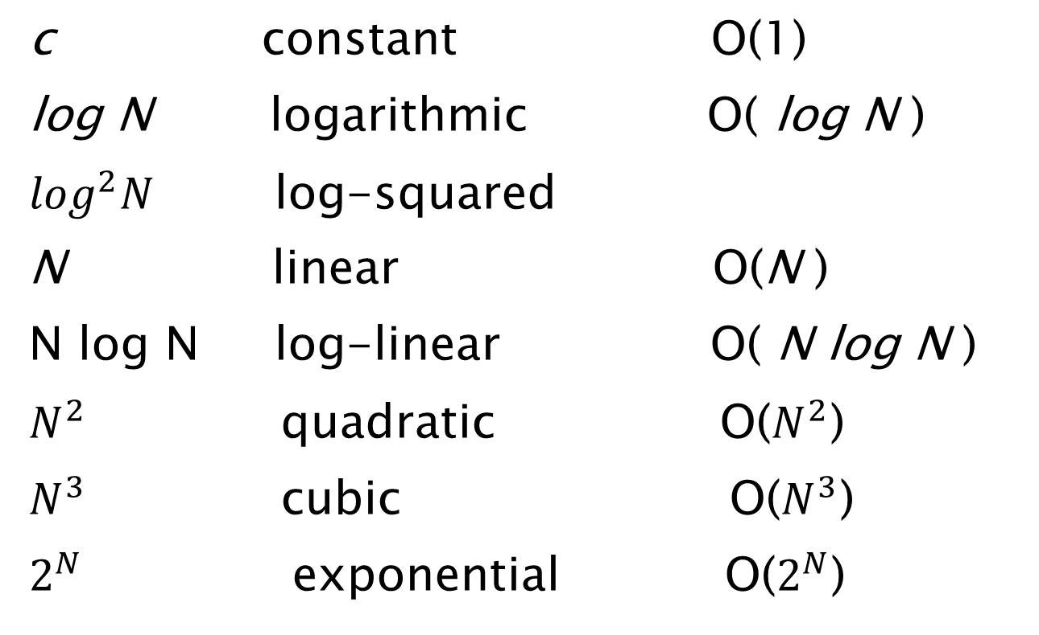
Big-Oh Categories
c constant O(1)
log N logarithmic O( log N )
$\log^{2}N$ log-squared
N linear O(N )
N log N log-linear O( N log N )
$N^{2}$ quadratic O($N^{2}$)
$N^{3}$ cubic O($N^{3}$)
$2^{N}$ exponential O($2^{N}$)

Slide 10
Complexity Curve Comparison
http://science.slc.edu/~jmarshall/courses/2002/spring/cs50/BigO/index.html
Beginners Guide to Big-Oh

Slide 11
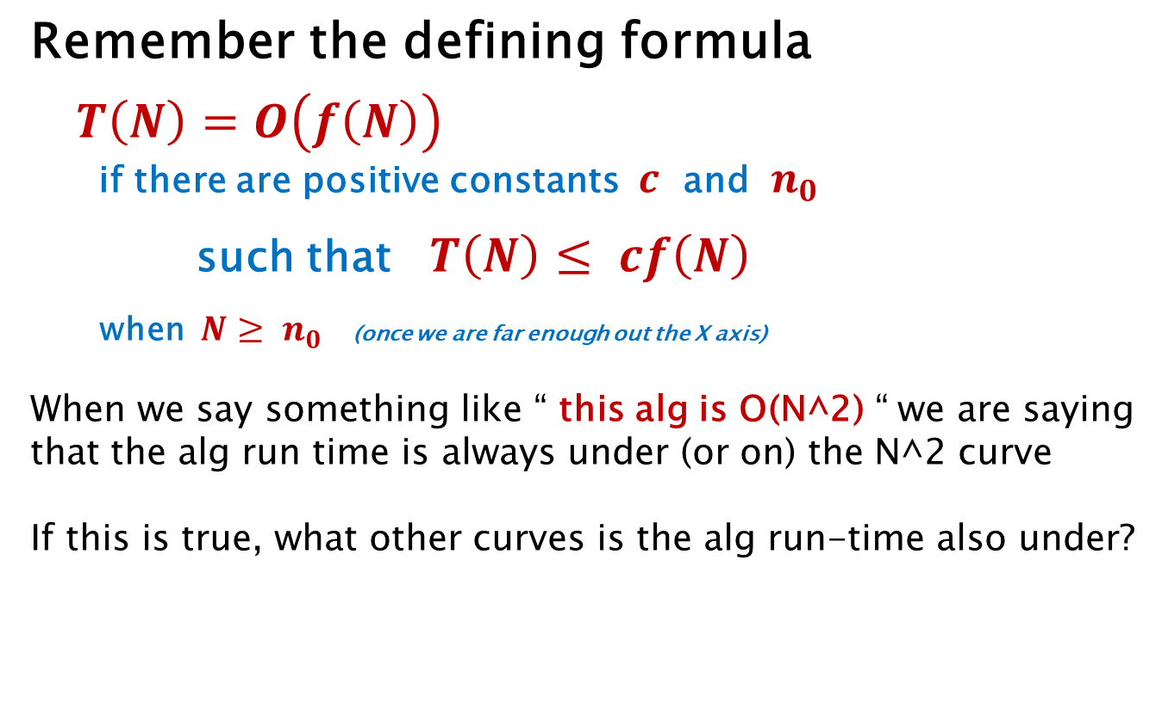
Big O is an Upper Bound
Remember the defining formula
$T\left(N\right)=O\left(f\left(N\right)\right)$
if there are positive constants $c$ and $n_{0}$
such that $T\left(N\right)≤ cf\left(N\right)$
when $N≥ n_{0}$ (once we are far enough out the X axis)
When we say something like “ this alg is O(N^2) “ we are saying that the alg run time is always under (or on) the N^2 curve
If this is true, what other curves is the alg run-time also under?
5N^2, N^3, N^5, 15*(2^N), N!, etc.

Slide 12
Big O is an Upper Bound
So… if an algorithm is O(N^2)
(like, say, bubble sort)
It is also O(N^3)
It is also O(2^N)
But, O(N^3) and O(2^N) and others are
NOT GOOD tight upper bounds… they are not as good an estimate as we can do
We generally mean “best” or
closest fit when we ask what is
the O( ) worst case complexity

Slide 13
Which Upper Bound is Best?
time
N^2
N^3
N
My Alg
log N
Problem size

Slide 14
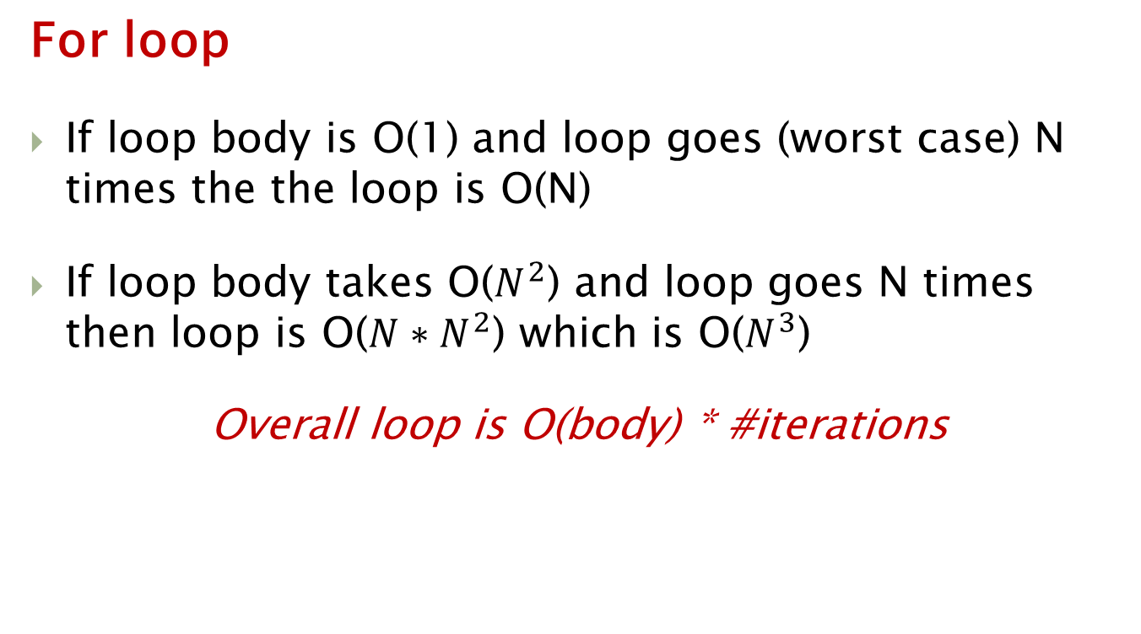
Code Analysis
For loop
If loop body is O(1) and loop goes (worst case) N times the the loop is O(N)
If loop body takes O($N^{2}$) and loop goes N times then loop is O(${N∗N}^{2}$) which is O($N^{3}$)
Overall loop is O(body) * #iterations

Slide 15
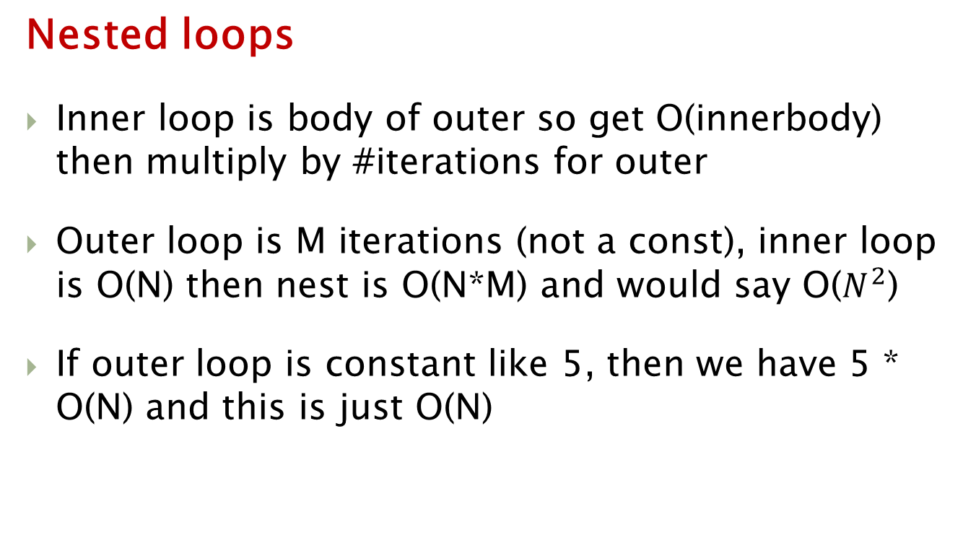
Code Analysis
Nested loops
Inner loop is body of outer so get O(innerbody) then multiply by #iterations for outer
Outer loop is M iterations (not a const), inner loop is O(N) then nest is O(N*M) and would say O($N^{2}$)
If outer loop is constant like 5, then we have 5 * O(N) and this is just O(N)

Slide 16
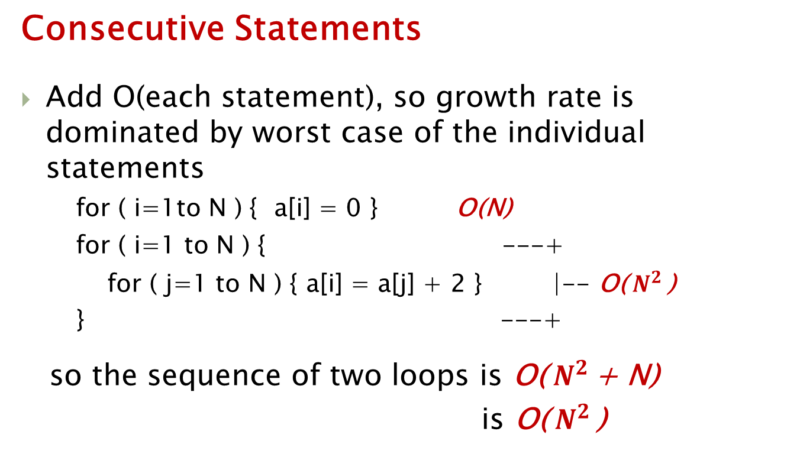
Code Analysis
Consecutive Statements
Add O(each statement), so growth rate is dominated by worst case of the individual statements
for ( i=1to N ) { a[i] = 0 } O(N)
for ( i=1 to N ) { ---+
for ( j=1 to N ) { a[i] = a[j] + 2 } |-- O(${ N}^{2 }$)
} ---+
so the sequence of two loops is O(${ N}^{2 }$+ N)
is O(${ N}^{2 }$)

Slide 17
Code Analysis
If/Then/Else
Find O(then block) and O(else block)
take the worst case as O(entire if)

Slide 18
Code Analysis
Recursion
Very powerful for programming many data structure operations
Data structures are often recursively defined, so recursive coding can often more directly and succinctly express an algorithm to manipulate such a structure
Often can write code to directly reflect a mathematical formula

Slide 19
Code Analysis
Recursion
Can get very inefficient implementations if used haphazardly
Consider Fibonacci sequence
F(n) = F(n-1) + F(n-2)
F(0) = 1, F(1) = 1
Short and sweet to code this directly
public long fib ( long n ) {
if (n==0) return 1;
if (n==1) return 1;
return fib(n-1) + fib(n-2);
}

Slide 20
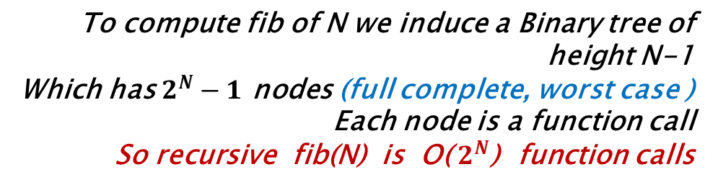
Code Analysis
Problem size
N
Tree height
fib(5)
fib(4)
fib(3)
fib(3)
fib(2)
fib(2)
fib(1)
fib(2)
fib(1)
fib(1)
fib(0)
fib(1)
fib(0)
To compute fib of N we induce a Binary tree of height N-1
Which has $2^{N}−1$ nodes (full complete, worst case )
Each node is a function call
So recursive fib(N) is O( $2^{N}$) function calls
fib(1)
fib(0)

Slide 21
Another Fib
public long fib(long n) {
long A[max];
A[0] = 1;
A[1] = 1;
if (n==0) return 1;
if (n==1) return 1;
for (i=2; i<=n; i++) {
A[i] = A[i-1] + A[i-2] ;
}
return A[n];
}
This code runs in O(n) time…
linear, not exponential
How can it be so much better?
1) space–time tradeoff
Exponential recursive
algorithm is just a bad idea
for this problem

Slide 22
END

