Slide 1

Data Structures and Analysis (COMP 410)
David Stotts
Computer Science Department
UNC Chapel Hill

Slide 2
Basic Graph Theory
(part 1)

Slide 3
Definitions
Graph is not a picture or a chart
Mathematical structure based in sets and relations/functions
G = ( V, E ) where V is a set of vertices (nodes)
E is a set of edges (arcs)
E is a set of ordered pairs E = { (a,b) | a ∈ V ∧ b ∈ V }
directed graph
E is a set of sets, E = { {a,b} | a ∈ V ∧ b ∈ V }
undirected graph
We let edges represent (model) different things…
road from a to b, a is parent of b, a employs b
a must be taken before b, a explains b, …

Slide 4
Directed Graph
adjacent
we say b is adjacent to a iff (a,b) ∈ E
directed graph
edges in E are directional
pairs in E are ordered
draw with arrows
we say “digraph”
Example
(a,b) ∈ E
a
b
V = { a, b, c, d }
a
b
E = { (a,b), (b,c), (c,a), (c,d), (d,b) }
so
G = ( { a, b, c, d },
{ (a,b), (b,c), (c,a), (c,d), (d,b) } )
c
d

Slide 5
Undirected Graph
Edges have no direction
If b is adjacent to a, then a is also adjacent to b
Elements in E are sets, not ordered pairs
Example
We say
a is adjacent to b, AND
b is adjacent to a
{a,b} ∈ E
a
b
V = { a, b, c, d }
a
b
E = { {a,b}, {a,c}, {b,c}, {b,d} }
G = ( V, E )
c
d

Slide 6
Undirected Graph
(a,b) ∈ E ∧ (b,a) ∈ E
Symmetry:
Not so here… only one edge
a
b
a
b
This …
not the same as this …
This is
shaking hands
This is hand on
the shoulder
If a shakes b’s hand,
It is impossible for
b not to shake a’s hand

Slide 7
Weighted Edges
Some problems may need a “weight” associated with each edge
2
4
a
b
a
b
5
E = { (s,d,w) |
s∈V ∧ d∈V ∧ w∈Int }
or weights might be real
Unweighted graphs can be thought of
as having weight of 1 on each edge

Slide 8
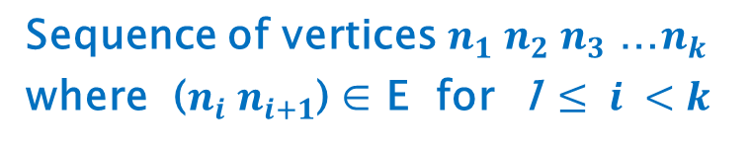

Path
Path
Path Length
$k−1$, the number of edges in the path
Every vertex has a path of length 0 to itself
This is not the same as (b,b) ∈ E
Sequence of vertices $n_{1} n_{2}{ n}_{3}$ …$n_{k}$
where ($n_{i} n_{i+1}$) ∈ E for 1 $≤ i <k$
Here ( b, b ) ∈ E
So there is a path b to b
that has length 1
b
c
d

Slide 9
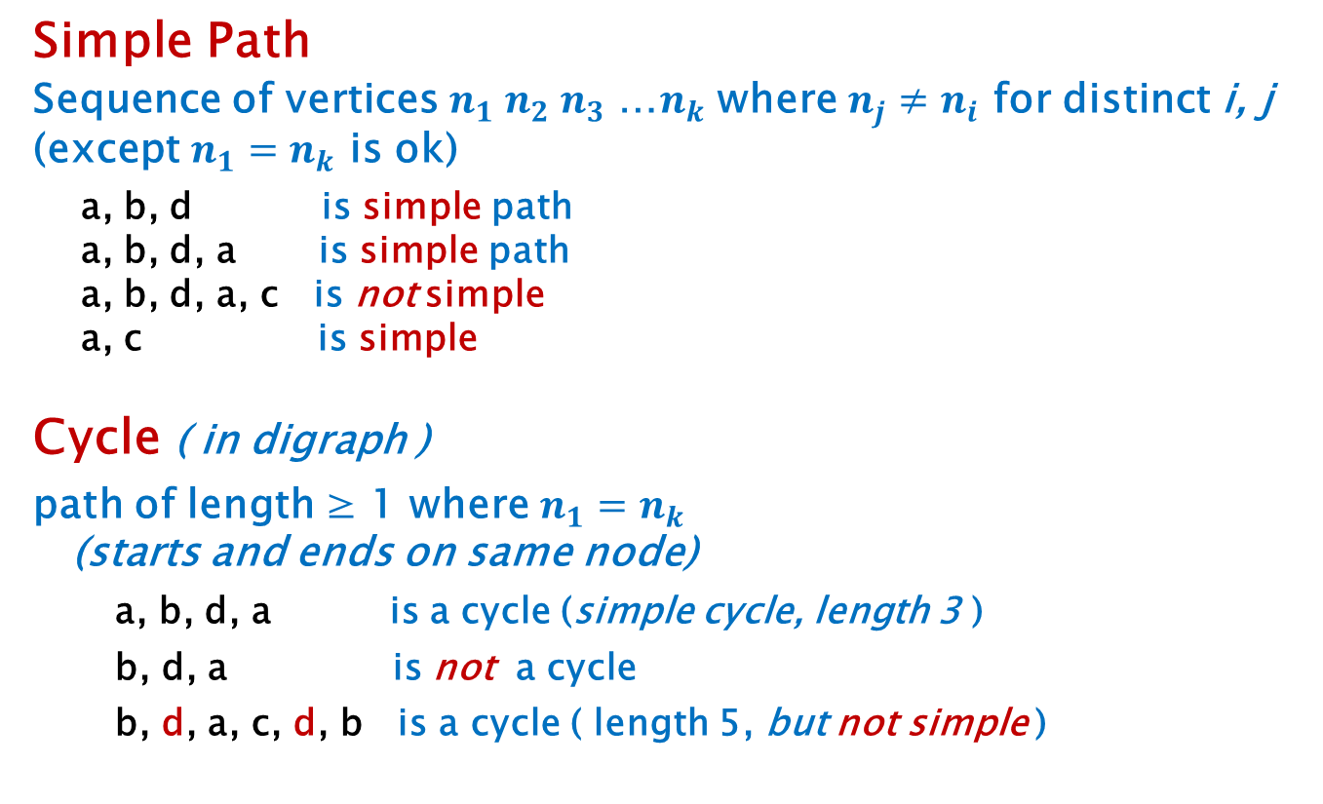
Simple, Cycle
Simple Path
Sequence of vertices $n_{1} n_{2}{ n}_{3}$ …$n_{k}$ where $n_{j}≠n_{i}$ for distinct i, j (except $n_{1}=n_{k}$ is ok)
a, b, d is simple path
a, b, d, a is simple path
a, b, d, a, c is not simple
a, c is simple
Cycle ( in digraph )
path of length ≥ 1 where $n_{1}=n_{k}$
(starts and ends on same node)
a, b, d, a is a cycle (simple cycle, length 3 )
b, d, a is not a cycle
b, d, a, c, d, b is a cycle ( length 5, but not simple )
a
c
b
d

Slide 10
Cycle in Undirected Graph
We require the edges to be distinct
If (a,b) ∈ E there is no cycle between a and b per se
a, b, a is not a cycle, that would imply an edge (a,b)
and another edge (b,a)… (path length 2)
but these are one edge, the same edge
a
b
Another reason these are technically not the same
a
b

Slide 11
Cycle in Undirected Graph
We require the edges to be distinct
a
b
a
b
No cycles in this graph
c
cycles in this one
a,b,a
a,b,a,c,a
b,a,c,a,b
etc.
c
a
b
cycles now…
a,b,c,a
b,c,a,b
etc.
c

Slide 12
DAG
DAG: Directed Acyclic Graph
Special form used in many problems
Directed edges
No cycles ... DAG
a
b
a
b
e
c
e
d
f
c
Directed edges
But cycles ?
d
f
Yes, so
not a DAG

Slide 13
DAG
We have been using DAG’s already…
Anyone?
Trees
Directed edges
No cycles ... DAG
b
a
e
We often use directed
edges because the parent-
child relation is one-way,
not symmetric
c
d
h
i
f
g

Slide 14
Graph Algorithms
Lets go back to the previous DAG example
How can we answer the question
“ Is there a cycle? ”
Directed edges
But cycles ?
No… a DAG
Now?
No… a DAG
a
b
Now?
No… a DAG
Now?
Cycles… not a DAG
e
Graph Algorithm:
For each vertex v {
trace paths from v
see if you revisit a node on the path
each path must end or revisit (why?)
}
c
d
f

Slide 15
Connected
Undirected Graph
Has a path from every vertex to every other vertex
a
b
a
b
e
e
c
c
d
f
d
f
connected
Not connected

Slide 16
Connected
Directed Graph
Strongly Connected:
Has a path from every vertex to every other vertex
a
d
a
d
b
c
b
c
Strongly connected
Not strongly connected

Slide 17
Connected
Directed Graph
Weakly Connected:
underlying undirected graph is connected
a
d
a
d
Underlying undirected graph
b
c
b
c
Not strongly connected
this is connected
This is weakly connected
so …

Slide 18
More Examples
a
s.c. yes
so also
w.c. yes
a
s.c. no
w.c. yes
b
c
b
c
a
e
d
w.c. no
so also
s.c. no
we just say
not connected
b
c

Slide 19

Complete Graph
An edge between any two distinct vertices
{$n_{i}$,$n_{j}\}$ ∈ E for every${ n}_{i}$,$n_{j}$ ∈ V, and $i≠j$ (undirected graph)
K1
K2
K4
(4*3)/2
= 6 edges
K5
K3
K6
(6*5)/2
= 15 edges
N nodes, N(N-1)
------- edges
2

Slide 20
Planar Graph
All edges can be drawn on a plane with none crossing
This earlier graph
is planar
K3
is planar
K4 planar?

Slide 21
Planar Graph
May be planar, but drawn poorly
Determining planarity is important in laying out VLSI circuits on boards
Redraw one of the crossing edges, “rubber-band” it outside the others
Metal “wires” cant cross
So here’s another
graph algorithm…
given graph G, is it planar?
K4
K4 is planar
Have to solve this by wandering around in data structures for V, E you don’t have a drawing

Slide 22
Planar Graph
What about K5?
K5
not planar
Turns out that K4 is the largest complete graph that is planar
No matter which inner edge you “stretch” you get a cross

Slide 23
Planar Graph
So rule of thumb…
This graph “drawing” looks not planar…
This graph “drawing” looks planar… so the graph IS planar
The graph might still be planar… it just might be drawn poorly to show that
A graph is not the drawing… a graph is the math object

Slide 24
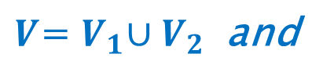
Bipartite Graph
Nodes are in two disjoint sets (types), and every edge connects different type nodes
$V$=${ V}_{1}∪V_{2}$ and
$E$ = { $(a,b)$| $(a$∈$V_{1}$∧$b$∈$V_{2})$∨ $(a$∈$V_{2}$∧$b$∈$V_{1})$}
$or, E$ = { $\{a,b\}$| $(a$∈$V_{1}$∧$b$∈$V_{2})$∨ $(a$∈$V_{2}$∧$b$∈$V_{1})$}
is bipartite
still is …
is bipartite
not bipartite
but now not

Slide 25
More Bipartite
Can think of bipartite as colorable with 2 colors
Every edge goes between the 2 color collections
a
e
a
e
b
b
d
f
c
g
g
d
f
c
is bipartite

Slide 26
More Bipartite
Tree is an acyclic graph. Prove it is bipartite
By induction on #nodes N
b
Base: 1 node, just color it B
Inductive Hypothesis: Every tree T with N nodes is bipartite.
Inductive Step: Show that T’ with N+1 nodes is bipartite.
Consider T = T’ less a leaf node v. T is a tree, and T has N nodes, and so by IH is bipartite. Node v in T’ has one neighbor (its parent); whatever the color of the parent is, assign v the other color. Then the arc between p and v is an arc connecting different color nodes. Node v is not part of any other edge.
Therefore, T’ has N+1 nodes is also bipartite.
a
e
c
d
h
i
f
k
j
g

