Slide 1

Data Structures and Analysis (COMP 410)
David Stotts
Computer Science Department
UNC Chapel Hill

Slide 2
Modeling with Graphs,
Implementing Graphs
(part 2)

Slide 3
Finite State Machine
Automaton drawn as labeled directed graph
a
G
c
c
Token
Represents current state
F
H
g
k
A
r
E
a
B
C
D
h
r
g
,
g
a
c
c
c
k
,
Simple abstract “computer”
Recognizes and generate strings (languages)
Used in compilers, keyword tokenizers
COMP 455 models of languages and computation
a r r r r g h ,
a r g h ,
g a c c k ,
g a c c c c c k ,
a r r g h

Slide 4
Predicate Transition Nets
Automaton that is represented with bipartite graph
is bipartite
t3
p4
p3
t4
Token
Represents locus of activity
p1
t5
t1
p5
p2
t2
t6

Slide 5
Modeling with Graphs
Example: air routes, road maps
bost
seatt
20
70
chi
nyc
30
10
20
50
30
10
5
denv
50
sfr
20
70
dc
25
40
10
10
40
30
20
char
15
90
20
20
la
dall
25
atl
Weighted edges

Slide 6
Modeling
Weights can be “cost”
miles, speed, fuel, time, total $$, wire/fiber, etc.
Directed edges
cost might be less one way than another
jet stream, might be faster west than east
different planes on different routes
uploads copper, downloads satellite
Add weights to get total cost of a route A to B
Add #hops to get other solutions
#take off/landings = tire wear, maint hours, taxes, risk

Slide 7
Modeling
What is min cost NYC to LA?
NYC to LA min hops?
NYC –30> Chi –50> Denv –40> LA 3 hops, cost is 120
NYC –5> DC –70> Denv –40> LA 3 hops, cost is 115
NYC –30> Chi –70> Seatt –20> SFr –10> LA 4 hops, cost is 130
NYC –5> DC –10> Char –30> Dall –20> Denv –40> LA
5 hops, cost is 105
Can I get from DC to any other city?
Is the map strongly connected?
If so, then yes

Slide 8
Representing Graphs
Adjacency Matrix (unweighted edges)
For N nodes, we use an NxN array of Boolean
if AM[a,b]==True then (a,b)∈E
destination
A B C D
A
D
A
B
C
D
F
T
T
T
source
F
F
F
F
F
T
F
F
B
C
F
F
T
F

Slide 9
Representing Graphs
Weighted Edges
Array elements can be integer, real, etc.
destination
2
A B C D
A
D
A
B
C
D
0
3
6
2
6
4
3
source
0
0
0
0
0
2
0
0
B
C
2
0
0
4
0

Slide 10
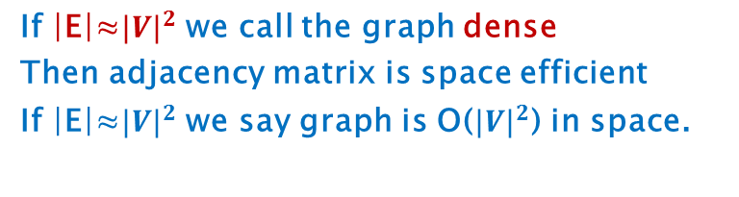

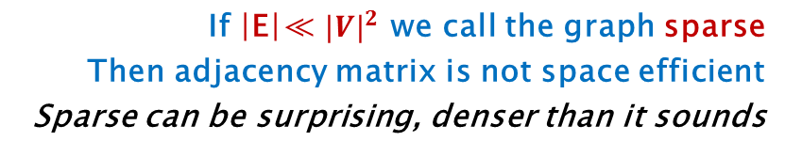
Adjacency Matrix
Problem is wasted space
O($N^{2}$) space
If |E|≪ $N^{2}$ lots of wasted space
8 nodes
64 spaces, 55 not used
T
T
T
T
T
T
If |E|≈${|V|}^{2}$ we call the graph dense
Then adjacency matrix is space efficient
If |E|≈${|V|}^{2}$ we say graph is O(${|V|}^{2}$) in space.
T
T
T
If |E|≪ ${|V|}^{2}$ we call the graph sparse
Then adjacency matrix is not space efficient
Sparse can be surprising, denser than it sounds

Slide 11
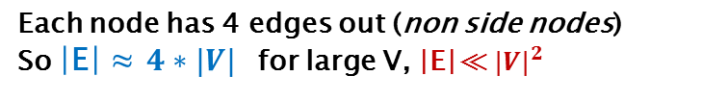
Sparse?
Let’s model traffic in Manhattan
Let V be intersections of streets
Let E be streets between V
Assume 2-way, use digraph
Graph seems complex… is it dense?
Each node has 4 edges out (non side nodes)
So |E| ≈ $4∗|V|$ for large V, |E|≪ ${|V|}^{2}$
Say we have 3000 intersections in Manhattan
Matrix has ${3000}^{2}$ cells, or 9,000,000 cells
Cells used ≈ 4*3000, or 12,000 cells used
This leaves 8,988,000 cells not used
Our traffic flow graph is NOT dense, it is sparse

Slide 12
Adjacency Matrix
T
T
T
T
Summary
Easy to build and code
Usually wastes most of its space
When a graph is sparse, finding adjacent nodes is expensive
Given vertex v, find all vertices adjacent to it
Go to row v in matrix
O(|V|) operation to look at all columns in that row
Only find a few vertices (graph is sparse)
Manhattan example: O(3000) looks to find 4 vertices
T
T
T
T
T

Slide 13
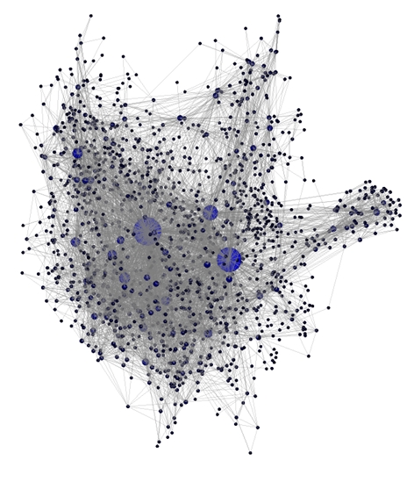
Dense? Or Sparse?
1538 nodes, 8032 edges
(1538 nodes)^2 is 2365444
8032 edges ≪ 2365444
so… Sparse
From Jzy3d plotting software website

Slide 14
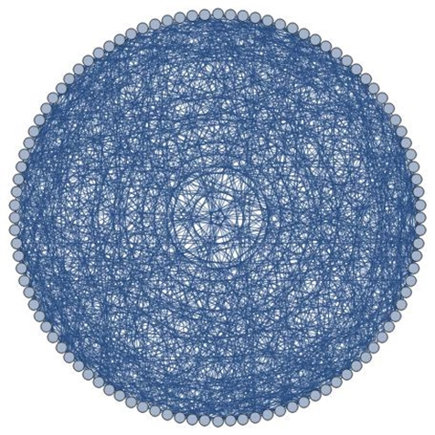
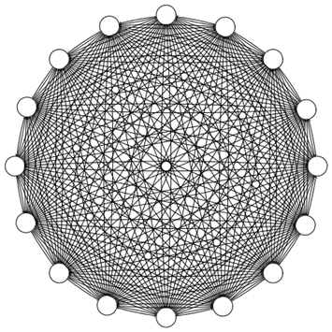
Complete Graphs are Dense
K100
K16
Effluviamagazine.com/effluviablog
Friday, June 27, 2014
from numerics.io

Slide 15
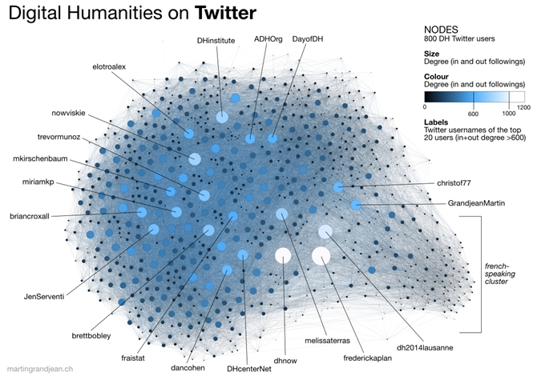
Dense? Or Sparse?
from Martin Grandjean on Digital Humanities site

Slide 16
Adjacency List
A better approach for sparse graphs
Keep list of vertices
Each vertex has a list of adjacent vertices
List of lists
HashMap of lists
Array of lists
A
B
C
D
A
D
B
C
B
D
C
B
C

Slide 17
Adjacency List
If edges are weighted store that in the link cell
2
A
A
D
3
6
2
6
4
B
3
C
B
C
2
2
D
4

Slide 18
Another Example
Array for nodes, linked cells for edges
4
A
3
E
0
1
2
3
4
A
2
2
3
1
4
3
6
B
2
1
B
2
1
C
1
3
3
5
D
1
D
C
5
E
1
6
0
4
3

Slide 19
Adjacency List
Space needed: O( |V|+|E| )
We call this “linear” for graphs
So “size” of a graph is |V|+|E|
Find all vertices adjacent to some node v ?
Worst case O(|V|) (complete graph)
Normally O( adj list for v )
Adj Matrix gives O(|V|) every search, worst and avg

Slide 20
Efficiency
You will need a hashmap for vertices
Hash each vertex name to the vertex object
Many graph algorithms will be inefficient without
If you need to find a vertex, you cannot afford to do O(|V|) search through an “all vertices” list without making many algorithms become quadratic, or worse
You will still want the vertices linked, for times you need to visit every vertex systematically
May need similar hash structure for edges

Slide 21
END

