Slide 1

Data Structures and Analysis (COMP 410)
David Stotts
Computer Science Department
UNC Chapel Hill

Slide 2
Graph Algorithms
(part 3)

Slide 3
Topological Sort
Computed for a DAG G
An ordering (sequence) of all vertices in G
s.t. if (u,v) ∈ E then u<v in the sort,
that is, u precedes v in the sequence
Every DAG has at least 1 topological sort
Some have more than 1
If a graph has a cycle, then it has no topo sort

Slide 4
Examples
A
Note that A has no in-edges,
and B has no out-edges
A
B
C
only 1 topo sort
A, C, B
Check:
(A,B) in E… A<B in sort
(A,C) in E… A<C in sort
(C,B) in E… C<B in sort
B
C
no topo sort
Note that every vertex has at least one in-edge and one out-edge

Slide 5
Examples
A
D
A
D
B
C
B
C
3 topo sorts
A, B, D, C
A, D, C, B
A, D, B, C
only 1 topo sort
A, D, C, B

Slide 6
Properties
A
X
Y
B
C
Not sufficient: If there is some vertex with no in-edge, or some vertex with no out-edge, there may still be no Topo Sort
A
If all vertices have both
in-edges and out-edges,
there is no Topo Sort
B
C
A
D
Necessary: If a graph has a Topo Sort, there will be at least one node with no in-edge, and one node with no out-edge
B
C

Slide 7
Uses
401
493
524
533
Use topo sort for structures like course pre-requisites
The sorts give OK orders of classes to take
410
411
523
431
283
455
426
520
541
535
550
Numerous topological sorts
283, 401, 455, 410, 426, 535, 493, 520, 550, 411, 431, 533, 541, 520, 523
401, 283, 455, 410, 426, 535, 493, 520, 550, 411, 431, 533, 541, 520, 523
401, 283, 455, 410, 426, 535, 493, 520, 550, 411, 431, 533, 541, 523, 520
etc.

Slide 8
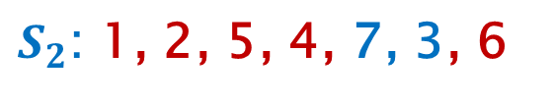
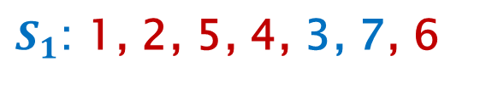

Algorithm to Find a Topo Sort
1
2
3
4
5
$$Two topological sorts$$
6
7
$S_{1}$: 1, 2, 5, 4, 3, 7, 6
$S_{2}$: 1, 2, 5, 4, 7, 3, 6

Slide 9
Algorithm
Find a topo sort in O(|V|+|E|) time (linear)
In-degree of vertex b
number of edges (a,b) ∈ E for distinct a
number of edges “coming into” b
number of vertices that b is adjacent to
Assume G=(V,E) has been built using adjacency list, and that in-degree of each node was stored during the build
Step 0) Any nodes with in-degree 0? If no, then cycle, done
Step 1) Pick any node v with in-degree 0. Put v into the TS
Step 2) Decrement in-degree of any node w where (v,w) ∈ E
(essentially remove v and its out-edges from graph)
Step 3) More nodes? goto 0, else done

Slide 10
Execute on Example
0
1
1
2
2
3
1
1
TS:
, 2
3
4
5
Node 1 has in-deg 0 so put it into TS
6
7
Remove node 1, out edges, and redo in-degrees
3
2
0
Node 2 has in-deg 0 so put it into TS
2
Remove node 2, out edges, and redo in-degrees
1
2
1
3
4
5
1
1
0
3
4
5
6
7
3
2
6
7
3
2

Slide 11
Execute on Example
1
1
0
3
4
5
TS:
1
, 2
, 5
, 4
, 7
, 3
, 6
6
7
Node 5 has in-deg 0 so put it into TS
3
2
Remove node 5, out edges, and redo in-degrees
1
0
Node 4 has in-deg 0 so put it into TS
3
4
Remove node 4, out edges, and redo in-degrees
Nodes 3 and 7 have in-deg 0 so pick one, put in TS
6
7
3
1
Node 3 into TS, remove it
3
0
Node 6 into TS, remove, done
2
0
3
0
0
6
1
6
7
6

Slide 12
What happens with cycles?
0
1
C
A
TS:
C
A
Length is not |V|
2
2
B
E
0
A
1
1
B
E
D
1
2
2
B
E
D
1
D
1
There are no vertices with
in-degree 0
However there are unprocessed nodes
So, we have found cycle(s)
So, no Topo Sort possible

Slide 13
What happens with cycles?
1
2
TS:
A
D
Can’t even start this one
1
1
C
There are no vertices with
in-degree 0
B

Slide 14
Example not in Text
1
0
1
1
Topo Sort:
1 choice: 0, 1
5 choice: 0, 5
0 choice: 0, 8
8
2
7
6
3
4
10 choice: 9, 10
9
8
2
2
2
2
5
7
3
0
2
4
0
3
9
3
6
10
2

Slide 15
Algorithm Analysis
What is Big-O for topo sort ?
We examine and remove each node, so we handle each node once
For each node, we remove its out edges, which means we operate on each edge once
So O(|V|+|E|) which in linear for graphs
In theory, this is what we hope for
Actual complexity depends on implementation choices
Depends on “handle a node” being O( 1 )
Depends on “handle all nodes” being O( |V| )
Depends on “remove edge” being O( 1 )
Depends on “find a node with indegree(0)” being O(1) ( or efficient )

Slide 16
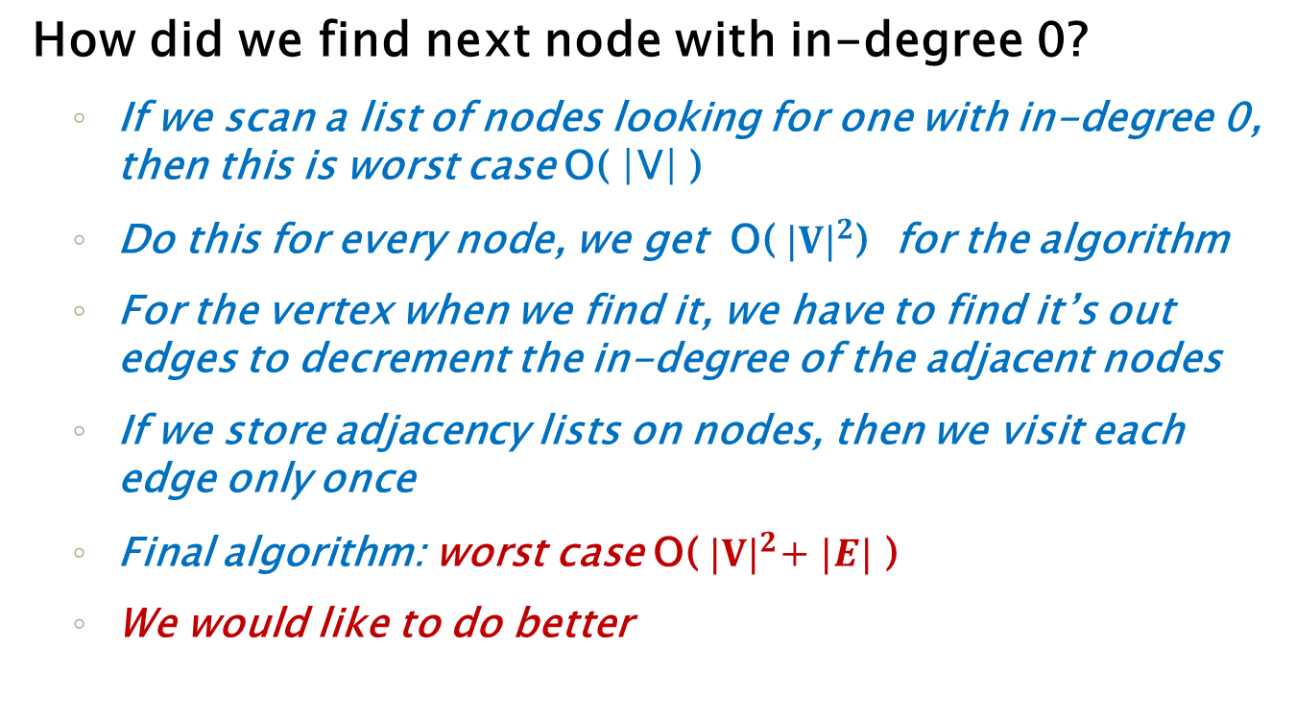
Algorithm Analysis
How did we find next node with in-degree 0?
If we scan a list of nodes looking for one with in-degree 0, then this is worst case O( |V| )
Do this for every node, we get O( ${|V|}^{2}$) for the algorithm
For the vertex when we find it, we have to find it’s out edges to decrement the in-degree of the adjacent nodes
If we store adjacency lists on nodes, then we visit each edge only once
Final algorithm: worst case O(${ |V|}^{2}$+ $|E|$ )
We would like to do better

Slide 17
Algorithm Improvements
We compute initial in-degrees as we build the graph
that’s O(|V|) … and we have to do it to build anyway
Then when we first scan the vertices… O(|V|)
put each vertex with in-degree 0 into a queue Q
when need next in-degree 0 node, Q.deq it : O(1)
when you decrement in-degree of each adjacent node, if one drops to 0, Q.enq it : O(1)
When Q is empty we have no more in-degree 0 nodes… check to see if we have processed all nodes in the graph (cycles)
Now total algorithm is O(|V|+|E|), linear
Re-run the earlier examples,
but use a queue to keep track of nodes with indegree(0) as you create them

Slide 18
Shortest Path
We say “shortest path”
For un-weighted digraph this is ok term, as it means path length (every edge weight 1)
Many problems require us to find the shortest path
from vertex v to vertex w in a graph.
We will look at 2 situations:
digraph, unweighted edges (weight 1 on all)
digraph, weighted edges
For weighted digraph we really mean “cheapest path”
Digraph Example
2
A
B
Going from A to F
4
1
3
10
Weighted: shortest path is
A, D, G, F with a cost of 6
2
7
C
D
E
5
8
4
6
Unweighted: shortest path is
A, D, F with a length/cost of 2
F
1
G

Slide 19
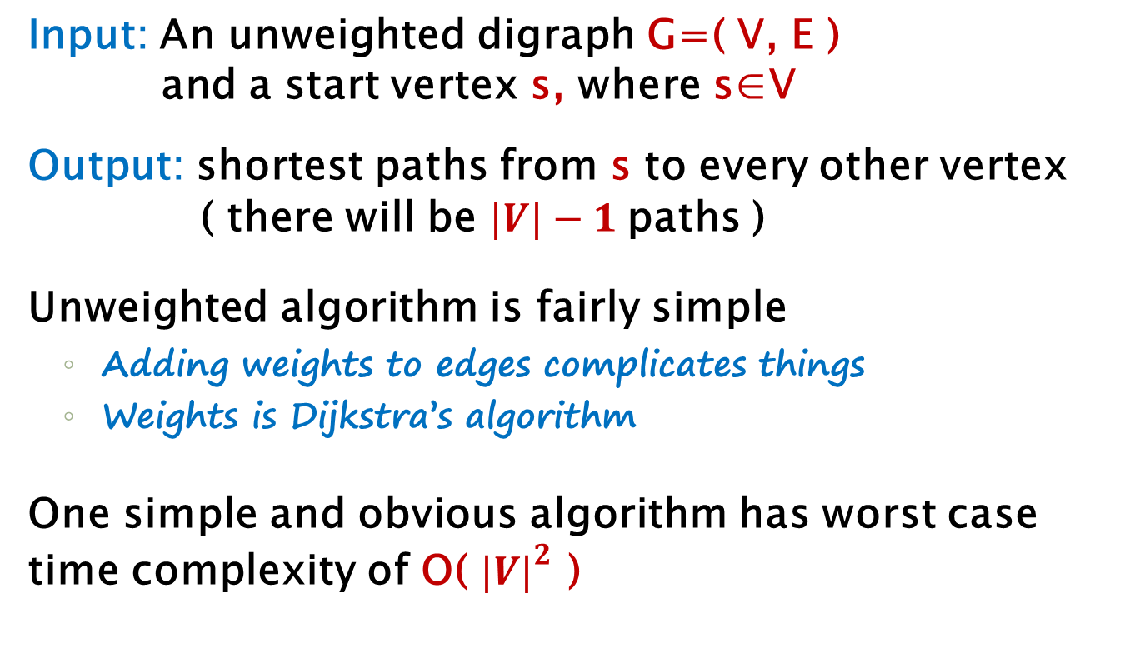
Unweighted Shortest Path
Input: An unweighted digraph G=( V, E )
and a start vertex s, where s∈V
Output: shortest paths from s to every other vertex
( there will be $|V|−1$paths )
Unweighted algorithm is fairly simple
Adding weights to edges complicates things
Weights is Dijkstra’s algorithm
One simple and obvious algorithm has worst case time complexity of O( ${|V|}^{2}$ )

Slide 20
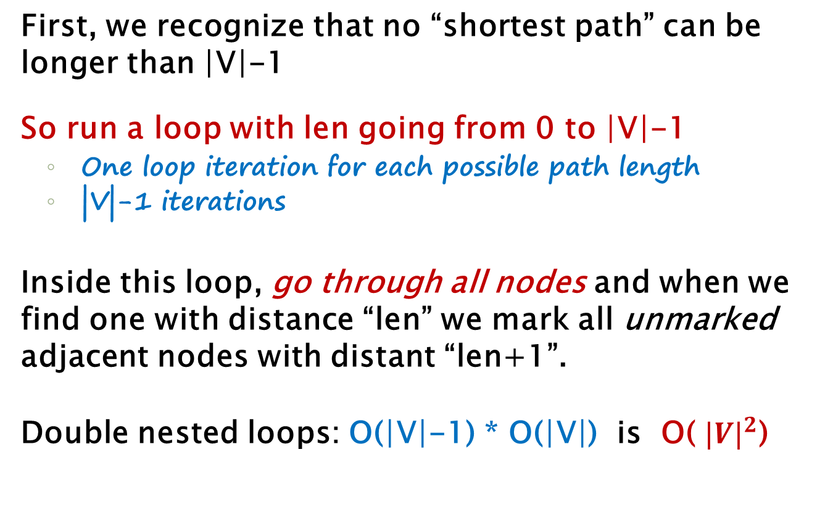
(Bad) Unweighted Shortest Path
First, we recognize that no “shortest path” can be longer than |V|-1
So run a loop with len going from 0 to |V|-1
One loop iteration for each possible path length
|V|-1 iterations
Inside this loop, go through all nodes and when we find one with distance “len” we mark all unmarked adjacent nodes with distant “len+1”.
Double nested loops: O(|V|-1) * O(|V|) is O( ${|V|}^{2}$)

Slide 21
(Bad) Unweighted Shortest Path
void bad_SSSP_unweighted( Vertex s ) {
for each Vertex v { v.dist = -1; }
s.dist = 0;
for( int currDist=0; currDist<|V|; currDist++ )
for each Vertex v
if( v.dist == currDist ) {
for each Vertex w adjacent to v
if( w.dist == -1 ) {
w.dist = currDist + 1;
w.path = v;
}
}
}
For each distance
For each node

Slide 22
(Bad) Unweighted Shortest Path
C is marked 0 to start
currDist = 0,
find all nodes marked 0
A
B
2
We find C, and mark adjacencies 0+1
1
2
3
currDist = 1,
find all nodes marked 1
C
D
E
We find A, and mark adjacencies 1+1
0
1
3
We find F, no adjacencies
F
G
currDist = 2,
find all nodes marked 2
We find B, and mark unmarked adjacencies 2+1
We find D, and mark unmarked adjacencies 2+1

Slide 23
Get Smarter
Recognize that once we deal with a node with some length (like 1) we will not work on that node again
So the outer loop revisits C, A, F (lengths 0, 1) just to get to B, D (length 2).
We can visit only the “rest of the nodes”
by doing a
breadth-first search
A
B
1
2
2
3
C
D
E
0
1
3
F
G

Slide 24
Unweighted Shortest Path
Consider G and start node C
We will annotate each node N with an integer
This integer tells the shortest path from C to N
Start with 0 on C, since there is a path length 0 from C to C
Now visit vertices adjacent to C
If we can go from C to C in 0, then we can go from C to A in 1
A
B
1
If we can go from C to C in 0, then we can go from C to F in 1
C
D
E
0
Now visit adjacent to A, then F,
continue visiting vertices in breadth-first order
1
F
G

Slide 25
Unweighted Shortest Path
Now consider vertices adjacent to A
B: C to A is 1, so C to B is 2
D: C to A is 1, so C to D is 2
Now visit vertices adjacent to F
No vertices adjacent to F
Now visit vertices adjacent to B
A
B
D: D is already done (in 2)
1
E: C to B is 2, so C to E is 3
2
2
Now visit vertices adjacent to …
D
C
D
E
E: E is already done (in 3)
0
3
F: F is already done (in 1)
1
3
F
G
G: C to D is 2, so C to G is 3

Slide 26
Unweighted Shortest Path
This algorithm visits each node once
At each node, visit each adjacent out-edge
So this is O(|V|+|E|)
Key is to efficiently find “next node”
Use a queue like in topological sort
A
B
1
2
2
3
Visiting a node, enq the adjacent nodes
C
D
E
0
1
3
deq to get “next” node
F
G

Slide 27
Queue Gives Breadth-first
Deq C
Let’s look at Queue
Q:
Enq adjacent to C: A, F
Deq A
C
A
F
B
D
E
G
Enq adjacent to A: B, D
Deq F
Put start node C on Q
Enq adjacent to F:
Deq B
A
B
Enq adjacent to B: D, E
1
2
Deq D
2
3
Enq adjacent to D: E, G
C
D
E
Deq E
Enq adjacent to E: G
0
Q is empty
1
3
Deq G
F
G
Enq adjacent to G: F

Slide 28
Dijkstra’s Algorithm
Weighted Shortest Path
We will use a priority queue to hold adjacent nodes
(0,A)
V known dv pv
----------------------------
A F i
B F i
C F i
D F i
E F i
F F i G F i
(2,B)
(2,B)(3,C)
(2,B)
PQ:
(1,D)(2,B)
(2,B)(3,C)(9,F)
(8,F)(9,F)
(2,B)(3,C)(4,E)(5,G)(9,F)
(2,B)(3,C)(5,G)(9,F)
(9,F)
(8,F)(9,F)
(6,F)(8,F)(9,F)
(5,G)(8,F)(9,F)
(3,E)(4,E)(5,G)(8,F)(9,F)
(3,C)(3,E)(4,E)(5,G)(9,F)
(4,E)(5,G)(8,F)(9,F)
(3,C)(4,E)(5,G)(9,F)
(3,E)(4,E)(5,G)(9,F)
T
0
_
2
T
2
A
A
B
T
3
D
1
3
1
4
T
1
A
2
3
T
4
3
D
B
C
D
E
T
9
8
6
D
C
G
8
4
5
D
5
6
T
1
F
G
(0,A)
(1,D)
(2,B)
(3,C)
(3,E)
(5,G)
(6,F)
DONE

Slide 29
Dijkstra’s Algorithm
Basic algorithm
Put start s node in table with dist of 0
Put (0,s) on priority queue PQ
Loop: until PQ is empty:
n=PQ.getMin().node; d=PQ.getMin().dist; PQ.delMin()
Is n known? Back to Loop and get another from PQ;
Mark n as known
For each unknown node a adjacent to n
if a.dist>d+edge.weight then
update a.dist in table to be d+edge.weight
and add a to PQ with priority d+edge.weight
Trace the path itself using “from” fields

Slide 30
Minimum Spanning Tree
For undirected graph G=(V,E)
Spanning Tree ST of G is a
tree
formed using edges in E
all vertices in V appear in ST
Minimum Spanning Tree MST of G is a
spanning tree
edge weights sum as small as possible for G
MST exists iff G is connected
MST is: T ( it is tree, acyclic )
S ( all nodes in G are in MST )
M ( no other ST has smaller edge weight sum )
#edges in ST is |V|-1

Slide 31
Example
Graph G
3
A
B
2
3
2
A
B
1
1
2
2
C
D
E
1
1
2
C
D
E
3
Another
Spanning Tree
Cost: 8
F
2
F
3
A
B
2
How do we know 8 is minimum?
One Spanning Tree
Cost: 11
1
All 1 edges are used
All 2 edges are used
Any other edge would replace a 1 or 2 with 3 or higher
C
D
E
2
3
F

Slide 32
Trees?
A
B
2
2
1
1
C
D
E
B
Grab a node, let the others “hang” down from it
2
2
F
E
1
2
A
B
2
2
D
F
1
1
2
C
D
E
1
2
A
C
F

Slide 33
Properties
Have seen that a graph may have >1 ST
A graph may also have >1 MST
1
1
A
B
C
A
B
C
4
3
2
5
3
3
3
2
D
3
D
2
E
F
2
E
F
MST: cost 11
1
A
B
C
2
3
MST: cost 11
D
3
2
E
F

Slide 34
Properties
In a weighted undirected graph G=(V,E)
If all edge weights are 1 (or equal)
then every ST is also an MST
this is because all ST have |V|-1 edges
If each edge has a different unique weight
then there is exactly 1 MST
What do we do with MST?
Want to connect |V| cities with wire/fiber, how do I decide which cities to connect?
Make graph, cities at nodes, connect all, weight edges with length/cost, find MST

Slide 35
Kruskal’s Alg for MST
Example of a greedy algorithm:
picking local best at each step gives global best solution
Builds forest, merges the trees into one
Basic Steps
Start with all nodes, no edges ( initial forest )
Select edges in order of smallest weight up
Stop when all vertices have been included (we have a connected graph/tree)
Reject an edge if it creates cycle
Cycle detection step could be costly, must create an efficient way to keep entire algorithm efficient

Slide 36
Example
Small examples easy
by inspection
2
1
2
1
2
4
3
10
1
1
2
7
3
4
5
3
4
5
8
4
5
6
6
7
6
7
1
1
2
1
3
4
5
1
6
7

Slide 37
Example
2
1
2
1
2
4
1
3
10
1
2
7
3
4
5
3
4
5
8
4
5
6
1
6
7
6
7
1
1
2
1
2
2
2
1
1
3
4
5
3
4
5
2
1
1
6
7
6
7

Slide 38
Example
2
1
2
1
2
4
1
3
10
2
1
2
7
3
4
5
3
4
5
8
4
2
5
6
1
6
7
6
7
1
reject
1
2
2
1
2
1
2
reject
4
1
3
3
4
5
2
4
3
4
5
6
2
4
5
1
1
6
7
6
7
reject
Now connected, so done
MST cost is 16

Slide 39
Smallest edge weights first
How do we do this?
Generate a sorted list of edges?
O( |E| log |E|) just to sort
O(1) to get next
Build binary heap (priority queue) using edge weight as priority
O( |E| ) just to build
O( log |E| ) to get next
But we don’t usually do this |E| times

Slide 40
Prims’s Alg for MST
Another greedy algorithm
Basic Steps
Start with empty tree T
Pick any node n, add to T
Examine edges (n,k) and add the one with lowest weight
Now add min weight edge (u,v) where u is in the tree, but v is not ( reject cycles )
Repeat until all vertices are included

Slide 41
Example
2
1
2
4
1
3
10
2
7
1
3
4
5
1
8
4
5
6
1
6
7
1
4
2
2
1
2
1
2
reject
1
1
2
3
1
2
2
3
4
4
1
4
2
3
4
7

Slide 42
Example
2
1
2
4
1
3
10
2
1
2
2
7
3
4
5
1
8
4
5
6
2
6
7
3
4
1
4
7
2
All nodes in
so done
MST cost is 16
1
2
2
1
1
2
2
1
3
4
2
5
3
4
4
6
7
4
6
1
6
7
1

Slide 43
END

Slide 44
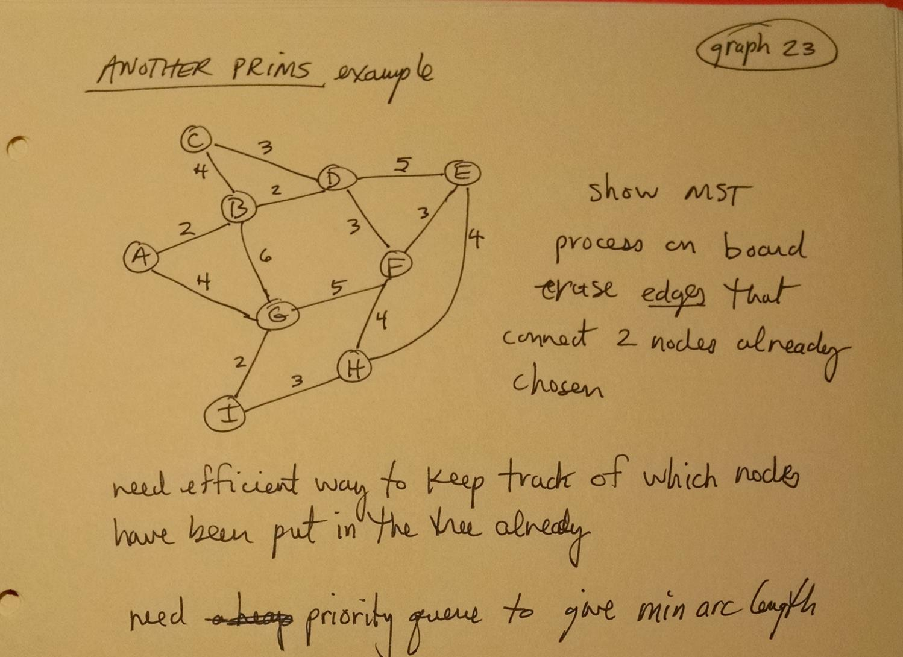

Slide 45
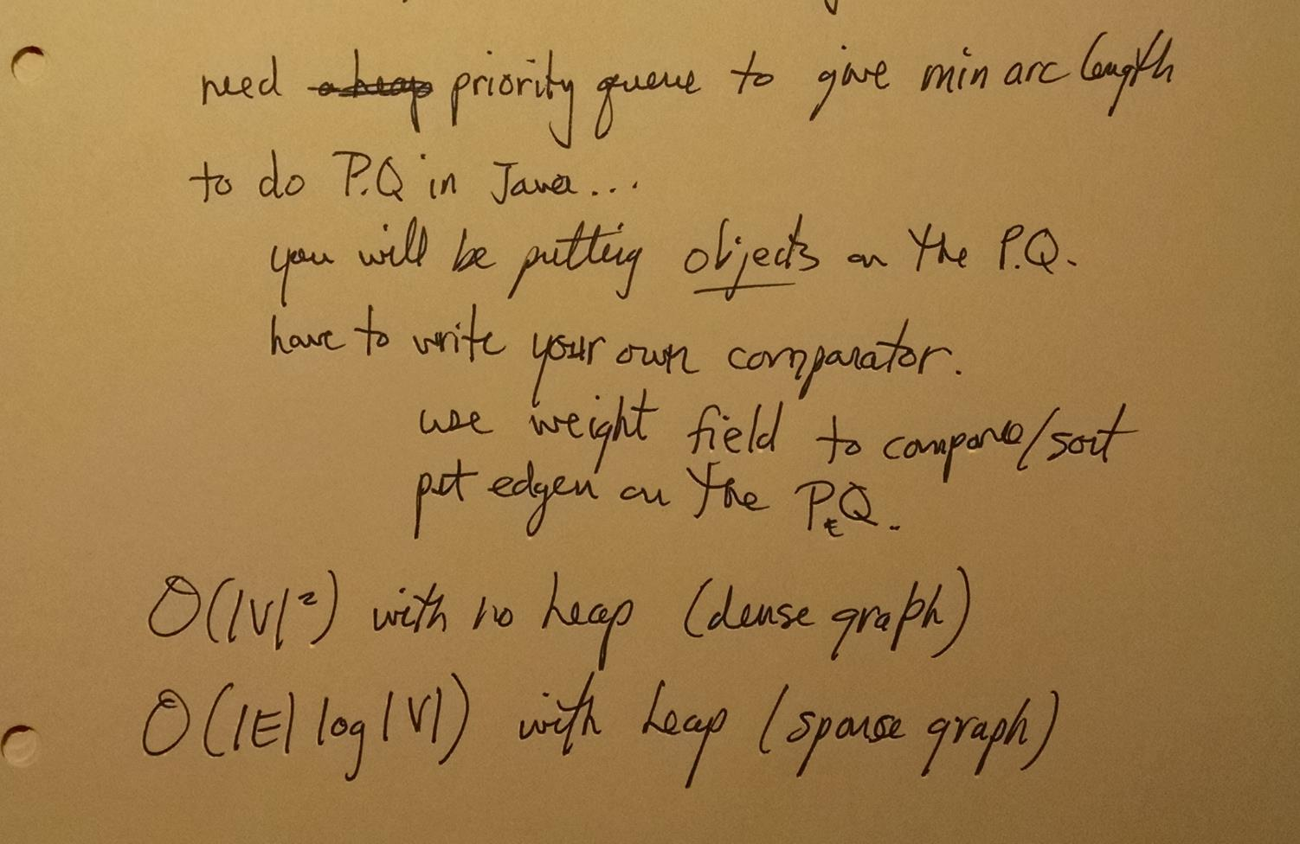

Slide 46
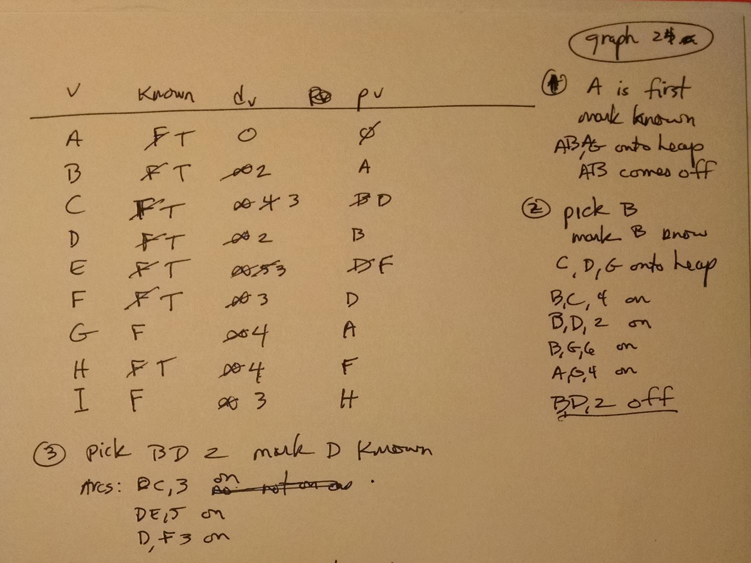

Slide 47
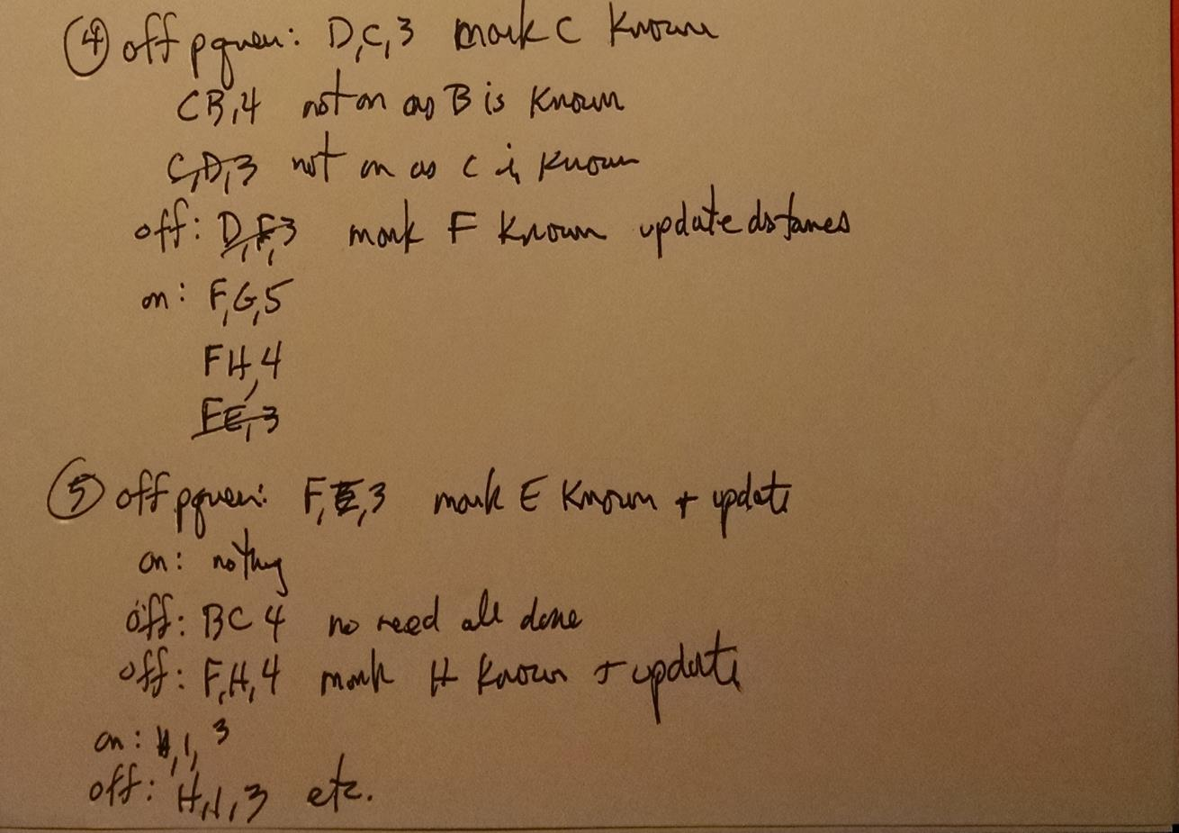
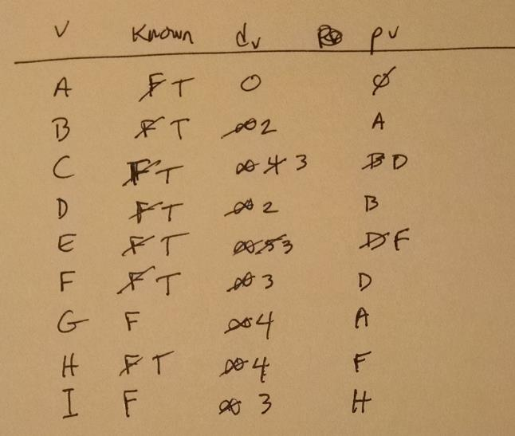

Slide 48
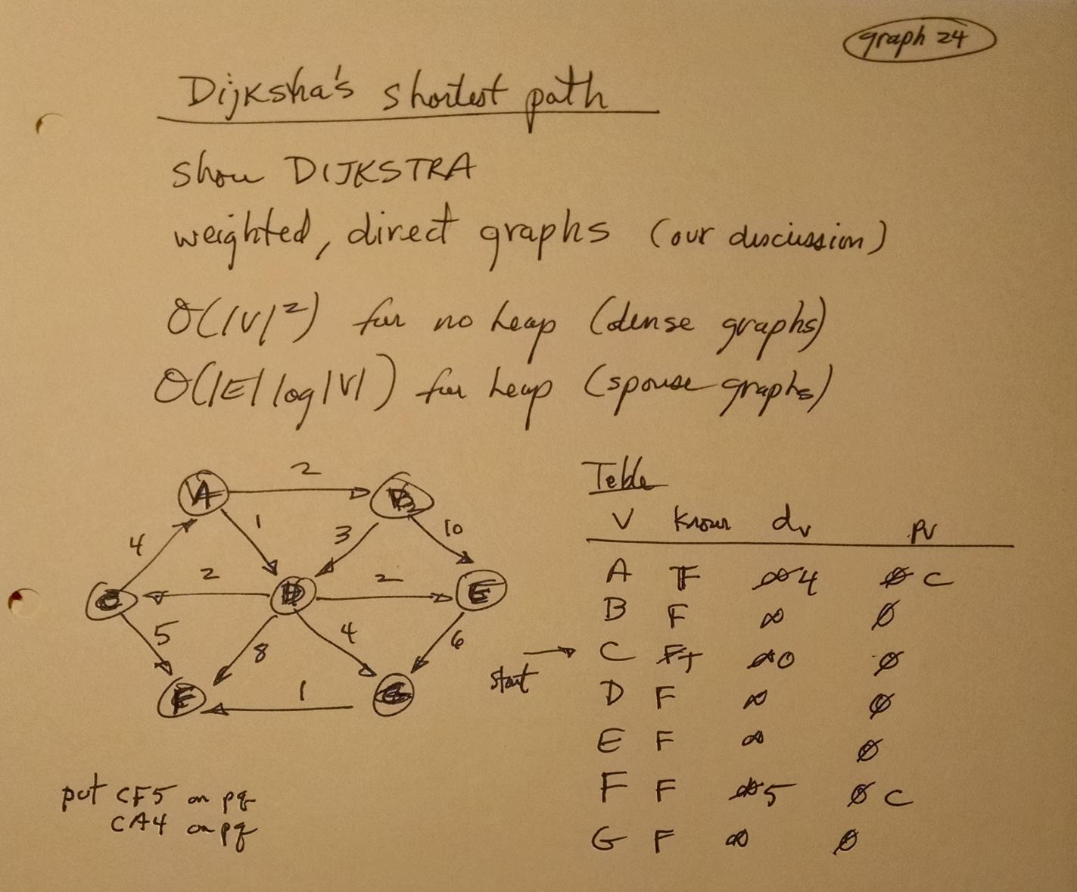

Slide 49
Use for Shortest Path
0 1 2 3
Solve the Maze
A
B
C
D
E

Slide 50
Use for Shortest Path
0 1 2 3
Solve the Maze
A
B
C
D
E
8

Slide 51
END

Slide 52
2
3
1
N1
5
4
6
7
9
8
N2
10

Slide 53
N1 = {
{ 1,2,3,4,5 },
{ (1,4),(2,1),(2,4),(4,3),(4,5),
(5,2),(5,3) }
}
N2 = {
{ 6,7,8,9,10 },
{ (6,7),(6,8),(7,9),(7,10),(8,7),
(8,10),(10,9) }
}
2
3
1
5
4
6
7
9
8
N2
10

