Slide 1

Data Structures and Analysis (COMP 410)
David Stotts
Computer Science Department
UNC Chapel Hill

Slide 2
Graph Theory and Algorithms
(part 4)

Slide 3
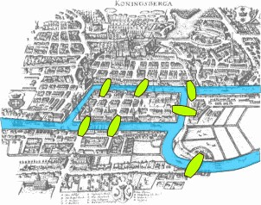
7 Bridges of Konigsberg
Popular 1600’s 1700’s pastime…
can you walk through the city and cross each bridge exactly once (either direction)?

Slide 4
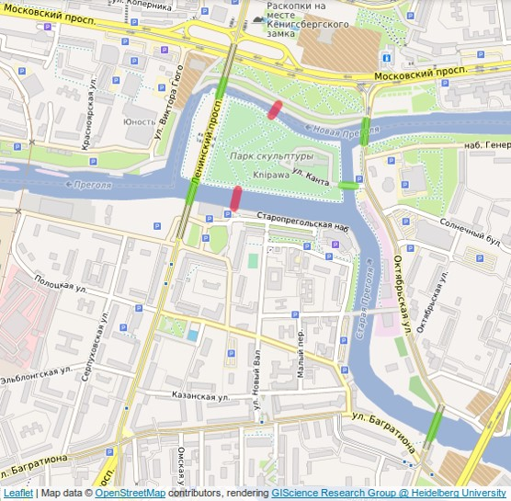
Present day Kaliningrad, Russia red bridges are no longer there

Slide 5
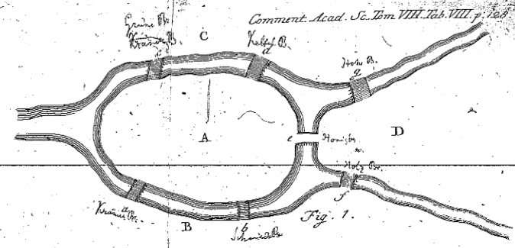
Leonard Euler in 1735
Created an abstraction of this problem and laid the groundwork for graph theory (and also topology)
Represented land masses as vertices
Represented bridges as connecting lines (edges)
Euler’s original description

Slide 6
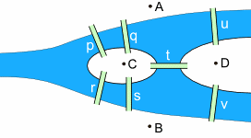
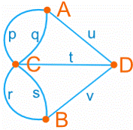
Euler’s Graph Model
We model the city with an undirected graph, because we can walk across the bridge in either direction

Slide 7
The problem
Can a person execute a walk that crosses each bridge once and only once?
You can start anywhere and end up anywhere
Informal:
Put a pen on a vertex.
Can you trace the diagram without picking up the pen, or redrawing an edge?

Slide 8
Euler Path, Circuit
Euler Path (EP): A path in the graph that passes through every edge once
Euler Circuit (EC): An EP that begins and ends on the same vertex
Degree of a vertex v: #edges involving v
The question:
“ does G have any EP or EC ? ”
To answer:
first compute the degree of every vertex in G

Slide 9
Euler Theorems
Given connected undirected G=(V,E)
Theorem 1: EC
If G has any odd vertices then it has no EC.
If G has all even vertices then there is at least one EC.
Theorem 2: EP
If G has more than 2 odd vertices, then it has no EP.
If G has exactly 2 odd vertices, then it has at least one EP, which must start at one odd vertex and end at the other.
Theorem 3: General
The sum of the degrees of all vertices in G is even ( exactly twice |E| ). The number of odd vertices is even.

Slide 10
Euler Theorems
#odd v implication
--------------------------------------
0 >=1 EC (no EP that is not EC)
1 impossible (th.3)
2 no EC, >=1 EP
every EP must start on one odd
and end on the other
>2 no EC, no EP

Slide 11
Examples
2 odd
no EC
at least 1 EP
2
3
3
4
4
4
3
3
4
3
3
2
4 odd
no EP (so no EC)
4
they start, end here
4
4
4
4
0 odd
at least 1 EC
2

Slide 12
Euler Path, Circuit
Memory aid:
G has an EC iff #odd vertices = 0
G has an EP iff #odd vertices = 2
(EP means that is not EC)
There is an algorithm to find EC in a graph that is worst case O( |E|+|V| )

Slide 13
Algorithm for EP/EC
Given undirected unweighted G=(V,E)
1) Start with empty tmp stack, empty EC stack
If 0 odd nodes pick any as cn, the curr node
else if 2 odd nodes pick one odd as cn, the curr node
else no EP/EC: end
2) If cn has no neighbors:
push cn to EC stack
cn = pop tmp stack
Else // cn has neighbors
push cn to tmp stack
pick any neighbor nb of cn
remove edge (cn,nb)
make nb the new cn
3) Repeat step 2 until
cn has no neighbors and tmp stack is empty

Slide 14
Euler and Topology
Inventing graphs allowed Euler to begin defining what we now know as topology
This is a cube (3D) “stretched” flattened to 2D
The graph allows us to study some properties of the cube
Every convex polyhedron can be projected into 2D as a connected planar graph

Slide 15
Euler and Topology
Can a bug crawl along all edges of the cube without crossing any twice?
No, tough luck for the bug !
3
3
Sounds like EP in 3-space
So maybe we can do EP on the flattened graph
3
3
compute degree of all vertices
3
3
#odd vertices = 8
3
3
no EC (needs 0 odds)
no EP (needs exactly 2 odds)

Slide 16
Hamiltonian Path, Cycle
Given undirected connected graph G=(V,E)
Hamiltonian Path (HP):
path in G that contains each vertex once
Hamiltonian Circuit (HC):
a HP with endpoints that are adjacent
HC: 1, 2, 3, 4, 5, 1
1
2
HP: 1, 2, 3, 4, 5
3
HC: 2, 3, 4, 5, 1, 2
HC: 2, 3, 4, 1, 5, 2
5
4
HP: 1, 5, 2, 4, 3
HP: 2, 5, 1, 4, 3

Slide 17
Another Example
HC: none
1
3
5
HP: 1, 2, 3, 4, 5
HP: 1, 4, 3, 2, 5
2
4
HP: 1, 4, 5, 2, 3
HP: 3, 2, 5, 4, 1
etc.

Slide 18
Hamiltonian vs. Eulerian
Memory aid:
To remember which does edges, and
which does vertices…
Euler Edge

Slide 19
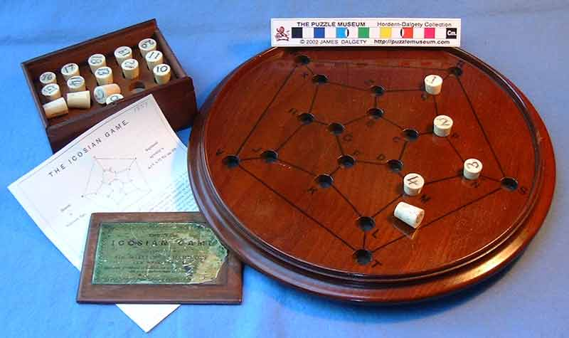
The Icosian Game
Invented by Sir William Rowan Hamilton in 1857
Sold as a physical board game
Put pegs in the holes in number order to define a path that uses each peg exactly once, and ends where it starts
From puzzlemuseum.com

Slide 20
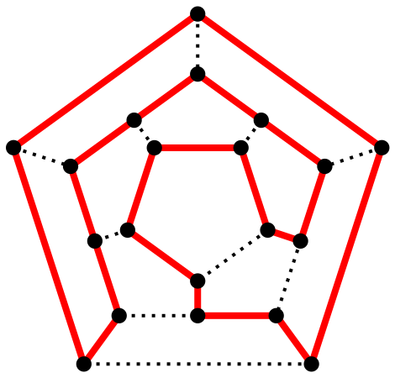
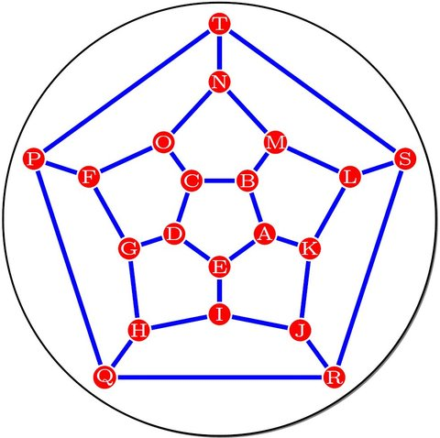
Icosian Game
Planar graph,
a flattened dodecahedron
There is a HC for this graph
From “Wordplay”, the NYT crossword blog
By Christoph Sommer - Own work, CC BY-SA 3.0, https://commons.wikimedia.org/w/index.php?curid=1724516

Slide 21
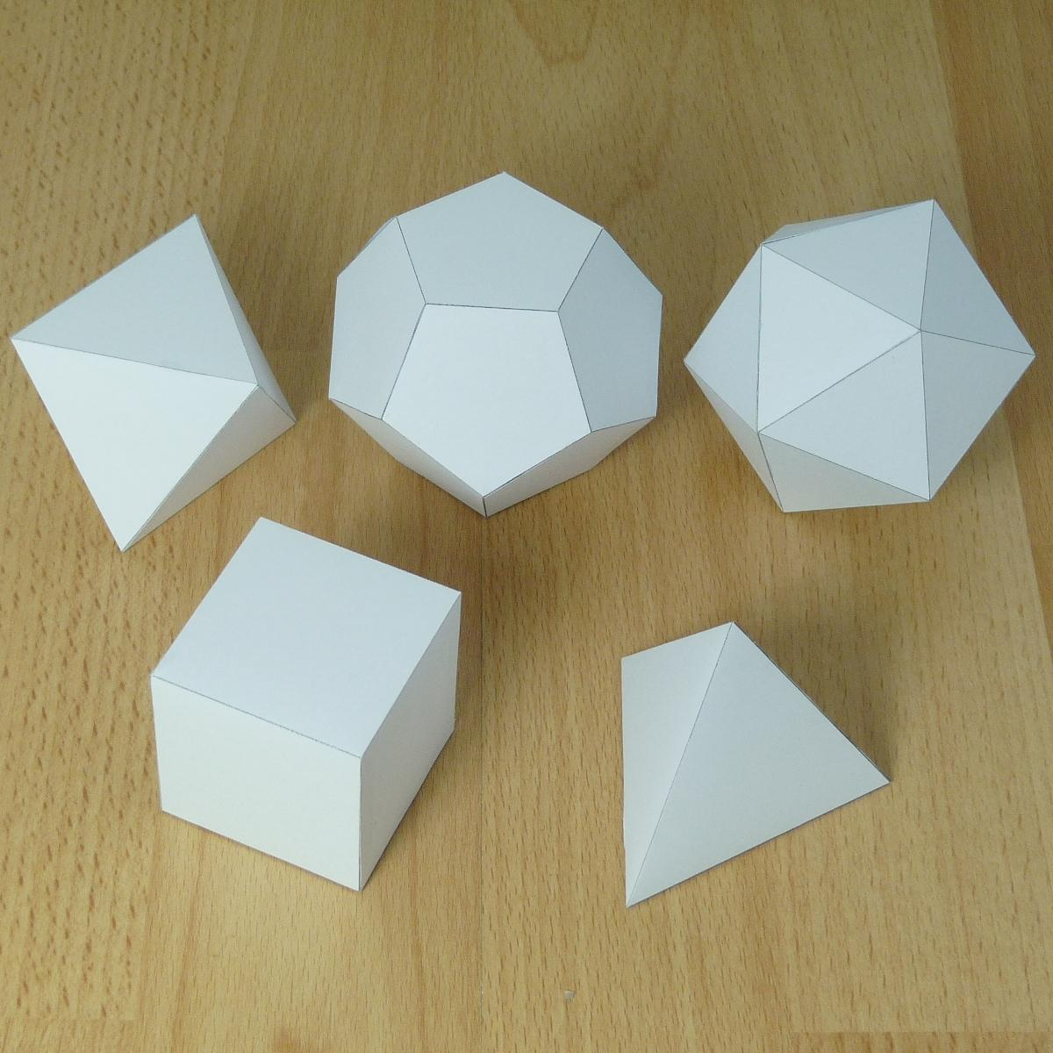
Platonic Solids
We said earlier that any convex polyhedron will project down to a connected planar graph
The 5 platonic solids produce graphs that are Hamiltonian,
i.e. have an HC
From http://www.korthalsaltes.com/

Slide 22
No Nice Theorems like Euler
We saw an O(|V|+|E|) algorithm for EP/EC
HP/HC is not nearly so easy for some strange reason
Dirac 1952 (sufficient condition)
A simple graph G (no loops, no multi-edges) with N vertices is Hamiltonian if degree of each vertex is >= N/2.
does NOT say if G is Hamiltonian, then the vertex degrees are >= N/2
Ore 1960 (sufficient condition)
A graph G with N vertices is Hamiltonian if for every pair of non-adjacent vertices the sum of their degrees is >=N.
Existence proofs, not constructive
Same for Euler’s Theorems

Slide 23
Efficiency: P vs. NP
No known efficient algorithm for finding HP/HC
So EP/EC is linear O(|V|+|E|) worst case
But HP/HC is exponential on some data
Efficient means polynomial
Bubble Sort? O(N^2) we said its horrible, but its polynomial
HP/HC exponential is way worse
Note:
We have not proven that HP/HC is not polynomial…
We have not yet found a polynomial time algorithm
All known algorithms are exponential time worst case

Slide 24
Efficiency: P vs. NP
Note:
If we are given a path/circuit, we can easily (in polynomial time) check if it is a HP/HC for a graph
See the difference:
Does this G have an HC?
Given this path P in G, is it a HC?
Find a HC for G
Y/N decision procedure
Checking, verify
Constructive

Slide 25
Travelling Salesman Problem
https://en.wikipedia.org/wiki/Travelling_salesman_problem
Computes a Hamiltonian Path (or circuit) on a graph
No known efficient (polynomial time) algorithm for solving this
Known algorithms are exponential (non-polynomial) in the size of the graph (#nodes + #edges)

Slide 26
END

Slide 27
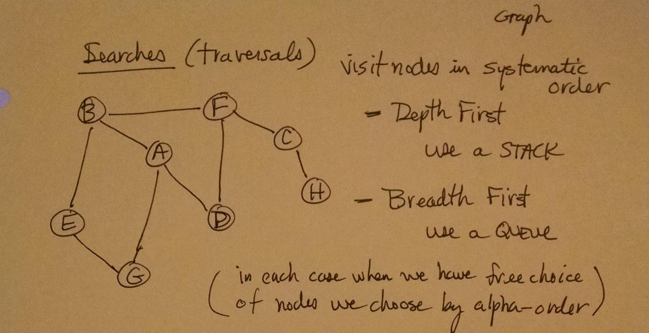
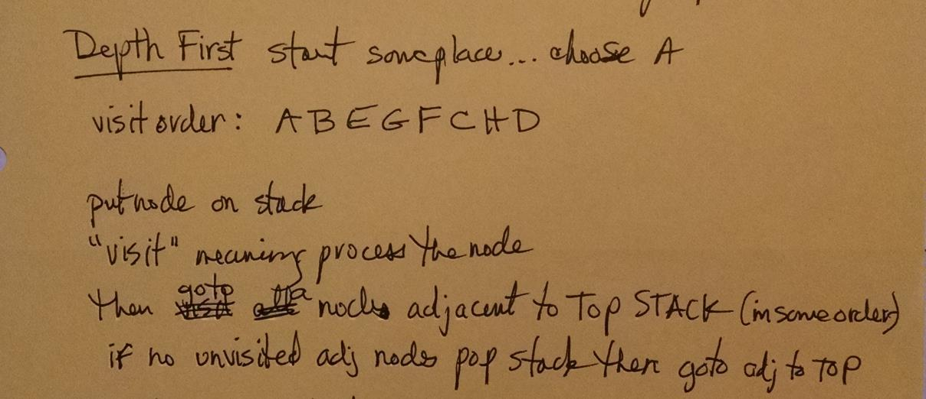

Slide 28
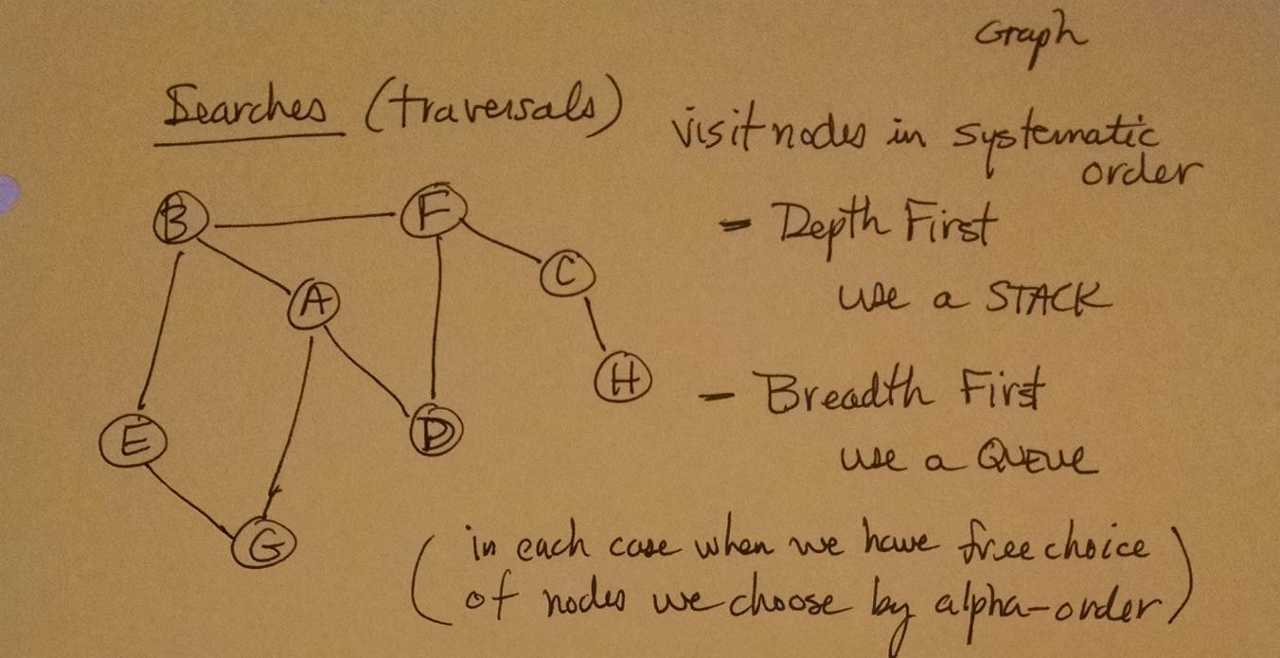
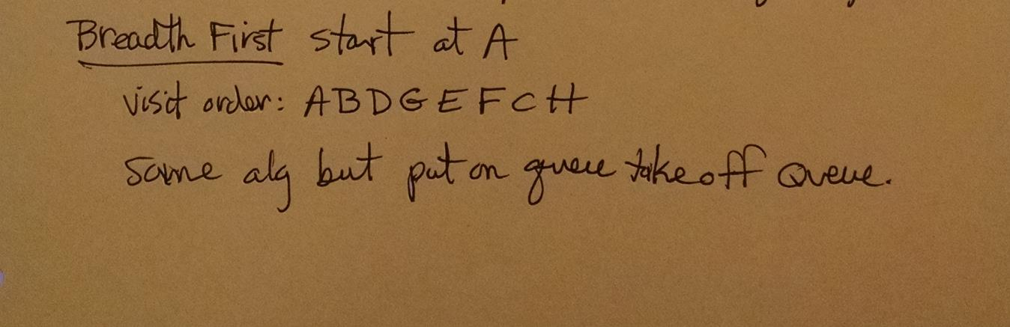

Slide 29
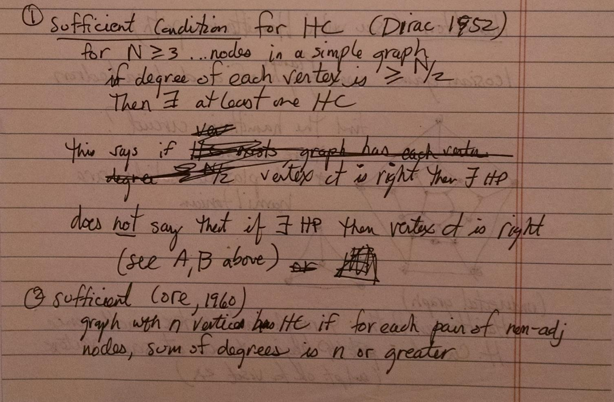

Slide 30
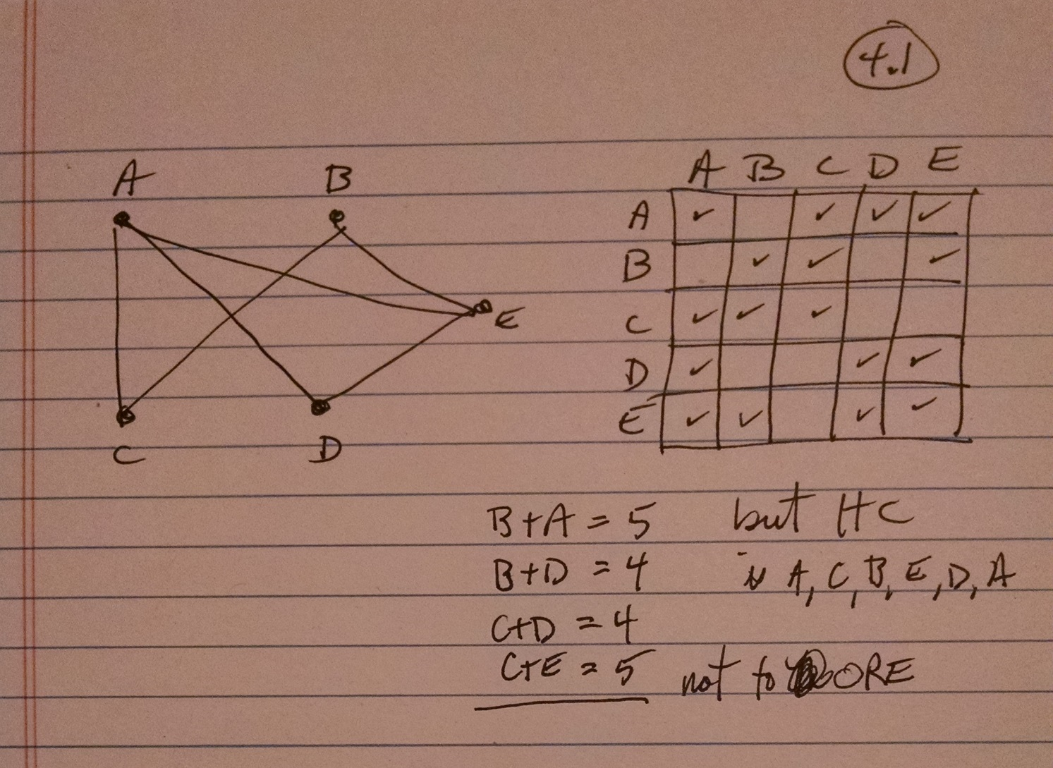

Slide 31
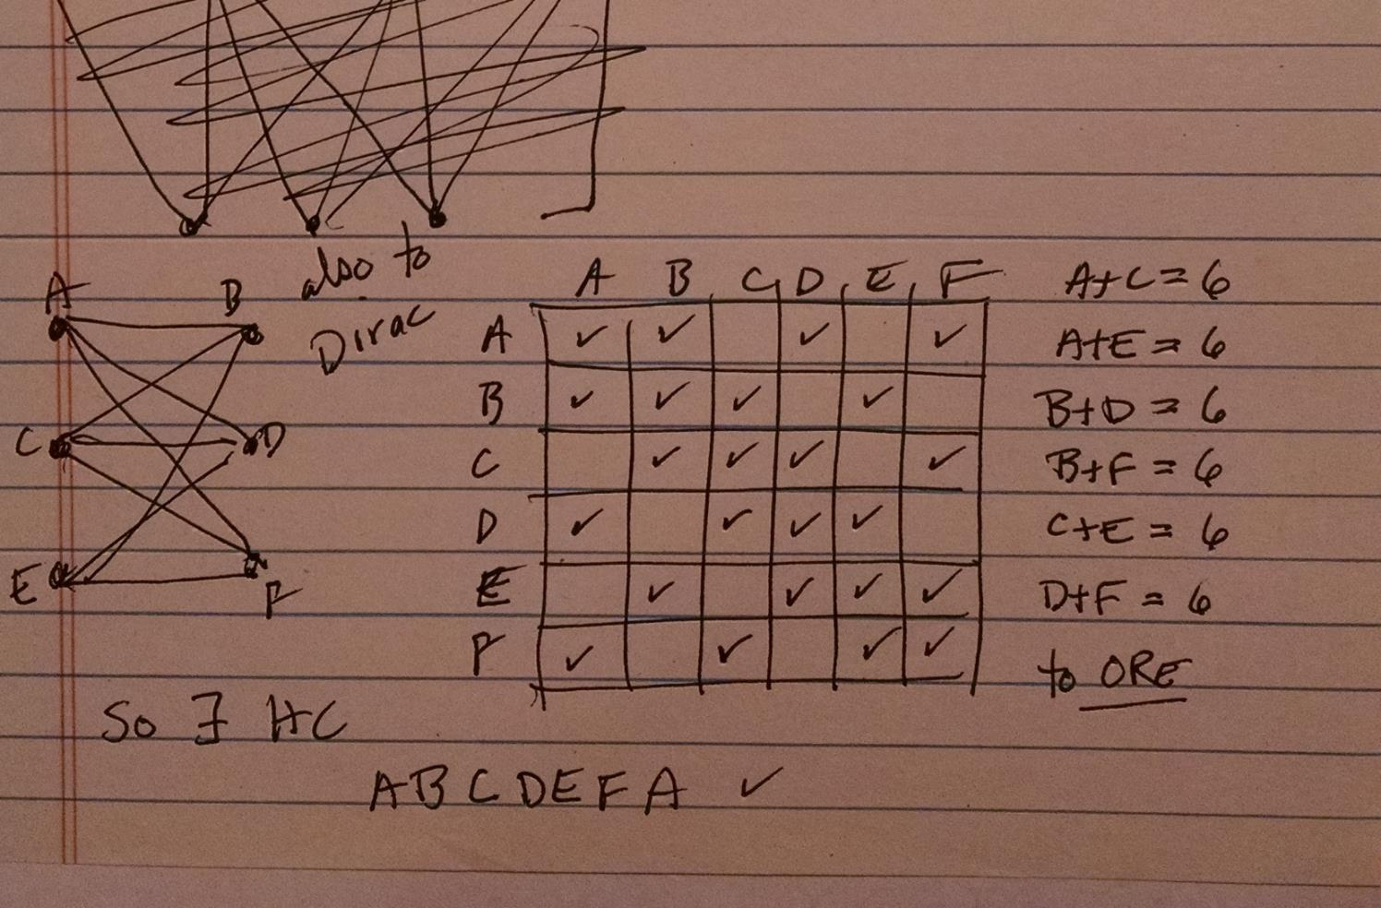

Slide 32
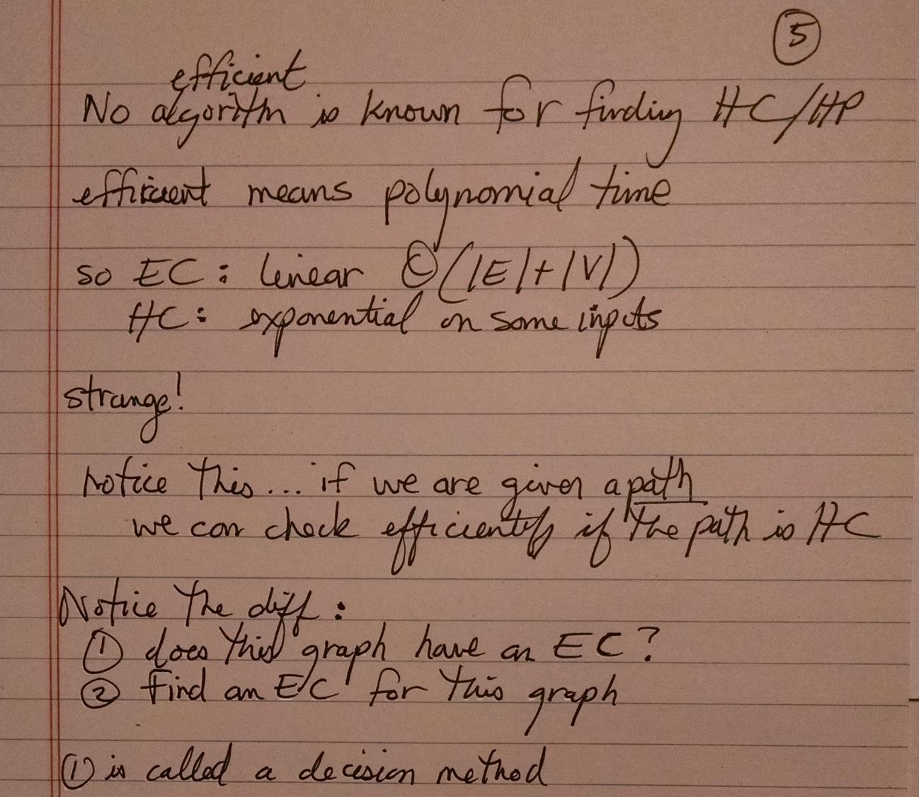

Slide 33
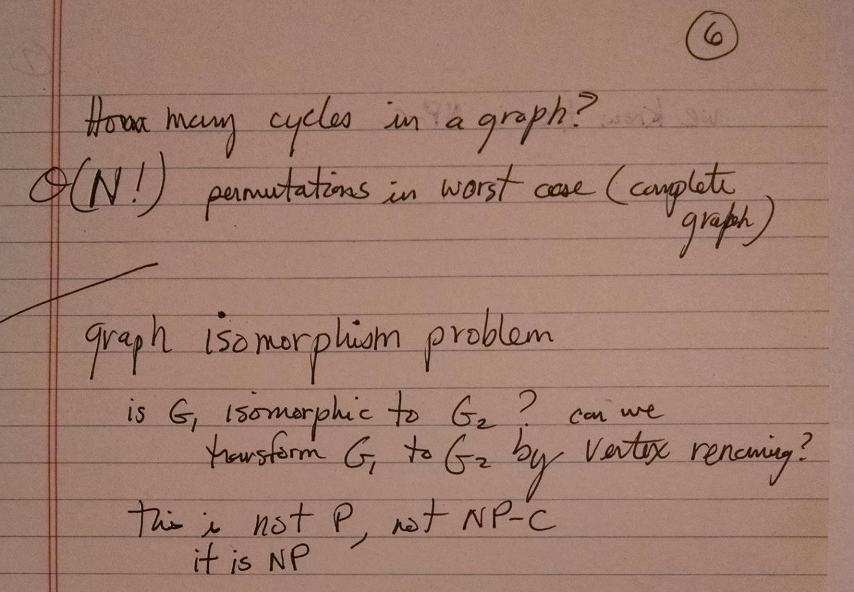

Slide 34
