Slide 1

Data Structures and Analysis (COMP 410)
David Stotts
Computer Science Department
UNC Chapel Hill

Slide 2
Binary Heaps
and
Priority Queues

Slide 3
Find the highest priority
Consider an emergency room at a hospital
Patients arrive at various time with various injuries and maladies
Triage is done to determine level of emergency and priority
Doctors finish with one patient, take the next
not in FIFO order
but in highest priority order

Slide 4
Find the highest priority
Consider an operating system
Processes are created (by user, by system) each with a priority, and go into a “pool”
Higher priority processes get more time, or first use of processor
When one process finishes (or ends time slice) the next process to run is the one with highest priority
Must select this from the pool somehow, might have 1000’s of processes

Slide 5
Priority Queue at the abstract level
Let’s work with elements composed of two pieces:
the data value (injury, process, document, etc.)
a priority (something like int that can be ordered)
2.4
9
9.5
8
6.4
1
4.7
3
7.3
5
8.0
7

Slide 6
Find the highest priority
From this blob get the element with highest priority
Now get the next element with highest priority
6.4
1
9.5
8
2.4
9
Add another element
3.1
2
Get next highest priority element
4.7
3
7.3
5
8.0
7

Slide 7
PrQUE ADT
Priority Queue is an abstract type
like Queue, Stack are abstract
enq : PrQUE x elt x priority → PrQUE
deq : PrQUE → PrQUE
front : PrQUE → elt
size, empty, etc.
The “enq” puts an item with its priority into the PrQUE
The “front” gives the item with highest priority
The “deq” removes the highest priority item from the PrQUE
PrQUE is not FIFO, not LIFO,
order is based on priorities

Slide 8
PrQUE ADT
OO signature
enq : Elt x Priority → ( or Boolean or something else )
deq : → ( or Boolean etc. )
front : → Elt
frontPri → Priority ( maybe int )
size, empty, etc.
The “enq” puts an item with its priority into the PrQUE
The “front” gives the item with highest priority
The “deq” removes the highest priority item from the PrQUE
PrQUE is not FIFO, not LIFO,
order is based on priorities

Slide 9
Implementations?
How can we make a priority queue?
Linked List
O(1) enq as normal as tail
O(N) deq traverse list to find smallest
Sorted List
O(N) enq sorted, find the right spot
O(1) deq as normal, from head

Slide 10
Priority Queue
Consider a List where each element has extra info along with it… a priority
3.3
4
4.8
1
9.2
3
2.8
0
8.1
5
2.4
3
6.1
0
5.4
3
7.3
1
tail
head
When we need to find the highest priority element, we scan through the entire list and look at the priorities

Slide 11
Priority Queue
Consider a List where each element has extra info along with it… a priority
8.1
5
2.4
3
5.4
3
9.2
3
4.8
1
7.3
1
2.8
0
6.1
0
tail
head
We keep head and tail, like a Queue, but it will not have FIFO behavior

Slide 12
Priority Queue
Rather, when we “enq” the priority is used to find a place in the list where the element goes
8.1
5
2.4
3
5.4
3
9.2
3
4.8
1
7.3
1
2.8
0
6.1
0
tail
head
ins(6.4,1)
6.4
1
tail
head
data value order
8.1
5
2.4
3
5.4
3
9.2
3
4.8
1
6.4
1
7.3
1
2.8
0
6.1
0

Slide 13
Priority Queue
This placement could be done different ways
8.1
5
2.4
3
5.4
3
9.2
3
4.8
1
7.3
1
2.8
0
6.1
0
tail
head
ins(6.4,1)
6.4
1
tail
head
Arrival order
8.1
5
2.4
3
5.4
3
9.2
3
6.4
1
4.8
1
7.3
1
2.8
0
6.1
0

Slide 14
Priority Queue as Array (not Array List)
Assume priorities are unique
Assume priorities are non-neg ints
enq(5,D5)
enq(2,D2)
enq(7,D7)
O(?) for enq() ?
O(1)
getMin(), delMin() ➔ D2
O(?) for getMin() ?
O(N)
enq(6,D6)
enq(4,D4)
O(?) for delMin() ?
O(N)
getMin(), delMin() ➔ D4
D2
D4
D5
D6
D7
0
1
2
3
4
5
6
7
. . .

Slide 15
Priority Queue as Array
Assume priorities are not unique
Assume priorities are non-neg ints (could we do neg priorities?)
enq(5,D5a)
enq(2,D2a)
enq(7,D7a)
enq(7,D7b)
enq(2,D2b)
getMin(), delMin() ➔ D2a
enq(6,D6a)
enq(7,D7c)
FIFO queue
D7c
getMin(), delMin() ➔ D2b
D2b
D7b
D2a
D5a
D6a
D7a
0
1
2
3
4
5
6
7
. . .

Slide 16
Implementations?
How can we make a priority queue?
BST (no balance)
O(N) insert as normal (worst case)
O(N) findMin (worst case)
AVLT / SPLT
O(log N) insert as normal (worst or amort case)
O(log N) findMin (worst or amort case)

Slide 17
Implementations?
How can we make a priority queue?
Balanced search trees are overkill
They contain full sort information
They have structure and complexity needed for other ops that PrQUE doesn’t need
PrQUE only needs largest (smallest) element
We have a specialized structure that is faster than
O(log N) a tree gives.
Binary Heap

Slide 18
Binary Heap
Binary Heap is NOT same as Priority Queue
BHEAP is so often used to implement PQUE that they get used interchangeably
Binary Heap is NOT the same thing as the Heap used in implementing programming languages
PL Heap is a means of organizing memory so that objects can be allocated dynamically with “new”
Not even related

Slide 19
Binary Heap
BHEAP has 2 properties
1. Structure property:
a binary tree, completely filled except for the
last row of leaves; we fill that L to R
( called a complete binary tree )
2. Heap-order property:
minimum element in heap is at root
every child >= parent
each path is ordered list, root to leaf small to large
* Every subtree of a BHEAP is also a BHEAP .

Slide 20
Binary Heap
Structure property
Not complete
Complete binary tree

Slide 21
Binary Heap
Heap-order property
Min at root
3
7
4
16
12
11
9
every child >= parent
31
18
21
every path root to leaf is an ordered sequence small to large

Slide 22
Binary Heap
Heap-order property
3
7
4
16
12
11
9
31
18
21
Every subtree is a BHEAP

Slide 23
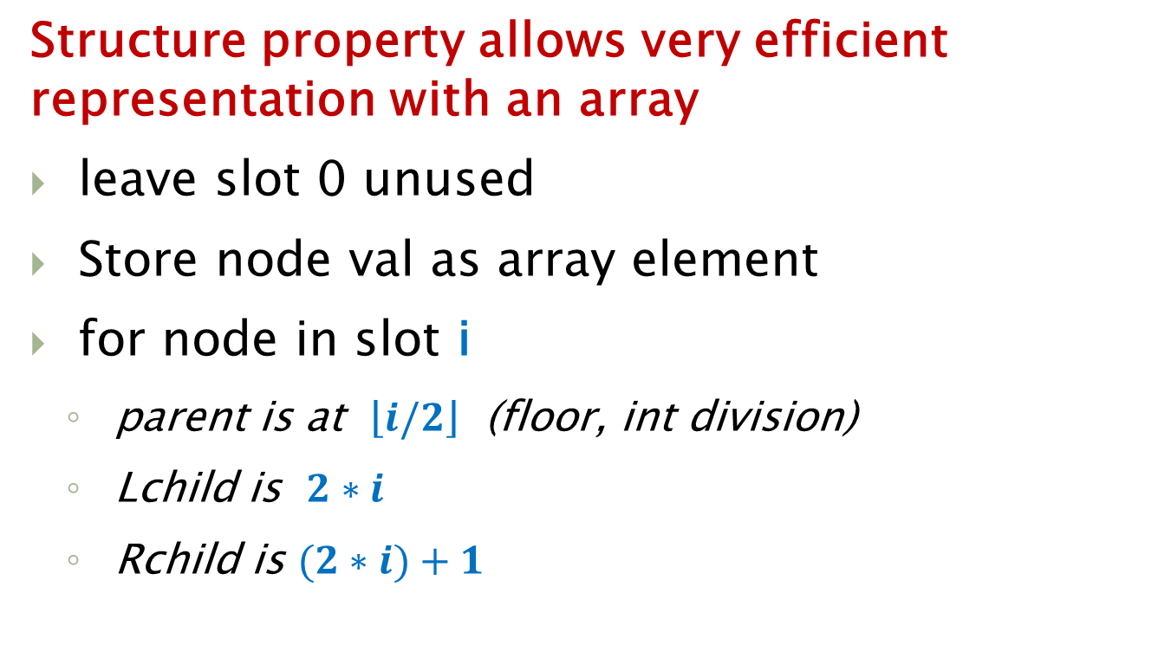
Implementation
Structure property allows very efficient representation with an array
leave slot 0 unused
Store node val as array element
for node in slot i
parent is at $\left\lfloor i/\left.2\right\rfloor \right.$ (floor, int division)
Lchild is $2∗i$
Rchild is $(2∗i)+1$

Slide 24
Example
3
To fill array, breadth-first across tree
root in slot 1: 3
then level 1 in slots 2,3: 7, 4
level 2 in slots 4,5,6,7: 16,12,11,9
next level in slots 8, 9, 10 …15: 31,18,21
Next item causes slot 11 to fill
7
4
16
12
11
9
31
18
21
3
7
4
16
12
11
9
31
18
21
0 1 2 3 4 5 6 7 8 9 10 11 ...

Slide 25
Example
To infer tree structure from array
node in slot 1: 3
Parent: floor(1/2) is 0 (root, no parent)
Lchild: 2*1 is 2, slot 2 has 7
Rchild: (2*1)+1 is 3, slot 3 has 4
3
7
4
16
12
11
9
31
18
21
3
7
4
16
12
11
9
31
18
21
0 1 2 3 4 5 6 7 8 9 10 11 ...

Slide 26
Example
To infer tree structure from array
node in slot 4 is 16
Parent: floor(4/2) is 2, slot 2 has 7
Lchild: 4*2 is 8, slot 8 has 31
Rchild: (4*2)+1 is 9, slot 9 has 18
3
7
4
16
12
11
9
31
18
21
3
7
4
16
12
11
9
31
18
21
0 1 2 3 4 5 6 7 8 9 10 11 ...

Slide 27
Example
3
7
4
node in slot 4 is 16
Parent: floor(4/2) is 2, slot 2 has 7
Lchild: 4*2 is 8, slot 8 has 31
Rchild: (4*2)+1 is 9, slot 9 has 18
16
12
11
9
31
18
21
parent
L-child
R-child
3
7
4
16
12
11
9
31
18
21
0 1 2 3 4 5 6 7 8 9 10 11 ...
half back
double forward

Slide 28
Insert
3
Next item causes slot 11 to fill
this maintains structure property
insert ( 17 )
still has heap-order property ?
We are good
( by luck of it being 17, > parent 12 )
7
4
16
12
11
9
31
18
21
17
3
7
4
16
12
11
9
31
18
21
17
0 1 2 3 4 5 6 7 8 9 10 11 ...

Slide 29
Insert… what if ?
3
insert ( 10 )
still has heap-order property ?
We are not good
( since 10 < parent 12 )
swap 10 with parent 12
Good here
And good here
7
4
16
12
11
9
31
18
21
10
3
7
4
16
12
11
9
31
18
21
10
0 1 2 3 4 5 6 7 8 9 10 11 ...
Slot 11 parent is floor(11/2) = 5

Slide 30
Swap-Up the Value
3
insert ( 2 )
Check for heap-order, swap upwards
repeat until we get it
In the array representation…
Slot 11 parent is floor(11/2) = 5
Slot 5 parent is floor(5/2) = 2
Slot 2 parent is floor(2/2) = 1
7
4
16
12
11
9
31
18
21
2
3
7
4
16
12
11
9
31
18
21
2
0 1 2 3 4 5 6 7 8 9 10 11 ...
Slot 11 parent is floor(11/2) = 5

Slide 31
Code details
Bubble up element
Each swap takes 3 assignments
O(log N) swaps
O(3 log N) is O(log N)
Book mentions “Bubble down hole”
Pull root element aside
Move child up into the “hole”
Repeat until heap-order achieved
Put root val into hole

Slide 32
Bubble-up the hole
3
insert ( 2 )
Check for heap-order, if 2 were put in the hole
Move parent down into hole,
check 2 again, and again
In the array representation
Move values into the hole,
hole moves to wards slot 1
7
4
16
12
11
9
31
18
21
temp
2
2
3
7
4
16
12
11
9
31
18
21
0 1 2 3 4 5 6 7 8 9 10 11 ...

Slide 33
BHEAP Operations
insert
put new val in next open slot in array/tree
swap/bubble up towards root until heap-order is achieved
O(log N) as it follows path to root (height)
getMin
just read the value at root (array slot 1)
O(1) complexity

Slide 34
BHEAP Operations
delMin
Remove root node val (it is min val)
Leaves a “hole” at root node
Pull out val in last leaf (eliminates a node)
See if it fits in root hole
If so, put leaf val into root hole
If not, move hole down to smaller child
repeat

Slide 35
delMin Example
2
delMin ( )
Remove root value
Save out last element
Bubble hole down from root
Stop when last element causes heap-order in the hole
Array representation
3
4
16
7
11
9
31
18
21
12
temp
2
3
4
16
7
11
9
31
18
21
12
0 1 2 3 4 5 6 7 8 9 10 11 ...

Slide 36
delMin Complexity
Remove root node: O(1)
Save out last element: O(1)
Bubble down the hole: O(log N)
One copy per bubble move, +1 at end
Swap down method: O(log N), but…
3 assigns per swap, O(log N) swaps
O(3 log N) is O(log N)

Slide 37
BHEAP Summary
 | Average | Worst case
insert | O(1) * | O(log n)
delete | O(log n) | O(log n)
getMin | O(1) | O(1)
search | O(n) | O(n)
½ to ¾ of the nodes are in the bottom 2 layers. Avg insert time is 2.67
which is O(1)

Slide 38
BHEAP has Limits
2
BHEAP is faster than BST for finding min
O(1) to just get root val
TANSTAAFL
Can’t get a full sort out of a BHEAP
directly like you can out of a BST
O(N) to traverse a BST to get a sort
How can we get a sort from a BHEAP ?
3
4
16
7
11
9
31
18
21
12
Array is NOT sorted
2
3
4
16
7
11
9
31
18
21
12
0 1 2 3 4 5 6 7 8 9 10 11 ...

Slide 39
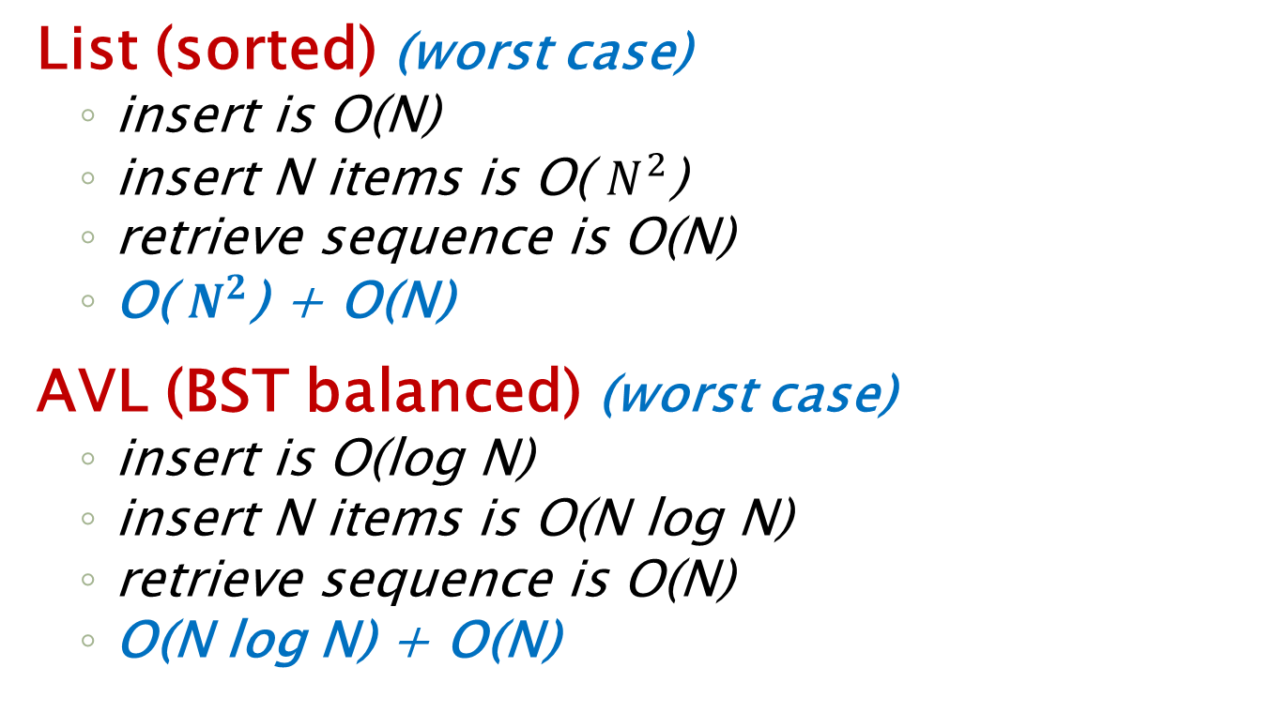
Sorting Review
List (sorted) (worst case)
insert is O(N)
insert N items is O( $N^{2}$)
retrieve sequence is O(N)
O( $N^{2}$) + O(N)
AVL (BST balanced) (worst case)
insert is O(log N)
insert N items is O(N log N)
retrieve sequence is O(N)
O(N log N) + O(N)

Slide 40
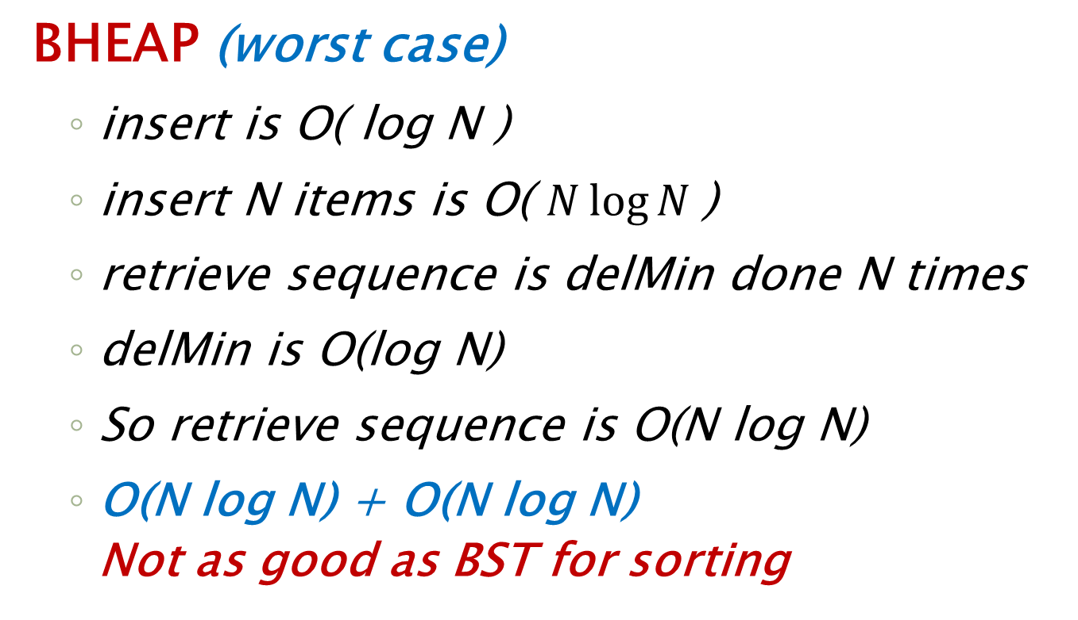
Sorting with BHEAP
BHEAP (worst case)
insert is O( log N )
insert N items is O( $N\log{N }$)
retrieve sequence is delMin done N times
delMin is O(log N)
So retrieve sequence is O(N log N)
O(N log N) + O(N log N)
Not as good as BST for sorting

Slide 41
Make BHEAP by N Inserts
Insert(6)
Insert(12)
Insert(9)
Insert(4)
6
6
6
6
6
4
12
12
9
12
9
4
9
6
9
4
12
12
Insert(5)
Insert(3)
4
4
4
4
3
6
9
5
9
5
9
5
3
5
4
12
5
12
6
12
6
3
12
6
9
12
6
9
O( N log N)

Slide 42
Efficient Build Heap
There is a method for building an initial heap from a list of N values that is O(N)
Structural Property
First load the N values into an array, from slot 1 to last… order you put them in is unimportant (gives structural property)
Heap-order
Start with parent of last node, and bubble down as needed (like in delete)
Go node to node, backwards to root, sequentially, and do this for each node

Slide 43
Make BHEAP by Build
Insert 6, 12, 9, 4, 5, 3
we have all values at the start so
no need to do individual Insert ops
6
12
9
4
5
3
0 1 2 3 4 5 6 7 8 9 10 11 …
Initial tree form
Now bubble down …
start with first non-leaf that has a child
6
What array slot is this?
parent of the last array item
Last item (3) is in slot 6.
Parent of 3 is floor(6/2) which is 9, in slot 3
12
9
4
5
3
So start bubble down at item in slot 3.

Slide 44
Bubble Down in Build
Initial tree form
6
6
6
12
9
12
3
4
3
4
5
3
4
5
9
12
5
9
Heap we got with N separate inserts
3
3
5
4
4
6
12
6
9
12
5
9

Slide 45
Bubble Down in Build
Initial tree form
16
16
16
12
9
12
3
4
3
4
5
3
4
5
9
12
5
9
Bubble down goes to leaf if needed
3
3
4
16
4
9
12
5
9
12
5
16

Slide 46
Sorting with new Build
Build heap : O(N)
Retrieve sequence:
N * delMin( )
is N * O(log N)
Final sort: O(N) + O(N log N)

Slide 47
END
Beyond this is just templates

Slide 48
Example
3
12
9
16
24
11
19
21
18
31
41
29
63
0 1 2 3 4 5 6 7 8 9 10 11 ...

Slide 49
Example
3
12
19
16
14
17
23
15
18
21
41
31
0 1 2 3 4 5 6 7 8 9 10 11 ...

Slide 50
Example
13
22
15
26
44
19
53
35
28
83
61
21
0 1 2 3 4 5 6 7 8 9 10 11 ...

Slide 51
Example
3
12
9
16
24
11
19
21
18
41
0 1 2 3 4 5 6 7 8 9 10 11 ...

