Slide 1

Data Structures and Analysis (COMP 410)
David Stotts
Computer Science Department
UNC Chapel Hill

Slide 2
Lists and List-based
Data Structures
(Stack, Queue)

Slide 3
Lists
Lists are one of the first data structures extensively studied and used
LISP: List Processing
Invented by John McCarthy at MIT in 1958, used list as the main way of representing data and programs
Second oldest major PL, only Fortran is older (by 1 year)
Other data structures were built using lists
Still heavily used today, in variants like Scheme, and Common Lisp

Slide 4
In General… with data structures
Don’t worry too much about exact operation names
In your code you will be given operation names
In these slides the names we use might differ a bit from your text, or other web explanations
Most data structures will have at least 3 kinds of operations
-- add an item (build a structure)
-- remove an item (un-build a structure)
-- find an item (search a structure)

Slide 5
ADT: LIST of Elt
OO Signature (methods)
ins: Elt x Int → Boolean (add)
rem: Int → Boolean (remove)
get: Int → Elt (searching)
find: Elt → Int (searching)
size: → Nat (natural number)
empty: → Boolean

Slide 6
ADT: LIST of Elt
Functional Signature
new: → LIST
ins: LIST x Elt x Int → LIST
rem: LIST x Int → LIST
get: LIST x Int → Elt
find: LIST x Elt → Int (searching)
size: LIST → Nat (natural number)
empty: LIST → Boolean

Slide 7
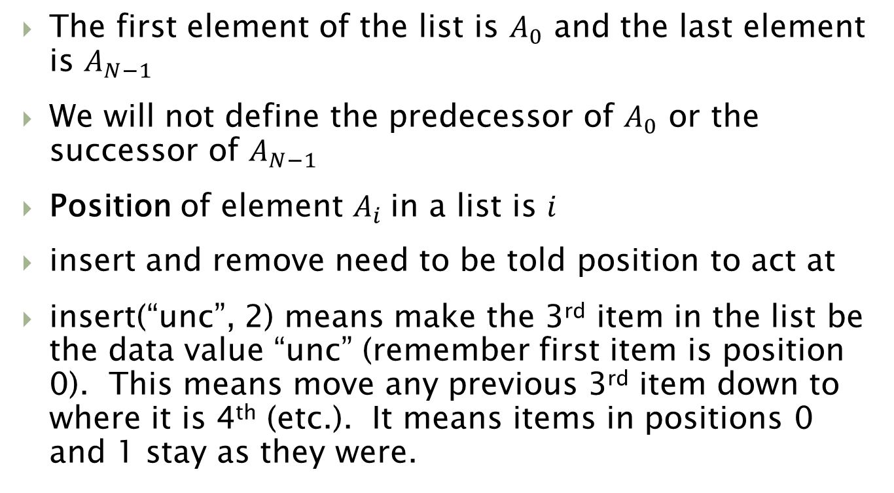
Behavior: ins and rem
The first element of the list is $A_{0}$ and the last element is $A_{N−1}$
We will not define the predecessor of $A_{0}$ or the successor of $A_{N−1}$
Position of element $A_{i}$in a list is $i$
insert and remove need to be told position to act at
insert(“unc”, 2) means make the 3rd item in the list be the data value “unc” (remember first item is position 0). This means move any previous 3rd item down to where it is 4th (etc.). It means items in positions 0 and 1 stay as they were.

Slide 8
Using a List Object
var lst = new LIST( );
print( lst.empty() );
print( lst.size() );
lst.ins( “hi”,0 );
lst.ins( “lo”,0 );
print( lst.get(0) );
print( lst.get(1) );
print( lst.size() );
“hi”
“lo”
“hi”
0
1

Slide 9
Using a List Object
“lo”
“hi”
lst.ins(“un”,1);
lst.rem(0);
print( lst.get(0) );
print( lst.find(“hi”) );
print( lst.size() );
print( lst.empty() );
“lo”
“un”
“hi”
“un”
“hi”
0
1
2

Slide 10
Behavior? Properties?
What are the behavioral properties we must have an implementation exhibit?
On ins, the elements that were in the list before, remain in the list after
On ins, the elements that were in the list before are in the same relative order after
On rem, the elements that remain after are in the same relative order as before
On ins the size increases by at most 1
On rem the size decreases by at most 1
Empty lists have size 0

Slide 11
Behavior? Properties?
More behavioral properties …
A list does not fill up… there is no maximum size
A list starts with the first element in position 0
On ins, when adding to position i, the list elemets from 0 to i-1 are the same (and in the same order) before and after; the list before from i to “size-1” has positions i+1 to “size” after
If we have a list with N items, then they are in positions 0 to N-1, and adding to a position larger than N cannot happen
On get(k) , the element is produced such that there are k elements before it in the list
On get(k), if k > size-1 then it cannot happen

Slide 12
LIST Implementation
Two main ways: array and linked structure
Array:
31
17
8
1
0
1
2
3
4
5
ins( 27, 2 )
31
17
27
8
1

Slide 13
LIST Implementation
Array: Time complexity of operations
ins O(n) takes time proportional to list length
rem O(n)
get O(1) we also say constant time
find O(n) content searching
empty O(1)
size O(1)

Slide 14
LIST Implementation
head
linked structure
31
17
8
1
ins( 27, 2 )
31
17
8
1
head
27

Slide 15
LIST Implementation
Linked: Time complexity of operations
insCell O(1) move 2 link pointers
remCell O(1)
ins(e,i) O(n) + O(1) is O(n)
get + insCell
rem(i) O(n) + O(1) is O(n)
get O(n) no index like array
find O(n) content searching
empty O(1)
size O(n), or O(1) if keep a counter

Slide 16
Our First Sort
Let’s look at using a linked list for solving an important problem
Sorting: We are given a sequence of numbers and asked to produce the sequence in sorted order, smallest to largest
Basic idea:
Create a new (empty) linked list.
Add each item from input to the list, at the proper place by sort order
In this way, list is always sorted

Slide 17
LIST Sorting
head
linked
4
7
18
31
Input: 18, 7, 31, 4, 12, 72, 8, 63, 10
head
4
7
18
31
< 12
>= 12
12

Slide 18
ADT Behavior
An “insort” op will insert an element in the right place… if we start with a sorted list, the op will create a list that ends up still sorted, but with a new element in it.
We will allow duplicates… so every “insort” will extend the list
The new op will put the element in between the first two elements it finds that it fits between.
In case of duplicates, put the new element before the first occurrence of its duplicate.
Might help to have a version of “find” that will locate the place the new elt belongs

Slide 19
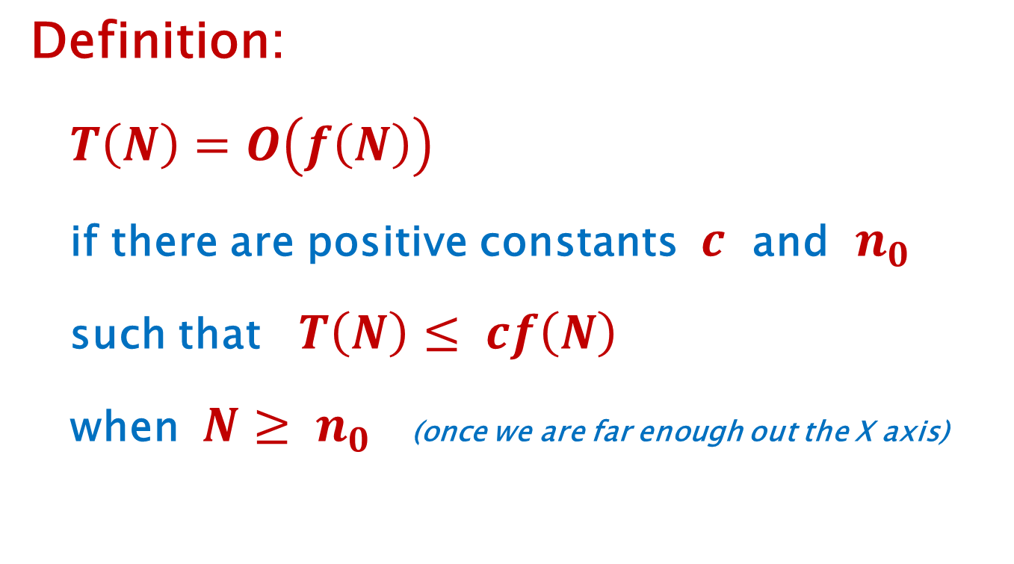
LIST Sorting
What is the time complexity of this algorithm?
What is cost of adding the next input item?
O(N)
How many “next” items are there?
N
O(N)*O(N)
which is O($N^{2}$)

Slide 20
More Detailed Analysis
What is the time complexity of this algorithm?
First insert takes 1 unit of work
Second insert takes 2
Third insert takes 3
Nth takes N units of work
Total work is 1+2+3+ … +N
SUM(k) for k=1 to N is (½)N(N+1) is (½)N^2 + (½)N
this term dominates ^
ignore this term ^

Slide 21
Another view
What is the time complexity of this algorithm?
N
N-1 . . .
.
. blue area is N^2 work units
. green area above purple line
3 is about ½ N^2
2
1
1 2 3 . . . N-1 N

Slide 22
Build on LIST
STACK and QUEUE are LISTs with special access disciplines
STACK is LIFO, access top only
QUEUE is FIFO, access ends only
This gives efficient implementation benefits
No find (search) by content
No get (go into center of list)

Slide 23
Build on LIST
Special lists are useful for solving many problems
STACK: reversing sequences, balancing parens
QUEUE: fairness, maintain order of arrival

Slide 24
Stack
LIFO: last in first out
new()
push(73)
push(8)
push(-61)
push(12)
top
12
-61
size is 4
8
73

Slide 25
Stack
pop( )
12
top
-61
top
-61
8
8
size is 3
73
73

Slide 26
STACK of Int Signature (Java)
new: → STACK
push: Int → void
pop: → void
top: → Int
size: → Nat (natural number)
OR… maybe something like this
new: → STACK
push: Int → Boolean
pop: → Boolean (or maybe Int)
top: → Int
size: → Nat

Slide 27
Using a Stack Object
var stk = New STACK( );
print( stk.size( ) ); // 0
stk.push(73);
stk.push(8);
print( stk.top( ) ); // 8 most recent pushed
stk.push(-61);
stk.push(12);
print( stk.top( ) ); // 12 is most recent pushed
print(stk.size( ) ); // 4
stk.pop( ); // removes the 12 on top
print( stk.size( ) ); // 3
print( stk.top( ) ); // -61 is now on top

Slide 28
Uses for a Stack Object
Stacks used to reverse sequences
Data comes in: A, B, C, D
Push each data item as you get it
push(A), push(B), push(C), push(D)
When data is done, pop until stack is empty
pop( ) → D
pop( ) → C
pop( ) → B
pop( ) → A

Slide 29
QUEUE
FIFO: first in, first out
new( )
enq(4)
enq(-31)
enq(15)
tail
front
size is 3
4
31
15

Slide 30
QUEUE
front
tail
4
31
15
deq ( )
front
tail
31
15
size is 2

Slide 31
QUEUE of Int Signature (Java)
new: → QUEUE
enq: Int → void
deq: → void
front: → Int
size: → Nat (natural number)
OR… maybe something like this
new: → QUEUE
enq: Int → Boolean
deq: → Boolean (or maybe Int)
front: → Int
size: → Nat (natural number)

Slide 32
Using a Queue Object
var que = New QUEUE( );
print( que.size( ) ); // 0
que.enq(73);
que.enq(8);
que.enq(-61);
que.enq(12);
print(que.size( ) ); // 4
print( que.front( ) ); // 73 is at the head
que.deq( ); // removes 73
print( que.size( ) ); // 3 items remain
print( que.front( ) ); // 8 is at the head

Slide 33
Complexity
STACK:
top (get) is now O(1) (only top item available)
push (ins) is now O(1) (how with array impl?)
QUEUE:
enq is O(1) for linked impl
deq is O(1)
enq is O(1) for array impl
deq is O(n) why?

Slide 35
Formal ADT Semantics
This segment will cover how to define the
Behavior
of a data structure without being bogged down in the details of an
Implementation
of the operations

Slide 36
ADT is a definition
One ADT definition
will be correct for
Many implementations
Define the behavior once, then
it guides implementation
it provides an oracle for determining correctness of the code

Slide 37
How can Data be Abstract?
We want a model …
Left out:
details related to implementation in any particular programming language
Left in:
changes made to state of the data (the values and their relationships) when various operations are performed

Slide 38
Guttag’s Method
Use a functional notation to define functions (no surprise there)
We think of ADTs as a model for objects in programs, so there is a slight mismatch…
Function takes input and produces output, like a black box… no state remains
Object has persistent state and a method call alters that state

Slide 39
Using a Stack Object
var stk = New STACK( );
print( stk.size( ) );
stk.push(73);
stk.push(8);
stk.push(-61);
stk.push(12);
print(stk.size( ) );
stk.pop( );
print( stk.size( ) );
print( stk.top( ) );

Slide 40
Functional view
stk = new ( );
print ( size ( stk ) );
stk = push(stk,73);
stk = push(stk,8);
stk = push(stk,-61);
stk = push(stk,12);
print(size(stk));
stk = pop(stk);
print(size(stk));
print(top(stk));

Slide 41
Specifying (Defining) an ADT
First develop the functional signature
list of all operations, the types of the arguments to them, and the types of the results
Next provide an axiomatic specification of the behavior of each operation (method)
Today we will use a math notion to get used to the idea of specifying ADTs
Next time we will use ML (and get executable specifications)

Slide 42
Example: STACK of Int
Signature
new: → STACK
push: STACK x Int → STACK
pop: STACK → STACK
top: STACK → Int
size: STACK → Nat (natural number)

Slide 43
Example: STACK of Int
Axioms for Behavior
Idea is to write an equation (axiom) giving two equivalent forms of the data structure
pop ( push ( new(), -3 ) ) = new( )
LHS same as RHS
pop(push(push(new(), 7) ,4) ) = push(new(),7)
Similar to axioms in integer algebra
2 + 2 + 3 = 2 + 5

Slide 44
Example: STACK of Int
Axioms for STACK Behavior
Ex: size( new() ) = 0
Ex: size( push( new(), 6 ) ) = 1
Ex: top ( push ( push ( new(), 3 ), -8 ) ) = -8
Ex: pop ( push ( new(), -3 ) ) = new()
Ex: top(pop(push(push(new(),2),7))) = 2
More?
Will this end?
How can we capture all possible behavior?

Slide 45
Back to STACK of Int
top
How can we create this element of type STACK ?
push( push( new,8 ), 5)
push( push( pop ( push(new,12) ), 8), 5)
pop( push( push( push( new, 8), 5), 9) )
push( push( pop( push( pop( new ), 8), 8), 8), 5)
push( pop( pop( push( push( push( new, 8), 5), -10) ) ), 5)
unlimited ways…
5
Which is the “easiest way” to construct it?
-- the first one… no pop use
Can any ST in STACK be built with no “pop” use?
-- yes… sequence of push on a new
8
push and new are “canonical” operations

Slide 46
Back to STACK of Int
A canonical operation is one that is needed if your goal is to generate ALL possible stack values by calling successive operations
A non-canonical op is one that is not needed… in other words, all uses of it can be replaced by some use of others (canonicals).
Ex: push ( pop ( push ( new(), 6) ), 3)
is the same as
push ( new(), 3 )
the pop operation is not needed to create the
stack with a single element, the “3”

Slide 47
Back to Guttag
Follow this procedure to generate set of axioms that are finite and complete
Find canonical operations
Make all LHS for axioms by applying each non-canonical op to a canonical op (cross product)
Use your brain and create an equivalent RHS for each LHS

Slide 48
STACK (cont.)
STACK ops: new, push, pop, top, size
Canonicals: new, push
Note that all ops that return something other than STACK are non-canonical (top, size)
Canonicals are ops that construct values, and even so only the necessary ones
pop constructs… it returns a STACK
But we showed it can be successfully avoided with judicious use of new and push

Slide 49
STACK (cont.)
LHS of axioms (non-canon applied to canon)
size( new( ) ) = ?
size( push( S, i ) ) = ?
pop( new( ) ) = ?
pop( push( S, i ) ) = ?
top( new( ) ) = ?
top( push( S, i ) ) = ?

Slide 50
STACK (cont.)
LHS of axioms (non-canon applied to canon)
size( new( ) ) =
size( push( S, i ) ) =
pop( new( ) ) =
pop( push( S, i ) ) =
top( new( ) ) =
top( push( S, i ) ) =
0
size( S ) + 1
new( )
S
err
i

Slide 51
Notes
How do the axioms specify behavior like “when we pop a STACK the size goes down by one” ?
Think of STACK values as sequences of ops
push( pop( push( push(new( ),6), 3 ) ), 4 )
Think of axioms as rules for rewriting these sequences into simpler form
pop( push(S,i) ) = S
lets us rewrite by pattern matching parts of the sequence with variables in the axiom

Slide 52
Notes
Lets us rewrite by pattern matching parts of the sequence with variables in the axiom
STACK: push( pop( push( push(new(),6), 3 ) ), 4 )
AXIOM: pop( push( S, i ) ) = S
In the STACK value this part is S from the AXIOM
S matches push(new(),6)
Axiom rewrites the STACK as
push( push( new(), 6) , 4 ) size is 2
3 pushes in STACK value, but size is 2 when done

Slide 53
Notes
Why non-canonical applied to canonical?
Canonical op constructs (or extends) a STACK
Non-canonical op then measures it… tells us something about its state
“We just built a STACK by using push on some previous STACK.. what happens to the size? what item is now on top? “ etc.

Slide 54
Example: QUEUE of Int
Signature
new: → QUEUE
enq: QUEUE x Int → QUEUE
deq: QUEUE → QUEUE
front: QUEUE → Int
size: QUEUE → Nat (natural number)
Canonical ops
Note: we never ask “what is on the back of the Queue?”
This is not an operation in the abstract behavior
(it is something an implementation can reveal)

Slide 55
QUEUE (cont.)
LHS of axioms (non-canon applied to canon)
size( new( ) ) = ?
size( enq( Q, i ) ) = ?
deq( new( ) ) = ?
deq( enq( Q, i ) ) = ?
front( new( ) ) = ?
front( enq( Q, i ) ) = ?

Slide 56
QUEUE (cont.)
LHS of axioms (non-canon applied to canon)
size( new( ) ) = 0
size( enq( Q, i ) ) = size(Q) + 1
front( new( ) ) = err
front( enq( Q, i ) ) = ite( Q=new( ), i, front(Q) )
deq( new( ) ) = new()
deq( enq( Q, i ) ) =
ite( Q=new( ), Q, enq( deq(Q), i) )

Slide 57
Functional vs. Java
The signatures have been expressed in functional notation (since axiomatic definitions are functional)
Functional signatures help when “implementing” ADT behavior is a functional language like ML (or LISP)
Java is not functional, so signature will look a little different

Slide 58
Formal List Semantics
Following are Guttag Axioms for LIST
You may study them if you are interested but you may ignore them for now as well

Slide 59
ADT: LIST of Elt
Signature
new: → LIST
ins: LIST x Elt x Int → LIST
rem: LIST x Int → LIST
get: LIST x Int → Elt
find: LIST x Elt → Int (searching)
size: LIST → Nat (natural number)
empty: LIST → Boolean

Slide 60
Behavior for LIST
LIST ops: new, ins, rem, get, find, size, empty
Axioms LHS
rem( new(), i ) = ?
rem( ins(L,e,k), i ) = ?
get( new(), i ) = ?
get( ins(L,e,k), i ) = ?
find( new(), e ) = ?
find( ins(L,e,i), f ) = ?
size( new() ) = ?
size( ins(L,e,i) ) = ?
empty( new() ) = ?
empty( ins(L,e,i) ) = ?

Slide 61
Behavior for LIST 1.3
size( new() ) =
0
size( ins(L,e,i) ) =
size(L) + 1
empty( new() ) =
true
empty( ins(L,e,i) ) =
false
get( new(), i ) =
err
get( ins(L,e,k), i ) =
if ( i=k )
then e
else if (i<k) then get( L, i )
else (* i>k *) get(L, i-1)

Slide 62
Behavior for LIST 2.3
find( new(), e ) =
err
find( ins(L,e,i), f ) =
if ( e=f )
then i
else if ( find( L, f ) < i )
then find( L, f )
else find( L, f ) + 1
This finds *some* instance of f , if it’s there
What if we need to find the first instance of f ?

Slide 63
Behavior for LIST 3.3
rem( new(), i ) =
new()
rem( ins(L,e,k), i ) =
if ( i=k )
then L
else if (i>k)
then ins( rem(L,i-1), e, k )
else ins( rem(L,i), e, k-1 )

Slide 64
Implementation?
We can use ML to write these ADT specs
With ML we can then “execute” the specs and see if the behavior is what we like
Download and install ML on your computer and if you like you can begin to try ML…
OR.. Online ML interpreter:
https://www.tutorialspoint.com/execute_smlnj_online.php
See the ML notes on the class website

Slide 65
END

