Slide 1

Data Structures and Analysis (COMP 410)
David Stotts
Computer Science Department
UNC Chapel Hill

Slide 2
Sorting

Slide 3
Sorting
Fundamental Problem in many applications
Ebay:
I got 300,000 hits on my search for “widgets” please put them into “ending soonest” order
Put them into “lowest price first” order
This happens in ½ second or so
Efficiency is critical for large data sets

Slide 4
Bubble Sort
Bubble Sort has been our gold standard for badness
O(N^2) worst case time complexity for lists of N items
It works “in-place”
means if we have the items in an array, the sort happens without needing another array of size N as “temp” space
It is “stable”
means it preserves original order for items with the same value

Slide 5
Stability
Original unsorted list:
3, 5, 1, 8, 2, 7, 9, 2, 4
Stable sort gives this:
1, 2, 2, 3, 4, 5, 7, 8, 9
Unstable sort might give this:
1, 2, 2, 3, 4, 5, 7, 8, 9
This matters if you have secondary keys to sort on as well as primary key

Slide 6
Insertion Sort
Insertion Sort is a comparison and “swap” sort
O(N^2) worst case time complexity for lists of N items
in-place
Pass through main array once
Compare current item to its up neighbor
If out of order, pull out up neighbor and shift elements up until you find a slot the item belongs between
“insert” due to shifting
, stable
Stable ?
YES

Slide 7
Selection Sort
Selection Sort is a comparison and “swap” sort
O(N^2) worst case time complexity for lists of N items
in-place
not inherently stable (due to long range swaps)
Pass through main array N times
Each pass i, find smallest item in array and swap it with slot i
Stable ?
NO

Slide 8
Heap Sort
Heap Sort we studied with heaps
O(N log N) worst case time complexity for list of N items
not in-place (the way we discussed in class is not)
not stable (due to heap)
Do BuildHeap with array of items ( O(N) )
Do delMin N times back into array ( O(N log N) )
Stable ?
NO

Slide 9
In-Place Heap Sort
Heap Sort can be done in-place (still not stable)
BuildHeap loads all elements into an array
delMin removes an element from heap array
This makes one array slot open (at the end)
Put removed element at array end (heap last+1)
Keep doing this… when heap is empty array will contain all the elements in reverse order

Slide 10

In-Place Heap Sort
Elements: 7, 2, 19, 8, 11, 4, 16
Load heap array: x 7 2 19 8 11 4 16
0 1 2 3 4 5 6 7
Complete Build: x 2 7 4 8 11 19 16
0 1 2 3 4 5 6 7
First delMin: x 4 7 16 8 11 19 2
0 1 2 3 4 5 6 7
Next delMin: x 7 8 16 19 11 4 2
0 1 2 3 4 5 6 7
Final array: x 19 16 11 8 7 4 2
0 1 2 3 4 5 6 7
such that $T\left(N\right)≥ c1 ∗ f\left(N\right)$

Slide 11
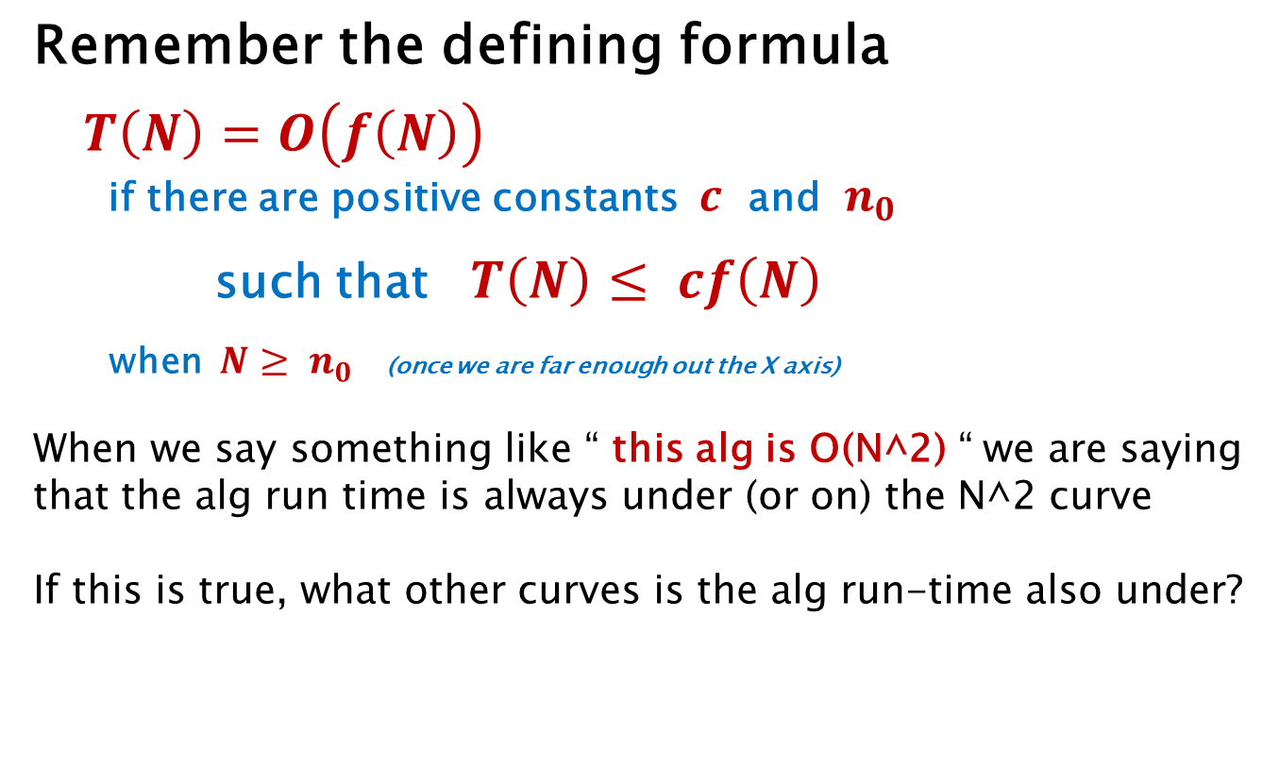
Recall: Big O is an Upper Bound
Remember the defining formula
$T\left(N\right)=O\left(f\left(N\right)\right)$
if there are positive constants $c$ and $n_{0}$
such that $T\left(N\right)≤ cf\left(N\right)$
when $N≥ n_{0}$ (once we are far enough out the X axis)
When we say something like “ this alg is O(N^2) “ we are saying that the alg run time is always under (or on) the N^2 curve
If this is true, what other curves is the alg run-time also under?
5N^2, N^3, N^5, 15*(2^N), N!, etc.

Slide 12
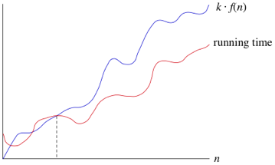


Big Ο Visual Illustration
$$cf\left(N\right)$$
$$n_{0}$$
N
( adapted from Kahn Academy )

Slide 13
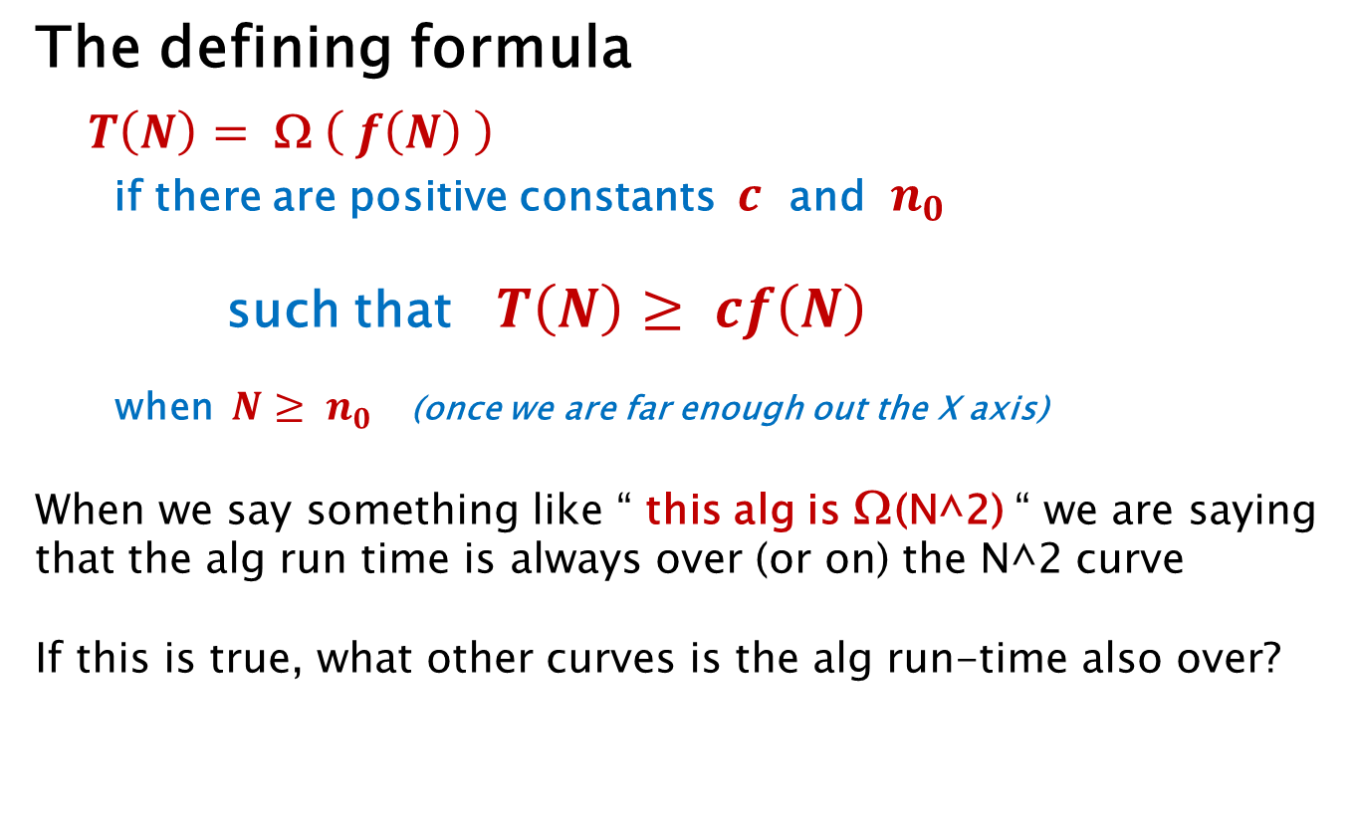
Big Ω is Lower Bound
The defining formula
$T\left(N\right)=$ Ω $\left( f\left(N\right) \right)$
if there are positive constants $c$ and $n_{0}$
such that $T\left(N\right)≥ cf\left(N\right)$
when $N≥ n_{0}$ (once we are far enough out the X axis)
When we say something like “ this alg is Ω(N^2) “ we are saying that the alg run time is always over (or on) the N^2 curve
If this is true, what other curves is the alg run-time also over?
N, sqrt(N), log N, N log N, 1, etc.

Slide 14
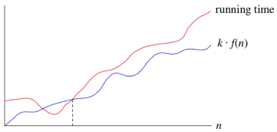


Big Ω Visual Illustration
$$cf\left(N\right)$$
$$n_{0}$$
N
( adapted from Kahn Academy )

Slide 15
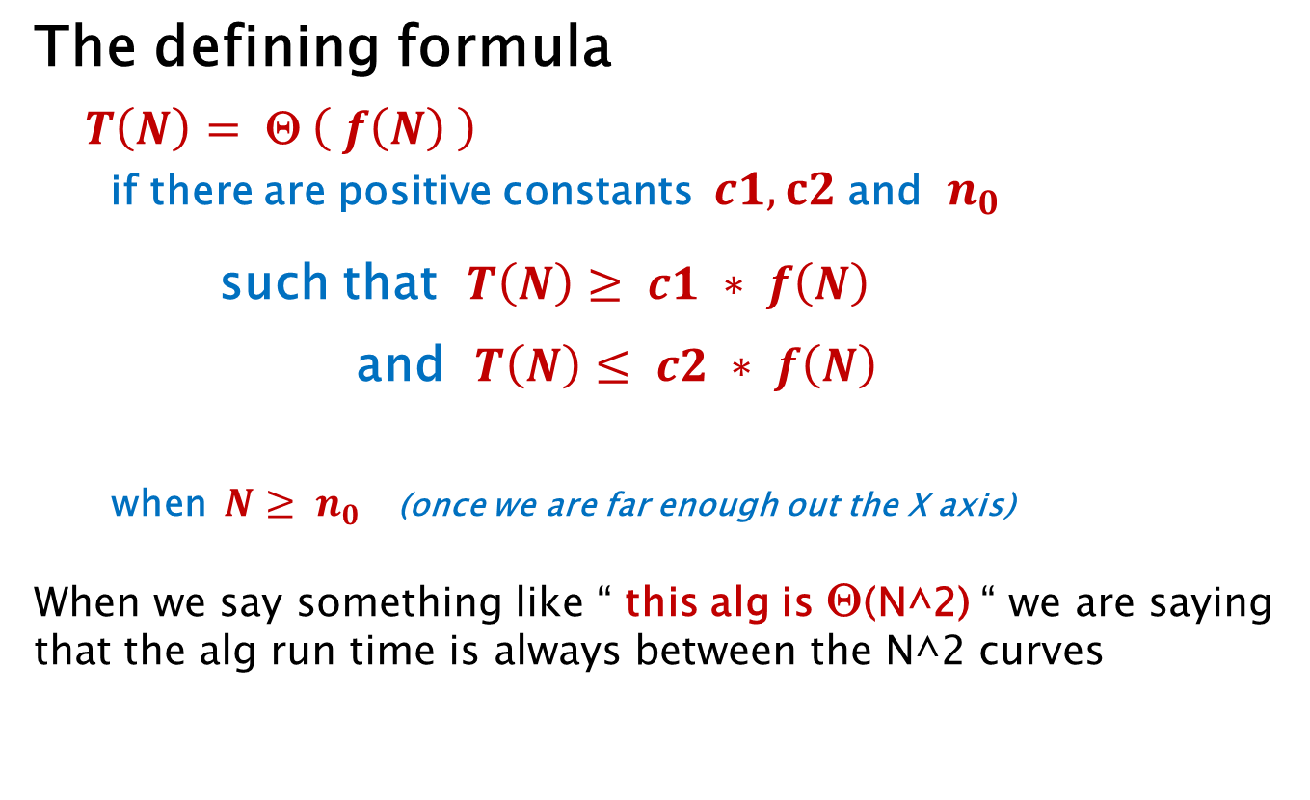
Big Θ is Both Bounds
The defining formula
$T\left(N\right)=$ Θ $\left( f\left(N\right) \right)$
if there are positive constants $c1, c2$and $n_{0}$
such that $T\left(N\right)≥ c1 ∗ f\left(N\right)$
and $T\left(N\right)≤ c2 ∗ f\left(N\right)$
when $N≥ n_{0}$ (once we are far enough out the X axis)
When we say something like “ this alg is Θ(N^2) “ we are saying that the alg run time is always between the N^2 curves

Slide 16
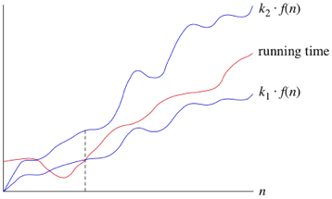



Big Θ Visual Illustration
$$c2∗f\left(N\right)$$
$$c1∗f\left(N\right)$$
$$n_{0}$$
N
( adapted from Kahn Academy )

Slide 17
Complexity of Sorting
Sorting by swapping two elements
We know it is O( N log N ) from other discussions
We can prove it is Ω( N log N ) … see text, using decision tree
So this means it is also Θ( N log N )

Slide 18
Merge Sort
Merge Sort we discussed when I had to sort your midterms
O(N log N) worst case time complexity for list of N items
can be in-place, usually done with extra arrays
can easily be made stable
Halve list repeatedly until single elements ( O(log N) )
Merge neighbor 1-lists into 2-lists
Repeat (2-lists, into 4-lists, etc.)
Stable ?
YES

Slide 19
Analysis of Merge Sort
Solve a recurrence relation
T(1) = 1 time to MS list of size 1
T(N) = 2 * T(N/2) + N time to MS list of size N
time to merge 2 halves
time to MS sort half the list
T(N) = 2 * T(N/2) + N divide both sides by N
---- -------------
N N
T(N) T(N/2)
---- = ------ + 1
N N/2

Slide 20
Analysis of Merge Sort
Solve a recurrence relation
T(N/2) T(N/4) if it works for N, then also N/2
------ = ------ + 1
N/2 N/4
T(N/4) T(N/8) if works for N/2, then also N/4
------ = ------ + 1
N/4 N/8
. . . etc.
T(2) T(2/2) to smallest divide in the sort
----- = ------ + 1
2 2/2
T(2) = T(1) + 1
---- ----
2 1

Slide 21
Analysis of Merge Sort
Sum up all these equations… (Sum all LHS) = (Sum all RHS)
T(N) T(N/2) T(N/4) T(N/8) . . . T(2)
---- + ------ + ------ + ------ + + ----
N N/2 N/4 N/8 2
=
T(N/2) T(N/4) T(N/8) . . . T(2) T(1)
------ +1 + ------ +1 + ------ +1 + + ---- +1 + ---- +1
N/2 N/4 N/8 2 1
T(N) T(1)
---- = ---- + 1 + 1 + 1 + . . . + 1
N 1
log N of these

Slide 22
Analysis of Merge Sort
Sum up all these equations… (Sum all LHS) = (Sum all RHS)
T(N) T(1)
---- = ---- + 1 + 1 + 1 + . . . + 1
N 1
T(N)/N = T(1) + log N
T(N) = N + N log N
so T(N) is O( N log N )
log N of these
T(1) = 1 from first eqns

Slide 23
Quick Sort
Quick Sort is a comparison/swapping sort
O(N log N) average case time complexity of for lists of N items
Worst case is O(N^2) but it is rare so Quick Sort is heavily used
in-place
not stable (due to long range swaps)
An example (see videos)

Slide 24
Combo Sorts
Selection and Insertion are worst case O(N^2) but in practice they are efficient for small lists
Merge and Quicksort are efficient on large sets but slow on small lists due to dividing, merging, recursive calls, etc.
Common to do Merge/Quick until sub-lists get smallish, then finish small lists with (say) Insertion sort

Slide 25
END

Slide 26
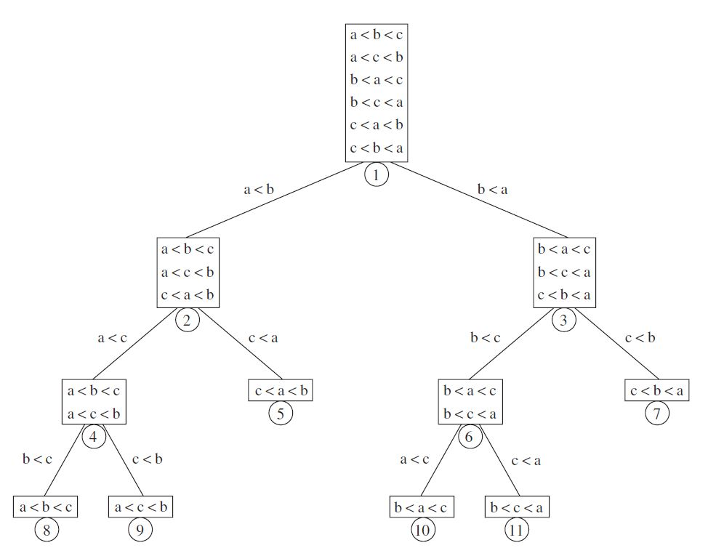
Decision Tree for Comparison Sorting

