Slide 1

Data Structures and Analysis (COMP 410)
David Stotts
Computer Science Department
UNC Chapel Hill

Slide 2
Tree Data Structures
binary tree
binary search tree (BST)

Slide 3
Binary Tree
“lo”
Tree with arity 2
Every node has max of two children
“ok”
“hi”
“ya”
“re”
“ad”
“so”
“ti”
“fa”
“mi”
“tu”
“no”
“ok”
“go”
“zz”
arity 2, a binary tree

Slide 4
Binary Tree Implementation
Linked structure
BinCell {
root: string
left: BinCell
right: BinCell
}

Slide 5
Binary Search Tree
A binary search tree (BST) is a binary tree (BT) with a special condition on how data values in the nodes relates to each other
BST is a subset of BT
Every BST is also a BT
Every BT is NOT necessarily a BST
Some BT are not BST… some are

Slide 6
Binary Search Tree
A binary search tree (BST) gives us a way to organize a set of data values for rapid access
At least, we want that
We will see that adding and removing data,
and finding data,
will be efficient on average
but might be bad if we hit worst case

Slide 7






Binary Search Tree
Binary tree with extra conditions
val > all vals in
val < all vals in
let’s assume no duplicates for now
and are both BST
We can use a BST when the values can be ordered
Ex: int, real, string, char
Won’t work for organizing images, files, functions, etc. unless you can define some lessThan, Eq functions for the data
$$T_{L}$$
val
$$T_{R}$$
$$T_{L}$$
$$T_{R}$$
$$T_{L}$$
$$T_{R}$$

Slide 8
Not every Binary Tree is BST
6
6
2
8
2
8
1
4
7
1
4
5
3
5
3
7
Binary, and is BST
Binary, but not BST

Slide 9
Degenerate Case
1
7 elements in each
2
6
3
2
9
5
is BST
6
1
5
7
height is 6
is BST
7
3
height is 3
9

Slide 10
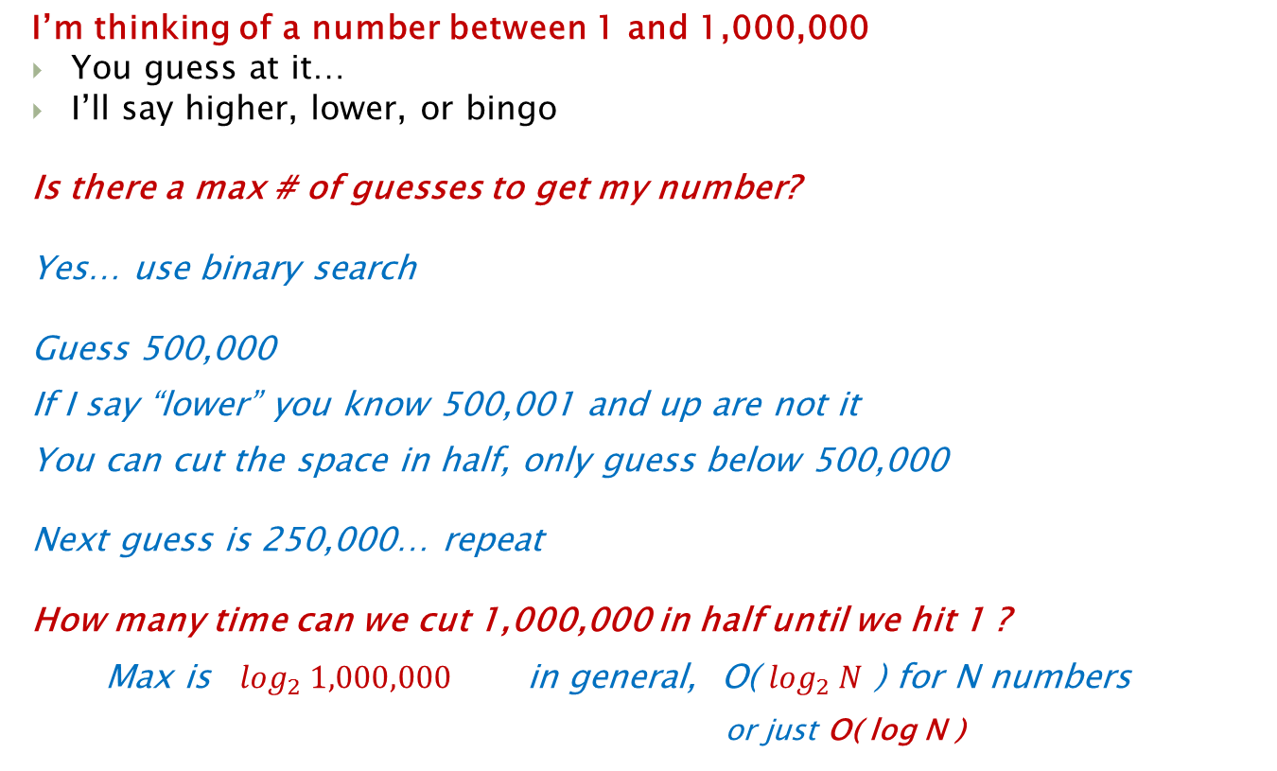
Number Guessing Game
Log base 2 of 1,000,000
is about
20
I’m thinking of a number between 1 and 1,000,000
You guess at it…
I’ll say higher, lower, or bingo
Is there a max # of guesses to get my number?
Yes… use binary search
Guess 500,000
If I say “lower” you know 500,001 and up are not it
You can cut the space in half, only guess below 500,000
Next guess is 250,000… repeat
How many time can we cut 1,000,000 in half until we hit 1 ?
Max is $\log_{2} 1,000,000$ in general, O( $\log_{2} N$ ) for N numbers
or just O( log N )
guesses
Random (linear) guessing takes avg of 500,000 guesses

Slide 11
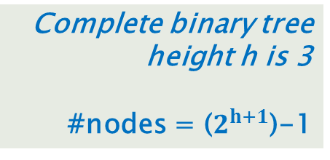
Number Guessing has a BST
8
4
12
2
6
10
14
1
3
5
7
9
11
13
15
Complete binary tree
height h is 3
#nodes = ($2^{h+1}$)-1

Slide 12
ADT: BST of Elt
OO Signature
new: → BST
insert: Elt → Boolean
remove: Elt → Boolean
findMin: → Elt
findMax: → Elt
contains: Elt → Boolean (searching)
get: Elt → BST (return a cell)
val: → Elt (get root value)
size: → Int+ (non-negative integers)
empty: → Boolean
height: → Int+

Slide 13
“contains” in BST
contains(3)
6
Start at root… is root val 3 ?
val: 6
no, so is root val > 3 ?
Yes, so go left
2
8
Is left root val = 3 ?
No, so is val > 3 ?
No, so go right
val: 2
1
4
Is right root val = 3 ?
No, so is val > 3 ?
yes, so go left
3
val: 4
Is right root val = 3 ?
yes, so we got it
val: 3

Slide 14
“contains” code
In node object… contains ( elt )
if ( this.val == elt ) {
// found it
return true;
} else if ( this.val > elt ) {
// item has to be in left subtree
return this.LChild.contains(elt);
} else {
// this.val < elt, so elt has to be in right subtree
return this.Rchild.contains(elt);
}
6
2
8
1
4
3
But this is not complete…
No false returns

Slide 15
“contains” code
In node object… contains ( elt )
if ( this.val == elt ) {
// found it
return true;
} else if ( this.val > elt ) {
// item has to be in left subtree
if (this.LChild ==null) return false;
else return this.LChild.contains(elt);
} else {
// this.val < elt, so elt has to be in right subtree
if (this.Rchild==null) return false;
else return this.Rchild.contains(elt);
}
6
2
8
1
4
3

Slide 16
“insert” in BST
insert(5)
6
6
8
2
8
2
1
4
7
1
4
7
3
5
3
Write code like “contains”…
at “4” we see no R link… so “5” is not there…
and we have the right spot to put it in

Slide 17
“insert” code
In node object… insert ( elt )
if ( this.val == elt ) {
// found it
return false;
} else if ( this.val > elt ) {
// item has to be in left subtree
if (this.LChild ==null) {
this.LChild = new Node(elt);
return true;
};
else return this.LChild.insert(elt); // recursion
} else {
// this.val < elt, so elt has to be in right subtree
if (this.Rchild==null) {
this.RChild = new Node(elt);
return true;
}
else return this.Rchild.insert(elt); // ← delegation one node to another
}
6
2
8
1
4
7
3
5

Slide 18
“findMin” in BST
8
4
12
2
6
10
14
1
3
5
7
9
11
13
15
Follow left links until hit null
findMax: follow right links

Slide 19
“remove” in BST
“contains” the node of interest
If leaf, just unlink it
If has 1 child, just make parent point to child
6
6
2
8
2
8
4
1
4
1
3
remove(4)
3

Slide 20
“remove” in BST
If has 2 children, then
findMin in R subtree
Replace node val being deleted with this min val
6
6
2
8
3
8
1
5
1
5
3
3
remove(2)
copy value
4
4

Slide 21
“remove” in BST
(2 children) … then
Recursive delete the min node
It will not have a L subtree so now it’s a one or no child case … here, it’s 1 child
6
6
3
8
3
8
6
1
5
1
5
3
8
3
3
1
5
Remove min in R
4
4
4

Slide 22
“remove” in BST (alt.)
If has 2 children, then
Can also do this with findMax in L subtree (as the animation page shows)
6
6
6
2
8
1
8
1
8
1
5
1
5
copy value
Remove max in L
5
3
3
4
4
3
remove(2)
4

Slide 23
“remove” in BST
BST get more linear as we do more deletes
BST very useful for largely static data sets… like lexicons (OED)
Sometimes do a “fake” remove (lazy delete) where we mark the node as inactive but leave it linked into the tree structure…. Not too bad if we don’t do many removes
See animations for BST

Slide 24
BST Depth
1
Depth depends on order of inserts
Insert(1)
Insert(2)
Insert(3)
Insert(5)
Insert(6)
Insert(7)
Insert(9)
2
3
5
6
7
height is 6
9
“unlucky” arrival order

Slide 25
BST Depth
Depth depends on order of inserts
Insert(6)
Insert(2)
Insert(9)
Insert(5)
Insert(1)
Insert(7)
Insert(3)
6
2
9
1
5
7
3
height is 3
tree is more balanced

Slide 26
Recall BT Height vs. #Nodes
8
4
12
2
6
10
14
1
3
5
7
9
11
13
15
Complete binary tree
height h is 3
#nodes = ($2^{h+1}$)-1

Slide 27
BST Implementation
Linked: Time complexity of operations
insert worst: O(n), avg: O(log n)
remove worst: O(n), avg: O(log n)
findMin worst: O(n), avg: O(log n)
findMax worst: O(n), avg: O(log n)
contains worst: O(n), avg: O(log n)
get worst: O(n), avg: O(log n)
empty O(1)
size O(1) (keep counter)
val O(1) (root access)

Slide 28
BST Implementation
Worst case is the pathological data set… insert order that leads to linear structure
Pathological data sets are nearly in order already
Average behavior happens when data arrival order is randomly (uniformly) distributed throughout data value range

Slide 29
Now… Sort with BST
How?
Big-Oh complexity?

Slide 30
Sort with BST
First build a BST that contains all elements you wish to sort
Then an in-order traversal (L then R) will produce sorted order, smallest to largest
In-order (LR):
1,2,5,6,7,9,10,11,12,14,17
Note: In-order but R then L will give sorted order high to low
10
5
12
2
7
11
17
1
6
9
14

Slide 31
Complexity of BST Sort
Building a BST of N elements:
N inserts
Each insert is avg O(log N) O(height of the BST)
O(N) * O(log N) → avg O( N log N )
In-order traversal… visit each N nodes…
O(N)
Build tree and then traverse:
O( N log N ) + O( N )
→ O( N + N log N )
→ O( N * ( 1+ log N ) ) → avg O ( N log N )

Slide 32
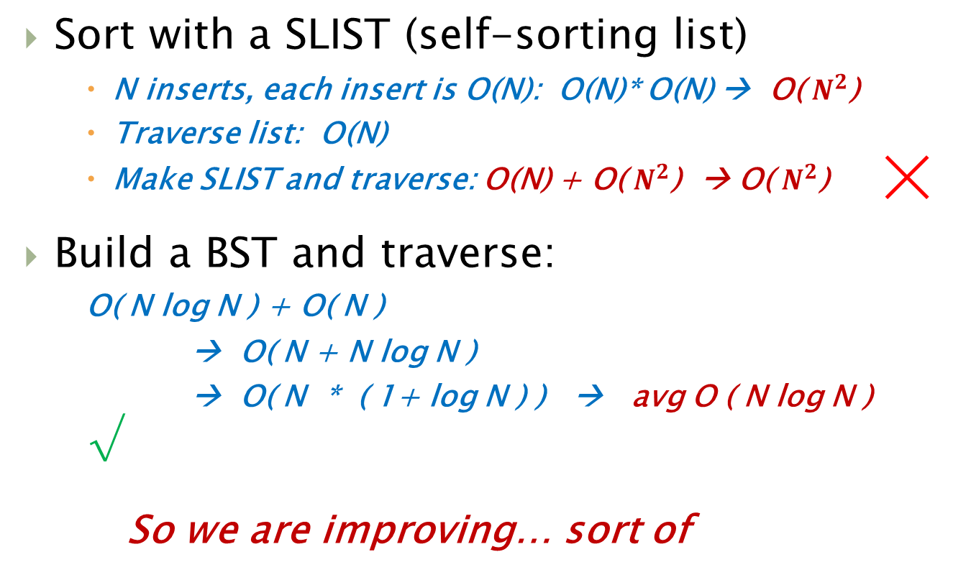
Sort Summary (so far)
Sort with a SLIST (self-sorting list)
N inserts, each insert is O(N): O(N)* O(N) → O( $N^{2}$)
Traverse list: O(N)
Make SLIST and traverse: O(N) + O( $N^{2}$) → O( $N^{2}$) ╳
Build a BST and traverse:
O( N log N ) + O( N )
→ O( N + N log N )
→ O( N * ( 1+ log N ) ) → avg O ( N log N ) √
So we are improving… sort of

Slide 33
Sort Summary (so far)
Worst case?
N inserts
worst case for each insert is O(N)
Traversal is O(N)
Worst case for sort is O(N) + O(N^2)
is O(N^2)
No improvement in worst case

Slide 34
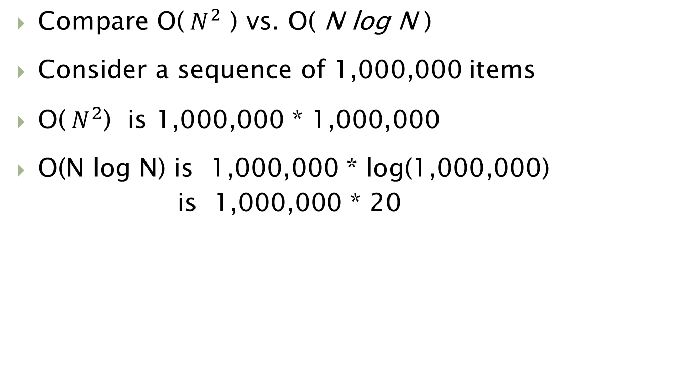
How much improvement?
Compare O(${ N}^{2}$ ) vs. O( N log N )
Consider a sequence of 1,000,000 items
O(${ N}^{2}$) is 1,000,000 * 1,000,000
O(N log N) is 1,000,000 * log(1,000,000)
is 1,000,000 * 20
20 secs
So if a computer does 1 million ops per second
1 million secs
1 million secs is 277 hrs
is 11.5 days

Slide 35
Note on BST Traversal
These two BSTs contain the same elements
8
9
3
10
4
12
1
4
9
12
1
8
10
3
In-Order traversal gives same order (sorted) for each
1, 3, 4, 8, 9, 10, 12

Slide 36
BSTs and Traversals
Any two BSTs with the same elements in them will have the same sequence generated by In-Order traversal
Post-Order: root is always last, so different root means different sequence
Pre-Order: root is always first, so different root means different sequence

Slide 37
END
Beyond this is just templates

Slide 38
remove in BST
8
4
12
2
6
10
14
3
5
7
9
11

