Slide 1

Data Structures and Analysis (COMP 410)
David Stotts
Computer Science Department
UNC Chapel Hill

Slide 2
Blockchain
as a data structure

Slide 3
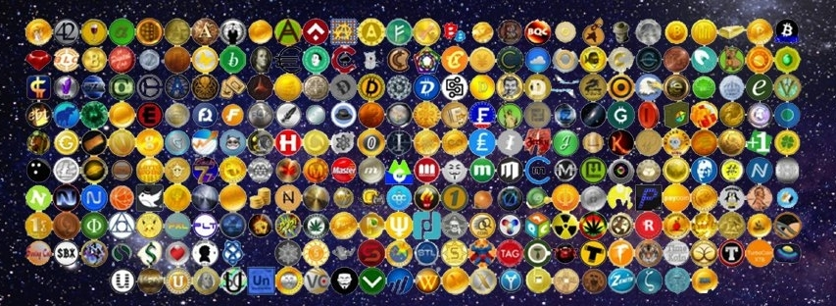
Cryptocurrencies
Digital medium of exchange (not tangible)
Bitcoin is (not) the first and is most famous (Aug.2008)
Bitcoin based on Hashcash
Dozens out there now, termed “Altcoins”
Litecoin, Bytecoin, BC Cash, Ripple, Monero, Nexus …
Kodakoin (company/industry specific)

Slide 4
Cryptocurrencies
Traded on exchanges like stocks (and like tangible currencies)
Are cryptocurrencies used?
Some vendors accept them
Many governments are mulling over outlawing or regulating them
Private parties can use bitcoin… since the ledger is public, and open, and secure
So it is more than barter (due to exchanges)

Slide 5
Cryptocurrencies and Blockchain
Bitcoin and blockchain are not the same thing
Like claiming the voter registration records and Relational DB technology are the same thing
Bitcoin (and other many other Altcoins) are implemented on a blockchain
Blockchain is being used for many applications others than digital currencies now as well

Slide 6
Blockchain features
Blockchain technology is
database
distributed
tamper-proof
no central control
sequential (temporal) record trace
Database
ledger for financial transactions in the coin
records who gains wealth (mines)
records who transfers how much to whom

Slide 7
Cryptocurrencies
Tamper proof
security via encryption
security via replication
No central control
open software
run your own copy of the Bitcoin software (mine, use)
Distributed
many copies of the chain exist world-wide
survives many local failure events (flood, fire, willful destruction, computer outage, etc.)
every computer in the network has a copy (almost)

Slide 8
How blockchain works
Chain of blocks ( surprise ! )
Block is an encrypted collection of data (in general)
For Bitcoin, that data is financial transaction info
Each block has a “digital fingerprint”, a hash value
Each block contains (and encodes) the hash of its previous block in chain, and next in chain
In COMP 410 terms, a blockchain is a doubly linked list

Slide 9
Hashing in security
Hashing used for encryption and security (not access into a hash table)
We want a hash to be a “fingerprint” of some data
we want the fingerprint to be unique
want fingerprint to be fixed size no matter the data size
If dA !== dB (even a little different) we want
hash(dA) !== hash(dB)
hash(dA) is VERY different from hash(dB) so we cant guess hash(dB) if we know dA and hash(dA)
These are called cryptographic hash functions

Slide 10
SHA-256 Hash
SHA (Secure Hash Algorithm) is a collection of related cryptographic hash functions
SHA-256 generates an almost-unique, fixed size 256-bit (32-byte) hash
a one way function – it cannot be decrypted back
How many 256 bit values are there? 2^256
this is 1.158 x 10^77
compare 10^80 atoms in the known universe
Try it online

Slide 11
Who loves large numbers?
How many different possible NCAA brackets are there?
Let’s say in 64 teams even… 2^63 … 9,223,372,036,854,775,808
9.2 quintillion (sounds big but how big?)
How many different card shuffles?
52 ! which is 8.0658175e+67
Total atoms in the galaxy? 10^68
How big?

Slide 12
Data Structure
Blockchain is a doubly-linked list
chain head
(block 0000)
A “link” also is SHA-256
hash of the block
With a special condition
Financial transaction
information
Financial transaction
information
Financial transaction
information
next
next
prev
X
prev
Financial transaction
information
next
prev
next
X
Watch this explanation
prev

Slide 13
Mining
Every ten minutes, one lucky Bitcoin miner earns a reward for extending the block chain by one block.
In 2009, the reward was 50 BTC. Today it is 12.5 BTC. (See https://blockchain.info/q to issue queries about the block chain.)
Mining is the only mechanism for creating new bitcoins. The total number of Bitcoins will never exceed 21M.
The rewarded miner also receives all (optional) transaction fees in the block.
Smallest division of a bitcoin is a Satoshi, 1/100th of a millionth of a Bitcoin ( 0.00000001 of a BTC )

Slide 14
Mining
Mining costs electricity and hardware
My computer will do about 220,000 SHA-256 encryptions per second
Mining “rigs” in common use do about 2.2 billion SHA-256 hashes per second
So my laptop does 2.2 gHashes in 2.77 hours
One mining rig does the work of 10,000 of my laptops
So, I can mine bitcoins on my laptop if I wish… there is a chance my snail-paced miner will luckily hit a good block hash
BUT that chance is like winning the Powerball lottery

Slide 15
Speed of hashing
Look at average #hashes must be done to mine a block
Demo in JavaScript how many SHA-256 can do per sec
My laptop does 10 million per minute
1 million per 6 seconds, is ~170000 per second
Measure 220000 per second
Mining rigs do 2.2 gHashes per sec to find a new block every 10 minutes
So my laptop does 2.2 gHashes in 2.7 hours

Slide 16
END
Beyond this is just templates

