Slide 1
Turning in Assignments

Slide 2
Java Version
IF YOU USE JAVA 9 THERE IS A GOOD CHANCE YOUR CODE WILL FAIL
Our grader and tester use and rely on Java 8, if you use Java 9 or a different version of java there is a chance you will fail all tests resulting in a 0
DO NOT USE JAVA 9

Slide 3
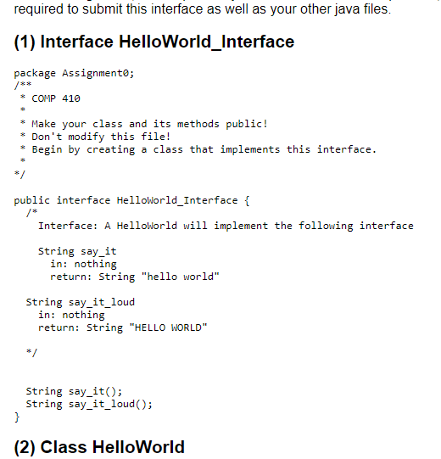
Naming Conventions
Project name: yourOnyen_assignment
Example: Torell_assignment0
Package name: Provided with each assignment
Class name: also provided
Failure to follow these conventions will result in the autograder failing to find your work and assigning a 0

Slide 4
Testing your code
We have provided some testing code
Passing our checks does not guarantee a high grade
Write your own code to test edge cases
Passing our checks does not guarantee a high grade
Testing code is not always accurate, bugs are a thing
Passing our checks does not guarantee a high grade
TLDR: Passing our checks does not guarantee a high grade

Slide 5

Adding the tester
Download the LocalChecks.jar from Sakai and put it somewhere safe (Desktop, special folder, wherever it wont get deleted or moved by accident)
***Do not put it in your eclipse workspace***
When downloading on a windows machine it will say the file might be dangerous, this is normal, it isn’t dangerous

Slide 6
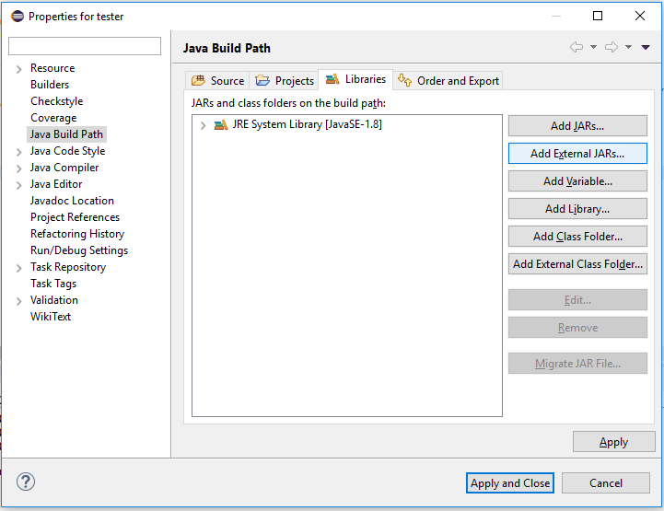

Adding the Tester
Right click on eclipse project, select properties → Java Build Path → Libraries → Add External JAR
Find the 410LocalChecks.jar and hit open
This should add it to the libraries list
Apply and close

Slide 7
Running the Tester
Copy the code we provide for the RunTests code and execute
If added correctly you should see the LocalChecks window appear, load, and run the tests
Red is fail
Green is pass
Yellow is partial fail, partial pass
The first time you run the tester you will see a popup about a consent form for Prasun Dewan, please accept it for research reasons
Close your local checks window after each use or you will be wasting resources and your computer might slow down

Slide 8
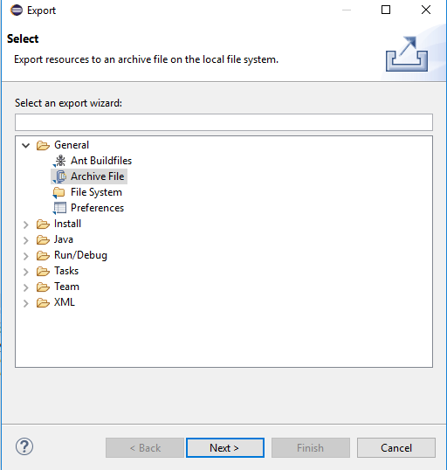
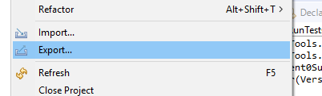
Turning in Your assignment
Remove LocalChecks from the build path
Zip the folder into a folder named yourOnyen_assignmentX.zip
Submit the zipped folder
To zip: Right click the Project and select Export → General → Archive File → Next

Slide 9
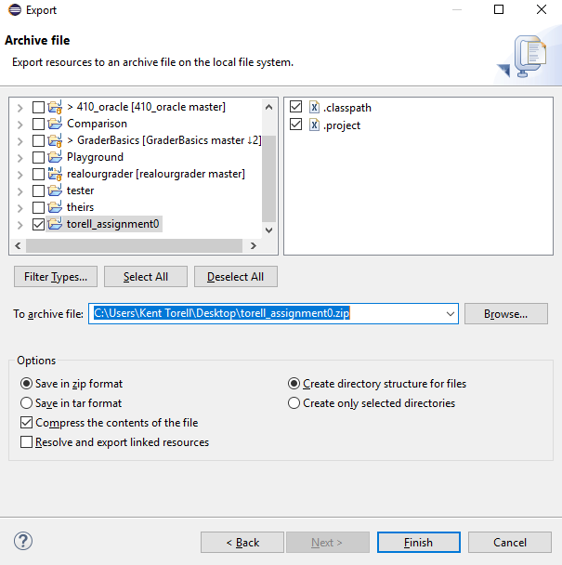
Turning in your Assignment

Slide 10
Sakai
Turn in your assignment to Sakai
Our grader automatically checks the submission date so if you submit 1 minute late you will receive a late penalty
When in doubt submit early!

