Slide 1
Notes on Assignment 1
Your code will have several classes, most notably the class that represents the entire list data structure, and the class that is a linked cell (an element in the list).
The class that is the entire list will have the methods of the ADT (insert, remove, size, isEmpty, constructors, etc.) and will have some data fields.
One field will be numElts… an integer that tells how many items are in the list at any given time;
aList
sentinel
constructor
function
getRoot, etc.
function
numElts
0

Slide 2
The Sentinel
Another field is named sentinel. The sentinel field will give access to the chain of linked cells that contain the elements that are in the list data structure.
The sentinel field will directly point to a special object of the Node class
We call this special node itself “the sentinel”. The sentinel is a Node object just like all the other Node objects in the linked chain of elements
The sentinel node is always there… even when the list is empty. It is created by the constructor
aList
sentinel
data
0
constructor
function
next
null, or
getRoot, etc.
function
prev
null, or
numElts
0

Slide 3
Empty (or new) list… no elements in it
The list will look this way when it is created new, and when it is cleared with the clear method, and when all elements are removed one at a time …
all the ways a list can come to attain size 0.
aList
sentinel
data
0
constructor
function
null, or
This assumes you add a numElts field to the list object to implement the size method in constant time
( O(1) “big oh of 1” ).
next
getRoot, etc.
function
prev
null, or
numElts
0

Slide 4
Sentinel data: not used
The Node object installed as sentinel when the list object is made is not used to contain data.
We never alter the value of the sentinel data field after the sentinel node is created
We never examine the data field of the sentinel node.
The value “0” is there simply because class Node wants something of type double in that field… any double value would do… maybe Double.NaN
aList
sentinel
data
0 (not data)
constructor
function
next
null, or
getRoot, etc.
function
prev
null, or
numElts
0

Slide 5
Sentinel is list start and list end
The sentinel node is used to indicate both the beginning and the end of a list of cells (rather than testing for null object pointers).
This node is always there, and the list of data-containing cells hangs off of it.
It is a single node object, but the list points to it in two places.

Slide 6
“Pointers” in Java code
Arrow in box-arrow diagram I call a “pointer”
In Java this is a reference to an object ( or just an object )
Reference is the address in memory where the object storage is located
public class Node {
double data;
Node next ; // link
Node prev ; // link
. . .
}
data
12.5
data
23.74
next
next
prev
prev
0
1

Slide 7
The next field of the sentinel will always point to the first data node in the linked cells (or itself)
the prev field of the sentinel will always point to the last data node in the linked node chain (or itself)
The next field of the last data node will point back to the sentinel
The prev field of the first data cell will point to the sentinel
List start and list end
aList
data
0
data
12.5
sentinel
constructor
next
next
getRoot, etc.
prev
prev
numElts
0
1

Slide 8
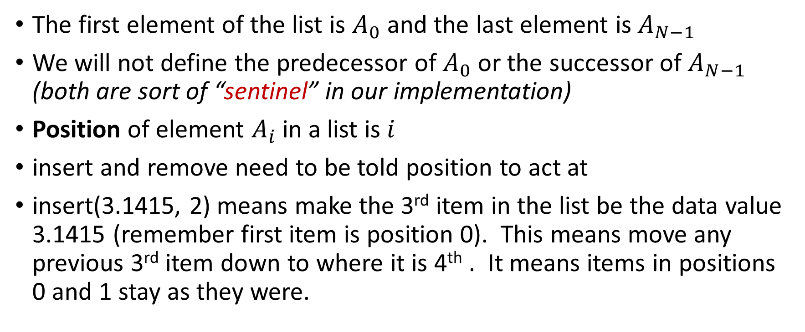
insert and remove
The first element of the list is $A_{0}$ and the last element is $A_{N−1}$
We will not define the predecessor of $A_{0}$ or the successor of $A_{N−1}$ (both are sort of “sentinel” in our implementation)
Position of element $A_{i}$in a list is $i$
insert and remove need to be told position to act at
insert(3.1415, 2) means make the 3rd item in the list be the data value 3.1415 (remember first item is position 0). This means move any previous 3rd item down to where it is 4th . It means items in positions 0 and 1 stay as they were.

Slide 9
List with one element in it
aList
after insert( 12.5, 0 )
sentinel
data
0
data
12.5
constructor
next
next
getRoot, etc.
prev
prev
0
numElts
1

Slide 10
List with two elements in it
after insert( 23.74, 1 )
aList
sentinel
data
0
data
12.5
data
23.74
constructor
next
next
next
getRoot, etc.
prev
prev
prev
numElts
2
0
1

Slide 11
List with three elements in it
after insert( 3.1415, 1 )
aList
sentinel
data
0
data
12.5
data
3.1415
data
23.74
constructor
next
next
next
next
getRoot, etc.
prev
prev
prev
prev
numElts
3
0
1
2

Slide 12
List with two elements in it
after remove( 0 )
aList
sentinel
data
0
data
3.1415
data
23.74
constructor
next
next
next
getRoot, etc.
prev
prev
prev
numElts
2
0
1

Slide 13
Back to “pointers” in Java code
Arrow in box-arrow diagram I call a “pointer”
In Java this is a reference to an object ( or just an object )
Reference is the address in memory where the object storage is located
public class Node {
double val;
Node nx ; // link
Node pv ; // link
. . .
}
val
12.5
val
23.74
nx
nx
pv
pv
0
1

Slide 14
Walking down a linked list of cells
Need some variables to hold obj refs (hold pointers)
head (type Node) never changes, always references “the list” (first cell in list)
curr (type Node) where we currently are as we “walk” down the cells
curr = head;
count = 0;
while (curr !== sentinel) {
count++;
curr = curr.nx;
}
curr
So count is 5
head
Sentinel, or null
val
23.74
val
3.61
val
0.454
val
241.2
val
7.31
nx
nx
nx
nx
nx
pv
pv
pv
pv
pv
Sentinel, or null
0
1
2
3
4

Slide 15
Adding a new cell
curr = head;
ct = 0;
while (curr !== sentinel) {
if (ct < 2) { curr=curr.nx; c++; }
else { break; }
}
// here, curr is loc of new cell
insert ( 6.8, 2 )
curr
head
val
23.74
val
3.61
val
0.454
val
241.2
val
7.31
Sentinel, or null
nx
nx
nx
nx
nx
pv
pv
pv
pv
pv
0
1
3
Sentinel, or null
2
4
5
3
4
Node c = new Node(6.8);
val
6.8
c.pv = curr.pv;
curr.pv = c;
c.pv.nx = c;
c.nx = curr;
nx
pv
2
c

Slide 16
Where does “head” var get a value?
Skip through sentinel to get to real data cells
aList
head
sentinel
val
0
val
3.1415
val
23.74
constructor
nx
nx
nx
getRoot, etc.
pv
pv
pv
numElts
2
0
1
Node head
= aList.sentinel.nx;

