Slide 1

Data Structures and Analysis (COMP 410)
David Stotts
Computer Science Department
UNC Chapel Hill

Slide 2
Notes on Time Complexity
Involving trees

Slide 3
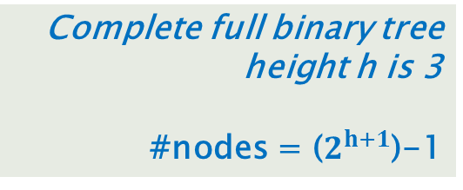
Recall BT Height vs. #Nodes
8
4
12
2
6
10
14
1
3
5
7
9
11
13
15
Complete full binary tree
height h is 3
#nodes = ($2^{h+1}$)-1

Slide 4
Recall BT Height vs. #Nodes
Traversal… visit each node
How expensive is it to handle each node?
#nodes is O(2^height)
but the problem is defined not is terms of height
Problem is defined in terms of #nodes…
we stored N nodes in the Tree…
We don’t say we have a tree of height
Log(N)
We say we have a tree with
N data elements stored
8
4
12
2
6
10
14
1
3
5
7
9
11
13
15

Slide 5
Traversal of BT
So traversals are O(N) where N is #nodes
Visiting each node takes
one link follow to the node
one link follow to return to parent
fixed amount of work to process the root
So N nodes * O(1) work per node
O(N)

Slide 6
Fibonacci recursively
Fib ( N ) {
if (N==0) return 1;
if (N==1) return 1;
return Fib(N-1) + Fib(N-2);
}
What is worst case time complexity?

Slide 7
Fibonacci recursively
Fib(6)
Fib(5)
Fib(4)
Fib(4)
Fib(3)
Fib(3)
Fib(2)
Fib(3)
Fib(2)
Fib(2)
Fib(1)
Fib(2)
Fib(1)
Fib(1)
Fib(0)
Fib(2)
Fib(1)
Fib(1)
Fib(0)
Fib(1)
Fib(0)
Fib(1)
Fib(0)
Fib(1)
Fib(0)
Method calls induce a tree
… a binary tree

Slide 8
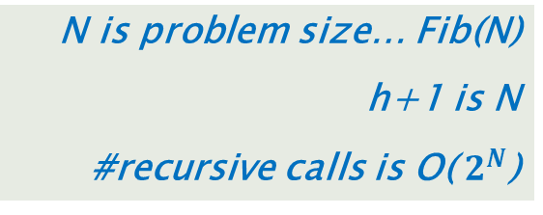
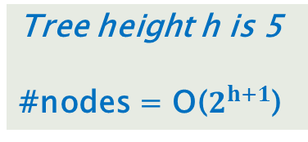
Fibonacci recursively
Tree height h is 5
#nodes = O($2^{h+1}$)
Fib(6)
Fib(5)
Fib(4)
Fib(4)
Fib(3)
Fib(3)
Fib(2)
Fib(3)
Fib(2)
Fib(2)
Fib(1)
Fib(2)
Fib(1)
Fib(1)
Fib(0)
Fib(2)
Fib(1)
Fib(1)
Fib(0)
Fib(1)
Fib(0)
Fib(1)
Fib(0)
Fib(1)
Fib(0)
N is problem size… Fib(N)
h+1 is N
#recursive calls is O( $2^{N}$)

Slide 9
END
Beyond this is just templates

