Slide 1
Background; provide sufficient context of the underlying biology.
Hypothesis/goals; describe the motivation of the work.
Methods; describe the approaches you used; best if these could be tied in to lessons learned in class.
If there are results, present.
Reflection on the learning experience; this is the key element of the presentation. What did you learn? What did you learn about yourself? How has this experience changed your thinking, career goals, etc? What was your greatest “a-ha” moment? What are you most proud of? How much help did you get from other REEU students?
Summary and acknowledgements (please use the logo available here to thank funding sources: https://nifa.usda.gov/resource/official-nifa-identifier).
Advice: take notes from your POD interactions and use them for your presentation. Start building your presentation early. Work with your mentor. Practice (alone, with the mentor/lab, and with other REEU students). Few people are natural public speakers and the only way to get good at it is to do it. We are a friendly audience.
Types of questions to prepare for: Questions will most likely be directed at points 3 and 5 above.

Slide 2
Potential Issues / Notes
Possibly creating a full pipeline sequence number tracker would be helpful -> violin plot
Must be able to defend/explain:
Choice for UNITE db amendment
Removal of zero sum columns (fungal ASVs present only in samples without metadata)
Removal of zero sum row (samples with metadata but no fungal ASVs)
Removal of Chytrids
Differences in sample sized between Disease Classes skewing statistical tests
Difference between sample and ASV ordination

Slide 3
Sphaerulina musiva and the Poplar Microbiome
Fungal endophyte community analysis project for the Big Data in Agriculture Internship
Student: Morgan Miller
Mentor: Ricardo Alcala Briseno
Principle Investigator: Jared LeBoldus

Slide 4
Project Overview
Objectives:
Use ITS metabarcoding to characterize the fungal wood microbiome of diseased and healthy Populus trichocarpa
Compare microbiome makeup and diversity to illuminate how fungal endophytes contribute to phytopathogen resistance
This Understanding Will:
Inform the design and approach of future studies investigating endophyte/host-genotype/phytopathogen interactions
Benefit the development of sustainable disease management techniques
Boardman Garden Background:
In 2018, Sphaerulina musiva was reported in a Populus trichocarpa plantation in NE Oregon
1,054 total trees
~25% cankered
Variety of host genotypes present
Wood tissue sampled from 430 individuals for microbiome characterization
S. musiva outbreak threatens:
  regional hybrid-poplar plantations
  native riparian ecosystem

Slide 5
Sphaerulina musiva
Biology:
Phytopathogenic ascomycete fungus
Native to Eastern United States (P. deltoides)
Leaf spot and canker disease
  Necrosis, tissue damage, girdling, reduced productivity, mortality
Management:
Disease management primarily focused on genetic host resistance
Growing interest in fungal endophytes as modifiers of plant disease

Slide 6
Fungal Endophytes
Fungal Endophytes:
Non-pathogenic fungal microbes living within plant tissues
Living-wood Microbiome:
Relatively unexplored / poorly understood
Low microbial biomass and diversity
Dominated by fungi (particularly Ascomycota)
Phytopathogen Interaction:
Variety, likely multiplicity, of mechanisms

Slide 7
ITS Metabarcoding
Internal Transcribed Spacers:
Non-coding region within Nuclear Ribosomal DNA (nrDNA)
Commonly used fungal genetic marker
Benefits:
High interspecific variability
Low intraspecific variability
Flanked by highly conserved gene regions
Amplification Biases:
Primer choice and PCR conditions
Taxonomic, Length, Mismatch

Slide 8
OTUs vs ASVs
Common Goal (De-noising):
Distinguishing reads representing biological reality from reads most-likely produced by sequencing error
Operation Taxonomic Unit Clustering:
Group similar sequences into single ‘unit’
Amplicon Sequence Variant Analysis:
Uses error model (Phred Score) to determine the probability that each sequence is the result of error
Useful for determining exact sequences with high statistical confidence

Slide 9
General Workflow
Quality Assessment
FastQC: Quality plots
SeqKit: Summary stats
Raw Reads
Illumina NGS
528 samples
1056 .fq.gz files
17,906,804 reads
Prefiltered Reads
DADA2: N prefilter
Cutadapt: Primer removal
Filtered Reads
DADA2: Filter
Length > 90bp
Quality > 28Q
526 samples
1052 .fq.gz files
9,469,419 reads
Aligned Reads
Bowtie2 -
Index host genome
Align reads & reject matches
Sequence Table
DADA2: Denoising Algorithm
520 samples
613 ASVs
Amended Database
Clustal-O: Group Host ASVs
Add to UNITE Database
Taxa Table
DADA2: Assign Taxonomy
466 Fungal ASVs
Phyloseq Object
Phyloseq
MicroViz
234 viable samples (w/ metadata)
356 viable fungal ASVs
Disease phenotype metadata
Plotting and Community Analysis

Slide 10
Taxa Abundance
Biology:
Phytopathogenic ascomycete fungus
Native to Eastern United States (P. deltoides)
Leaf spot and canker disease
  Necrosis, tissue damage, girdling, reduced productivity, mortality
Disease management primarily focused on genetic host resistance
Growing interest in fungal endophytes as modifiers of plant disease

Slide 11
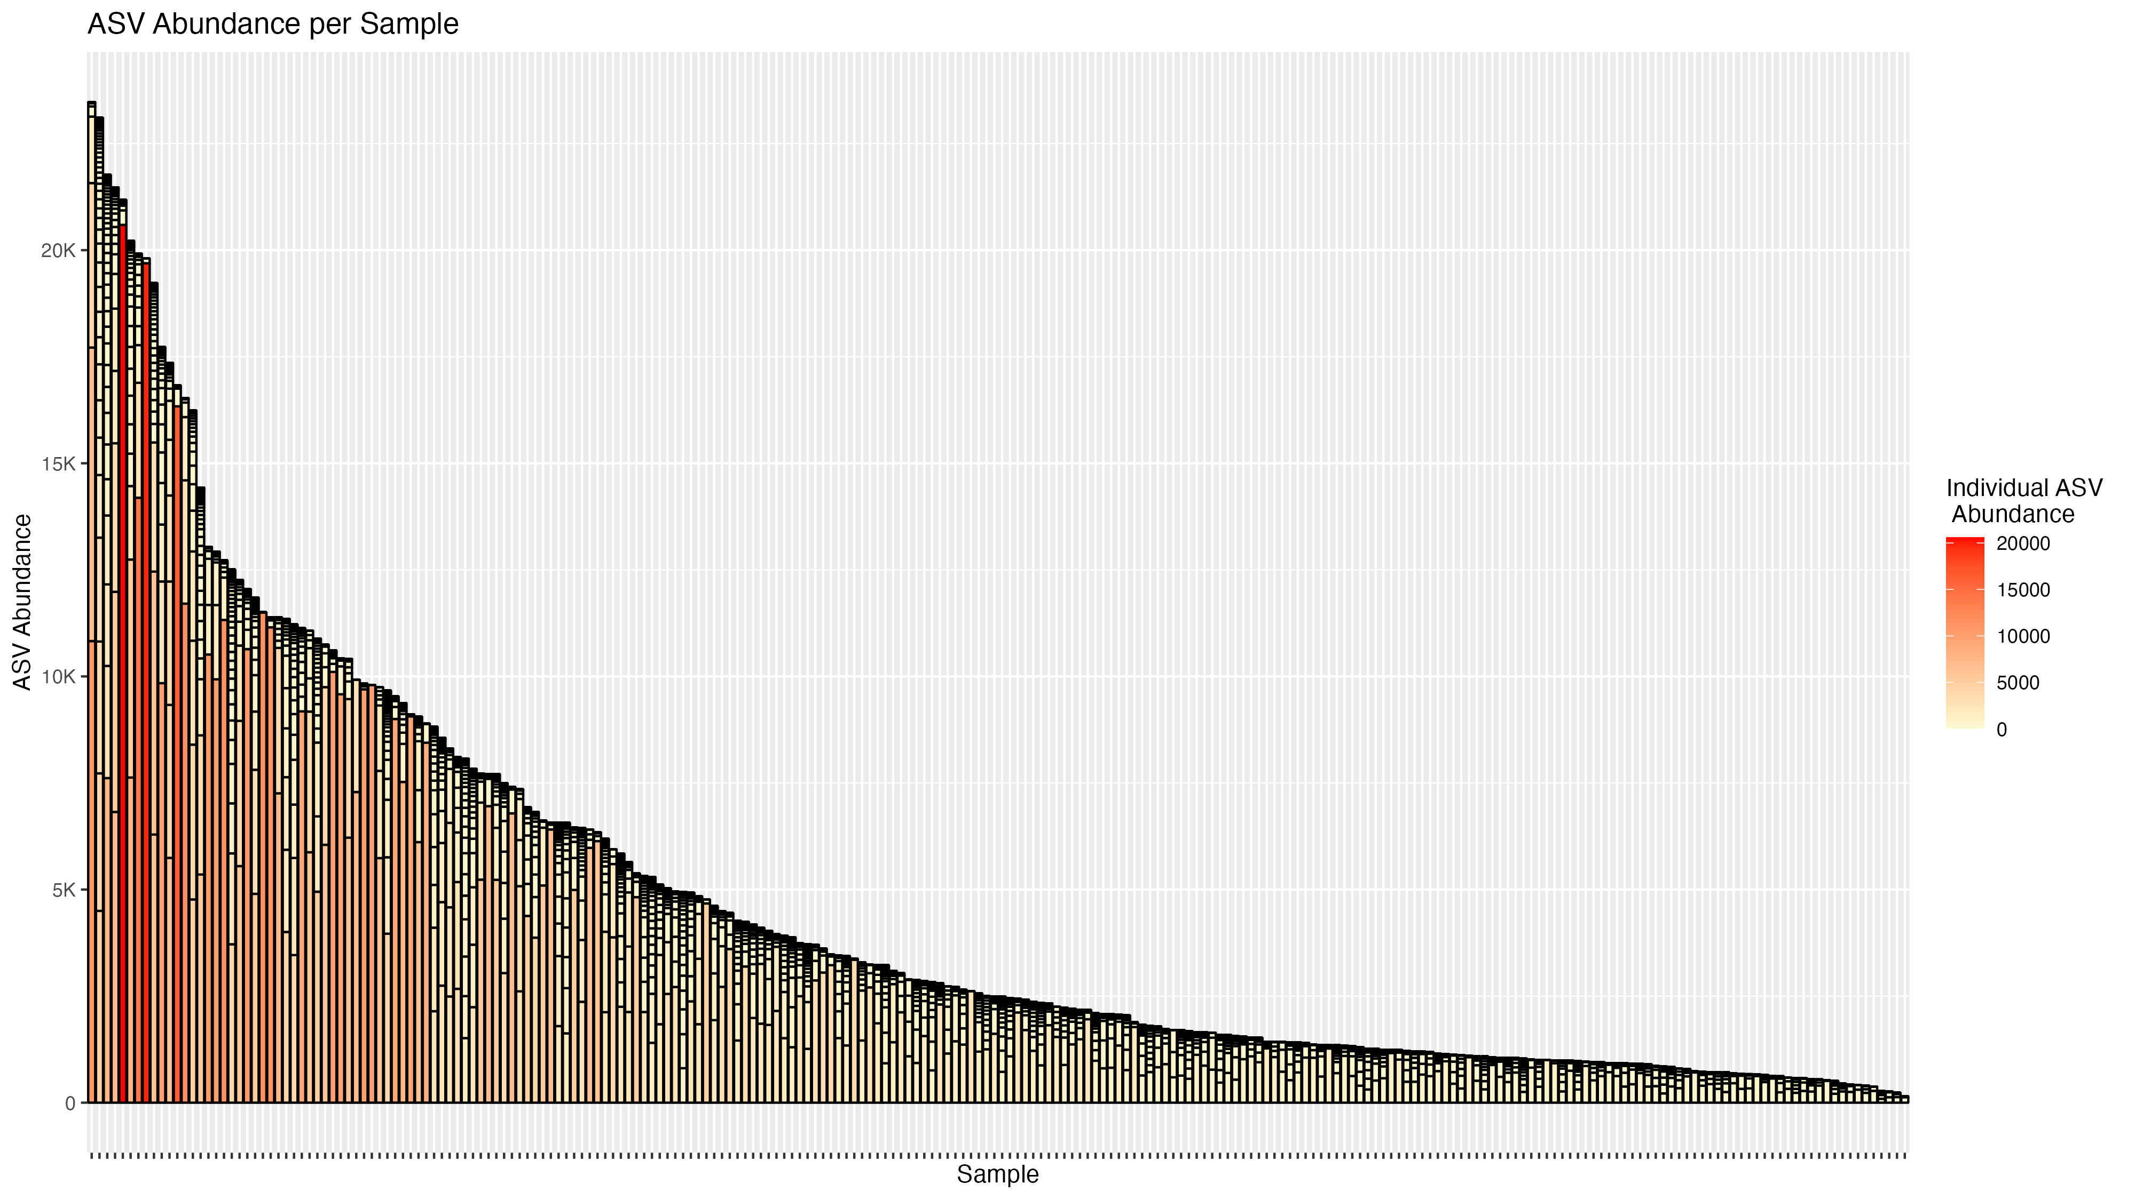

Slide 12
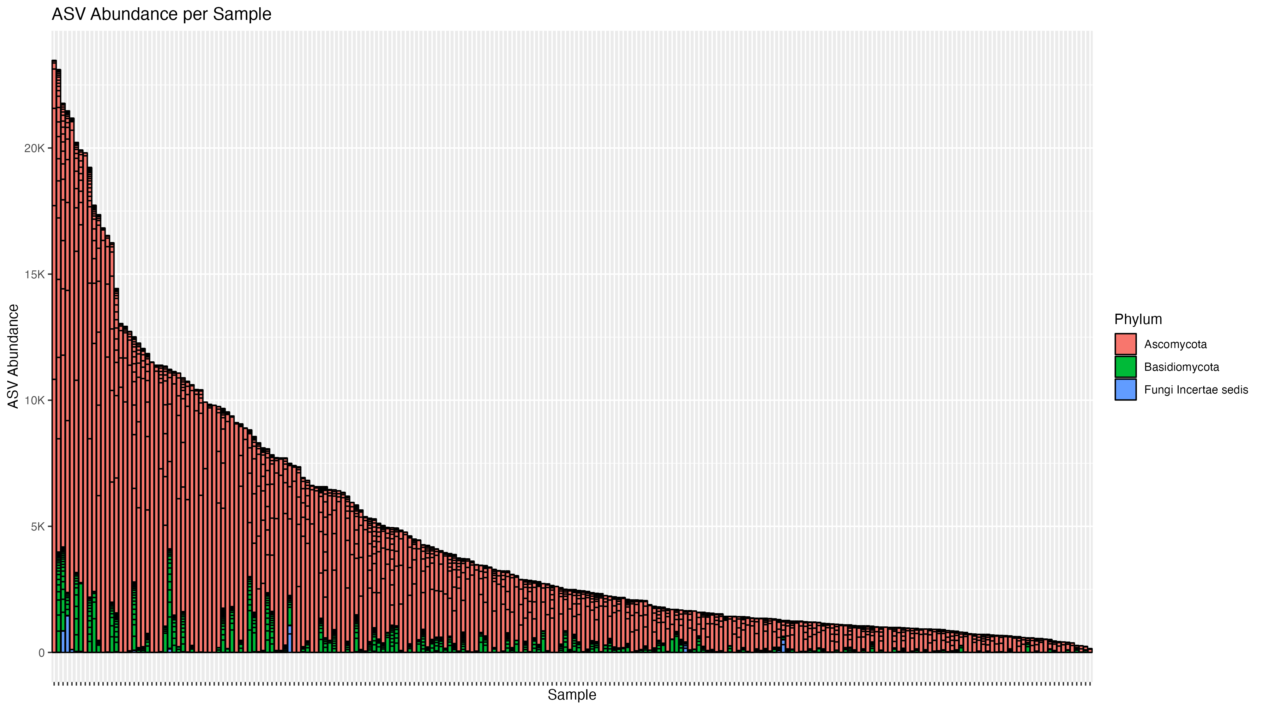

Slide 13
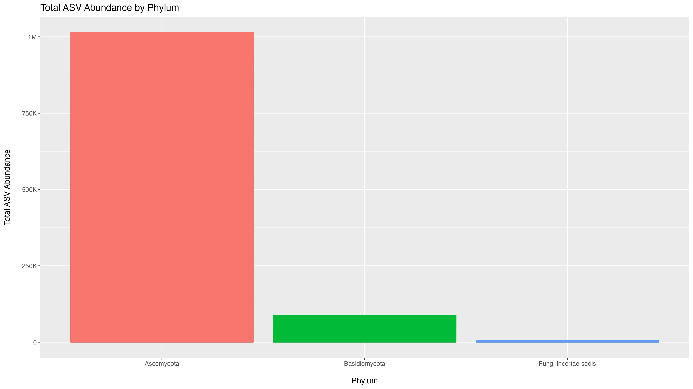

Slide 14
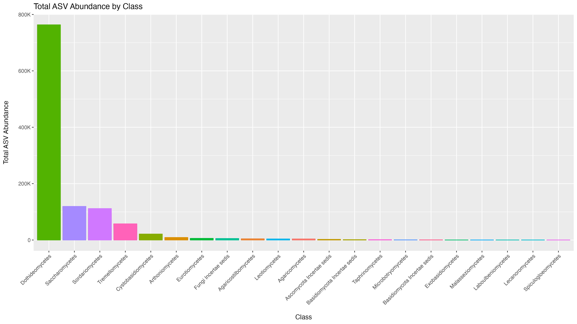

Slide 15
Relative Abundance
Biology:
Phytopathogenic ascomycete fungus
Native to Eastern United States (P. deltoides)
Leaf spot and canker disease
  Necrosis, tissue damage, girdling, reduced productivity, mortality
Disease management primarily focused on genetic host resistance
Growing interest in fungal endophytes as modifiers of plant disease

Slide 16
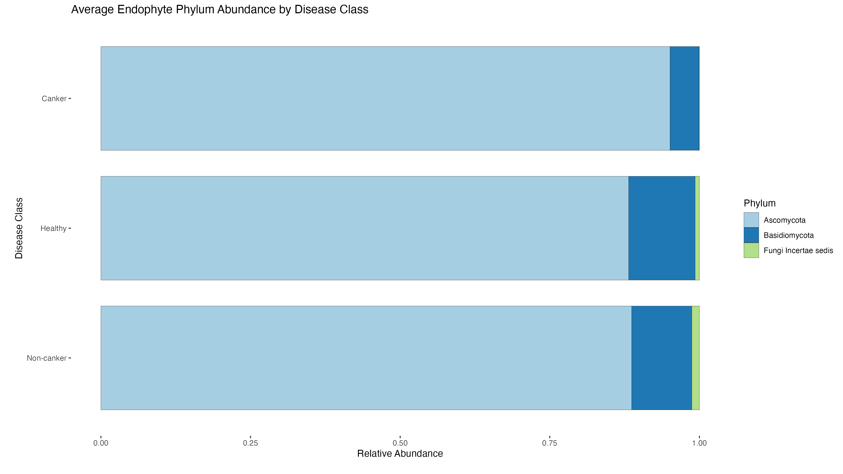

Slide 17
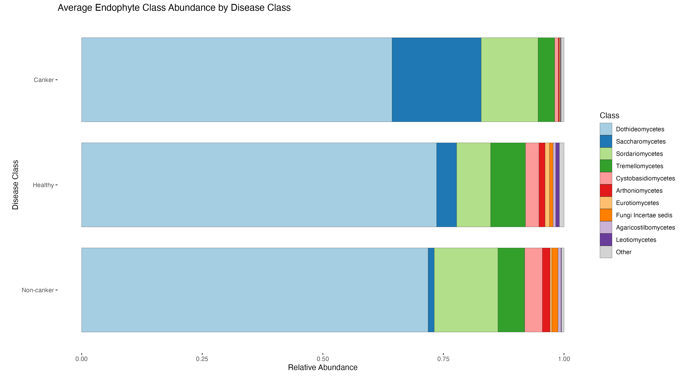

Slide 18
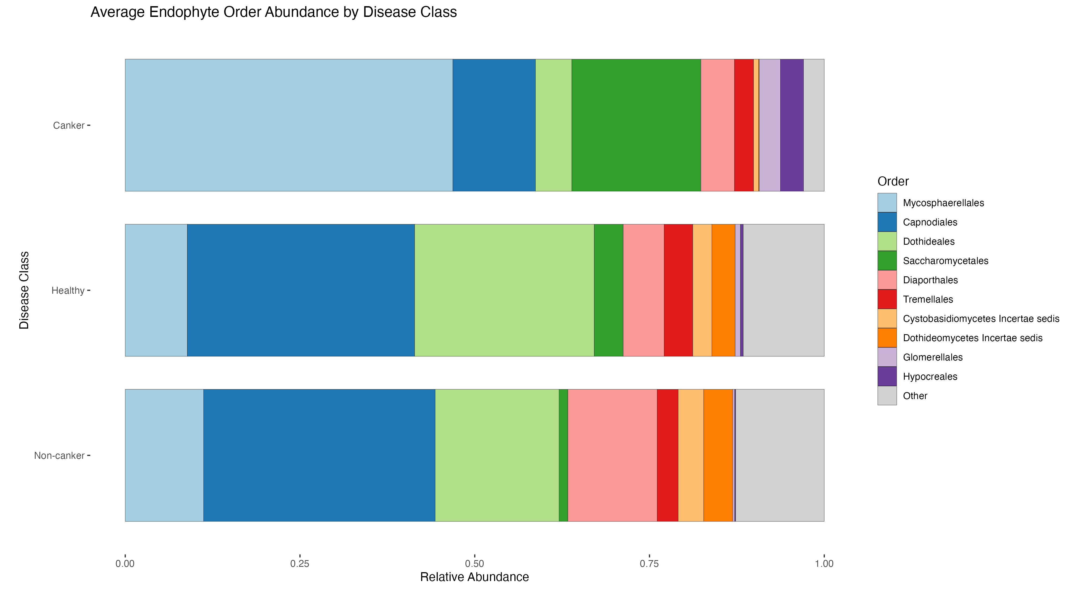

Slide 19
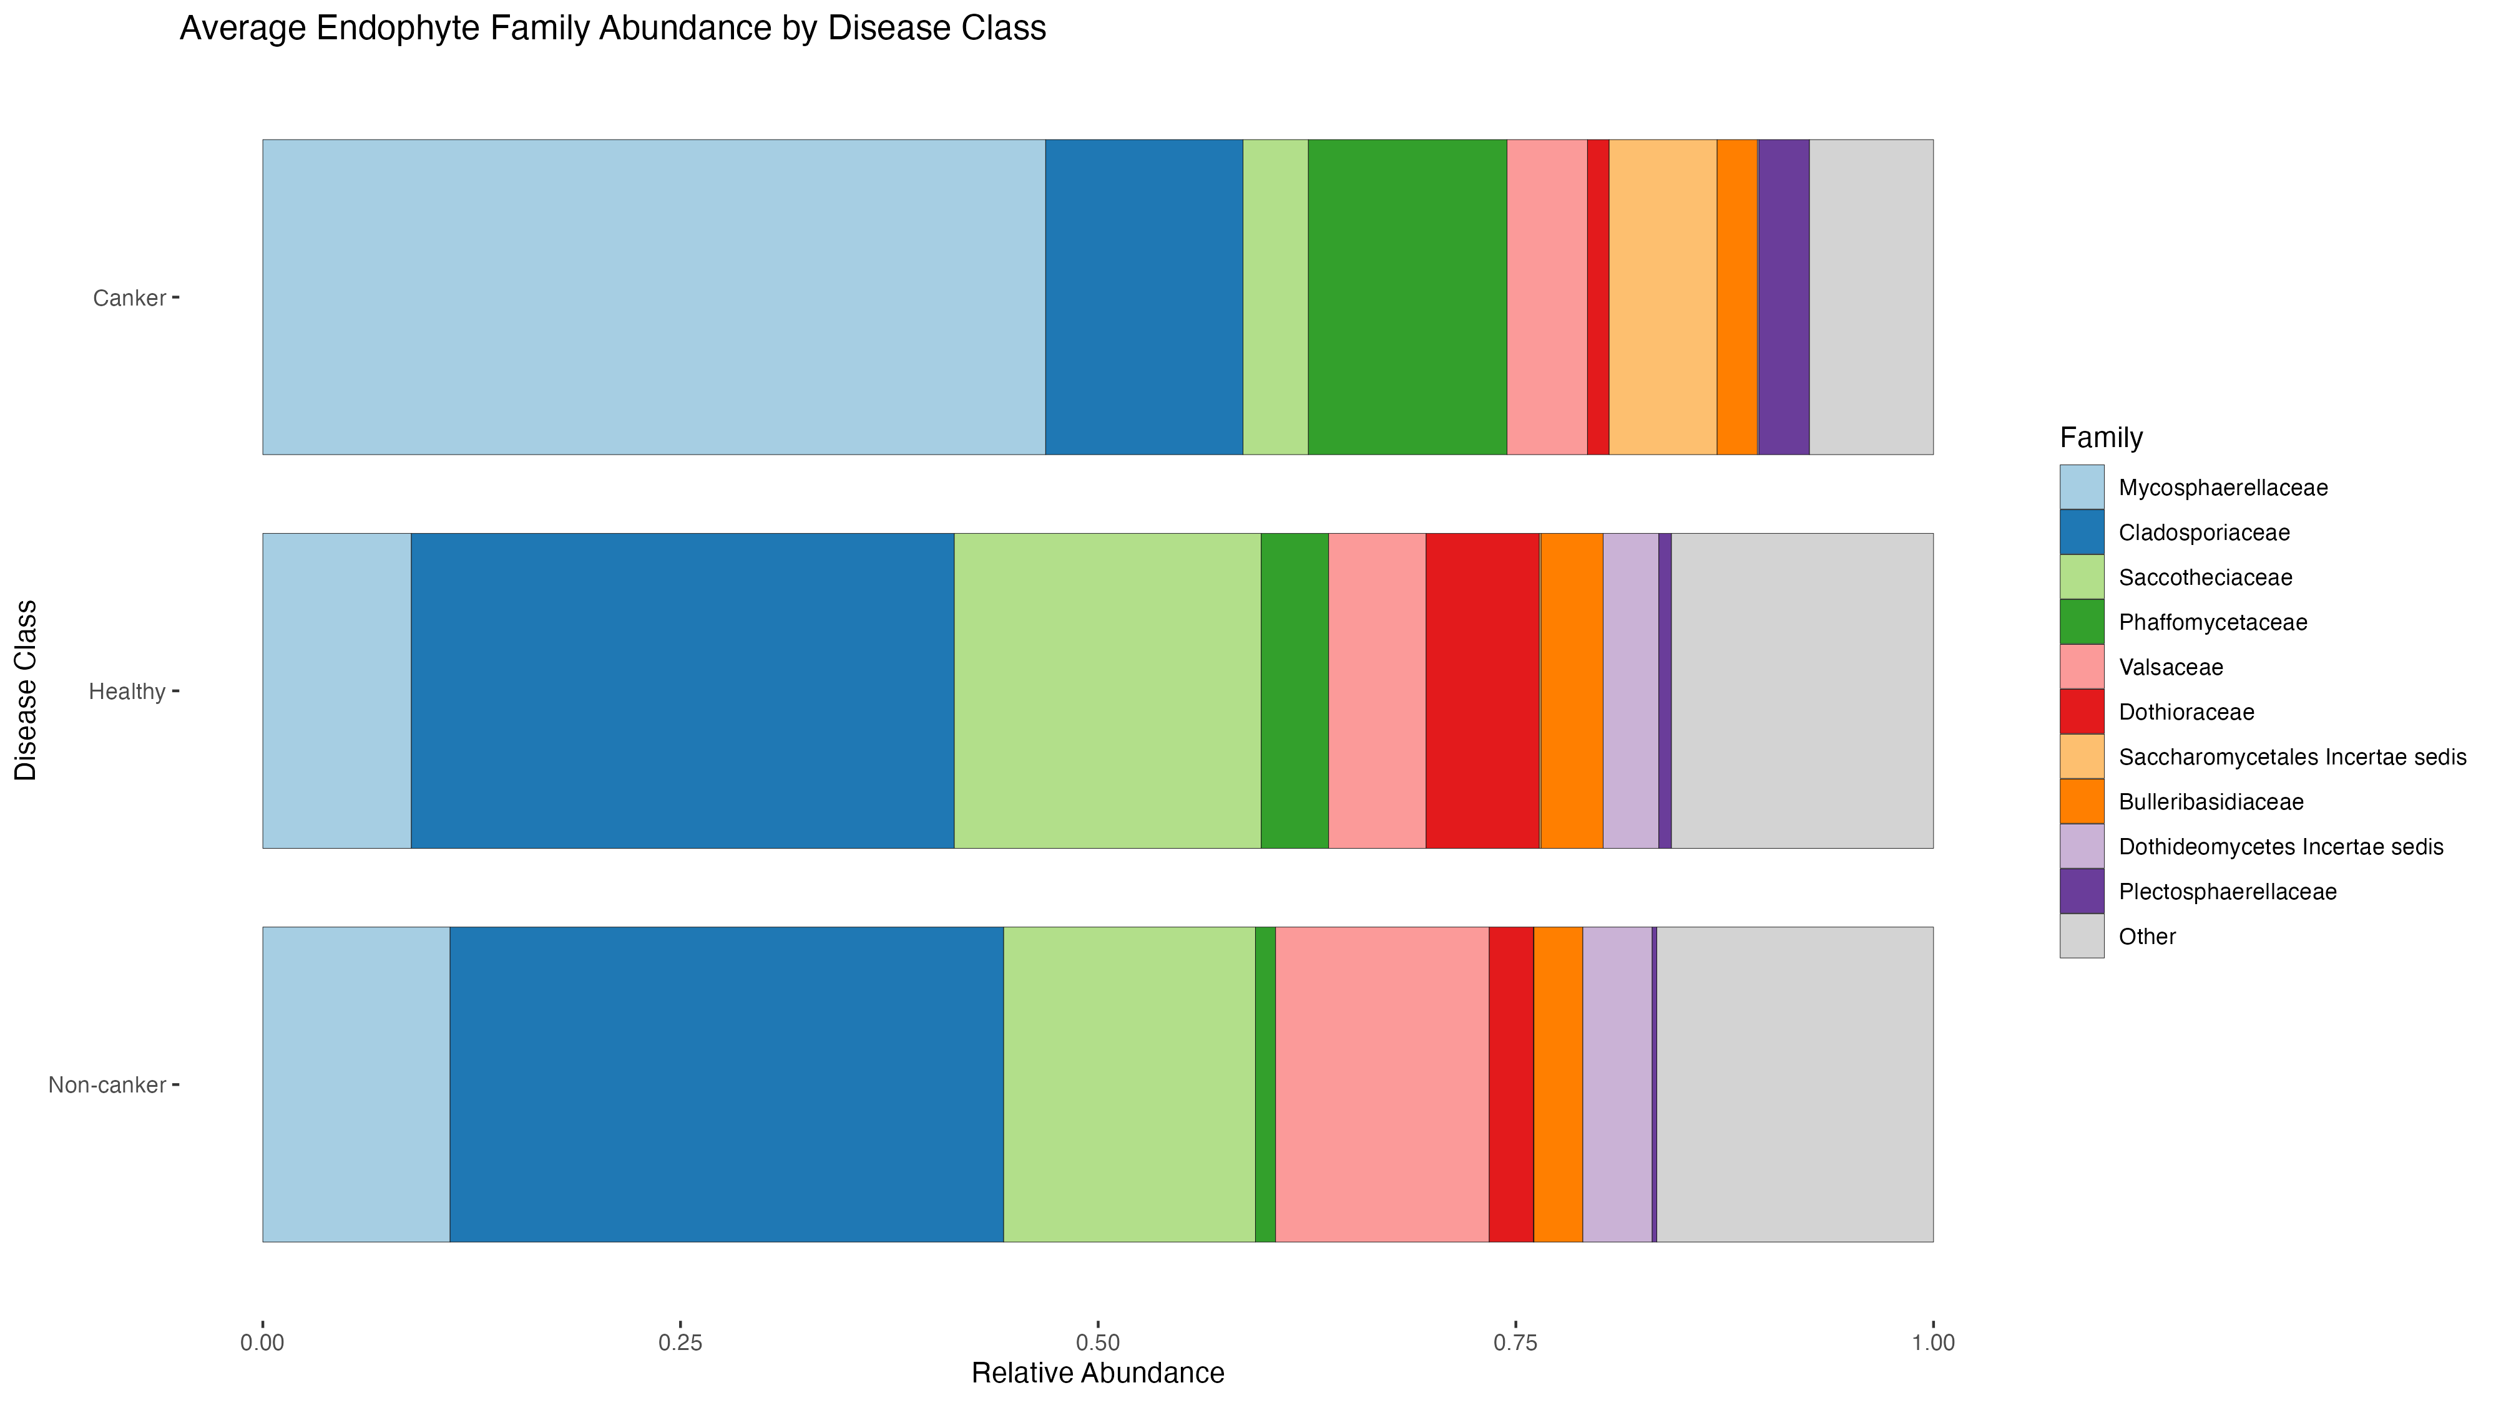

Slide 20
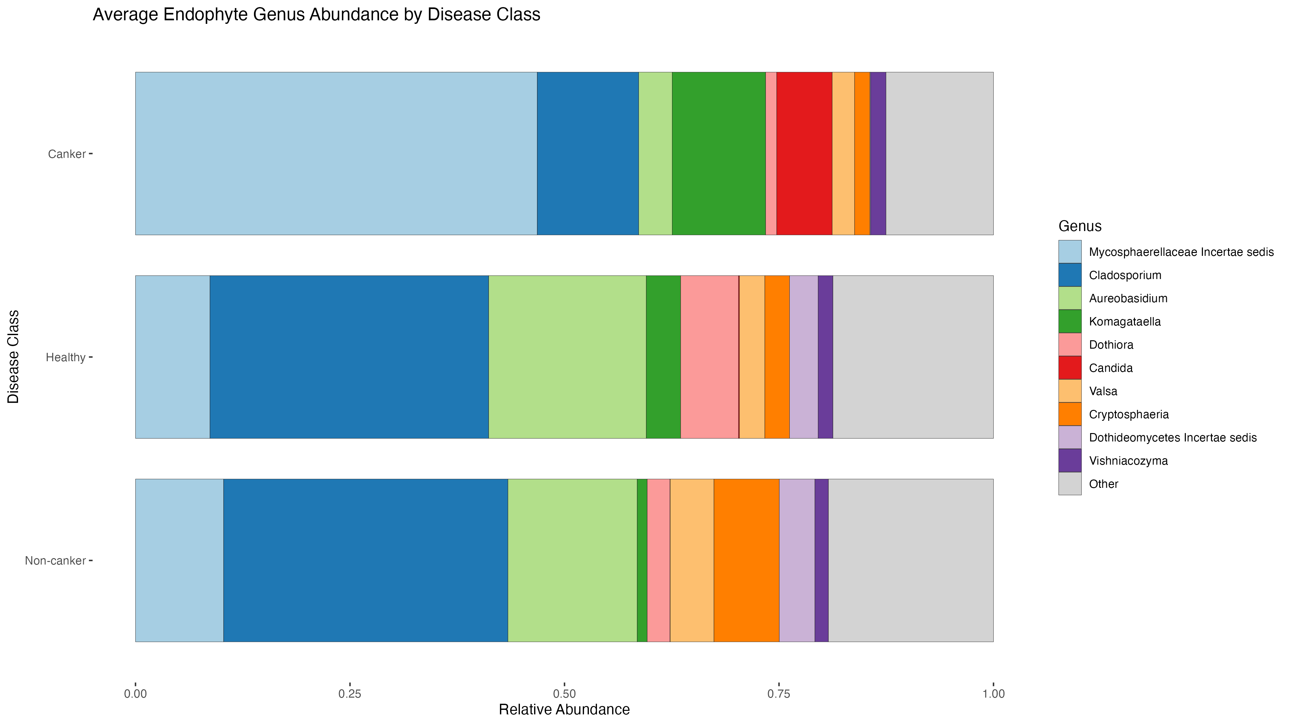

Slide 21
Beta Diversity
Beta Diversity Metric | Test | R² | p - value
Bray-Curtis | PREMANOVA | 0.07394 | 0.001
 | BETADISPER | NA | 0.254
Jaccard | PREMANOVA | 0.05411 | 0.001
 | BETADISPER | NA | 0.267
Biology:
Phytopathogenic ascomycete fungus
Native to Eastern United States (P. deltoides)
Leaf spot and canker disease
  Necrosis, tissue damage, girdling, reduced productivity, mortality
Disease management primarily focused on genetic host resistance
Growing interest in fungal endophytes as modifiers of plant disease

Slide 22
Alpha Diversity
Biology:
Phytopathogenic ascomycete fungus
Native to Eastern United States (P. deltoides)
Leaf spot and canker disease
  Necrosis, tissue damage, girdling, reduced productivity, mortality
Disease management primarily focused on genetic host resistance
Growing interest in fungal endophytes as modifiers of plant disease

Slide 23
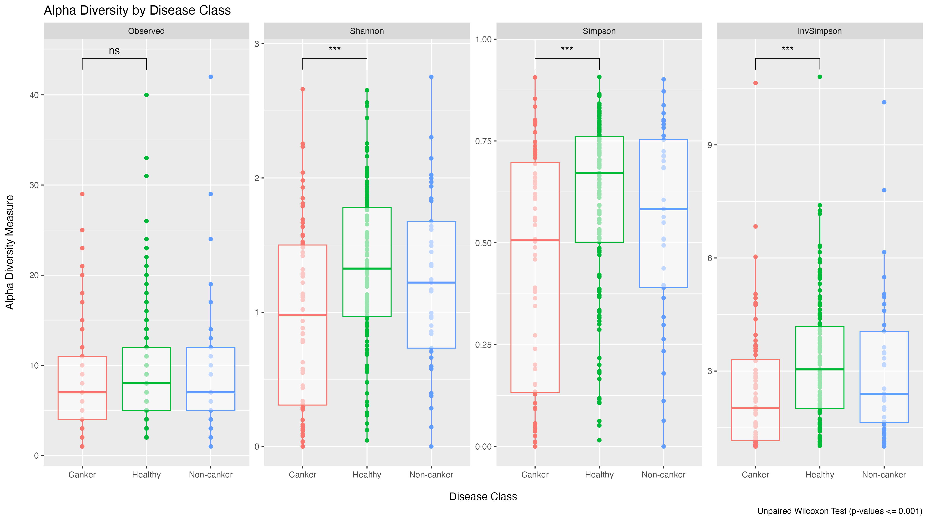

Slide 24
Ordination
Objectives:
Use ITS metabarcoding to characterize the fungal wood microbiome of diseased and healthy Populus trichocarpa
Compare microbiome makeup and diversity to illuminate how fungal endophytes contribute to phytopathogen resistance
This Understanding Will:
Inform and benefit the development of sustainable disease management techniques

Slide 25
Programs Cited
Objectives:
Use ITS metabarcoding to characterize the fungal wood microbiome of diseased and healthy Populus trichocarpa
Compare microbiome makeup and diversity to illuminate how fungal endophytes contribute to phytopathogen resistance
This Understanding Will:
Inform and benefit the development of sustainable disease management techniques

Slide 26
References
Objectives:
Use ITS metabarcoding to characterize the fungal wood microbiome of diseased and healthy Populus trichocarpa
Compare microbiome makeup and diversity to illuminate how fungal endophytes contribute to phytopathogen resistance
This Understanding Will:
Inform and benefit the development of sustainable disease management techniques

