Slide 1

ANONYMOUS
We are Anonymous. We are Legion.
We do not forgive. We do not forget. Expect us.
By Russell Miller 14 November 2011

Slide 2
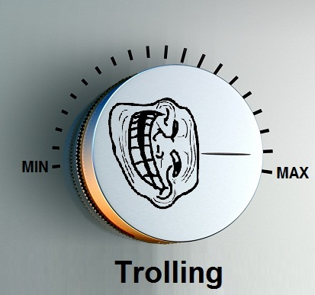
ANONYMOUS
Origins: 4chan

Slide 3
ANONYMOUS
Acting as Anonymous
Protests
A good cause vs. harassment
Often illegal

Slide 4
ANONYMOUS
Doing things for a cause:
Chris Forcand – Sexual Predator
Project Chanology – Church of Scientology
Iranian and Australian censorship
Operation Payback
Operation Bradical
Wikileaks
Operation Egypt/Tunisia

Slide 5
ANONYMOUS
For the “LuLz”:
Epilepsy Foundation
SOHH (Support Online Hip-Hop)
No Cussing Club

Slide 6
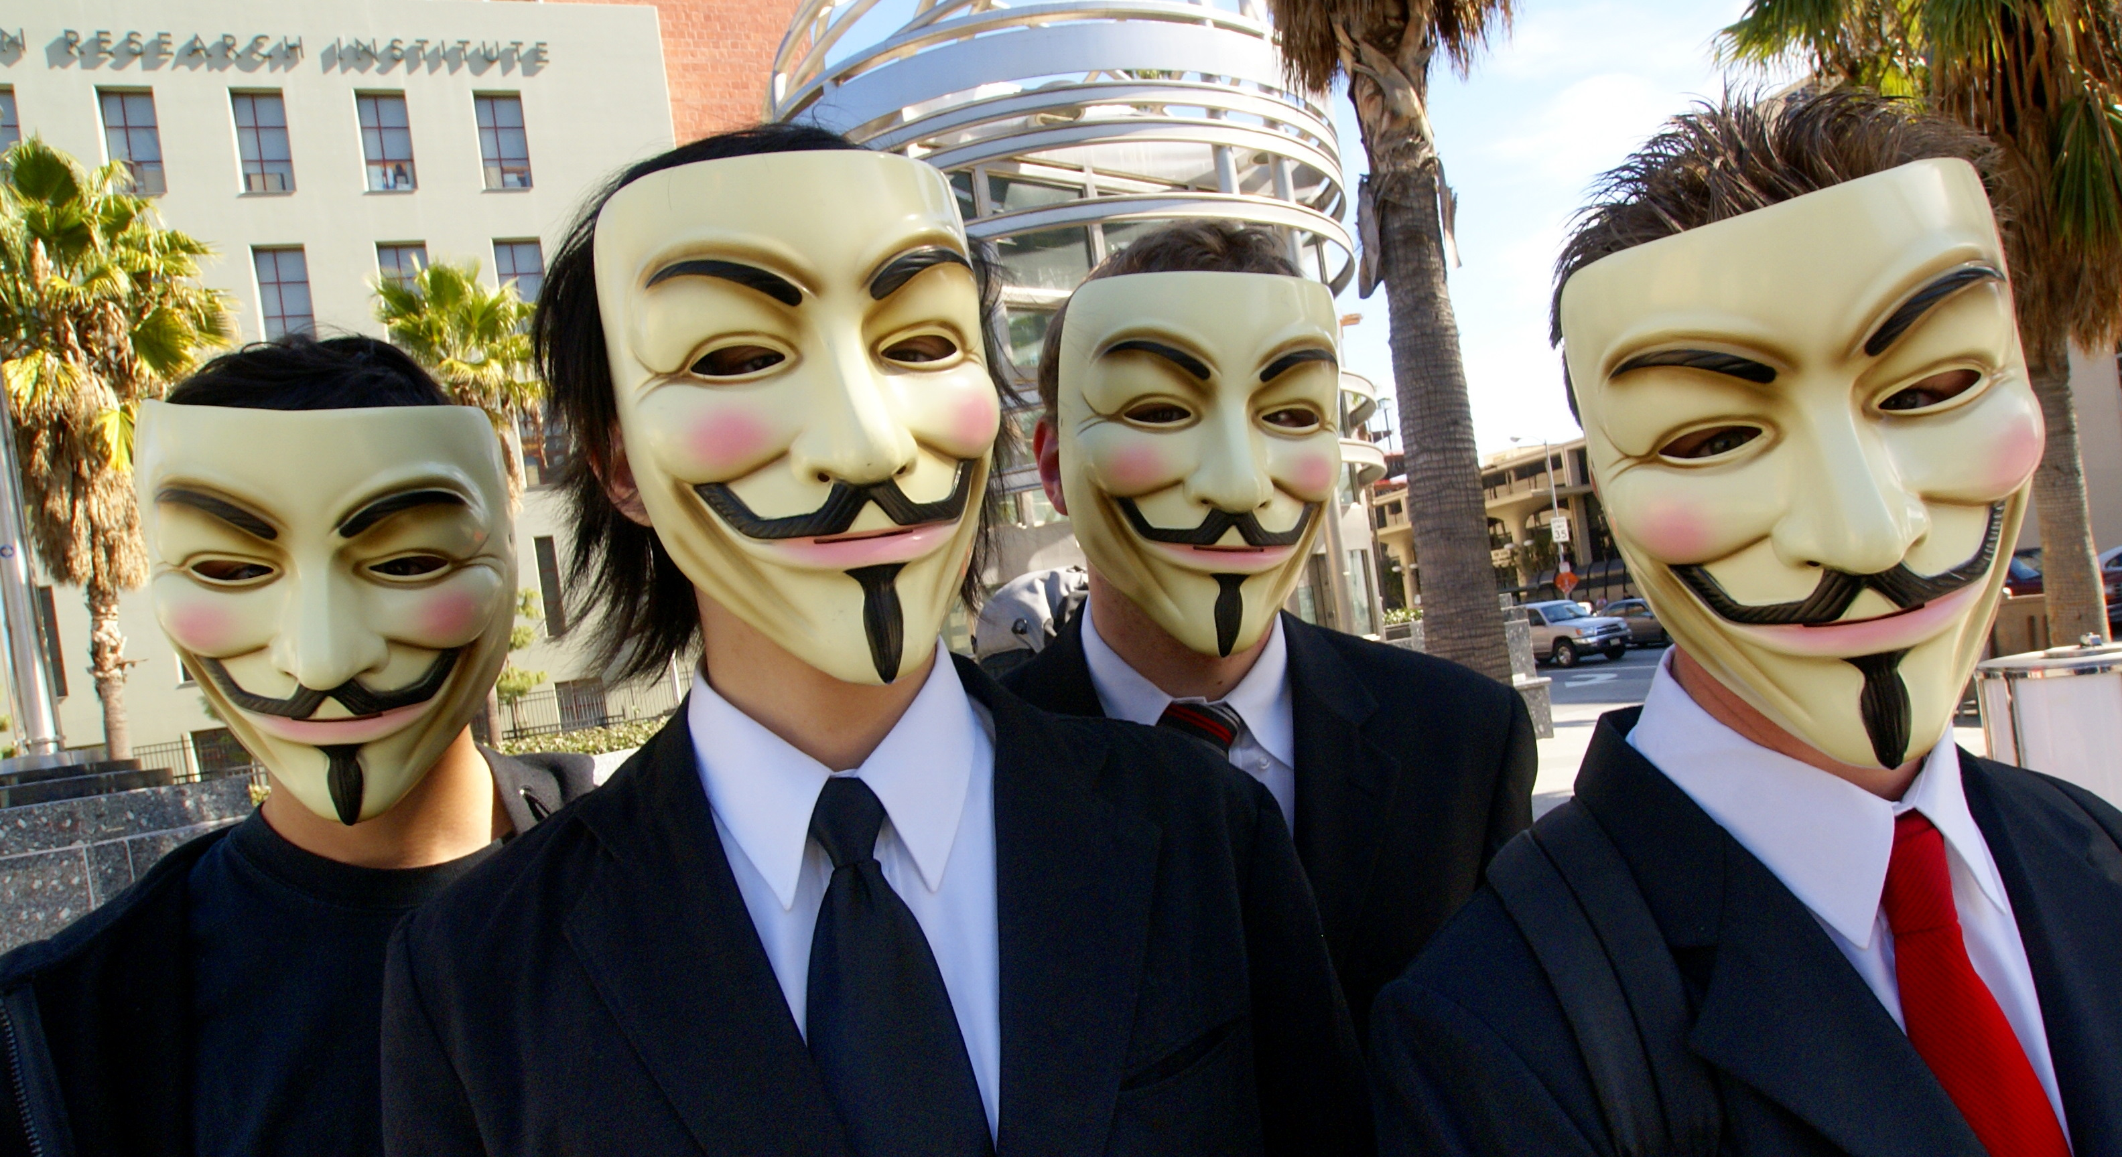
ANONYMOUS
You Can be Anonymous.
Anyone can be Anonymous.
But do you want to?

Slide 7
ANONYMOUS
Protest is necessary.
Hacktivism is perhaps too severe.
Extremely dynamic attitude.
Unidentification.

Slide 8
ANONYMOUS
References 1. Forcand (10 Mar 2008) http://internet-entrepreneurship.com/tag/chris-forcand/ 2. Church of Scientology (25 Jan 2008) http://www.theregister.co.uk/2008/01/25/ddos_scientology_controversy/ 3. Epilepsy Foundation (28 Mar 2008) http://www.wired.com/politics/security/news/2008/03/epilepsy http://www.news.com.au/technology/anonymous-attack-targets-epilepsy-sufferers/story-e6frfro0-1111115935811 4. Operation Payback (8 Dec 2010) http://www.guardian.co.uk/media/2010/dec/08/operation-payback-mastercard-website-wikileaks 5. Sony (4 April 2011) http://www.1up.com/news/hacker-group-anonymous-launches-attack-sony 6. Operation Avenge Assange (6 Dec 2010) http://www.rawstory.com/rs/2010/12/06/hackers-website-bank-froze-wikileaks-funds/ 7. Operation Bradical (8 Mar 2011) http://www.theregister.co.uk/2011/03/08/anonymous_investigated/ 7. And, of course, Wikipedia.

