Slide 1
BLAST Final Project
Vincent Miller (G’20)

Slide 2
Overall Workflow Overview
Specify the model of the database
Tables: Proteins and Alignments
Define query and reference foreign keys in the Alignments table which point to protein rows involved in an alignment
Establish multiple joins that allow us to do the inverse; given a protein find all the alignments it partakes in
Parse proteome files and extract relevant information about proteins
Populate data-values in the Proteins table
Gi, accession, name, length, species
Run BLAST twice, swapping the query and database files
Employ NCBI parser to obtain best hsp for each alignment if it meets a quality threshold
Store measures of alignment quality in the Alignments table
Insert relationship with Proteins table by looking up rows in Proteins table and equating to foreign key data members.

Slide 3
Project Components
Model.py → Establish the model of the database; including a proteins and alignments table and their constituent data members.
Load_proteins.py → Parse the proteome files to extract relevant information about each protein and assign those values as the data members (gi, accession,name,length,species).
Load_alignments.py → Run BLAST twice, swapping the query and database files. Employ NCBI parser to obtain best high scoring pair for each alignment if it meets a basic quality threshold. Extract measures of alignment quality we care about and store as data members in the Alignments object (table).
Align2proteins.py → Goal: Retrieve the unique alignment between two proteins. Method: Obtain protein object (row) from Proteins table associated with one input accession and leverage the multiple join to find all associated alignments. Then select the alignment that matches the second specified accession from that list.
Besthits.py → Goal: Find orthologous proteins between the two proteomes that are mutual best hits. Method: Take each protein from one proteome (query) and find its best hit and make sure it passes a quality threshold that signals orthology. Then check if that protein’s best hit passes the quality threshold and that it is the original query. Output these mutual best hits.

Slide 4
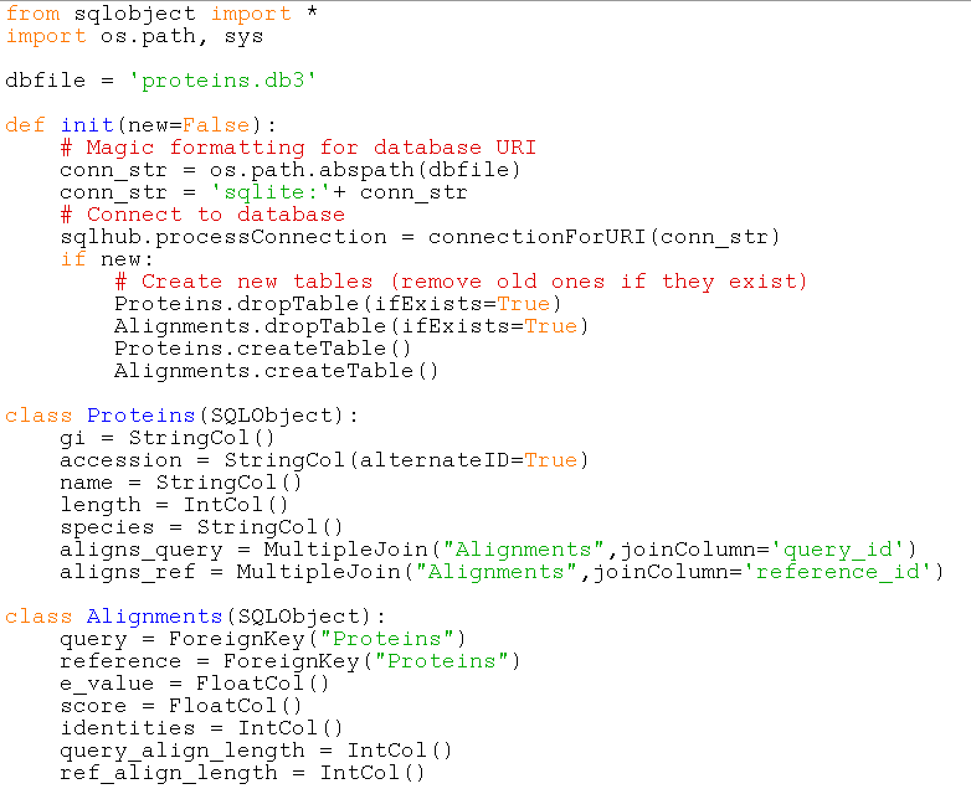
Model.py
Major Functions:
Establish proteins and alignments classes (tables)
Define their data members (columns) and types
Define foreign keys to establish the relationship between the two tables
Notes:
Init function connects python program to sqlite database
Wont do any of these things unless new is set to true
Declare Proteins class inherited from SQLObject; give us Proteins table in db. Has 7 data members. These first 5 correspond to basic values we care about for each protein in the proteomes. Its also going to have two multiple joins which I will get to in a little bit.
Then declare Alignments class with information we care about from each alignment to be stored in alignment table. Includes e value, scores, identities, query_align_length, is going to be length of alignment on query protein including gaps, and ref_align_length is length of alignment on reference protein including gaps. Ill show how i computed this in a bit. I also added a query and reference foreign key pointer back to the Proteins table.

Slide 5

Database Design: Proteins and
Alignments Table
Proteins Table
Alignments Table
Accession | Description | Species | ID
NP_1 | Protein A | Drosophila | 1
NP_2 | Protein B | Drosophila | 2
NP_3 | Protein C | Yeast | 3
NP_4 | Protein D | Yeast | 4
Query_ID | Ref_ID | Length Align | E-Value | Score
 |  | 500 aa | 1x10⁻² | 200
2 | 4 | 400 aa | 1x10⁻³ | 300
2 | 3 | 250 aa | 1x10⁻⁵ | 400
1 | 4 | 400 aa | 1x10⁻⁷ | 500
Query and Reference ID columns point to the rows of the proteins table associated with the query and reference protein for that alignment. They relate the data in our two tables and allow us access to relevant protein info from the other table (eg accession, description)
Notes:
Foreign key set equal to a row in the protein table that we retrieve by accession; for every protein involved in a blast alignment, which row in the Proteins table corresponds to it?

Slide 6
Database Design: Set up for Program (Retrieving Alignment Between Two Proteins)
Proteins Table
Alignments Table
Accession | Description | Species | ID
NP_1 | Protein A | Drosophila | 1
NP_2 | Protein B | Drosophila | 2
NP_3 | Protein C | Yeast | 3
NP_4 | Protein D | Yeast | 4
Query_ID | Ref_ID | Length | E-Value | Score
 |  | 500 aa | 1x10⁻² | 200
2 | 4 | 400 aa | 1x10⁻³ | 300
2 | 3 | 250 aa | 1x10⁻⁵ | 400
1 | 4 | 400 aa | 1x10⁻⁷ | 500
To go in reverse and find all the alignments that a particular protein is involved in, I used multiple joins to invert the foreign keys. Can then retrieve all the alignments for a particular protein and take the one with accession that matches a second protein of interest.

Slide 7
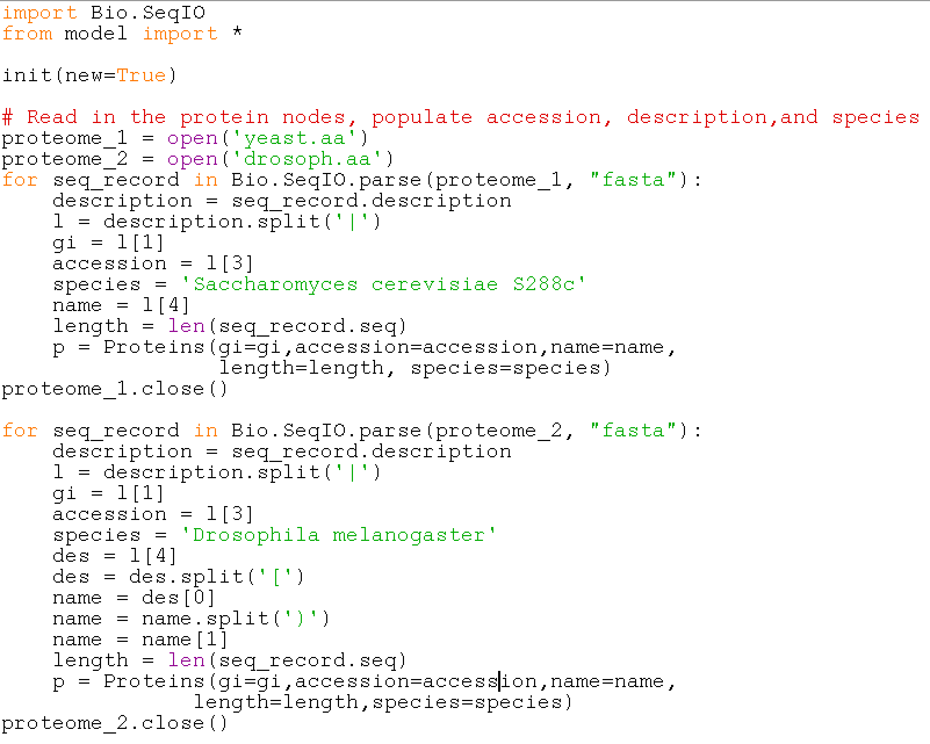
Load_Proteins.py
Major Functions:
Parse proteome files and iterate through each protein entry, extracting relevant info about proteins (gi,accession, species, length)
Assign these values to the data members defined in model
Difficulty parsing out the species so just directly defined it. If this program were more interactive I would need to generalize this
Notes:
New = true because first program to load the database

Slide 8
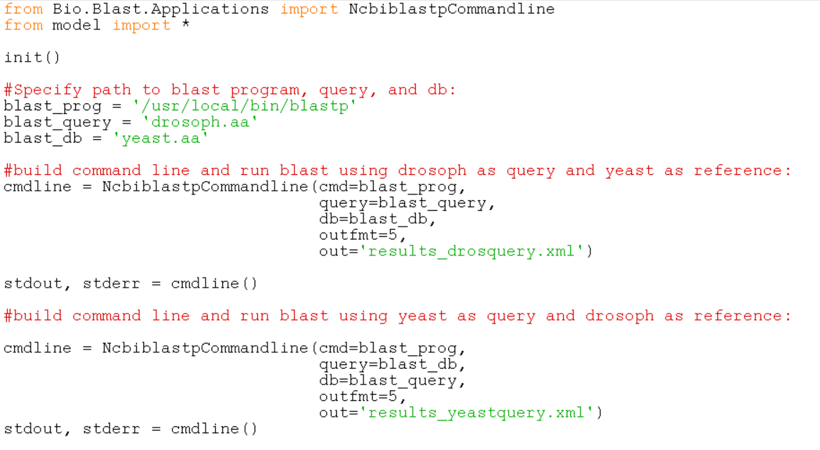
Load_Alignments.py: Part 1
Main Functions:
Run BLAST on the command line with drosoph proteins as query and yeast as database; then run the reverse.
Store output of blast in two different .xml files which we can then parse.
Must run this from the same directory that the proteome files are located in based on how paths were specified.

Slide 9
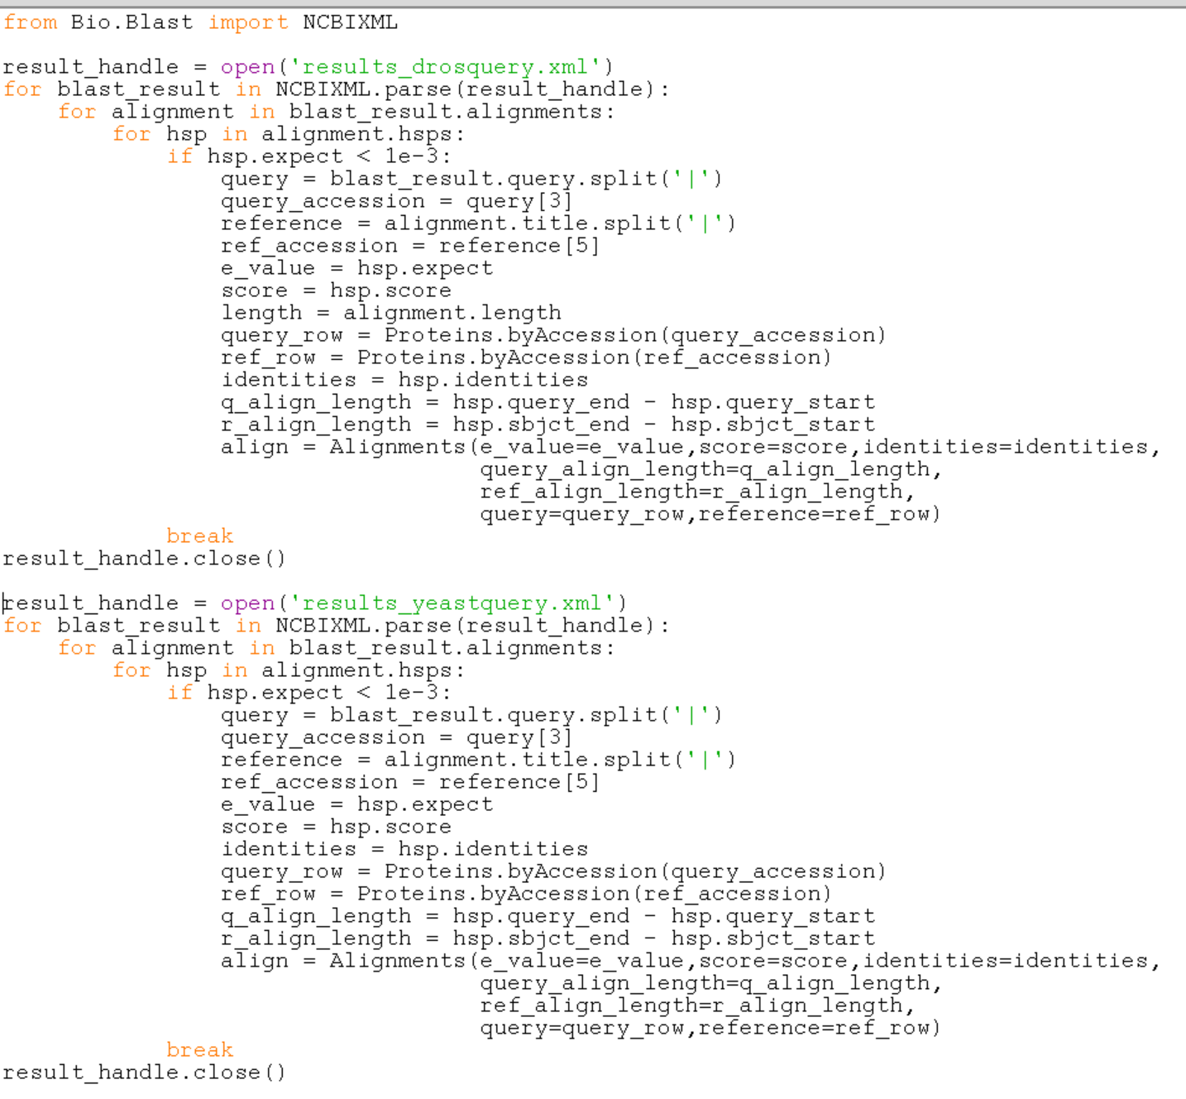
Load_Alignments.py: Part 2
Main Functions:
Parse BLAST results in each output file and extract relevant info about alignment quality and protein identity.
Set these values equal to the data members of the alignments object to load the table.
Only take the best high scoring pair for each alignment (break from loop), and that best hsp must have e_value below 10e-3.

Slide 10
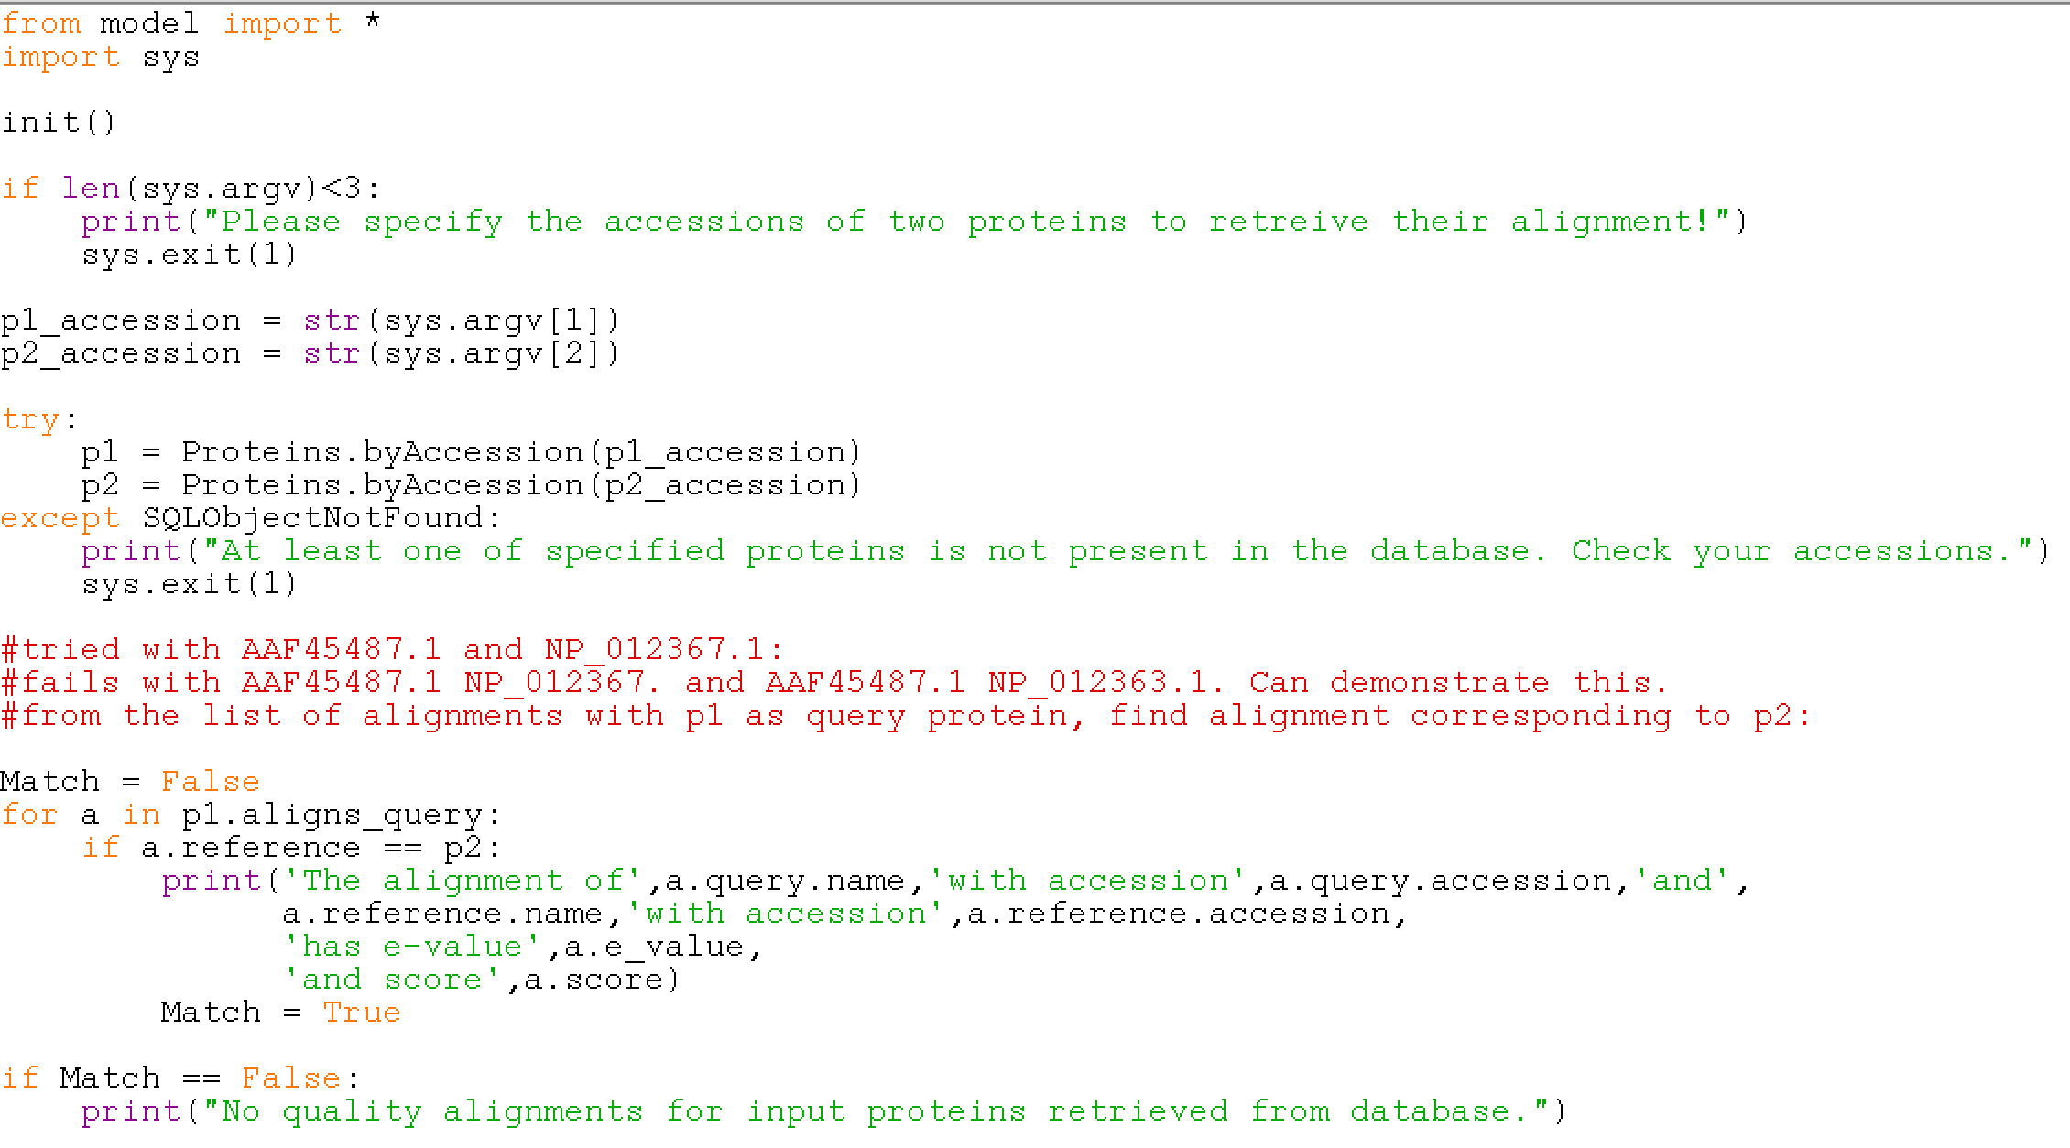
Program 1: Align2proteins.py
Major Functions:
Allow user to retrieve unique alignment for two proteins specified by their accession
Requires one protein to be from drosop proteome and one from yeast proteome
Outputs an error if user only providing a single accession or invalid accessions not found in the protein table
If there are no alignments that met the initial quality threshold (10e-3), output that this is the case

Slide 11
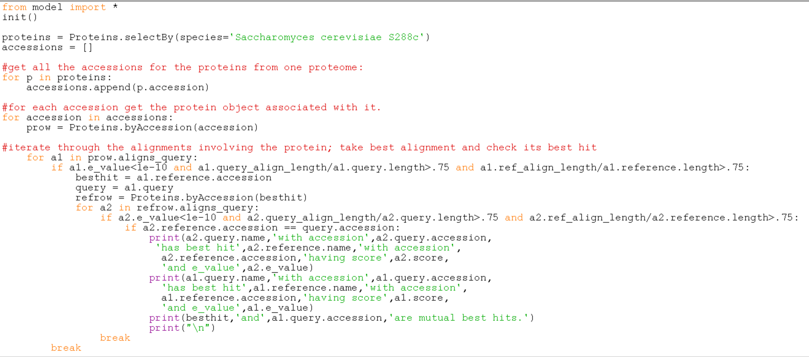
Program 2: besthits.py
Major Functions:
Get all accessions of all the proteins from yeast.
Access protein object associated with a protein’s accession
Iterate through all associated alignments leveraging the aligns_query multiple join.
Find the best hit and accept it if it meets ortholog criteria.
Find the best hit of the best hit and see if its the original query.
If so, print out the alignment info in both directions.

Slide 12
How Well the Program Meets the Requirements and Sticking Points
Successfully stores relevant information about all the proteins in two proteomes in a protein table
Stores information about alignments between proteins of the two proteomes in an alignment table if they meet a basic initial alignment quality threshold
Foreign keys and multiple alignments allow for easy movement between the two tables as they establish the relationship between the tables in the database
Major sticking point for me was understanding the multiple join logic which was necessary for me to run the align2proteins.py program
Deciding on criteria for what constitutes an orthologous pair was difficult
ended up requiring an e-value threshold be met as well as decent alignment cover (75%) of both the query and the reference protein
Limitation: the program only works for the two proteomes specified (drosoph.aa and yeast.aa), but could likely be generalized for other proteomes with some minor tweaks to the proteins_load.py program

Slide 13
What I Learned About Programming Generally and Bioinformatics
Lessons Learned: Programming
Deconstruct a large project into smaller more manageable tasks to get started.
Use print statements along the way to see what’s going on in chunks of your code.
Don’t modify too much without running the program or it might be harder to troubleshoot the source of your error.
Don’t start with a blank slate; use previous skeleton code to get going.
Lessons Learned: Bioinformatics
BLAST is an important resource for looking at homology between primary biological sequences, but it has a multi-layered data structure that requires some work to understand.
Large automated Bioinformatics projects involve running scripts on the command line rather than a web-based version of the tool.
Biological data is rich with information that we can access if we know how it is stored and can parse it effectively.

