Slide 1

module 1: the politics of planetary scale data
Today: Intro to the module and working with large spatial data (without downloading all of it)

Slide 2
1. Global biodiversity data
Where it lives and how it is distributed
2. Remote sensing data
Assessing the greenness of landscapes
3. Sociopolitical data
Querying GDP and other governance indices
4. Combine what you’ve learned
Module 1
planetary scale data

Slide 3
1. Work with different types of global data
Understand the scope of tools and data formats you might run into
2. Understand cloud native workflows and why they are important for big data analysis
3. Collaboratively create reproducible analyses
4. Think critically about the politics of planetary scale data
Who it represents and who it gives power to
Module 1
objectives

Slide 4



Do not edit
How to change the design
Tech setup status check
The Slido app must be installed on every computer you’re presenting from

Slide 5
Do not edit
How to change the design
Have you done analysis with spatial data before today?
The Slido app must be installed on every computer you’re presenting from

Slide 6



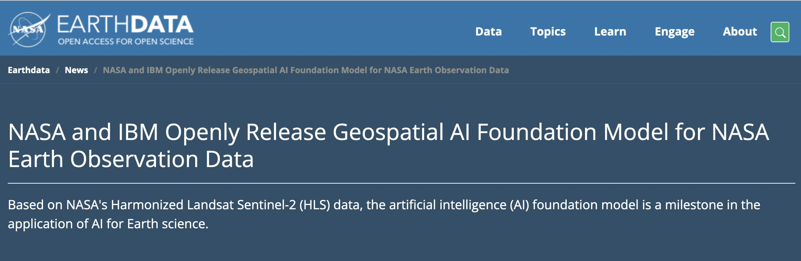
Notes:
Heroic amounts of data and computation are being brought to bear on developing better, more realistic models of our environments and ecosystems, in hopes of improving our capacity to address the many planetary crises.

Slide 7
Biodiversity data
Species Distribution Models
conservation/restoration priorities
other
other
GB
GB
NG
Chapman, et al. (2024) Science.
NG

Slide 8
How do the social, political, & historical dimensions
of biodiversity data impact …
Biodiversity data
Species Distribution Models
conservation/restoration priorities
other
other
GB
GB
NG
NG

Slide 9
How do the social, political, & historical dimensions
of biodiversity data impact …
Biodiversity data
Species Distribution Models
the ecological insights derived from these data?
conservation/restoration priorities
other
other
GB
GB
NG
NG

Slide 10
How do the social, political, & historical dimensions
of biodiversity data impact …
Biodiversity data
Species Distribution Models
conservation/restoration priorities
the distributional equity of decision strategies and priorities for conservation investment?
other
other
GB
GB
NG
NG

Slide 11
Biodiversity data
What can we do about it?
Species Distribution Models
conservation/restoration priorities
other
other
GB
GB
NG
NG

Slide 12
ecological insights
decision strategies
correct
for bias?
along
social & political
dimensions

Slide 13
problem 1:
bias of
datafication
Notes:
Residential segregation in the US or some industrial activities but not everything…
Two maps showing – the main two industrial uses of the high seas considered by alg.s to de
reflect the interest of a small and privledged portion of parties in international agreement

Slide 14
problem 2:
people —
our politics, economies, and histories
are major drivers of ecosystem composition
Notes:
human patterns captured by biodiversity data
reflect a reality of the anthropocene
people — and our politics, economies, and histories — are major drivers of ecosystem composition
Detect and attribute change!!

Slide 15
collect
more data
contextualizing data gaps in downstream decisions

Slide 16
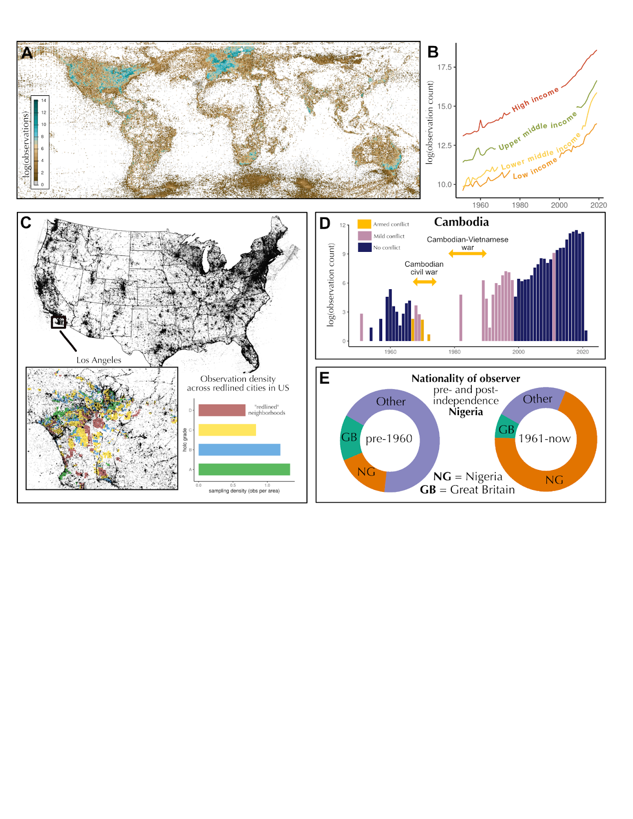
Biodiversity Data
I. models of species distributions
II. metrics of population and community changes
III. identification of invasive species spread
Notes:
Once primarily the concern of macroecological theory and scientific inventories, these data now guide the implementation of massive multilateral commitments and global investments that will impact nature and people for decades to come

Slide 17
Biodiversity Data
decision informed data
collection
I. models of species distributions
II. metrics of population and community changes
III. identification of invasive species spread
Strategic spatial planning of conservation areas, actions, & investment
Assessing the impact of management action on a population of a threatened species
Where to invest in elimination or mitigation of impact of invasive alien species

Slide 18
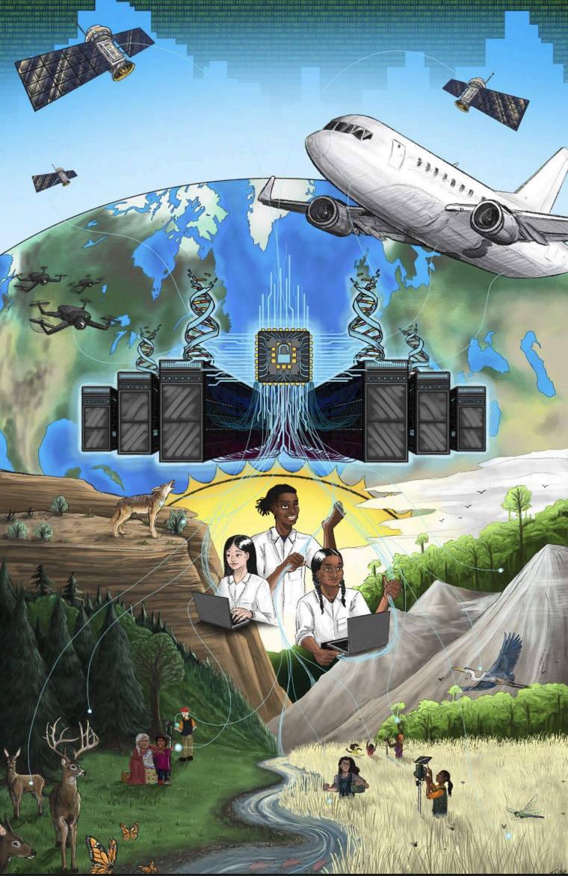
Centering human rights in biodiversity monitoring
collect
more data
Artwork by Mateo Silva

Slide 19
Two kinds of spatial data
Rasters
Vectors
A grid of values over space, at some resolution.
Discrete features with geometry: points, lines or polygons.
5 / 54

Slide 20
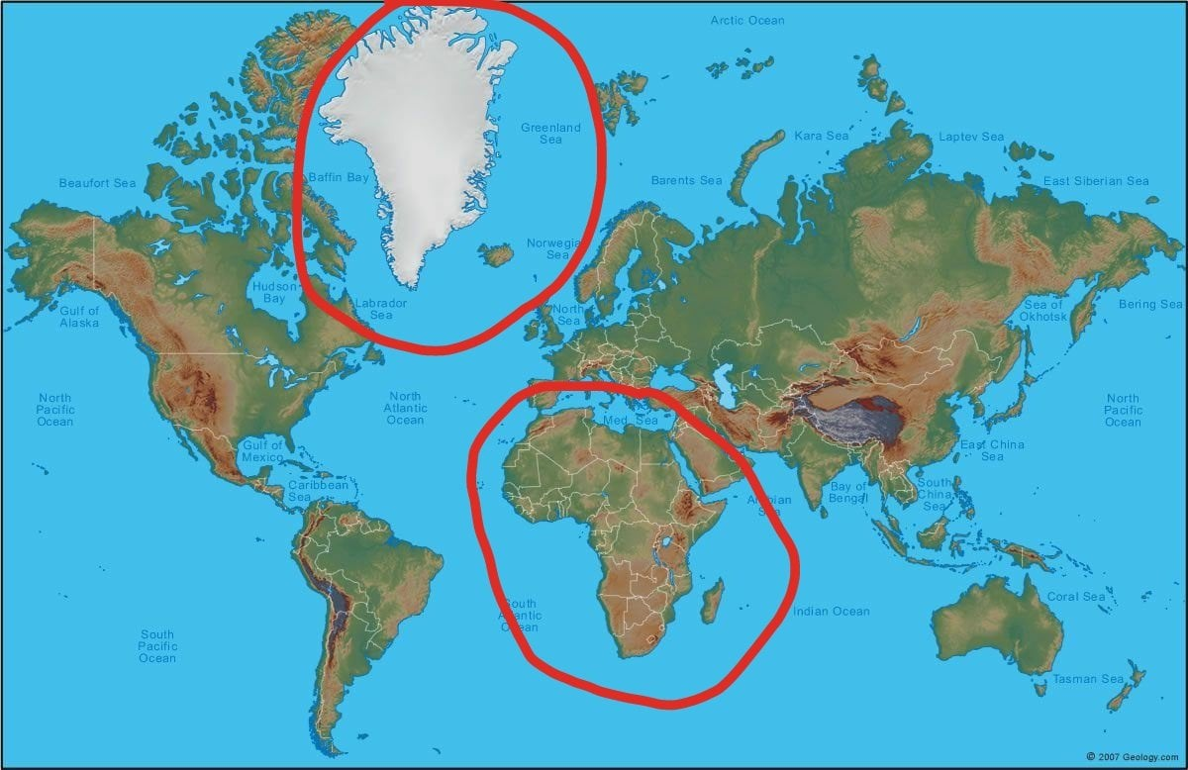
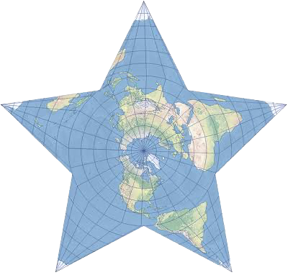
Quick point on coordinates (…the module doesn’t really get into this)
Reference system (CRS)
Says what the numbers in a coordinate mean
Geographic CRS: latitude and longitude in degrees, e.g. WGS 84
Projection
Flattens the curved Earth onto a grid of x/y in metres
Every projection distorts area, shape, distance or direction
EPSG codes
Short IDs for a CRS: EPSG:4326 is WGS 84, EPSG:3857 is Web Mercator
Stored in the file's metadata; check it before combining layers
Why it matters: on Web Mercator, Greenland looks about the size of Africa. Africa is roughly 14× larger.
5 / 54

Slide 21
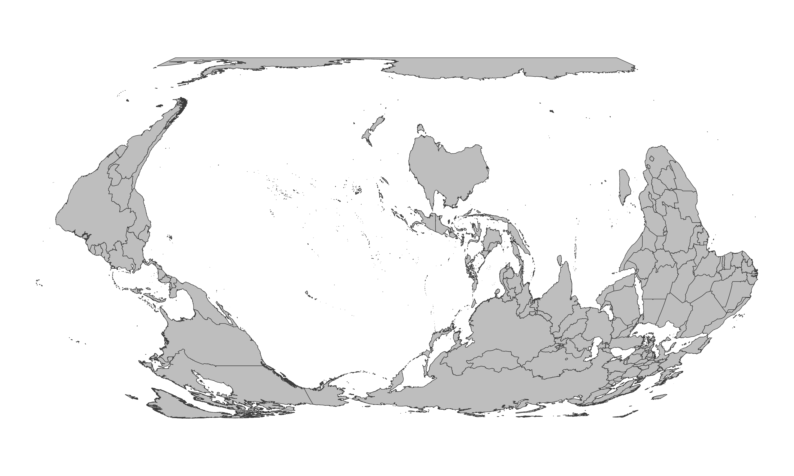
IPBES
Notes:
Reflecting on the histories that shape how we see and center our biosphere – not just in how we draw maps but in how we build the data and algorithmic infrastructures than increasingly influence its governance

Slide 22
These data have gotten
(and continue to get) really big*
* bigger than what can fit in memory on our laptops
7 / 54

Slide 23
The familiar workflow
Remote archive
Download everything
Filter, summarise
A small answer
You copy far more than you need to get a small answer
Your copy is a snapshot that nobody else can check against the source
A large analysis needs a lot of local disk space, or a cluster that not everyone has access to
Keeping the copy current means downloading it again
10 / 54

Slide 24
Cloud-native workflows: Ask for only the bytes you need
Catalogue and file metadata
Request only the needed bytes
Analyse the small result
depends on three things:
1. Object storage over HTTP: files at a URL that can return any slice of themselves on request
2. Formats designed for partial reads: Parquet for tables, Cloud Optimized GeoTIFF for rasters
3. Catalogues that describe data so you can search before reading anything: STAC
13 / 54

Slide 25
Parquet: columnar storage
row group 1
row group 2
row group 3
footer
id
country
year
class
id
country
year
class
id
country
year
class
A query that needs one column (yellow) reads that column, not the whole file.
The footer holds the schema, row counts, and min/max statistics per column chunk
Files are split into row groups, so many files can be read in parallel.
15 / 54

Slide 26
Cloud Optimized GeoTIFF (COG)
your window
internal tiles
overviews (lower resolution)
Tiles: a window overlaps a few tiles, so a few range requests fetch it.
Overviews: a zoomed-out picture is stored inside the file, so a quick look is cheap.
A Sentinel-2 tile is 10,980 x 10,980 pixels; a 15 km window is a small fraction of that.
16 / 54

Slide 27
Live coding

Slide 28

Do not edit
How to change the design
As you work through module 1, what topics do you want more explanation on? (e.g., STAC, COGs, a package your using, GBIF, etc.) I’ll give mini lectures on these as we go!
The Slido app must be installed on every computer you’re presenting from
Notes:
Hi everyone

Slide 29
If youre having trouble with httr2 package:
Remove line that says:
library(httr2)
Replace:
request(u) |> req_error(is_error = \(r) FALSE) |> req_perform() |> resp_status(),
with
attr(curlGetHeaders(u), "status"), # base R: returns the HTTP status code

Slide 30
a political ecology of data
nost & goldstein, 2021
“Data may not disruptively illuminate for all as much as it selectively spotlights for the state.”

Slide 31
“fourth wave environmentalism”
“the vast quantities of big data produced everyday supersede the need for what are increasingly unaccountable and unresponsive governments”
fred krupp, EDF, as described in nost & goldstein p. 4–5, 8
precision
holism
speed
transparency
objectivity
Notes:
The quote is the paper's summary of Krupp's argument (p. 5). The five promises are the paper's list of what data technologies "are said to provide" (p. 8). Data is treated as "a neutral, objective resource" (p. 4) and "the new 'oil'" (p. 8). Ask: who is making this promise, and who benefits if it's believed?

Slide 32
better environmental data leads to better environmental governance.
agree
disagree
Notes:
Students stand on a line across the room. Ask one person at each end to explain. Don't resolve it; come back at the end.

Slide 33
four themes from political ecology for understanding environmental data infrastructures
political economy
who funds it, controls it, profits from it?
production of knowledge
how is the data “cooked”? whose expertise counts?
materiality
where does data physically live? what does it depend on?
context
history, place, scale.
nost & goldstein p. 6–7
Notes:
One minute. These are the four political ecology themes the paper applies to data (p. 6–7).

Slide 34
10 min
discuss your case
1
who funds it, who has access, who benefits?
2
how is the data “cooked”? what is captured, what is left out?
3
where does it physically live? what does it depend on?
4
this data shows ___ but does ___.
cases
planet
global forest watch
global fishing watch
WDPA
Notes:
Questions adapted from the paper's questions about Planet (p. 7). Q4 comes from p. 10: satellite data may show deforestation but does little without other governance measures. Four groups of 4–5. The WDPA group applies the paper's ideas to a dataset it does not discuss. Give a 2-minute warning.

Slide 35
data is…
material
“a moment in socio-ecological metabolism”
practiced
“there is no such thing as raw data”; it is always “cooked”
governed
“a product of social, political, cultural, and economic circumstance”
… and requires praxis
a “trickster science” that “embraces yet critiques its objects of inquiry”
nost & goldstein p. 8–12
Notes:
The special issue's core claim: "against widespread beliefs in it as immaterial and as a resource ready and waiting to drive decision-making", data is "material, practiced, governed, and demanding of our praxis" (p. 8). Material: data centres, cables, lithium, water (p. 5, 8–9). Practiced: cleaning, curating and maintaining data (p. 9). Governed: rules over access, and data's role in statecraft (p. 9–10). Praxis: political ecologists working with data practitioners (p. 12). Then hand out the case cards.

Slide 36
share
2 min per group
1
your case in one sentence
2
this data shows ___ but does ___.
3
the most interesting thing you discussed as a group
Notes:
Note on the board which lens each point touches. Connect Global Forest Watch in Myanmar (transparency does not equal accountability) and WDPA (data that "selectively spotlights for the state", p. 11).

Slide 37
Module 1 a few reminders and tips
Remember to have one person code and one person direct
Switch roles ever 10-15 minutes
(practice add -> commit -> push and pull from github)
- Don’t be afraid to look things up – this course is about learning to learn!
- You will need to do some work on the module outside of class (6 CP = ~10hrs / wk, so ~6hr/wk out of class for reading, module work, going to step-by-step instructions)
Notes:
Tie each point back to the groups' "shows ___ but does ___" sentences. Point 3 links to the "irony of transparency" (p. 11). Then move to the re-vote.

Slide 38
STAC: catalogues before pixels
Catalog
entry point
Collection
a dataset
Item
one scene
Asset
a file
a URL
sentinel-2-l2a
date, cloud cover, footprint
red, nir, scl (COGs)
You search by place, time and cloud cover and get back items with links. No image is read yet.
Metadata first, pixels later, the same principle as the Parquet footer.
17 / 54

Slide 39
Section 2
Cloud-native computing
9 / 54

Slide 40
The stack: your verbs, an engine, remote files
Your R code: dplyr verbs
DuckDB is an analytical database that runs inside your R session. No server to set up.
It reads Parquet and CSV directly, including from the cloud.
dbplyr lets you write ordinary dplyr code; it generates the SQL.
Only the small result crosses the network back to R.
dbplyr: translates to SQL
DuckDB: plans and runs
httpfs: range requests
Note. You do not need to learn SQL first. You do need to know when the work actually happens.
Parquet files on S3
19 / 54

Slide 41
Slido poll placeholder
How much data would you download to count bird records per country?
3 / 54

Slide 42
What if we had downloaded?
 | Download first | Cloud native
Time | Hours before the first line of analysis | Minutes; you pay per query
Storage | The whole GBIF snapshot (estimate it), about 1 GB per scene | Results of a few MB
Reproducibility | "My copy" | Snapshot date plus a saved query
Freshness | Re-download to update | Change the date or the search
Skills needed | File handling | Query building, lazy evaluation
These sizes are rough. Estimate the GBIF snapshot yourself with range requests, as in Session 1.
51 / 54

Slide 43
Appendix
Code walkthroughs and worked applications
3 / 54

