Slide 1
Practical Predictive Analytics Seminar
Marshall Lagani
(marshall.lagani@gmail.com)
Analytics Topics in Financial Modeling
September 23, 2020

Slide 2

Overview
2018 SOA

Slide 3
Motivation
Modern insurance products incorporate various forms of equity risk.
Variable Annuities
Universal Life
Financial engineering techniques are commonly employed to price the equity risks of such products.
We will explore how analytics techniques can be used to develop various models, distinguishing between their explanatory power and their predictive power.

Slide 4
Agenda
Two Case Studies
Explanation of Variance in Volatility
Autoregressive models (e.g. Le Roux)
Traditional form (linear regression)
Modified form (generalized linear model)
Option Pricing under Black Scholes
Review for European Call
Using neural networks to build proxy models

Slide 5
Case Study 1 Volatile Volatility
2018 SOA

Slide 6
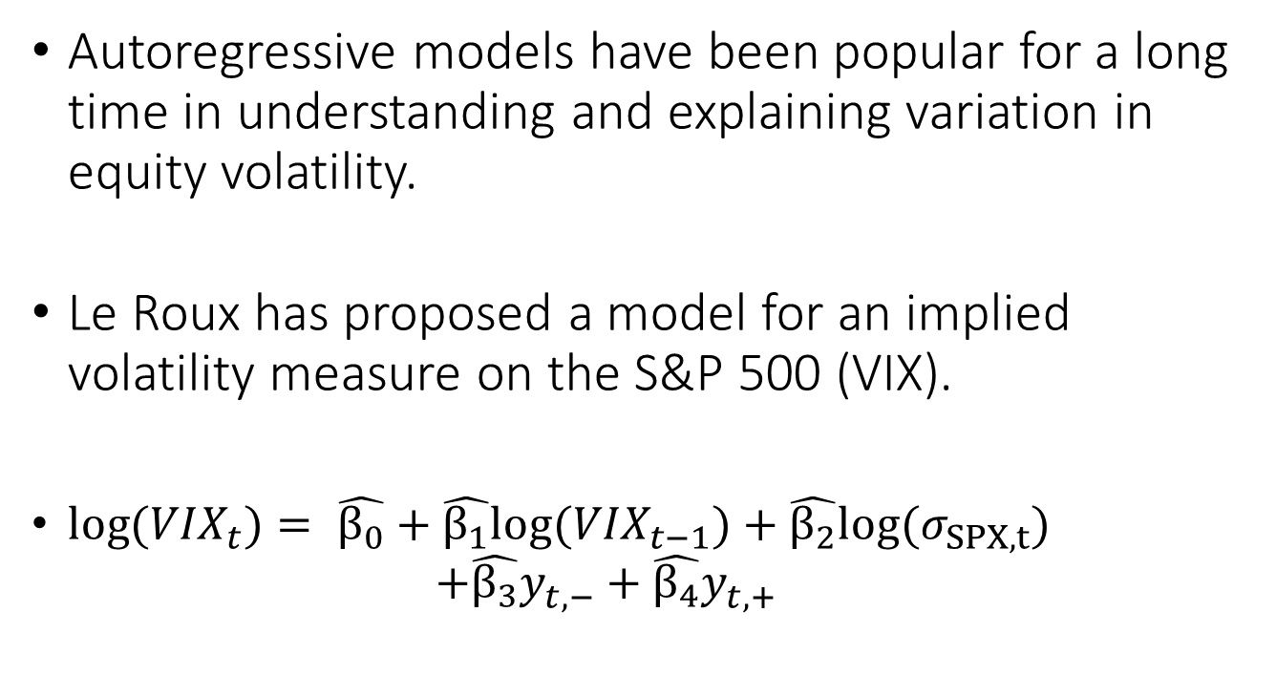
Volatility Modeling
Autoregressive models have been popular for a long time in understanding and explaining variation in equity volatility.
Le Roux has proposed a model for an implied volatility measure on the S&P 500 (VIX).
$log({VIX}_{t})= \hat{β_{0}}+\hat{β_{1}}log⁡({VIX}_{t−1})+\hat{β_{2}}{log⁡(σ}_{SPX,t})$
$$+\hat{β_{3}}y_{t,−}^{}+\hat{β_{4}}y_{t,+}^{}$$

Slide 7
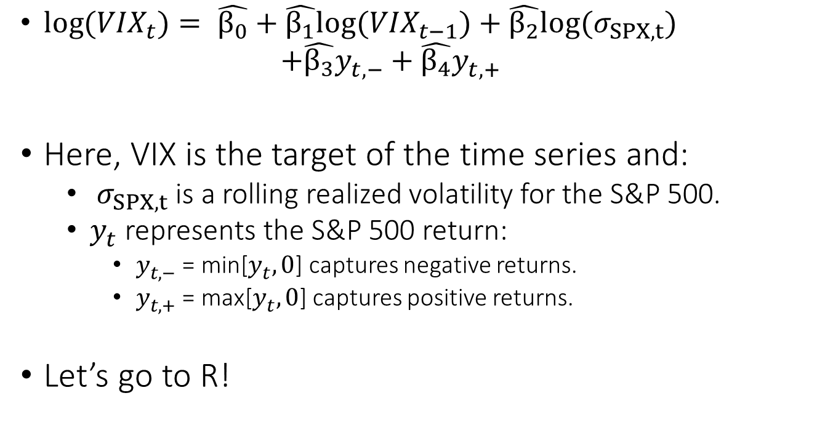
Volatility Modeling
$log({VIX}_{t})= \hat{β_{0}}+\hat{β_{1}}log⁡({VIX}_{t−1})+\hat{β_{2}}{log⁡(σ}_{SPX,t})$
$$+\hat{β_{3}}y_{t,−}^{}+\hat{β_{4}}y_{t,+}^{}$$
Here, VIX is the target of the time series and:
$σ_{SPX,t}$ is a rolling realized volatility for the S&P 500.
$y_{t}^{}$ represents the S&P 500 return:
$y_{t,−}^{}$ = min[$y_{t}^{},0$] captures negative returns.
$y_{t,+}^{}$ = max[$y_{t}^{},0$] captures positive returns.
Let’s go to R!

Slide 8
Case Study 2 Black Scholes, Neural Networks, and R
2018 SOA

Slide 9
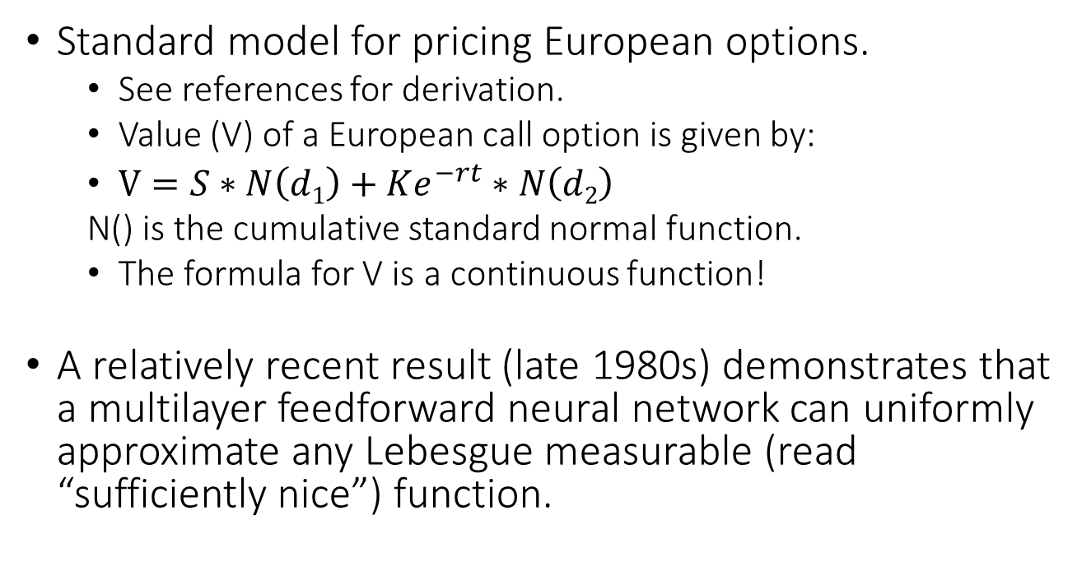
Black Scholes Model
Standard model for pricing European options.
See references for derivation.
Value (V) of a European call option is given by:
$V=S∗N\left(d1\right)+Ke^{−rt}∗N\left(d2\right)$
N() is the cumulative standard normal function.
The formula for V is a continuous function!
A relatively recent result (late 1980s) demonstrates that a multilayer feedforward neural network can uniformly approximate any Lebesgue measurable (read “sufficiently nice”) function.

Slide 10
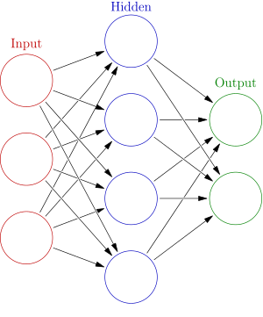
Neural Networks?
Developed in the 1940s as a mathematical model for neurological function.
Logistic regression on steroids!
See references for further discussion.
Moving to R code.
Image reprinted from Wikipedia.

Slide 11
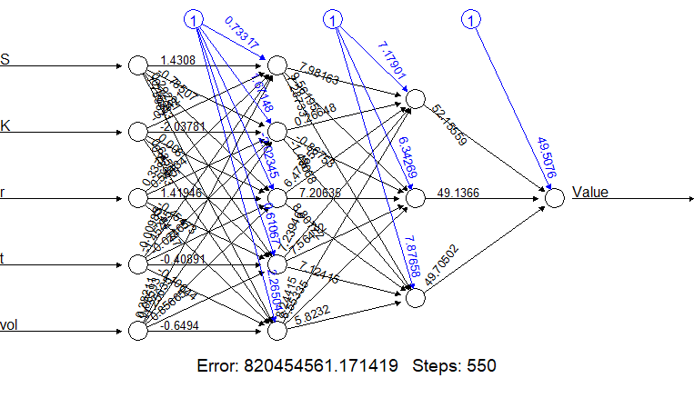
First Try… Runs Quickly!
Cool picture!
Error = 820 million (of something)… can’t be good.

Slide 12
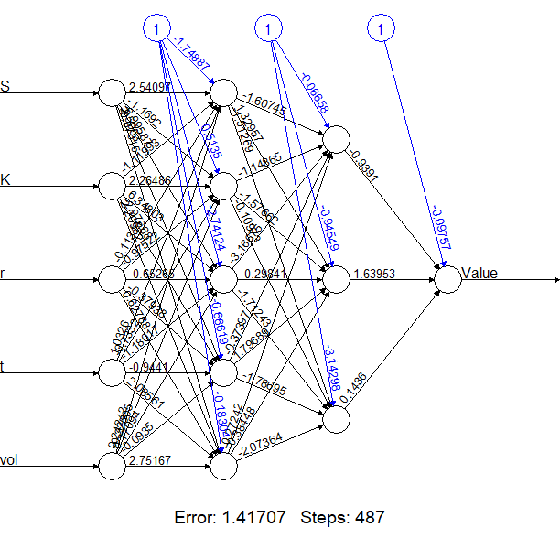
Second Try… Takes Forever!
Another cool picture!
Error = 1.41707… this is better, right?

Slide 13
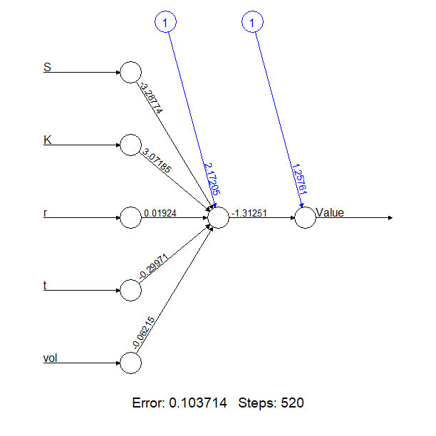
Third time’s the charm!
Another cool picture!
Error = 0.103714… feeling more confident.

Slide 14
Conclusions
2018 SOA

Slide 15
Summary
Testing the “r²” of the various models against the dataset yields some surprising results. The moral of the story here is that a model does not need to be more complex to produce better results.
Having built a low error estimate of a function that has a closed form formula does not actually add a lot of value for us… so why do it?

Slide 16
Extensions & Applications
Proof of concept of the effectiveness of neural networks.
Often there is no closed form formula for the target, but the target function is still provably Lebesgue measurable.
Neural Networks can be leveraged to build proxy models to support a variety of useful functions:
Reduce need for Monte Carlo simulation.
Support capital forecasting.
Support daily trading functions (e.g. trade grids)
Not a magic bullet… many data points are needed!

Slide 17
Closing Thoughts
This is only the tip of the iceberg. Discussions on network construction and earlier ideas on model selection should be incorporated prior to putting statistical computing results into production.
Standard functionality in R can deeply enhance our understanding of financial models.
Math is fun!

Slide 18
Thank you!
2018 SOA

Slide 19
For Further Exploration Internet References
rstudio.com
tidyverse.org
stackoverflow.com
playground.tensorflow.org

Slide 20
For Further Exploration Helpful Texts
Neural Networks in Finance, McNelis, 2005, Elsevier
Options, Futures, and Other Derivatives 6th Ed., Hull, 2006, Pearson
Paul Wilmott on Quantitative Finance, Wilmott, 2006, Wiley
R for Data Science, Wickham & Grolemund, 2017, O’Reilly

Slide 21
For Further Exploration Articles of Interest
“Multilayer feedforward networks are universal approximators”, Hornik, et. al., 1989, Neural Networks, Volume 2, Issue 5
“Dynamics of Implied Volatility Surfaces”, Cont & Fonseca, 2002, Quantitative Finance, Volume 2, Issue 1
“A Long-Term Model of the Dynamics of the S&P 500 Implied Volatility Surface”, Le Roux, 2007, North American Actuarial Journal, Volume 11, Issue 4
“Machine learning for quantitative finance: fast derivative pricing, hedging and fitting”, Spiegeleer, Madan, et. al., 2018, Quantitative Finance, 2018, Volume 18, Issue 10

