Slide 1
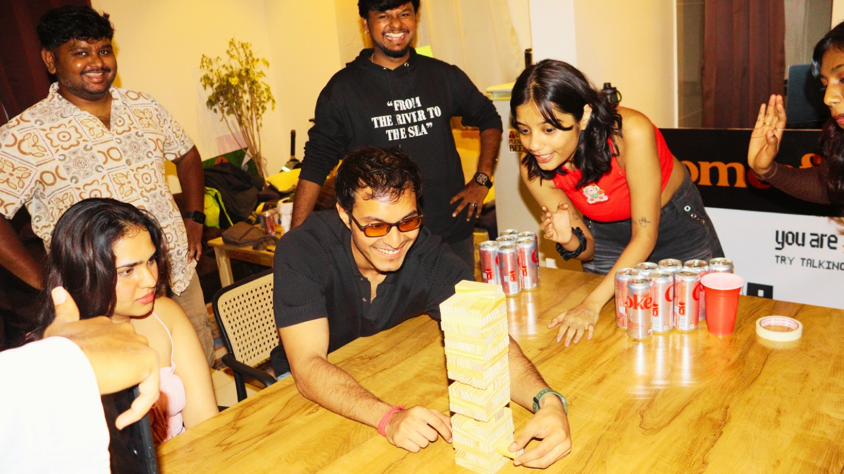
come offline · bangalore
get paid to go out.
a conversation about what your influence is actually worth.
the creator program · bangalore’s first ten
Notes:
Don't present this slide — just leave it up while you say hi. One framing sentence before anything else: “this isn't a brand-deal pitch. we want to talk about the money you're NOT making from something you already do.” Then go straight to slide 2 and shut up — the first ten minutes of this call should be them talking, not you.

Slide 2
✳ first — about you
before we explain anything, we want to understand you.
01
what do you create — and who actually listens?
not follower count. who texts you “where is this?” when you post a story?
02
what does going out look like for you right now?
how often, with whom, who plans it?
03
how does creator money work for you today?
brand deals? barters? nothing yet? what’s annoying about it?
Notes:
THE most important slide of the call — this is where value-based selling happens. Ask, then listen for 5–10 minutes. Take notes: their answers decide which value pillar you lead with later. Money frustration → lead with slide 7 (income). Content grind → slide 8. Lonely-at-the-top / community energy → slide 9. Ambition/status → slide 10. Everything they say here gets played back to them in their own words.

Slide 3
✳ the problem
being a creator pays worse than it looks.
✕
brand deals are one-offs.
you pitch, you wait, you post, you start from zero again next month.
✕
promo codes spend your credibility.
every app you shill that your audience regrets is trust you don’t get back.
✕
payment terms are built for agencies.
invoices, follow-ups, net-60 — for a reel that took your whole sunday.
✕
platforms pay reach. yours pays nothing for trust.
the algorithm rewards strangers scrolling — not the 40 people who’d actually show up for you.
Notes:
Only present the pains they actually named on slide 2 — skip the rest, or better, quote them: “you said brand deals ghost you after the first email…” If they said money is fine, don't force this; move to the unpaid-work angle on the next slide instead. The goal is agreement, not a lecture. End with: “does that match your experience?” and let them add to the list.

Slide 4
✳ the part nobody pays you for
your dms are already
a ticketing desk.
every “where is this place?”, every plan you organise, every friend who shows up because you said “come, i’m going” — that’s conversion. it’s just never been paid.
you’ve been the distribution. you’ve never been paid like it.
Notes:
This is the cost-of-doing-nothing slide — the core of value selling. Make it personal with their slide-2 answers: “you said 30 people DM you every time you post a restaurant — that's a funnel. right now it converts for the restaurant, for free.” Pause after the last line. The realization you want them to have: they already do this job; the only question is whether it pays.

Slide 5
here’s the shift we’re betting on —
your most valuable asset isn’t reach.
it’s that people actually show up when you say come.
ads monetise attention. we monetise trust — and trust compounds.
Notes:
The pivot from problem to solution. One beat of context: social media has enough ads — we'd rather have creators inside the room than posting about it from outside. Then the promise of the next four slides: “so we built a program around four things you told us you want” — and name the four in the order that matches THEIR slide-2 answers: money that repeats, content without a budget, an audience that becomes your people, and being early to something.

Slide 6
✳ value nº1 · income that repeats
a brand deal ends. an audience that goes out with you doesn’t.
brand deals
come offline
how it starts
you pitch. they ghost.
you’re invited. first ten only.
how it pays
one post, one payment, start over
same audience, new event every week — it stacks
when it pays
invoices, net-60, follow-ups
monthly, straight to your upi
what it costs you
credibility, if the product is meh
nothing — you only promote rooms you’re in
what you need
a big following
people who trust your plans
₹150+ a seat as the floor · campaign events up to ₹250 · clicks pay even before anyone buys.
Notes:
The economic argument: recurring beats one-off. A brand deal is a transaction; this is an asset — the same 40 trusted followers can buy again every single week, and events repeat. Don't read the table; pick the two rows that match their pain from slide 3. Land the compounding line out loud: “the work you did last month keeps paying this month, because the people you brought come back.”

Slide 7
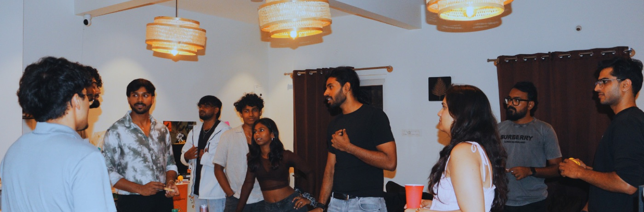
✳ value nº2 · a content engine you attend
stop producing content. start living it.
every room is a reel — real people, real moments, zero production budget. one reel per event you join, a one-paragraph brief, no scripts. that’s the whole job.
Notes:
For creators feeling the content grind (slide 2 tells you). The insight: IRL content is what's outperforming right now, and it's the one format you can't fake — and they get the setting for free. Their audience also becomes their footage: the room is full of their own people. If they worry about creative control: brief, not script. They talk like they're telling a friend, because they are.

Slide 8
✳ value nº3 · your audience becomes your people
the follower who dms you
becomes the person across the table.
most creator monetisation spends your audience’s trust. this one deepens it — you’re not selling them something to buy alone at home, you’re bringing them somewhere you’ll actually be.
the only program where “doing the job” means hanging out with your people.
Notes:
The emotional pillar — for many micro-creators this lands harder than money. Parasocial becomes real: they finally meet the people behind the usernames, and those people meet each other. That's also why this GROWS their account instead of burning it — every event produces tagged stories, new followers, and a tighter core audience. Free entry belongs here too: they never pay to enter a room they're filling.

Slide 9
✳ value nº4 · the ground floor
ten creators. nobody’s reached the top yet.
level three · 150 seats
founding creator. the perks up here are being saved for whoever arrives first.
level two · 50 seats
closer to the house — first look at campaigns, a louder say in what we run.
level one · 10 seats
payouts unlock — retroactive to your very first seat.
the first ten don’t join a program. they shape it — pages built with you, campaigns tuned together.
Notes:
Status and earliness — for the ambitious ones. Be honest that levels two and three are deliberately open: “we're defining the top of the ladder with whoever gets there first.” Do NOT invent perks for 50/150 seats. The real offer at this level is access: direct line to the founder, pages built together, a say in which events run. That access is what disappears once this scales past ten.

Slide 10
✳ what it costs you to try
nothing. we designed the risk out of it.
✓
clicks pay before anyone buys.
every 100 clicks on your link earns — a floor under a slow week.
✓
your link remembers for 30 days. your code never expires.
someone buys three weeks after your story died — still your sale.
✓
retroactive from ticket #1.
earnings unlock at 10 lifetime tickets, then every seat pays — including the first.
✓
no quotas. no exclusivity. no contracts to escape.
enrol only in events you’re excited about. leave whenever. keep your brand deals.
Notes:
Objection pre-emption. The subtext of every line: “what do you have to lose?” — the honest answer is one reel per event they were probably attending anyway. If they ask “what if my audience doesn't buy?”: clicks still pay, and free entry means they've lost nothing but gained the night. The no-exclusivity line matters to anyone with existing brand relationships — this stacks on top, it doesn't replace.

Slide 11
✳ let’s do your numbers — right now
story views on a normal day
________
for scale —
10 friends
≈ ₹1,500
50 seats a month
≈ ₹7,500
₹250 campaign event
≈ ₹12,500
examples, not promises. you see the exact rate before you post.
of those, people who’d click your link
________
every 100 clicks
earns you ₹
friends + followers who’d actually come
________
× ₹150–250 a seat
= ₹ ________
events you’d join in a month
× ________
your month = ₹ ____________
Notes:
The ROI moment — THEIR numbers, not our examples. Share your screen or just talk it through; write their figures down as you go. Be deliberately conservative — halve whatever they estimate — so the result feels like a floor, not hype. A number they computed themselves is one they defend to themselves later. Anchor against effort: “that's your number for one reel per event you were going to anyway.” Then stop selling.

Slide 12
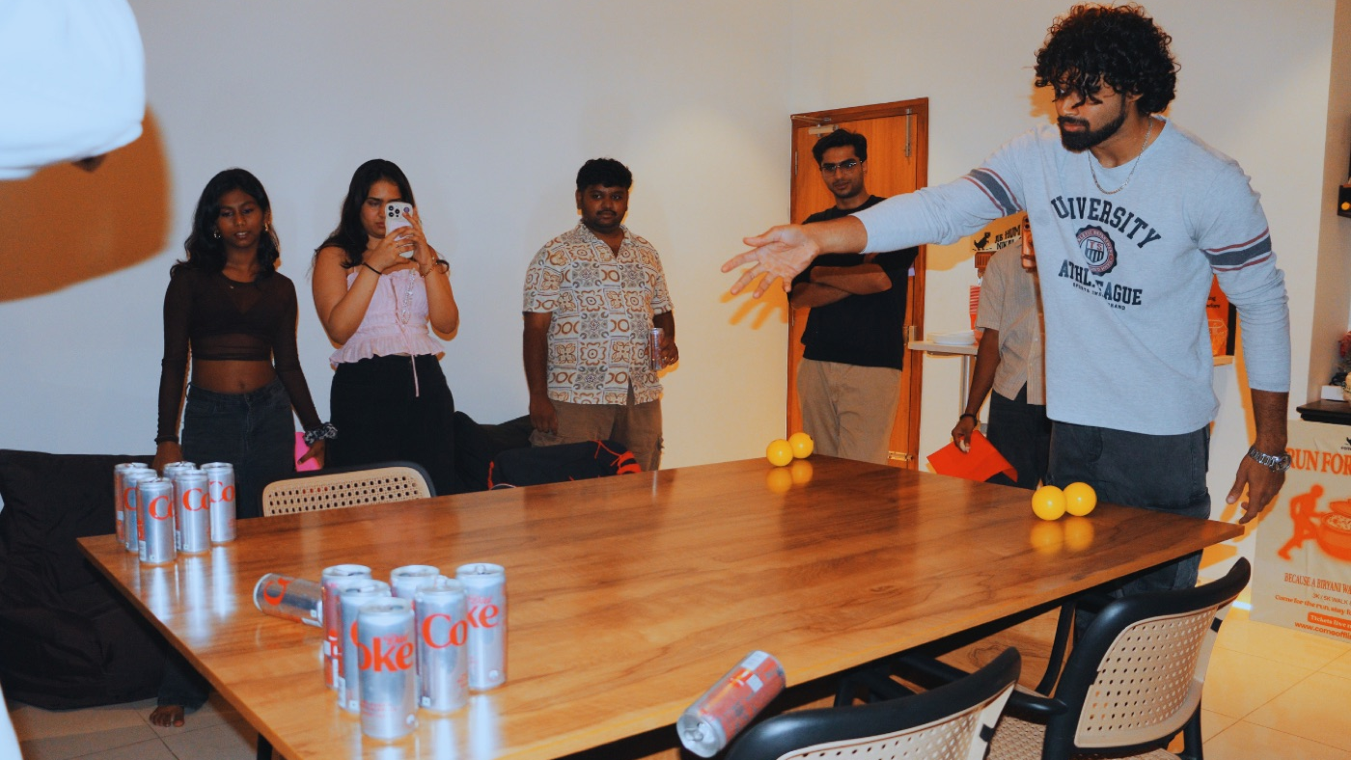
you were going out anyway.
get paid to bring people together.
this week, if you’re in: ① pick your handle ② pick your first event ③ we draft your page together
say yes on whatsapp →
+91 93809 06810 · a real human replies. usually fast.
creators disclose their partnership with come offline per asci guidelines. commissions apply to eligible completed purchases only — refunds, cancellations and personal purchases excluded. earnings examples are illustrative, not guarantees.
Notes:
Close on a decision, not “think about it.” The three steps are the ask — walk them: handle, first event, page draft this week. If they're in, send the WhatsApp message together while still on the call; that's the handshake. If they hesitate, ask which part gives them pause and go back to that ONE slide — don't re-run the deck. A soft close that works: “worst case, you come to one event free and decide it's not for you.”

