Slide 1
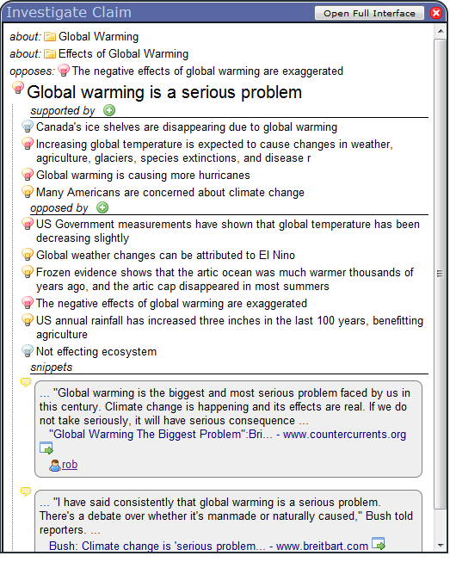
Topics it is about
Selected Claim
Claims that support it
Claims that oppose it
Web snippets that state it

Slide 2
Topics it is about
Claims it opposes
Selected Claim
Claims that support it
Claims that oppose it
Web snippets that state it

Slide 3
Create new supporting claim
Status Icons

Slide 4
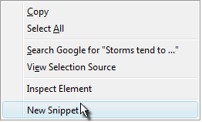
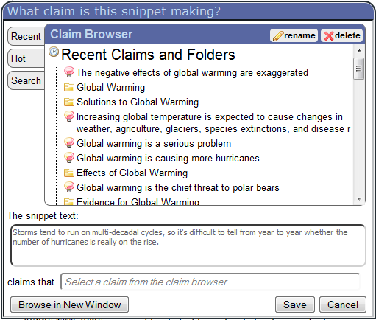
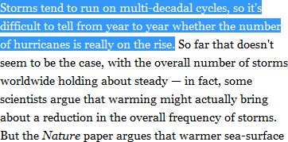
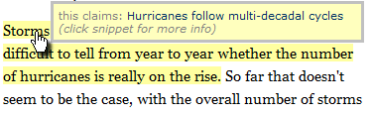

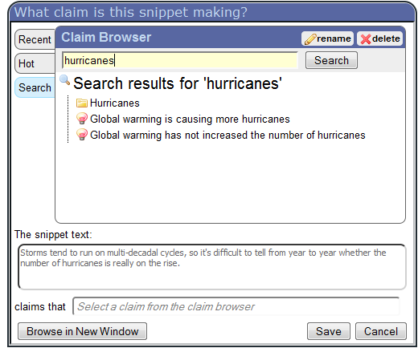
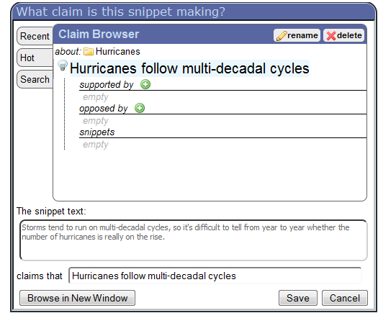
1.) Select Text
2.) Click toolbar button or context menu
3.) Select claim
4.) Snippet is now highlighted

Slide 5
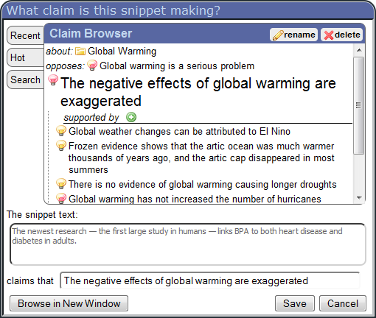
Rename or delete the selected claim
Quick Lists
Claim Browser
Text of new snippet
Selected Claim

Slide 6
Enhanced Claim Browser
Text of new snippet
Selected Claim

Slide 7
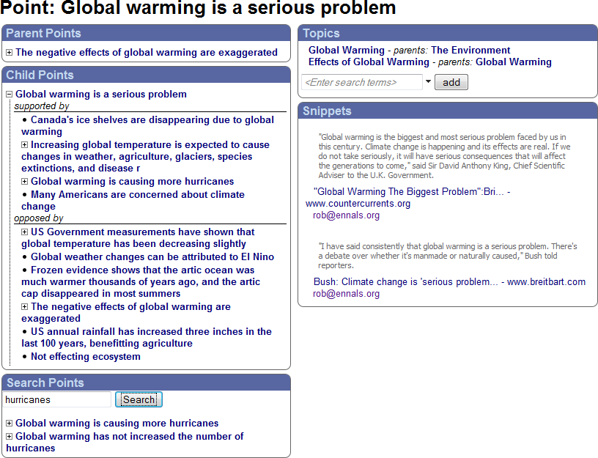
Selected Claim
Claims that this claim supports or opposes
Topics that this claim is about
Claims supporting or opposing the selected claim
Snippets that make this claim
Search for claims to connect to the selected claim

Slide 8
Topics that this claim is about
Selected Claim
Claims that this claim supports or opposes
Claims supporting or opposing the selected claim
Snippets that make this claim
Search for claims to connect to the selected claim

Slide 9
Rename or delete the selected claim
Quick Lists
Claim Browser

Slide 10
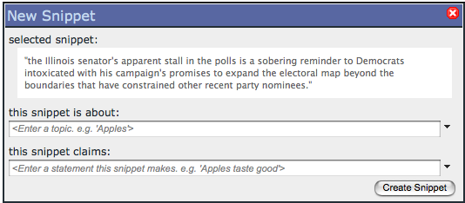
Snippet Text
Topic
Show Suggestions
Claim

Slide 11
Normal
Bookmarked
Normal
Bookmarked
Claim
Supported
Snippet
Opposed
Topic
Neither

Slide 12
Normal
Voted for
Normal
Voted for
Claim
Supported
Snippet
Opposed
Topic
Neither

Slide 13
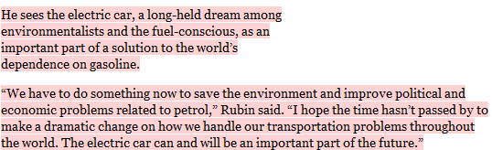
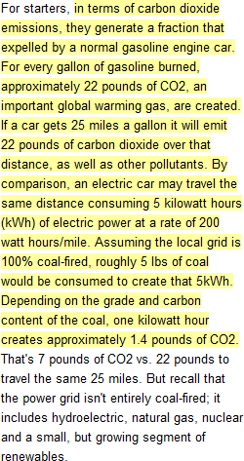
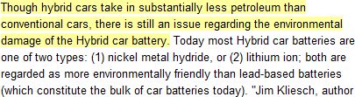
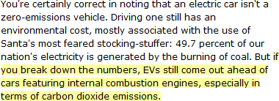
claims
Claim Graph
Electric cars are good for the environment
opposes
supports
Electric car batteries cause environmental damage
Electric cars emit less carbon dioxide than normal cars
claims
claims
claims

Slide 14
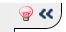


Slide 16
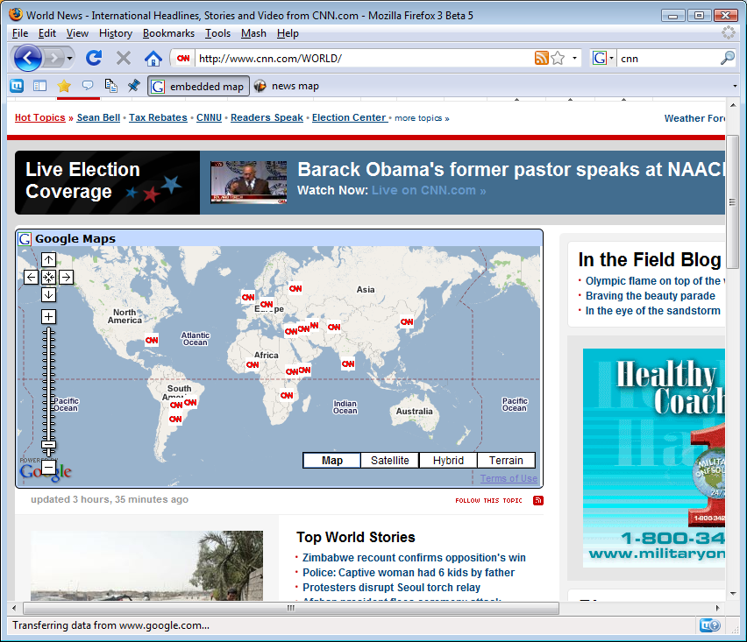
Improvement Enabled
Additional content inserted

Slide 17
Mashups Combine Multiple Widgets
Widgets Mini-apps that manipulate, import, and visualize data
Extractors
Extract meaning from web sites for use by widgets
Web Sites
Provide information for mashups

