Slide 1
Controller for Distributed Power Processing in Battery Packs
John Miller, researcher
Dr. Satish Ranade, research mentor

Slide 2
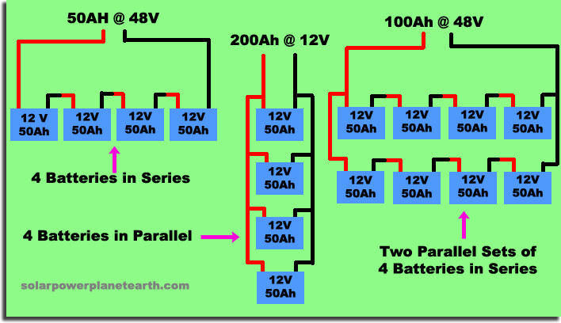
Batteries in Power Systems

Slide 3
Batteries in Power Systems
Series - add voltage
Parallel - add capacity
Series/parallel - add voltage and capacity
Notes:
Laptop batteries usually have good cells, but the one bad cell makes the entire pack worthless.

Slide 4
The Problem
Lithium Ion battery cells are 3.7 Volts
120V/3.7V = 33 cells
Cells frequently go bad
Charging capacity depends of the worst cell
Can be expensive and time consuming to find and replace
Need to bring the power off line

Slide 5
What if there was a better way?

Slide 6
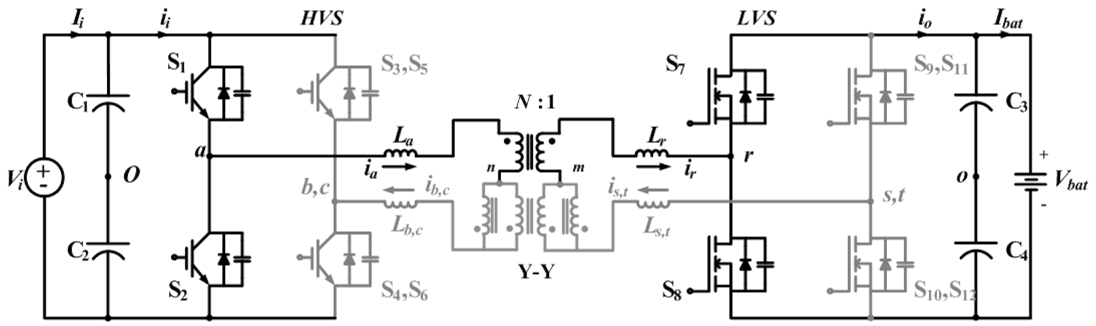
Dual-Active-Bridge

Slide 7
Dual-Active-Bridge
Step up the voltage of each cell
Charging more efficient
Bad cells easier to replace

Slide 8
The Problem

Slide 9
Problems with using a Dual-Active-Bridge
Expensive
Each cell will need its own DAB
Circuitry required to drive DAB relatively expensive
Bulky
Circuits are relatively large
Can be power hungry

Slide 10
The Big Picture

Slide 11
What is done so far
TI DSP based controller and power electronics completed
Transformer development in progress
Further (4x) reduction in footprint

Slide 12
REU Project
FPGA Based Controller
Integrate with DAB
Cell/Stack sensors/analytics

Slide 13
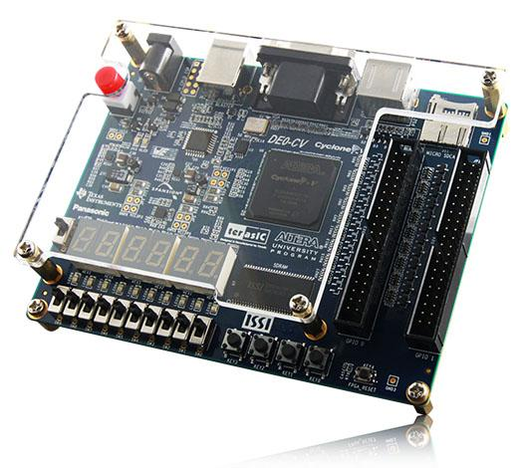
FPGA
Altera DE0-CV
VHDL
Programmable Logic/Circuits

Slide 14
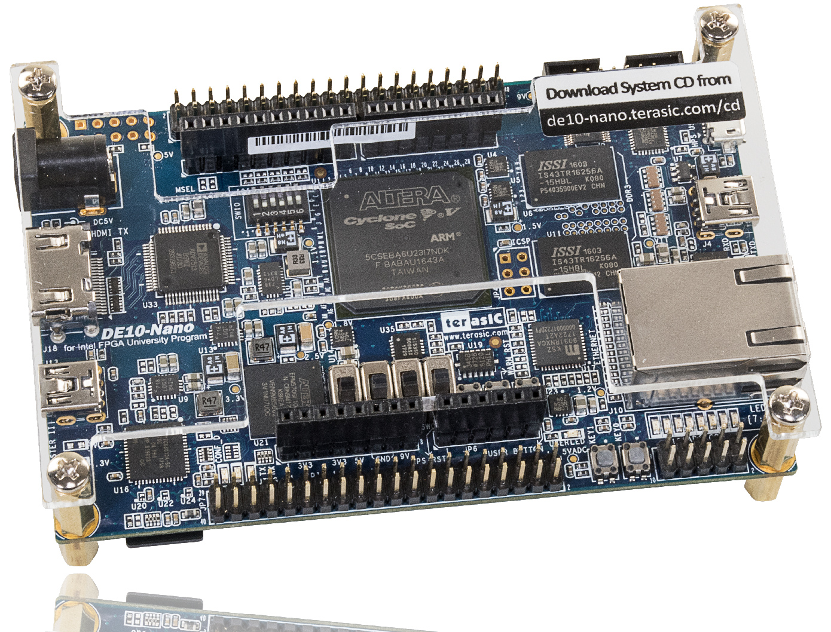
DE10-Nano
Similar to the DE0-CV
Cyclone V SOC
800MHz Dual-core ARM Cortex-A9 processor
A/D converter, 4-pin SPI interface with FPGA

Slide 16
ADC
SPI Communication Onboard
FPGA
Output Voltage Monitor
PWM Signal Generated
DAB

Slide 17
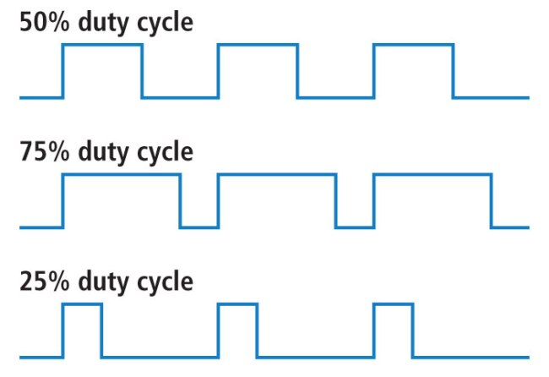
VHDL Design
Pulse Width Modulation (PWM)
Square wave
Variable duty cycle
Variable phase shift
UART Communication
For sensors
Sensor Feedback
Calculate modification

Slide 18
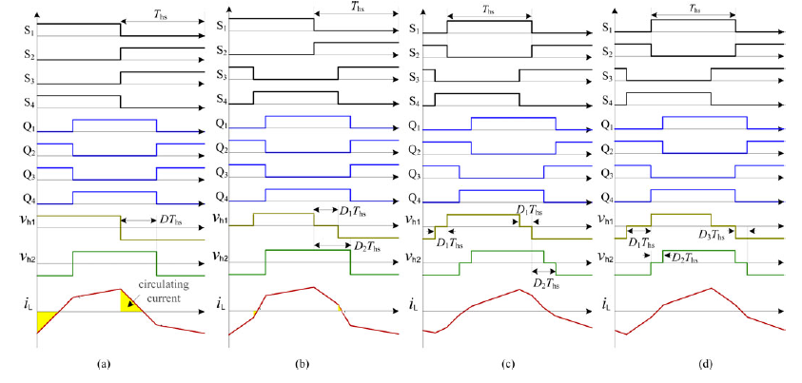

Slide 19
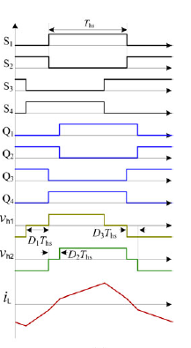

Slide 20
VHDL & Block Diagrams

Slide 21
PWM Output
if (count_1 = duty_cycle) then
pwm1_out <= '1';
end if;
if (count_1 = clock_ticks) then
pwm1_out <= '0';
end if;
duty_cycle
clock_ticks = 1000

Slide 22
PWM Output With Inverse
if (count_1 = duty_cycle) then
pwm1_out <= '1';
pwm1_out_bar <= ‘0';
end if;
if (count_1 = clock_ticks) then
pwm1_out <= '0';
pwm1_out_bar <= ‘1';
end if;
duty_cycle
clock_ticks = 1000

Slide 23
PWM Output With Phase Shift
if phase_2 /= abs (count_1 - count_2) then
count_2 := count_1 + phase_2
end if;
count_1 := count_1 + 1;
count_2 := count_2 + 1;
duty_cycle
clock_ticks = 1000

Slide 24
PWM Block Diagram
pwm1_out
pwm1_out
clk
pwm_double
phase_2
pwm2_out
pwm2_out

Slide 25
Auto Phase Shift Block Diagram
clk
phaser_auto
phase_shift

Slide 26
Top Level Block Diagram
clk
clk
pwm1_out
pwm1_out_bar
pwm2_out
pwm2_out_bar
phase_shft
GPIO_1
clk
ticker_out
phase_2
GPIO_2
phaser_auto
pwm_double
pwm_test

Slide 27
Phaser Block Diagram
clk
clk
ticker
ticker1
clk
clk
clk
pwm_out
pwm_out
pwm_phase
pwm
pwm
phase_control
ticker_out
phaser_auto

Slide 28
Phase_control
process(clock)
variable foward : std_logic :='0';
begin
if rising_edge(clock) then
if foward = '0' then
count <= count +1;
elsif foward = '1' then
count <= count - 1;
end if;
if count = max_val-1 then
foward := '1';
elsif count = 1 then
foward :='0';
end if;
end if;
end process;
clk
pwm_phase
phase_control

Slide 29
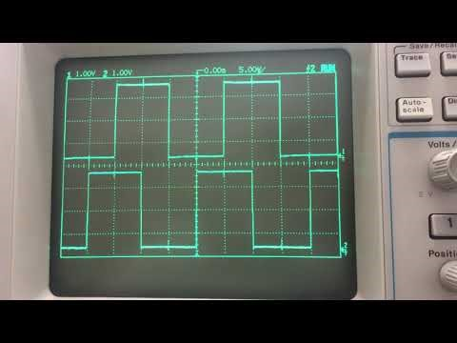

Slide 30
Challenges

Slide 31
Challenges
Change the phase of the PWM Signal
VHDL will not take default values at startup
Requires a state to compare startup
Difficult getting analog input
Limited documentation on ADC
Software version mismatch with what is available
Software not working with FPGA correctly

Slide 32
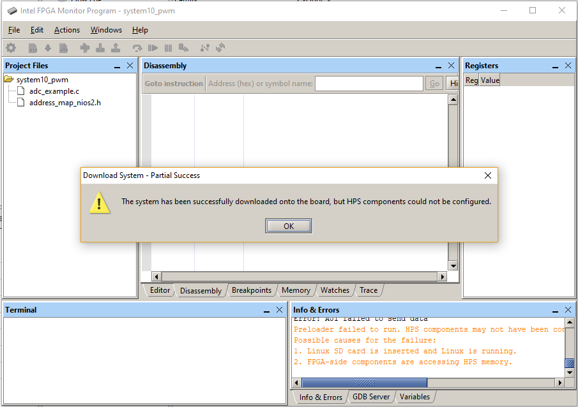

Slide 33
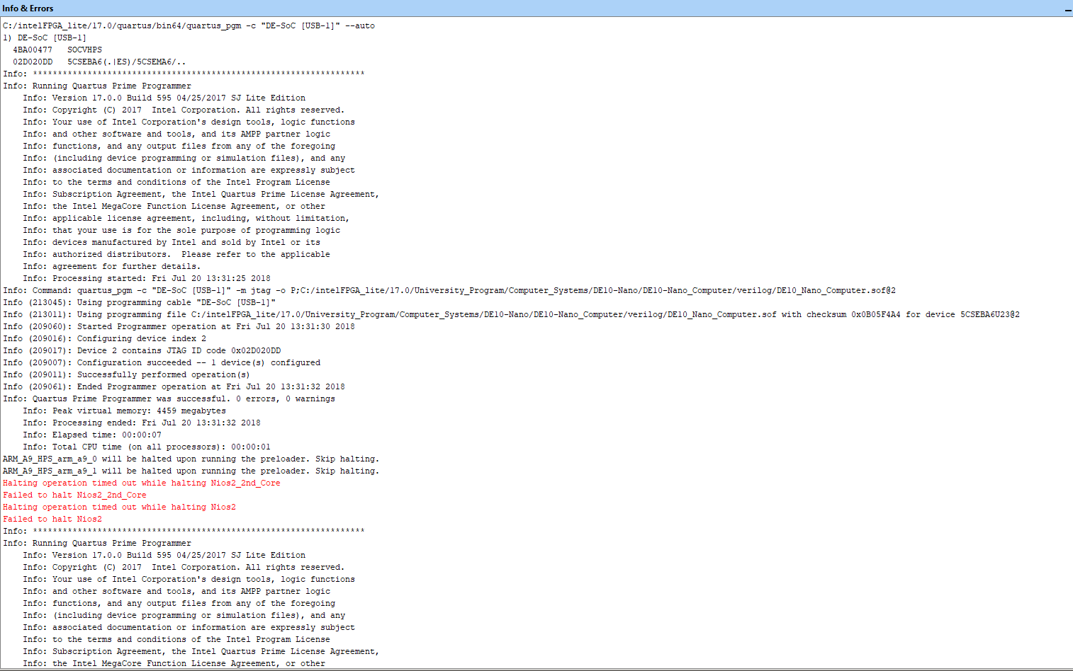

Slide 34
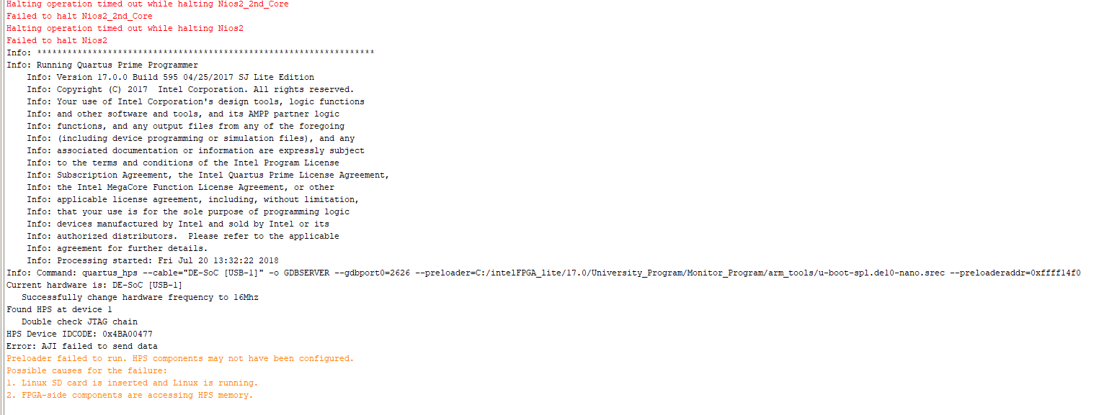

Slide 35
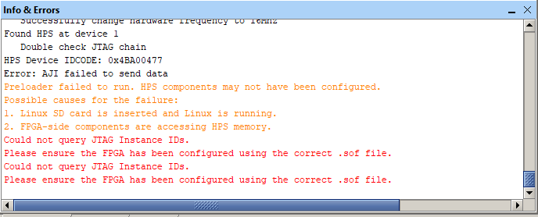

Slide 36
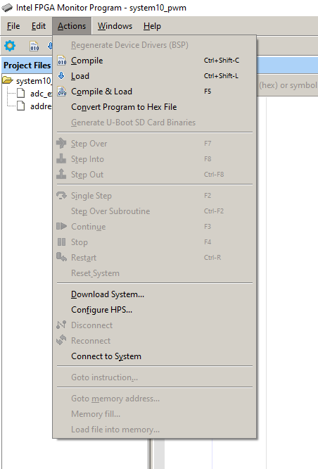

Slide 37
What’s Next?
Receive analog input into FPGA
Convert ADC input to integer
Integer input to PWM “phaser” is working

Slide 38
Literature

Slide 39
Overview of Dual-Active-Bridge Isolated bidirectional DC-DC Converter for High-Frequency-Link Power-Conversion System
Overview of Dual-Active-Bridges
Applications and Use
How they work
Methods of Control

Slide 40
FPGA Prototyping by VHDL Examples
Example projects
UART explanation

Slide 41
Altera Documentation
ADC Documentation and tutorials

Slide 42
Questions

